Slide 1

PROTRACTOR TOOL

Slide 2
Introduction
Protractor is a node.js framework that sits on top of the Selenium/Webdriver APIs.
Protractor is an end-to-end testing framework specially designed to perform automation testing on AngularJS based web applications.
Integrated with powerful tools such as NodeJS, Selenium, Webdriver, Jasmine, Cucumber and Mocha.
Protractor execution is faster than the selenium tool.
Protractor supports AngularJS and also Non AngularJS applications.
Protractor allows tests to be organized based on Jasmine, thus allowing you to write both unit and functional tests on Jasmine.
It runs on real browsers and headless browsers(pantamjs).

Slide 3
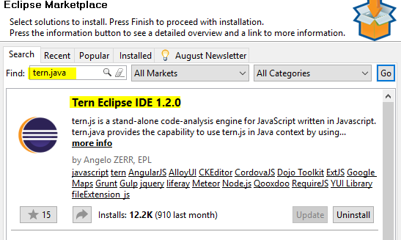
Installing Eclipse and Turn plug-in
For running protractor tests using eclipse we need to configure Turn Eclipse IDE, Please fallow below steps
Protractor plug-in in eclipse:
Goto Help → Eclipse Market place
Search for tern.java
Install Tern Eclipse IDE and Accept the License

Slide 4
Understanding Describe and It blocks
Describe block used to describe the scenario of the tests.
Describe block contains single or multiple ‘It’ blocks
Describe block can also contains other Describe block
It block is nothing but a Test case and It contains actual tests/Functionality of the particular test case
Syntax:-
describe('Test scenario description', function(){
it('Test case Name', function() {
});
});

Slide 5
Different locators in protractor
There is a massive increase in locator strategies in protractor tool
Locators which are inherited from webdriver
By.id Syntx :- element(By.id('userName')).sendKeys('mercury');
By.Name Syntx :- element(By.id(‘password')).sendKeys('mercury');
By.className
By.linkText
By.partialLinkText
By.tagName
By.Xpath
By.css

Slide 6
Different locators in protractor
Additional locators for protractor
By.binding Syntax:-
Syntax:- element(by.binding(“attribute value”).getText().then(function(text){
console.log(“Result is : “ +text);
});
By.repeater(Find elements inside an ng-repeat)
By.buttontext
By.model
Element.all

Slide 7
beforeEach and afterEach block
Any common code we want to execute before each “It” block we can write that code in beforeEach block.
Example:
beforeEach(function() {
// Handling for Non-angular web application
browser.ignoreSynchronization = true;
browser.driver.manage().window().maximize();
});
Any common code we want to execute after each “It” block we can write that code in afterEach block
Example:
afterEach(function() {
//Ignore synchronization for non angularjas web application
browser.ignoreSynchronization = false;
});

Slide 8
Creating Test Suites and running selective test cases/All test cases
suites: {
smoke: ['../smoke/test_spec.js'],
regression: ['../regression/test_spec.js'],
//functional: ['../functional/test_spec.js'],
//all: ['../!*!/test_spec.js'],
},
command for running smoke suite :- protractor conf.js --suite=smoke
command for running smoke and regression suite :- protractor conf.js --suite=smoke,regression.

