Slide 1
SCAMSHIELD
Indian Digital Scam Intelligence & Prevention System
Complete project presentation — technologies, working flow, program flow, usage, and start-to-end progress.
Version 0.3.0 (post final audit) • 472 tests passing • 100% local · offline · explainable

Slide 2
Agenda
01
• Why Indian scam & threat-link detection matters (problem & motivation)
• Proposed system: unified 0–100 explainable risk across messages, URLs, QR & UPI
• Supporting scam categories & multilingual coverage (en · hi · mr · hinglish)
• Technologies used & repository layout
• System architecture & program working flow (with visuals)
• Multi-stage attack-chain flow
• Security & privacy model (static-only, offline, no PII)
• Evaluation & research results (472 tests, metrics)
• Start-to-end development progress (Steps 1–10 + final audit)
• How to use: web command center, REST API, CLI, library, training & research

Slide 3
Problem & Motivation
02
The problem
Indian users face scams spread across multiple channels — SMS, WhatsApp/Telegram, malicious URLs, QR codes and UPI payment strings — delivered in multiple languages and code-mixed Hinglish.
Most tools are built for clean English or a single channel, and produce a bare 'safe / unsafe' verdict with no explanation.
Our response
A fully-local, offline, deterministic system that explains WHY: a 0–100 risk score, LOW/MED/HIGH/CRITICAL level, scam category, indicators, evidence and recommendations.
Zero running cost, no paid APIs, no internet call at analysis time.
Core honesty principle: risk scores are labelled heuristics, ML confidence is the raw model probability, and every limitation is documented.

Slide 4
Proposed System & Scam Categories
03
Unified analyzer output
• risk_score (0–100) + risk_level
• scam_type (fake_kyc, phishing, …)
• is_suspicious + confidence (labelled)
• indicators + evidence + explanation
• recommendations + full engine_results
• channel: message · URL · QR · UPI · chain
Scam categories monitored
• Fake KYC · UPI/payment scams · Bank impersonation
• Phishing · Fake customer care
• Job scams · Investment scams · Loan scams
• Delivery scams · Lottery/prize scams
• Social-media impersonation · Other social-engineering
Languages: English · Hindi · Marathi · Hinglish (code-mixing) — all analysed through curated multilingual dictionaries.

Slide 5
Technologies Used
04
Python 3.14.6 — Core engine, ML, web, research & docs
Flask 3.x — Final web command center + REST API (web/app.py)
Streamlit 1.32.x — LEGACY prototype UI only — not the final frontend
scikit-learn 1.3.x — TF-IDF + Logistic Regression local ML (offline)
OpenCV headless 4.8.x — Local QR decoding (no cloud OCR)
qrcode / numpy / joblib — QR fixtures, arrays, model persistence
pytest — 472 tests — 10 suites: message 50 · URL 95 · QR 56 · unified 84 · ML 40 · chain 49 · API 28 · frontend 16 · research 30 · web 24
Vanilla HTML/CSS/JS — Single-page UI — zero frontend framework, XSS-safe (esc())
python-docx / reportlab / python-pptx / matplotlib — This documentation + assets
Python stdlib — urllib.parse · re · csv · json · tempfile · pathlib — no sockets

Slide 6
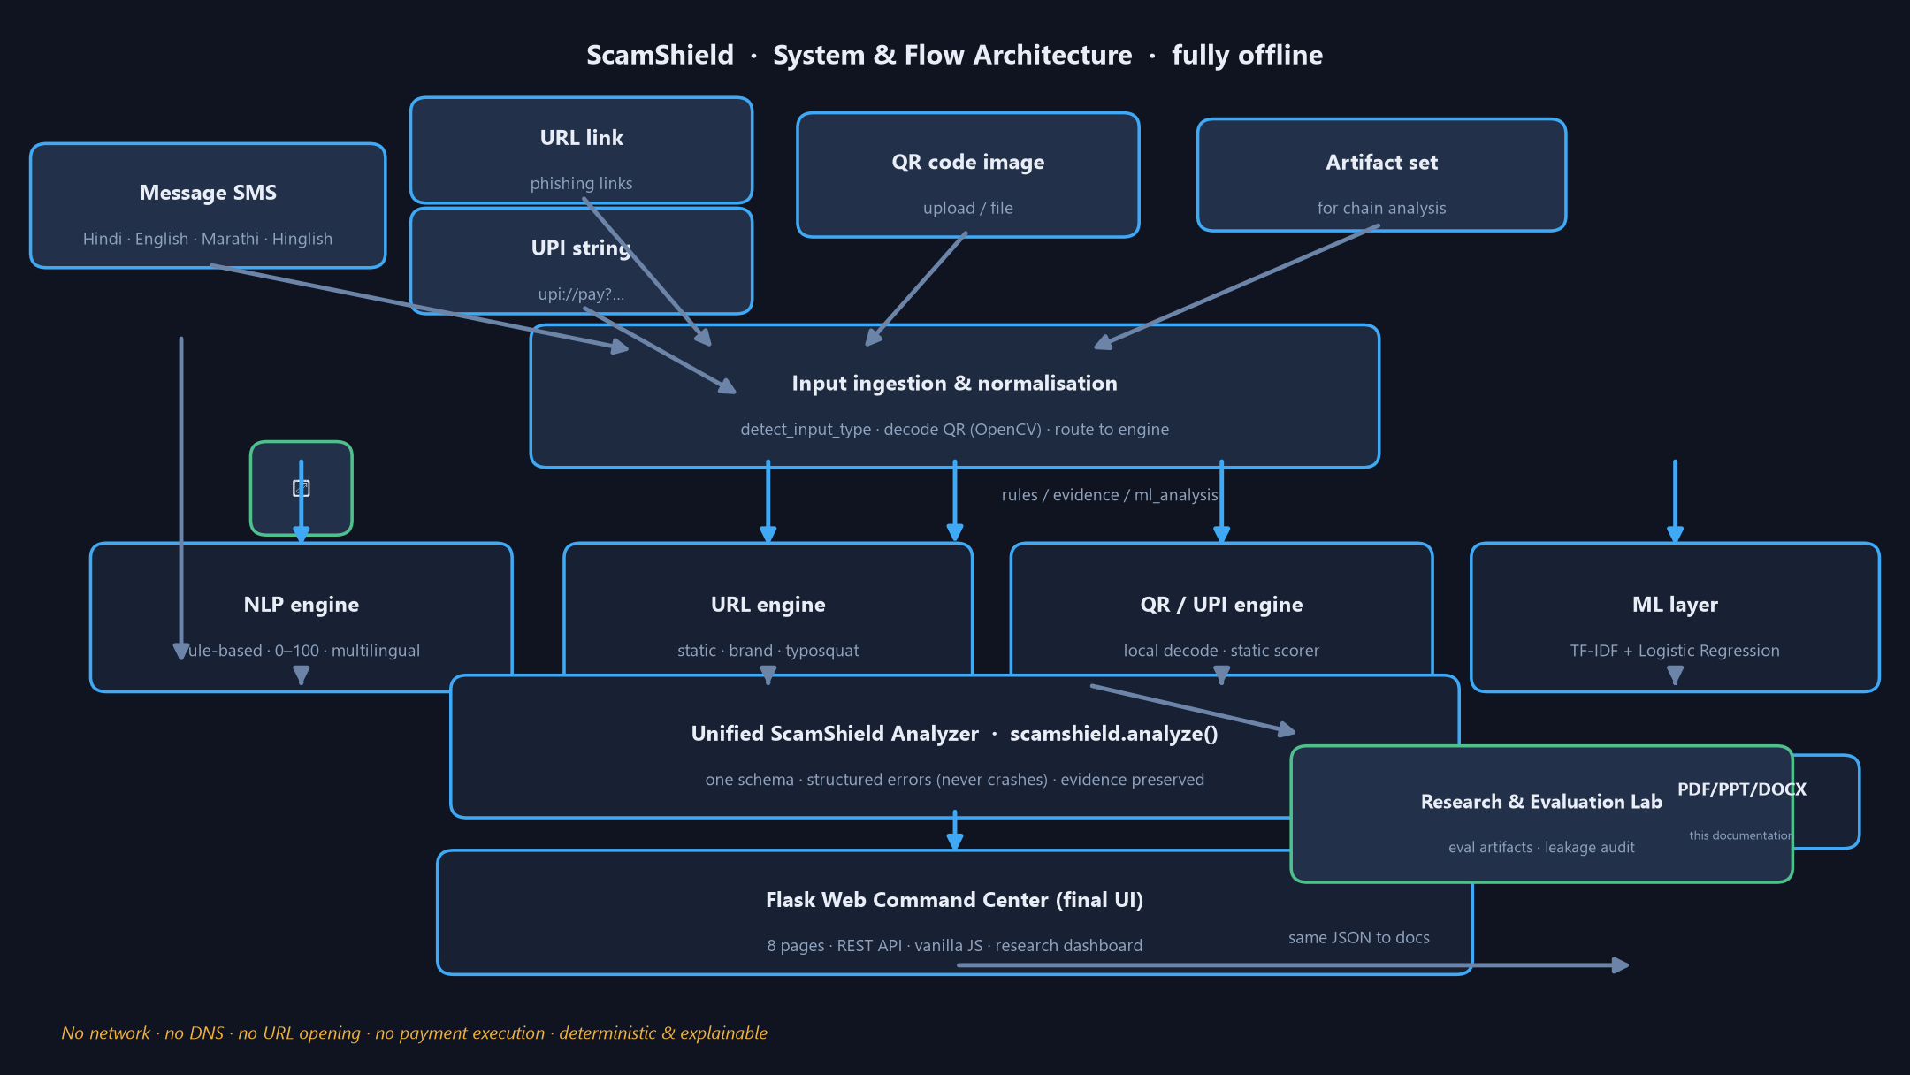
System Architecture (fully offline)
05
Data flows one way: inputs → engines → unified result → UI, with no external calls.

Slide 7
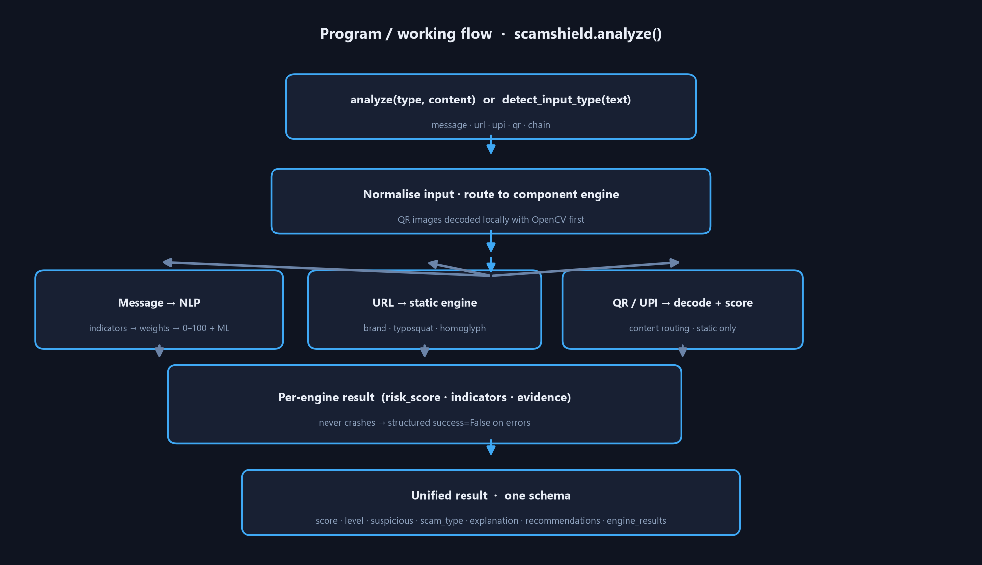
Working Flow — Program Flow
06
What a single analyze() call does under the hood.
Routing: message → NLP · url → URL engine · upi → UPI scorer · qr → decode then route · chain → correlation. Failures return structured success=False — never a crash.

Slide 8
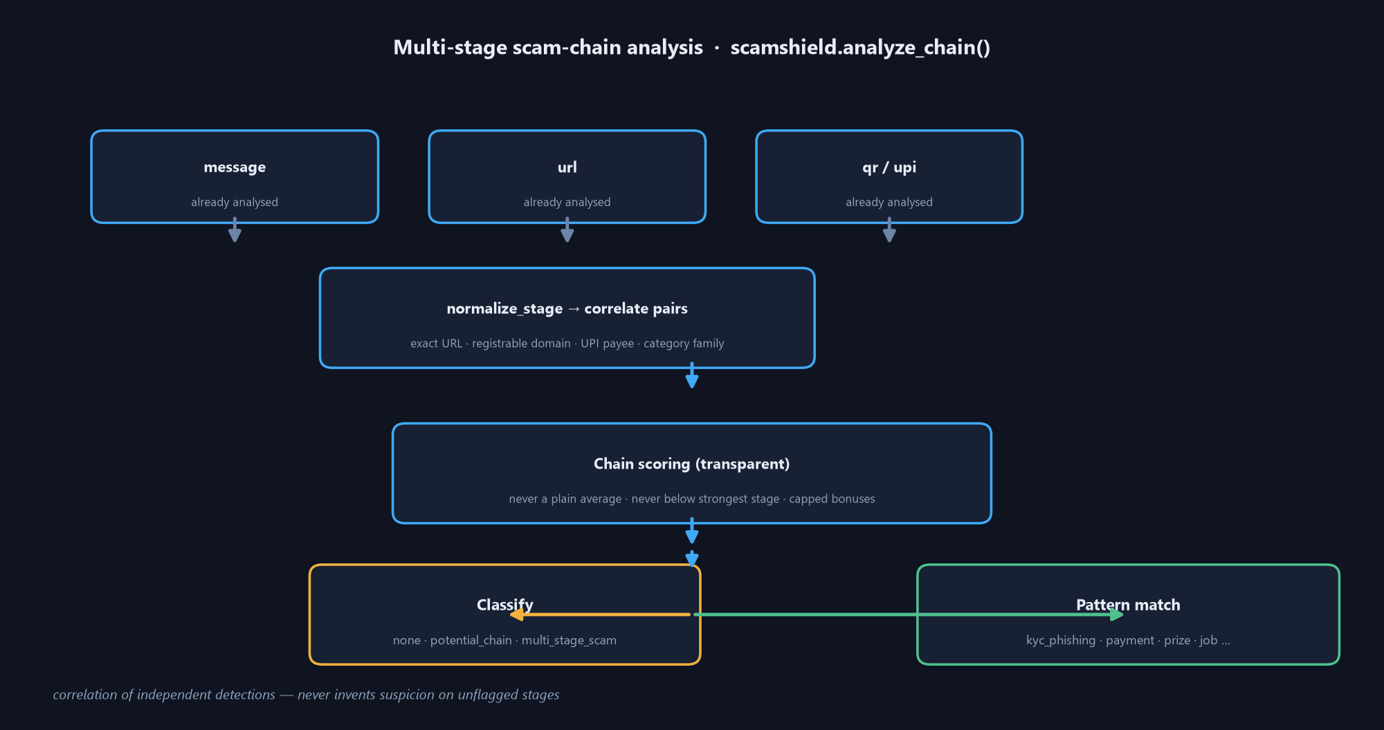
Multi-Stage Attack-Chain Flow (chain correlation)
07
Correlates already-analyzed artifacts (exact URL / root domain / UPI payee / category family). Never a plain average, never below the strongest stage — correlation, not proof of intent.

Slide 9
Security & Privacy Model
08
• Fully offline: no sockets, DNS, HTTP or urlopen in any engine (only urllib.parse + Path.resolve).
• URLs & UPI strings analysed statically — never opened, resolved, followed, fetched or executed.
• QR uploads: 5 MiB + extension validated; temp file deleted in a finally block (tested).
• No stack traces leaked: 400/404/405/413/500 return structured JSON; debug off by default.
• Web UI HTML-escapes every injected value — no XSS (verified by audit).
• No secrets, API keys, credentials or private data stored or logged anywhere.
• Dataset privacy: [OTP], [PHONE], [ACCOUNT], XX12, *.example.in, RFC 5737 IPs — no real PII.
• Stateless, no database, no cookies — local-first, WSGI-hostable.
Design rule: considered malicious only if the evidence is concrete; unknown schemes are never auto-flagged.

Slide 10
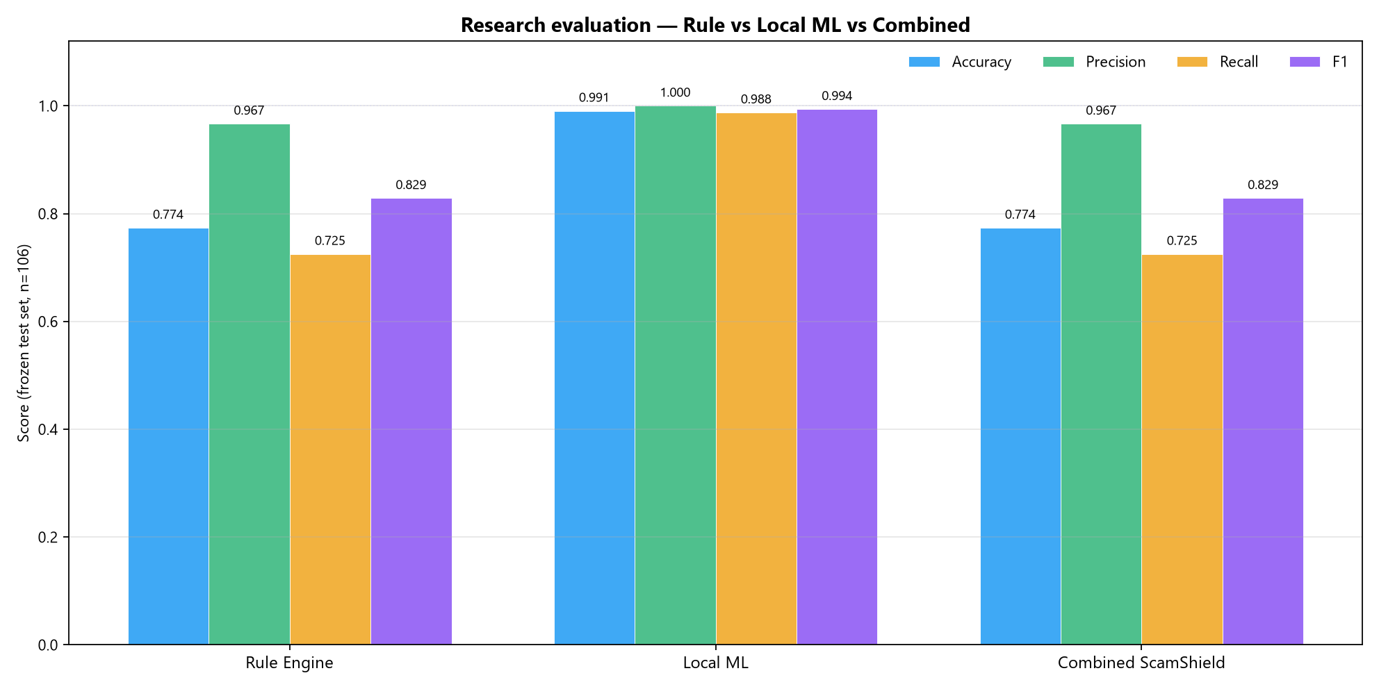
Evaluation & Research Results
09
Frozen deduplicated test set, n=106.
Key numbers
• Rule engine — F1 0.8286 (high precision 0.9667)
• Local ML — Acc 0.9906 · F1 0.9937
• 22 FN (missed scams) + 2 FP — documented
• Message ≈28 ms · URL ≈1.8 ms · QR ≈23 ms
• ML kept separate from the rule verdict (never hides a real signal)
• Leakage-clean subset re-evaluated at runtime (honest audit)

Slide 11
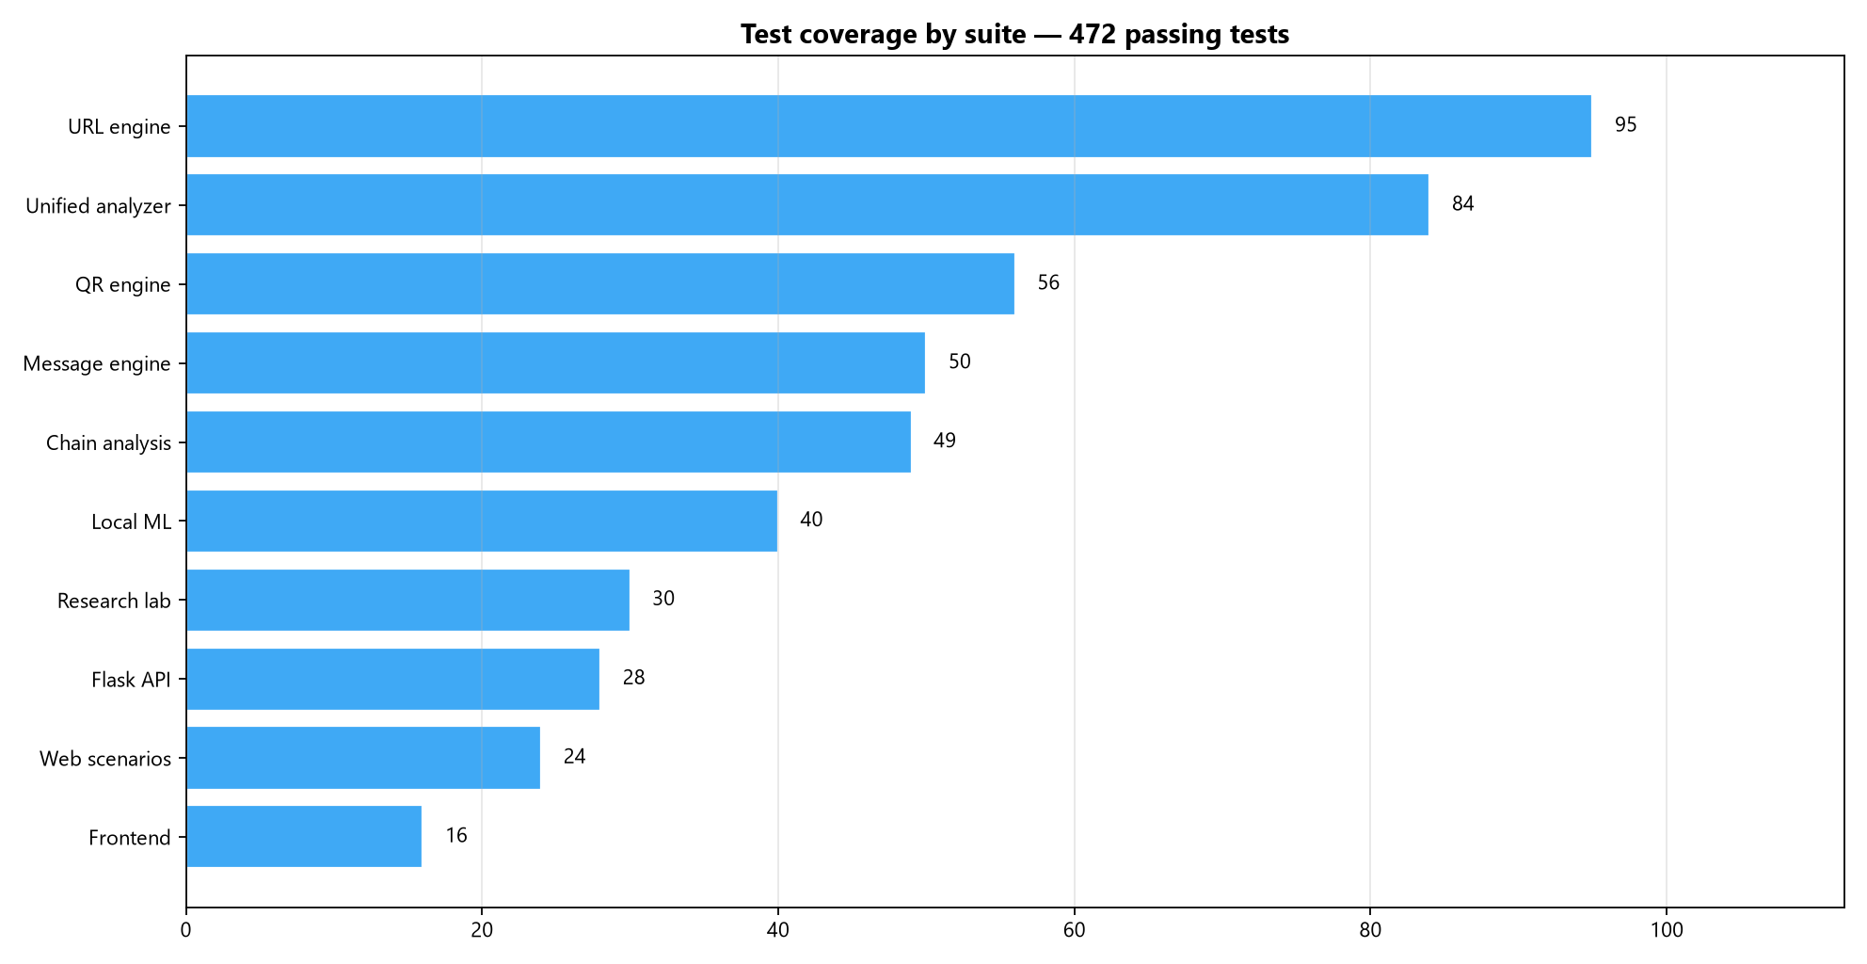
Test Coverage — 472 Tests, 10 Suites
10
Breakdown: URL 95 · unified 84 · QR 56 · message 50 · chain 49 · ML 40 · research 30 · Flask API 28 · web scenarios 24 · frontend 16. Compileall clean.

Slide 12
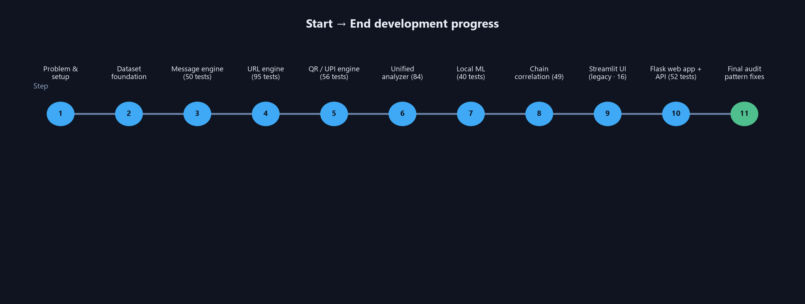
Start-to-End Development Progress
11
Steps 1–10 plus the final audit.
Step 1 setup & datasets → message → URL → QR/UPI → unified → ML → chain → Streamlit → Flask + API → research lab → final audit (patterns fixed, deps cleaned, research re-run, docs corrected).

Slide 13
How to Use
12
Web command center
python web/app.py → http://127.0.0.1:5000
8 pages: Overview · Message · URL · QR · UPI · Attack Chain · Research · Status
API: /api/analyze/{message,url,upi} · /api/analyze/qr (multipart) · /api/analyze/chain · /api/health
CLI & library
python -m app.scan "Your KYC has expired..."
from scamshield import analyze; analyze("message", ...)
python -m src.scamshield.ml.train (retrain ML)
python -m app.research_eval (evaluation lab → models/research/)
python -m pytest tests/ -q → 472 passed
Use it to: paste a suspicious SMS · check a link · upload a QR · inspect a UPI string · build an attack chain · browse research.

Slide 14
Honest Limitations
13
• Exact-phrase rule engine: heavily paraphrased scam variants can score LOW/MEDIUM (documented conservative misses).
• Small known FP pair: protective “do not share UPI PIN”-style receipts can be flagged (precision trade-off).
• Chain layer needs already-analyzed artifacts (the UI handles it); correlation is not proof of intent.
• Local ML is a binary classifier on a small synthetic dataset with class imbalance & leakage — not a production claim.
• URL/UPI analysis is static: no live reputation, DNS or threat-intel — a deliberate offline/no-paid-API choice.
• Latency & accuracy figures come from the local research lab, not production traffic.
Every weakness is documented in the research lab and READMEs — nothing is hidden or inflated.

Slide 15
Final Status: SCAMSHIELD FINAL AUDIT COMPLETE
472 tests passing · 22/22 live API checks · full E2E verified over real HTTP
Ready as a local, offline, explainable Indian scam & threat-link detection prototype — every technology, working flow, program flow and the complete start-to-end progress are documented in the PDF & DOCX companions.
process_threat_detection/ • ScamShield_Project_Details.docx · .pdf · ScamShield_Presentation.pptx

