Slide 1
Butty’s Python Tutorial
Mark Butterworth
July 2020

Slide 2
Welcome
Note I'm not an experienced teacher, so please give feedback and ask questions as we go.
When & how long would you like to break for lunch?
Let me know when you want or need a break.
About me & you:
Your favourite learning technique (book, classroom, video, etc)?
Python experience?
Other programming experience?
Why you want to learn Python and what you might use it for?

Slide 3
Agenda
Intro to Python
Installation and setup
First steps with Repl, Scripts, Jupyter (iPython), Thonny!
Core Language
Modules & namespaces
Editors and IDE's
Advanced Python (files, regex, ...)

Slide 4
Overview
Scripting language, interpreted high-level programming language for general-purpose programming.
Creator (BDFL - Benevolent Dictator For Life) Guido Von Rossum developed in the 1980's, first release 1991.
Python has a design philosophy that emphasizes code readability, notably using significant whitespace. It provides constructs that enable clear programming on both small and large scales.
Many versions of Python; CPython, PyPy, Stackless Python, MicroPython.
Cross-compliers; Jython (Java Bytecode), IronPython (.NET), Cython (C, C++), Grumpy (by Google complies to Go), etc...
CPython is written in C and compiles Python programs into intermediate bytecode which is executed by the Python Virtual Machine.
CPython has a very large library (OS, GUI, Database, Network, Web, ML/AI, Scientific, Data Analytics, etc)

Slide 5
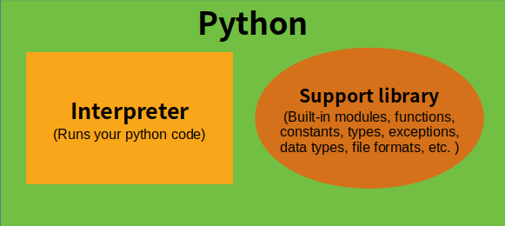
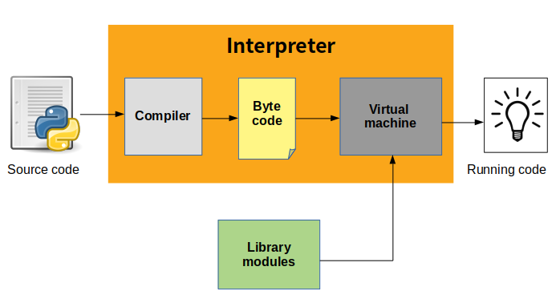
Python Architecture
Initialization : This involves the set up of the various data structures needed by the python process. This will probably only counts when a program is being executed non-interactively through the interpreter shell.
Compiling : This involves activities such as parsing source code to build syntax trees, creation of abstract syntax trees, building of symbol tables and generation of code objects.
Interpreting : This involves the actual execution of generated code objects within some context.

Slide 6
Zen of Python
Errors should never pass silently.
Unless explicitly silenced.
In the face of ambiguity, refuse the temptation to guess.
There should be one-- and preferably only one --obvious way to do it.
Although that way may not be obvious at first unless you're Dutch.
Now is better than never.
Although never is often better than *right* now.
If the implementation is hard to explain, it's a bad idea.
If the implementation is easy to explain, it may be a good idea.
Namespaces are one honking great idea -- let's do more of those!
Long time Pythoneer Tim Peters succinctly channels the BDFL’s
Guiding principles for Python's design into 20 aphorisms, only 19 of which have been written down:
Beautiful is better than ugly.
Explicit is better than implicit.
Simple is better than complex.
Complex is better than complicated.
Flat is better than nested.
Sparse is better than dense.
Readability counts.
Special cases aren't special enough to break the rules.
Although practicality beats purity.

Slide 7
Install Anaconda or Python
Download from:
https://www.python.org/downloads/release/python-380/
Or https://www.anaconda.com/download/
Or install minimal: https://docs.conda.io/en/latest/miniconda.html
Note: installing with dual x login means that administrator install is preferred.
Recommend Miniconda or Python (other packages needed):
> conda install jupyterlab click pandas matplotlib
> for %i in (ipython,click,pandas) do pip install %i
Select latest version 3+ package.
Most new programmers should use latest Python 3.
Python 2 still around and Python 2.7 version is the best bridge to version 3.

Slide 8
Anaconda the Python distribution
Anaconda is the most popular Data Science Python (and 'R') distribution
Full Anaconda is rather bloated and Miniconda is much smaller.
"Conda" is a distribution and package management system containing 1000+ popular modules for python
Most notable packages are:
click (CLI interface)
pandas (data wrangling)
matplotlib + seaborn (charting - difficult to install with pip)
xlsxwriter (Excel file creation)
flask (lightweight web framework)

Slide 9
Anaconda setup
Initializing shells:
> [path to anaconda]\condabin\conda init --all
(Note that uninstall does not clean this up)
Activating an environment:
> conda activate [env]
To upgrade run the "Anaconda Prompt" and type:
> conda update conda
> conda update anaconda
Clean up old Anaconda packages from prompt using::
> conda clean -a --dry-run
> conda clean -a -y
Rebuild Anaconda Start menu::
> "C:\Anaconda3\pythonw.exe" "C:\Anaconda3\Lib\_nsis.py" mkmenus

Slide 10
Python => Windows integration
The dual account is a real challenge for python & library installs.
There is a launcher included in python 3.3+ (but not Anaconda).
Type "py" from command line to check if installed.
https://bitbucket.org/vinay.sajip/pylauncher/downloads/
Checking associations:
> ftype | findstr -i python
> assoc | findstr -i python
Setting file type (as admin):
> ftype Python.File="C:\Anaconda\python.exe" "%1" %*
Right click a ".py" file and choose program as default to associate with the correct python.exe (in miniconda).

Slide 11
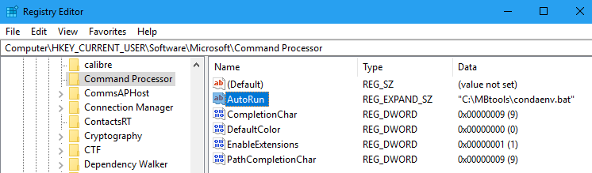
Setting default Anaconda environment
Create your own launch script, e.g. condaenv.bat:
@call "C:\Miniconda3\condabin\conda_hook.bat
@conda activate
Setup the cmd registry to autorun your batch file:
[HKEY_CURRENT_USER\Software\Microsoft\Command
AutoRun = "<path to your bat file>"

Slide 12
First steps into the REPL
From a command prompt type:
> python
Once you have a python prompt, try these commands:
1+2*3
print 'Hello World!' # This would work under python2
print('Hello World!')
name = 'Fred'
print(name)
greet = "Hello " + name + '!'
print(greet)
name = input('Enter your name?’)
print(f'Hello {name.upper()}!')
import this
help()

Slide 13
Code block indentation
Python isn’t delimited and uses indentation to separate code blocks:
if age < 18:
print('You cannot drink’)
if age == 17:
print('But you can drive')
else:
print('You can drink and drive')
print('But you must not, "drink and drive"')
Can be spaces or tabs but must be consistent (Tabnanny is a tool to fix indentation issues).
To exit the REPL on Windows type Ctrl-Z <enter>
Unix type Ctrl-D
Or type "exit()"

Slide 14
Creating a hello world script
At command prompt create a script file:
> mkdir \<yourname>tut
> cd \<yourname>tut
> Notepad hello.py
Type & save the following code into notepad or being careful to use consistent spacing <Tab> or <Spaces> for each indent:
def greet(name=None):
if name==None or name=='':
name = 'World'
text = 'Hello ' + name + '!'
print(text)
print(greet)
answer = input('What is your name? ')
greet(answer)
To run the script from the command line:
> python hello.py
(you may need to “conda activate” first)

Slide 15
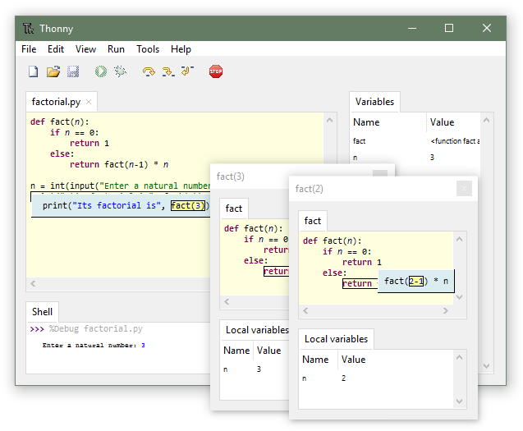
Exercise 1
Install and start “Thonny” (https://thonny.org/)
Type the same code from previous page into the Thonny editor and save as “greet1.py”.
Ensure tick is on for View => Variables & shell.
Start the code with Run => Debug (faster).
Use keys F6 – step over, F7 – step into.
Once more but use, Ctrl+F5, Debug (nicer).
Observe the variables and shell output.
What happens if you move the function to the end of the script?
Why does it error (see the assistant)?
Advanced: try stepping countdown.py and factor.py

Slide 16
REF: Python Naming Conventions
General
Avoid using names that are too general or too wordy. Strike a good balance between the two.
Bad: data_structure, my_list, info_map, dictionary_for_the_purpose_of_storing_data_representing_word_definitions
Good: user_profile, menu_options, word_definitions
Don’t be a jackass and name things “O”, “l”, or “I”
When using CamelCase names, capitalize all letters of an abbreviation (e.g. HTTPserver)
Packages
Package names should be all lower case
When multiple words are needed, an underscore should separate them
It is usually preferable to stick to 1 word names
Modules
Module names should be all lower case
When multiple words are needed, an underscore should separate them
It is usually preferable to stick to 1 word names
Classes
Class names should follow the UpperCaseCamelCase convention
Python’s built-in classes, however are typically lowercase words
Exception classes should end in “Error”
Global (module-level) Variables
Global variables should be all lowercase
Words in a global variable name should be separated by an underscore

Slide 17
REF: Python Naming Conventions (2)
Instance Variables
Instance variable names should be all lower case
Words in an instance variable name should be separated by an underscore
Non-public instance variables should begin with a single underscore
If an instance name needs to be mangled, two underscores may begin its name
Methods
Method names should be all lower case
Words in an method name should be separated by an underscore
Non-public method should begin with a single underscore
If a method name needs to be mangled, two underscores may begin its name
Method Arguments
Instance methods should have their first argument named ‘self’.
Class methods should have their first argument named ‘cls’
Functions
Function names should be all lower case
Words in a function name should be separated by an underscore
Constants
Constant names must be fully capitalized
Words in a constant name should be separated by an underscore

Slide 18
iPython (Interactive Python)
From a command prompt start "ipython"
Or "ipython qtconsole" (now depreciated use Jupyter qtconsole)
Note:
? = Help
%quickref = Reference of all ipython syntax/magics
help() = Python interactive help
<tab\> completion
<command\>? | ?<command\> = Object introspection and help (docstring)
! = to run shell commands
%magic and %%magic (%timeit)
Try some of the previous python commands.

Slide 19
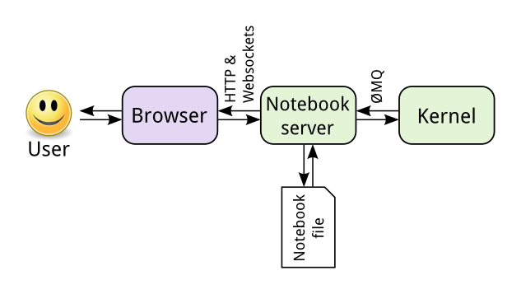
Jupyter architecture

Slide 20
Jupyter (iPython) notebook
Built upon iPython to provide a web application.
Great for coding and documentation at the same time.
From Anaconda start the "Jupyter notebook" or at a command prompt type "jupyter notebook".
<ESC> = command mode
<Enter> = edit mode
h = help in command mode
a = create cell above
b = create cell below
dd = delete cell
L = Toggle line numbers
<shift>+<tab> = Show parameter help (doc string)
<shift>+<enter> = run cell
! = to run shell commands
%magic and %%magic

Slide 21
Into the interactive tutorial notebooks...

Slide 22
VScode Exercise
Install GIT for windows first:
https://git-scm.com/download/win
Install VScode as your development environment:
https://code.visualstudio.com/download
Install recommended VScode extensions:
Python, Pylance, Material Icons, (Docker if adventurous)
Go through the VScode python intro tutorial:
https://code.visualstudio.com/docs/python/python-tutorial

Slide 23
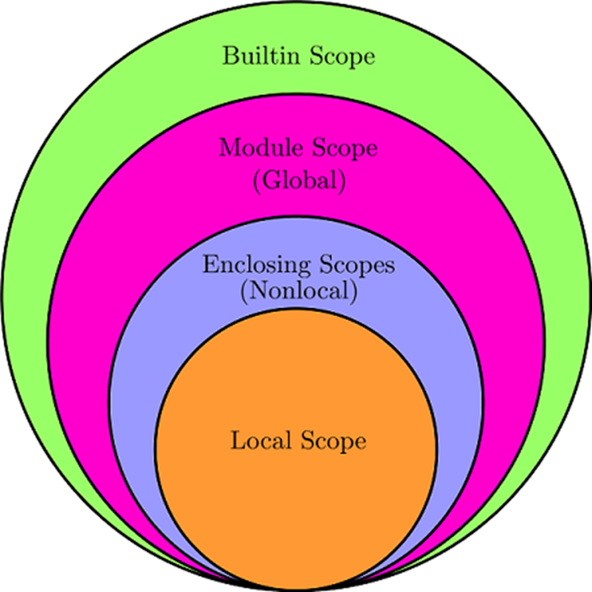
Namespaces
LEGB stand for Local, Enclosing, Global, and Built-in scopes:
Local (or function) scope is the code block or body of any Python function or lambda expression. This Python scope contains the names that you define inside the function.
Enclosing (or nonlocal) scope is a special scope that only exists for nested functions.
Global (or module) scope is the top-most scope in a Python program, script, or module.
Built-in scope is a special Python scope that contains names such as keywords, functions, exceptions, and other attributes that are built into Python.

Slide 24
CLI programs
Why?
Quick to develop.
If you follow a structure can easily be included in web & GUI apps.
Good CLI program structure:
If __name__=='__main__' to call cli function.
cli function parses and handles arguments.
Separate functions with main processing functionality.
Separate functions to render the output (text, html, etc).

Slide 25
First Programs
CLIargs1.py - Parameter argv in the sys module.
CLIargs2.py - Program structure separating CLI parsing.
CLIargs3.py - separating options and arguments.
skeleton.py - Uses argparse, a helpful python built-in module.
Take a look at clickskeleton.py

Slide 26
CLI Exercise
Write CLI program to accept a filename and text string:
Mygrep.py [options] <filename> <text string>
-c = case sensitive
It needs to output any lines containing the text string.

Slide 27
Debugging
Don't use print statements! (prefer a debug output option)
Running a script from command line with the debugger:
> python -m pdb -c continue myscript.py
Or put one of these into a script to break into pdb:
import pdb; pdb.set_trace()
breakpoint() # Python 3.7+
PDB Quick Ref:
h(elp) [command] = help.
p(rint) <expr> = print expression.
pp <expr> = pretty-print expression (good for long lists etc).
l(ist) [first [,last] | .] = list lines or '.' for current position.
ll = long list current function or frame.
n(ext) = execute until next.
s(tep) = execute and step into.
unt <line> = execuate up
Excersize: Try the VScode debugger!

Slide 28
Regular expressions (Regex)

Slide 29
Zip module

Slide 30
Pandas

Slide 31
Output to Excel

Slide 36
Other reading
https://realpython.com/python-application-layouts/
https://dbader.org/

