Slide 1
Butty’s Python Tutorial
Mark Butterworth
Feb 2021

Slide 2
Student system preparation
Install Git for windows: https://git-scm.com/download/win
Install Miniconda: https://docs.conda.io/en/latest/miniconda.html
At time of writing use python 3.8
Install as administrator for all users.
Once installed from an admin "Anaconda prompt" (In the start menu) install the following:
conda install jupyter pandas matplotlib
Install Vscode: https://code.visualstudio.com/
Use the stable build.
And install extensions for python & pylance.
Install Thonny: https://thonny.org/
Clone the tutorial repository using "GIT CMD":
mkdir %USERPROFILE%\pytut
cd %USERPROFILE%\pytut
git clone https://github.com/mrkbutty/PythonTutButty01.git

Slide 3
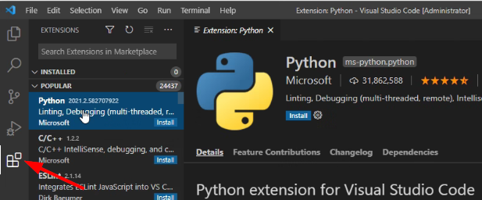
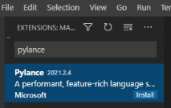
Python alternative preparation (do not use)
Install Git for windows: https://git-scm.com/download/win
Install Python 3.8 (as admin):
https://www.python.org/downloads/release/python-388/ (Windows installer 64-bit at the bottom)
Install into directory: C:\python38
Add following to your system path (if you miss installer question):
C:\python38
C:\python38\Scripts
From a command prompt test if python is working:
python<enter>
exit()<enter>
pip install jupyter pandas matplotlib
Install Vscode: https://code.visualstudio.com/ (as normal user)
Use the stable build.
And install extensions for python & pylance. (see screenshots)
Install Thonny: https://thonny.org/ (as normal user)
Clone the tutorial repository using "GIT CMD":
mkdir %USERPROFILE%\pytut
cd %USERPROFILE%\pytut
git clone https://github.com/mrkbutty/PythonTutButty01.git

Slide 4
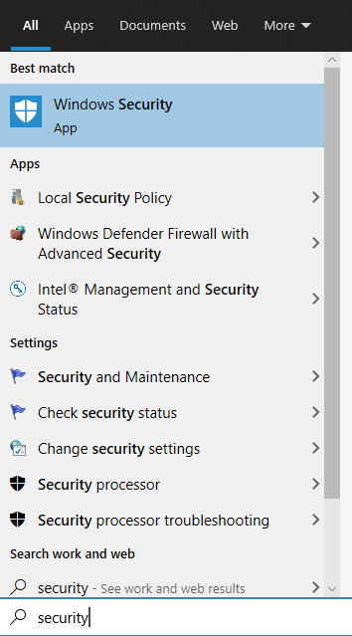
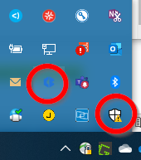
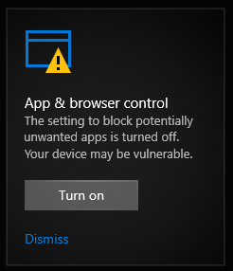
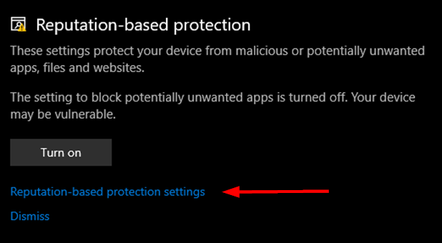
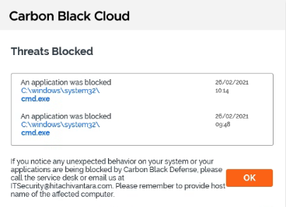
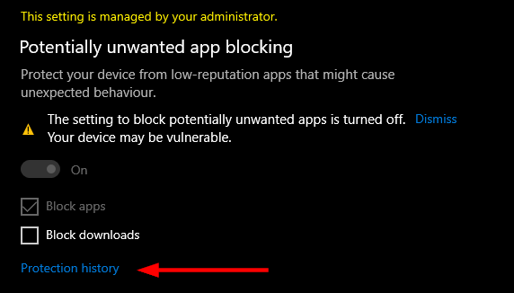
Install problems
Maybe carbon black or Windows security:

Slide 5
Welcome
Note I'm not an experienced teacher and the remote nature of this course will not help either.
So please give feedback and ask questions as we go.
When & how long would you like to break for lunch?
Let me know when you want or need a break?
About me & you:
Your favourite learning technique (book, classroom, video, etc)?
Python experience?
Other programming experience?
Why you want to learn Python and what you might use it for?

Slide 6
Agenda
Intro to Python
Installation and setup
First steps with Repl, Scripts, Jupyter (iPython), Thonny!
Core Language
Modules & namespaces
Editors and IDE's
First standalone CLI programs
Advanced Python (files, regex, zip files, pandas, excel)

Slide 7
Part 1
Introduction, installation & first steps

Slide 8
Overview
Scripting language, interpreted high-level programming language for general-purpose programming.
Creator (BDFL - Benevolent Dictator For Life) Guido Von Rossum developed in the 1980's, first release 1991.
Python has a design philosophy that emphasizes code readability, notably using significant whitespace. It provides constructs that enable clear programming on both small and large scales.
Many versions of Python; CPython, PyPy, Stackless Python, MicroPython.
Cross-compliers; Jython (Java Bytecode), IronPython (.NET), Cython (C, C++), Grumpy (by Google complies to Go), etc...
CPython is written in C and compiles Python programs into intermediate bytecode which is executed by the Python Virtual Machine.
CPython has a very large library (OS, GUI, Database, Network, Web, ML/AI, Scientific, Data Analytics, etc)

Slide 9
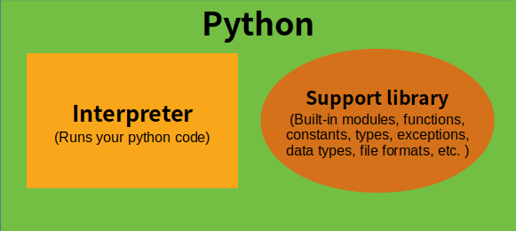
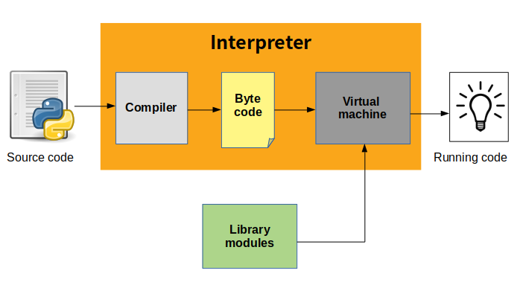
Python Architecture
Initialization : This involves the set up of the various data structures needed by the python process. This will probably only counts when a program is being executed non-interactively through the interpreter shell.
Compiling : This involves activities such as parsing source code to build syntax trees, creation of abstract syntax trees, building of symbol tables and generation of code objects.
Interpreting : This involves the actual execution of generated code objects within some context.

Slide 10
Python Ecosystem
Cpython (most widely used implementation of the language)
Standard Python Library
Standard tools - pip, easyinstall, pdb, venv, 2to3, pydoc, tabnanny
PyPi (aka the "Cheese shop")
Python Package Index with over 235K packages, accessed by "pip"
Anaconda/Miniconda (Very large distribution with 100's addons)
Addon tools
ipython/Jupyter notebooks
Virtualenv (or use built-in "-m venv")
Pipx (Creates self contained tool installs)

Slide 11
Zen of Python
Errors should never pass silently.
Unless explicitly silenced.
In the face of ambiguity, refuse the temptation to guess.
There should be one-- and preferably only one --obvious way to do it.
Although that way may not be obvious at first unless you're Dutch.
Now is better than never.
Although never is often better than *right* now.
If the implementation is hard to explain, it's a bad idea.
If the implementation is easy to explain, it may be a good idea.
Namespaces are one honking great idea -- let's do more of those!
Long time Pythoneer Tim Peters succinctly channels the BDFL’s
Guiding principles for Python's design into 20 aphorisms, only 19 of which have been written down:
Beautiful is better than ugly.
Explicit is better than implicit.
Simple is better than complex.
Complex is better than complicated.
Flat is better than nested.
Sparse is better than dense.
Readability counts.
Special cases aren't special enough to break the rules.
Although practicality beats purity.

Slide 12
Install Anaconda or Python
Download from:
https://www.python.org/downloads/release/python-380/
Or https://www.anaconda.com/download/
Or install minimal: https://docs.conda.io/en/latest/miniconda.html
Note: installing with dual x login means that administrator install is preferred.
Recommend Miniconda or Python (other packages needed):
> conda install jupyter pandas matplotlib
> for %i in (ipython,pandas,matplotlib) do pip install %i
Select latest version 3+ package.
Most new programmers should use latest Python 3.
Python 2 still around and Python 2.7 version is the best bridge to version 3.

Slide 13
Anaconda the Python distribution
Anaconda is the most popular Data Science Python (and 'R') distribution
Full Anaconda is rather bloated and Miniconda is much smaller.
"Conda" is a distribution and package management system containing 1000+ popular modules for python
Most notable packages are:
Jupyter (notebooks)
pandas (data analysis)
matplotlib (charting - can be difficult to install with pip)
xlsxwriter (Excel file creation)
flask (lightweight web framework)

Slide 14
Anaconda setup
Initializing shells:
> [path to anaconda]\condabin\conda init --all
(Note that uninstall does not clean this up)
Activating an environment:
> conda activate [env]
To upgrade run the "Anaconda Prompt" and type:
> conda update conda
> conda update anaconda
To upgrade Anaconda Python for example from 3.7 => 3.8:
> conda install python=3.8
Clean up old Anaconda packages from prompt using::
> conda clean -a --dry-run
> conda clean -a -y
Rebuild Anaconda Start menu::
> "C:\Anaconda3\pythonw.exe" "C:\Anaconda3\Lib\_nsis.py" mkmenus

Slide 15
Python => Windows integration
The dual account is a real challenge for python & library installs.
You may need to check the settings below in both normal accounts and your <name>x account.
There is a launcher included in python 3.3+ (but not Anaconda).
Type "py" from command line to check if installed.
Get from https://bitbucket.org/vinay.sajip/pylauncher/downloads/
Try setting PYLAUNCH_DEBUG=1 in the environment to debug launcher issues.
Checking associations:
> assoc | findstr -i python
> ftype | findstr -i python
Setting file type (as admin):
> ftype <specification> as per example:
Python.ArchiveFile="C:\WINDOWS\py.exe" "%L" %*
Python.CompiledFile="C:\WINDOWS\py.exe" "%L" %*
Python.File="C:\WINDOWS\py.exe" "%L" %*
Python.NoConArchiveFile="C:\WINDOWS\pyw.exe" "%L" %*
Python.NoConFile="C:\WINDOWS\pyw.exe" "%L" %*
Within explorer right click any ".py" file and choose program as default to associate with the correct py.exe (in windows directory) or python.exe (in miniconda directory).

Slide 16
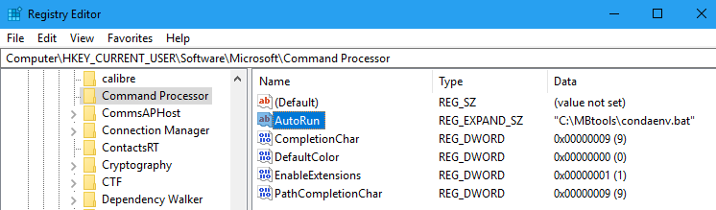
Setting default Anaconda environment
Configure anaconda to activate base (does not seem to work):
conda config --set auto_activate_base true
Alternative hack is to create your own launch script, e.g. condaenv.bat:
@call "C:\Miniconda3\condabin\conda_hook.bat
@conda activate
Setup the cmd registry to autorun your batch file (may need overwriting):
[HKEY_CURRENT_USER\Software\Microsoft\Command
AutoRun = "<path to your bat file>"

Slide 17
First steps into the REPL (Read, Eval, Print Loop)
From a command prompt type (or try the pylauncher "py"):
> python
Once you have a python prompt, try these commands:
1+2*3
print 'Hello World!' # This would work under python2
print('Hello World!') # Parenthesis needed for Python3
name = 'Fred'
print(name)
name
greet = "Hello " + name + '!'
print(greet)
name = input('Enter your name?’)
print(f'Hello {name.upper()}!')
help()
import sys
sys.version
sys.prefix
sys.executable
import this

Slide 18
Code block indentation
Python isn’t delimited and uses indentation to separate code blocks:
if age < 18:
print('You cannot drink’)
if age == 17:
print('But you can drive')
else:
print('You can drink and drive')
print('But you must not, "drink and drive"')
Can be spaces or tabs but must be consistent (Tabnanny is a tool to fix indentation issues).
To exit the REPL on Windows type Ctrl-Z <enter>
Unix type Ctrl-D
Or type "exit()"

Slide 19
Creating a hello world script
At command prompt create a script file:
> mkdir %USERPROFILE%\pytut
> cd %USERPROFILE%\pytut
> Notepad hello.py
Type & save the following code into notepad or another editor being careful to use consistent spacing <Tab> or <Spaces> for each indent:
def greet(name=None):
if not name:
name = 'World'
text = 'Hello ' + name + '!'
print(text)
greet()
answer = input('What is your name? ')
greet(answer)
To run the script from the command line:
> python hello.py
(you may need to “conda activate” first)

Slide 20
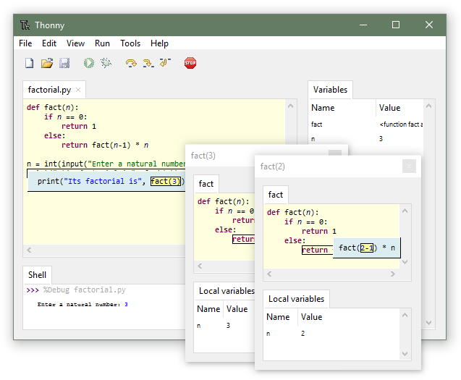
Exercise 1
Install and start “Thonny” (https://thonny.org/)
Create a new file and type the same code from previous page into the Thonny editor and save as “greet1.py” into the pytut directory.
Ensure tick is on for View => Variables & shell.
Start the code with Run => Debug (faster).
Use keys F6 – step over, F7 – step into.
Once more but use, Ctrl+F5, Debug (nicer).
Observe the variables and shell output.
What happens if you move the function to the end of the script?
Why does it error (see the assistant)?
Advanced: try stepping countdown.py and factor.py

Slide 21
REF: Python Naming Conventions
General
Avoid using names that are too general or too wordy. Strike a good balance between the two.
Bad: data_structure, my_list, info_map, dictionary_for_the_purpose_of_storing_data_representing_word_definitions
Good: user_profile, menu_options, word_definitions
Don’t be a jackass and name things “O”, “l”, or “I”
When using CamelCase names, capitalize all letters of an abbreviation (e.g. HTTPserver)
Packages
Package names should be all lower case
When multiple words are needed, an underscore should separate them
It is usually preferable to stick to 1 word names
Modules
Module names should be all lower case
When multiple words are needed, an underscore should separate them
It is usually preferable to stick to 1 word names
Classes
Class names should follow the UpperCaseCamelCase convention
Python’s built-in classes, however are typically lowercase words
Exception classes should end in “Error”
Global (module-level) Variables
Global variables should be all lowercase
Words in a global variable name should be separated by an underscore

Slide 22
REF: Python Naming Conventions (2)
Instance Variables
Instance variable names should be all lower case
Words in an instance variable name should be separated by an underscore
Non-public instance variables should begin with a single underscore
If an instance name needs to be mangled, two underscores may begin its name
Methods
Method names should be all lower case
Words in an method name should be separated by an underscore
Non-public method should begin with a single underscore
If a method name needs to be mangled, two underscores may begin its name
Method Arguments
Instance methods should have their first argument named ‘self’.
Class methods should have their first argument named ‘cls’
Functions
Function names should be all lower case
Words in a function name should be separated by an underscore
Constants
Constant names must be fully capitalized
Words in a constant name should be separated by an underscore

Slide 23
iPython (Interactive Python)
Provides an enhanced python REPL (Read Eval Print Loop) with syntax highlighting and auto completion.
Miniconda users may need to install with "conda install jupyter"
From a command prompt start with "ipython"
Note:
? = Help
%quickref = Reference of all ipython syntax/magics
help() = Python interactive help
<tab> completion
<command>? | ?<command> = Object introspection and help (docstring)
! = to run shell commands
%magic and %%magic (%timeit)
Try some of the previous python commands.
Ctrl-Z does not work - try "exit"
Fix: Revert from version 3.0.8: conda install prompt_toolkit=2.0.10

Slide 24
Jupyter (iPython) notebook
Jupyter is the newer language agnostic frontend.
Built upon iPython to provide a web application.
Great for coding and documentation at the same time.
From Anaconda menu start the "Jupyter notebook" or at a command prompt type "jupyter notebook".
Note that CWD is %USERPROFILE% directory unless you use CLI.
Miniconda users may need to install with "conda install jupyter"
Once opened a New=>Python3 notebook you can rename from "Untitled" to "#Scrap"
Exercise: Go through the notebook tour (in the help menu).
<ESC> = command mode <Enter> = edit mode <shift>+<enter> = run cell A = create cell above B = create cell below DD = delete cell | H = help M = set cell to markdown L = Toggle line numbers <shift>+<tab> = Show parameter help (doc string) ! = to run shell commands %magic and %%magic

Slide 25
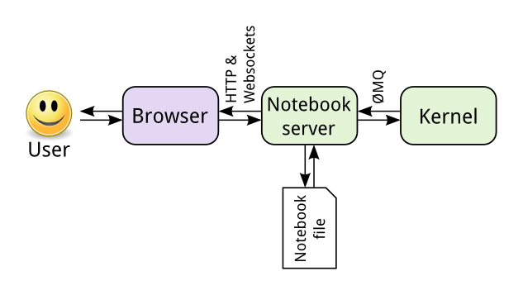
Jupyter Architecture
Tip to set a particular browser for your jupyter notebooks:
From CMD prompt run: "jupyter notebook --generate-config"
Change the following line in resultant file:
c.NotebookApp.browser = '"C:\\Program Files (x86)\\Microsoft\\Edge\\Application\\msedge.exe" %s'

Slide 26
Google colaboratory
What is "Colab"?
It's Jupyter in the cloud and much more...
Best let google explain:
https://colab.research.google.com/
After this course I would recommend trying "Machine learning crash course" from the Colabs intro notebook.

Slide 27
Part 2
Language fundamentals
Into the interactive tutorial notebooks...
Open the PyTut2_Types notebook

Slide 28
Part 3
Loops, functions, Classes, etc
Into the interactive tutorial notebooks...
Open the PyTut3_LoopsFunctionsClasses notebook

Slide 29
Prepare for next section
Clone the tutorial repository using "GIT CMD":
mkdir %USERPROFILE%\pytut
cd %USERPROFILE%\pytut
git clone https://github.com/mrkbutty/PythonTutButty02.git

Slide 30
Part 4
Vscode editor & Namespaces

Slide 31
VScode Exercise
Install GIT for windows first:
https://git-scm.com/download/win
Install VScode as your development environment:
https://code.visualstudio.com/download
Install recommended VScode extensions:
Python, Pylance, Material Icons, (Docker if adventurous)
Go through the VScode python intro tutorial:
https://code.visualstudio.com/docs/python/python-tutorial

Slide 32
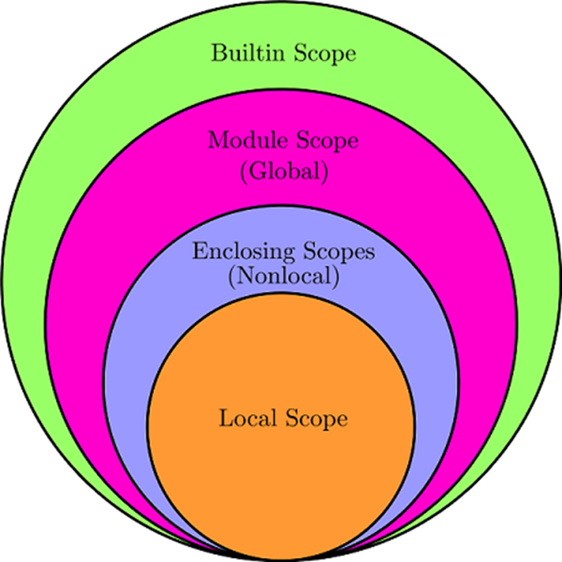
Namespaces
Open the new PythonTutButty02 folder in vscode
LEGB stand for Local, Enclosing, Global, and Built-in scopes:
Local (or function) scope is the code block or body of any Python function or lambda expression. This Python scope contains the names that you define inside the function.
Enclosing (or nonlocal) scope is a special scope that only exists for nested functions.
Global (or module) scope is the top-most scope in a Python program, script, or module.
Built-in scope is a special Python scope that contains names such as keywords, functions, exceptions, and other attributes that are built into Python.

Slide 33
Prepare for next section
Clone the tutorial repository using "GIT CMD":
mkdir %USERPROFILE%\pytut
cd %USERPROFILE%\pytut
git clone https://github.com/mrkbutty/PythonTutButty03.git
Open the new PythonTutButty03 folder in vscode

Slide 34
Part 5
Files & First CLI programs
Open the PyTut5_Files notebook

Slide 35
CLI programs
Why?
Quick to develop.
If you follow a sensible structure can easily be included in web & GUI apps.
Good CLI program structure:
If __name__=='__main__' to call cli function.
cli function parses and handles CLI arguments.
Separate functions with main processing functionality.
Separate functions to render the output (text, html, etc).
It can be a good idea for render functions to return strings and only print when the format is 'text'.

Slide 36
Debugging
Don't use print statements! Unless you have to ☺ (prefer a debug output option)
Many IDE have built in debuggers.
Running a script from command line with the debugger:
> python -m pdb -c continue myscript.py
Or put one of these into a script to break into pdb:
import pdb; pdb.set_trace() # < python 3.7
breakpoint() # Python 3.7+
PDB Quick Ref:
h(elp) [command] = help.
p(rint) <expr> = print expression.
pp <expr> = pretty-print expression (good for long lists etc).
l(ist) [first [,last] | .] = list lines or '.' for current position. ("l." is your friend)
ll = long list current function or frame.
n(ext) = execute until next.
s(tep) = execute and step into.
unt <line> = execuate up
Exercise: Try the VScode debugger!

Slide 37
Part 6
Pandas etc
Open the PyTut6_Pandas notebook

Slide 38
Zip module
Create program to open zip file xxx
List the contents
Find a certain file yyy
Get the file contents
Search lines containing zzz and output
Change previous regex program to make a zip file containing the csv file. Go direct from memory to file or from intermediate csv file.

Slide 39
Pandas
Read the previous csv file out of the zipfile into a Dataframe
Average the columns

Slide 40
Output to Excel
Change the previous Regex program to output an excel file
Change the Pandas program to read either a csv or an excel

Slide 43
Other reading & projects
https://realpython.com/python-application-layouts/
https://dbader.org/
https://github.com/vinta/awesome-python
https://pythonawesome.com/
https://www.streamlit.io/
https://wooey.readthedocs.io/en/latest/
https://github.com/man-group/dtale

