Slide 1
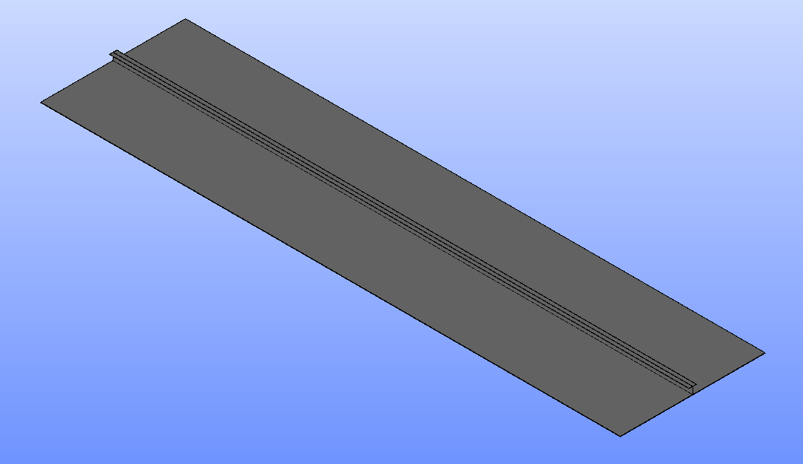
Validate ShellSolver with Beams
Model a plate with shell elements with a stiffener using beam elements
A 12 m long plate, 3 m wide plate
With a center beam stiffener,
.3 m deep subjected to a total lateral load of 100 N/m along the length.
Problem is modeled as a beam only with BeamSolver and
Then with ShellSolver modeling the plate as shells and the stiffener as a beam.

Slide 2
Modeling approach BeamSolver
In BeamSolver the plate and stiffener is modeled as a beam with a cross section
In ShellSolver the plate is model with a shell and the stiffener as a beam element.
Since there is not a neutral axis offset of a beam element the cross section of the beam element is effectively the same as the above
The plate adds little stiffness to the bending but will dominate axial loading
Shell is modeled at the neutral axis and will not be significant to lateral bending but will provide in plane stiffness and can be loaded with pressure loads. The area of the stiffener can be reduce by the area of the plate, to get the area correct.
This is known as the “Hybrid Method” and actually works better than an offset beam element.

Slide 3
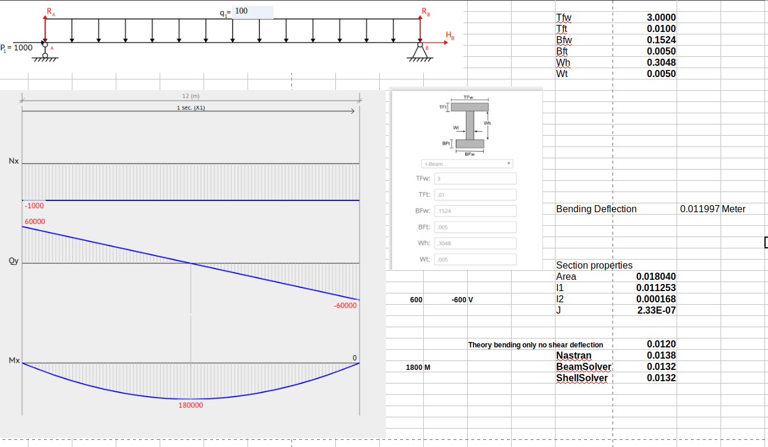
Deflection using bending only neglecting shear
flexibilty
Comparison of Solutions

Slide 4
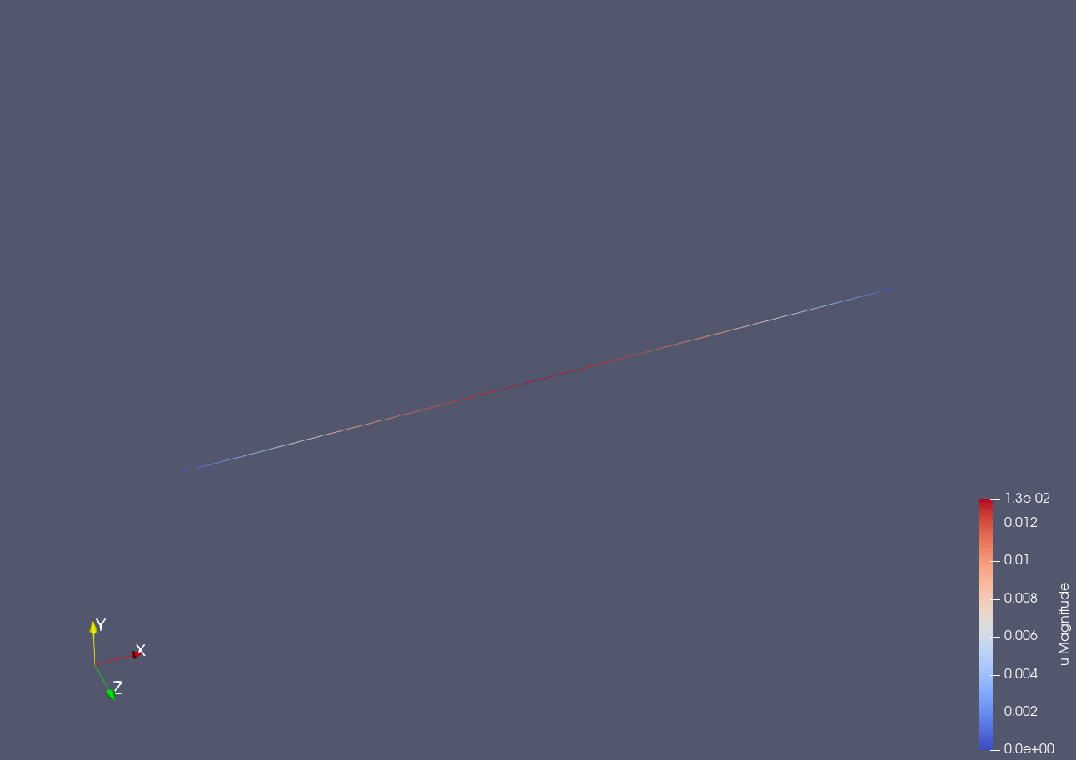
BeamSolver

Slide 5
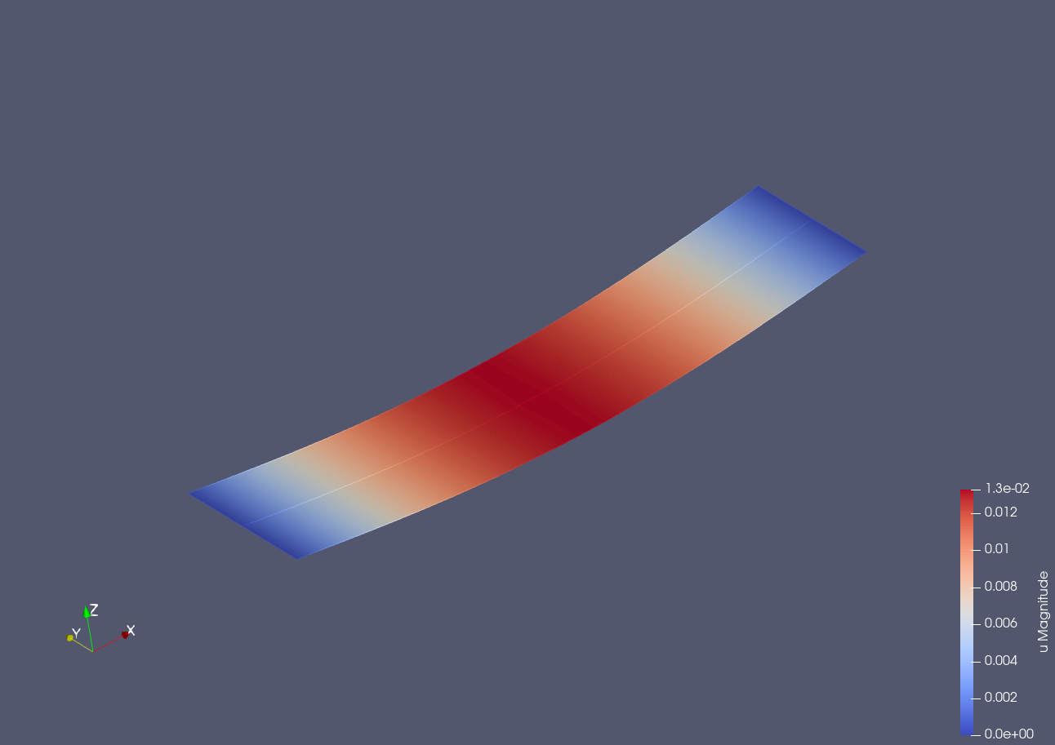
ShellSolver

