Slide 1

Projeto Final da Disciplina de Banco de Dados (CIC0097)
Sistema de Gerenciamento de Materiais para um Laboratório Didático (SGML)
Grupo:
Erick dos Santos - 222031116
Felipe Aguiar - 222032810
Gabriel Lucas - 190107111
Maria da Conceição - 170003370

Slide 2
Tópicos abordados
Contexto
Tecnologias e Linguagem
Modelo de BD
Implementação
Dificuldades
Notes:
https://www.youtube.com/watch?v=swlCK8lrtlU
https://www.youtube.com/watch?v=kuVAQ4TfyEw

Slide 3
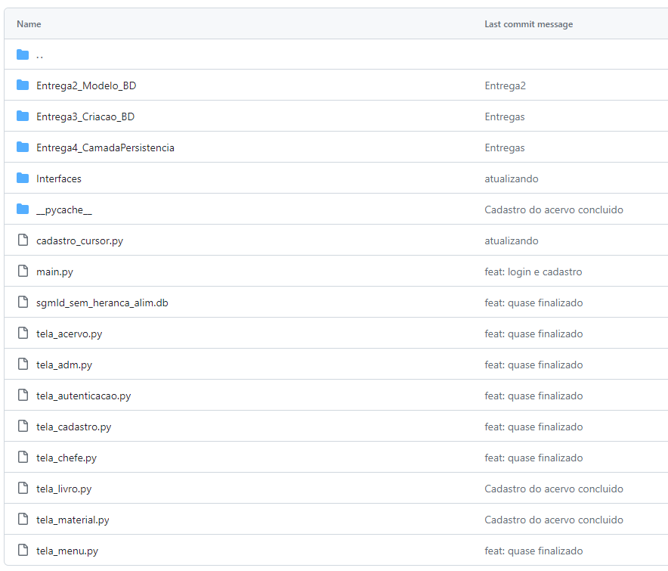
SGML: Repositório do projeto
Notes:
https://www.mongodb.com/pt-br/company
https://www.ibm.com/br-pt/topics/mongodb
https://www.youtube.com/watch?v=swlCK8lrtlU
https://intellipaat.com/blog/mongodb-vs-sql/#:~:text=In%20comparison%20to%20the%20SQL,of%20data%2C%20however%20MongoDB%20does.
https://github.com/mongodb/mongo

Slide 4






Tecnologias e Linguagem
Notes:
https://www.mongodb.com/pt-br/company
https://www.ibm.com/br-pt/topics/mongodb
https://www.youtube.com/watch?v=swlCK8lrtlU
https://intellipaat.com/blog/mongodb-vs-sql/#:~:text=In%20comparison%20to%20the%20SQL,of%20data%2C%20however%20MongoDB%20does.
https://github.com/mongodb/mongo

Slide 5
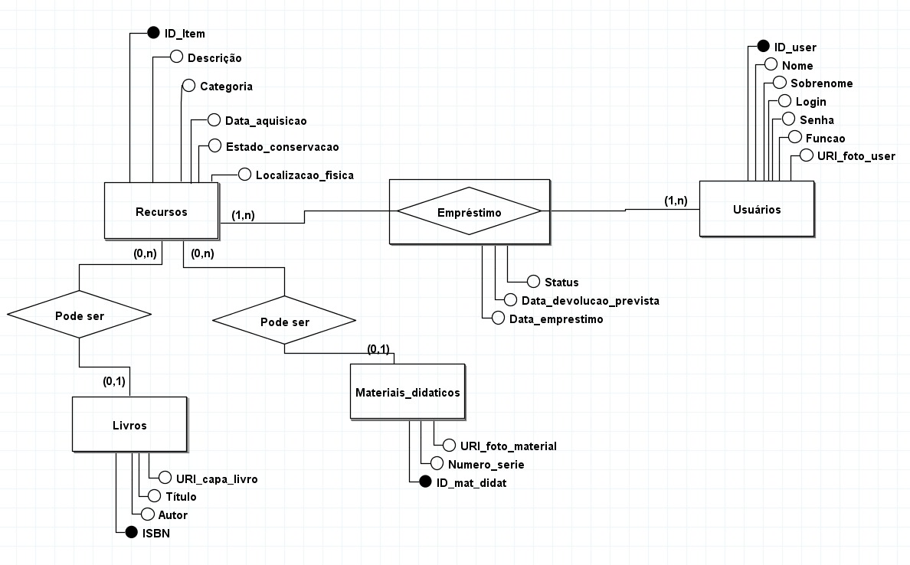
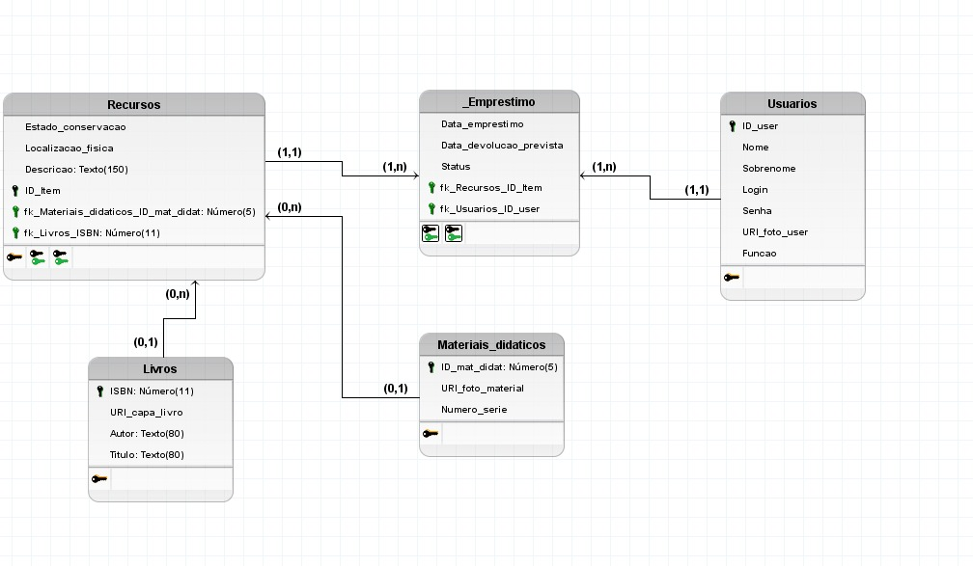
Modelo de BD
Notes:
https://www.mongodb.com/pt-br/company
https://www.ibm.com/br-pt/topics/mongodb
https://www.youtube.com/watch?v=swlCK8lrtlU
https://intellipaat.com/blog/mongodb-vs-sql/#:~:text=In%20comparison%20to%20the%20SQL,of%20data%2C%20however%20MongoDB%20does.
https://github.com/mongodb/mongo

Slide 6
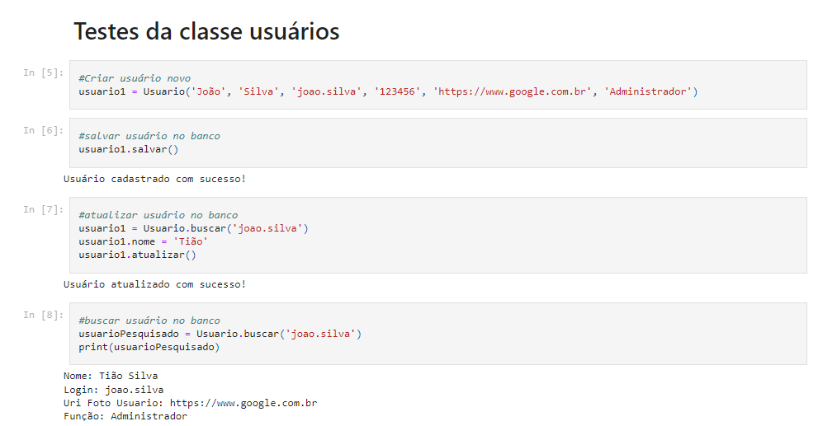
Implementação PERSISTÊNCIA
Notes:
https://www.mongodb.com/pt-br/company
https://www.ibm.com/br-pt/topics/mongodb
https://www.youtube.com/watch?v=swlCK8lrtlU
https://intellipaat.com/blog/mongodb-vs-sql/#:~:text=In%20comparison%20to%20the%20SQL,of%20data%2C%20however%20MongoDB%20does.
https://github.com/mongodb/mongo

Slide 7
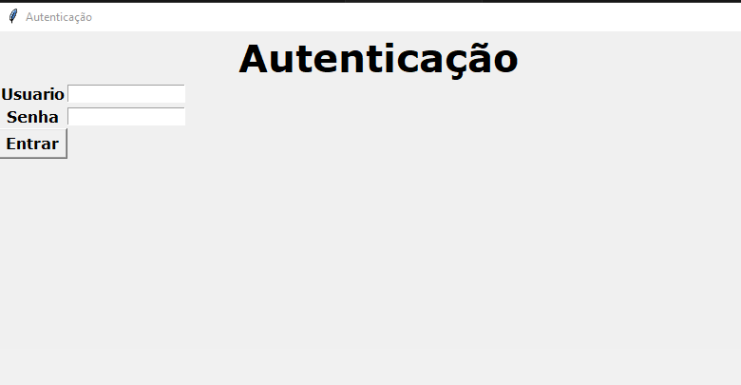
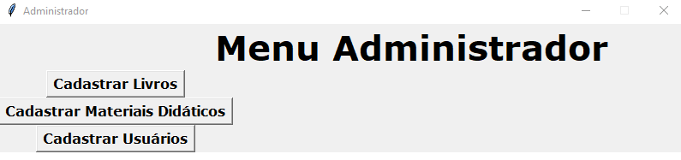
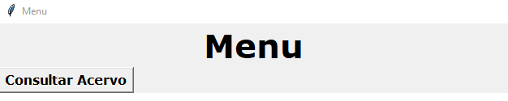
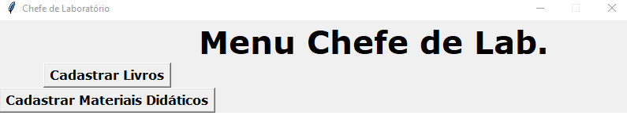
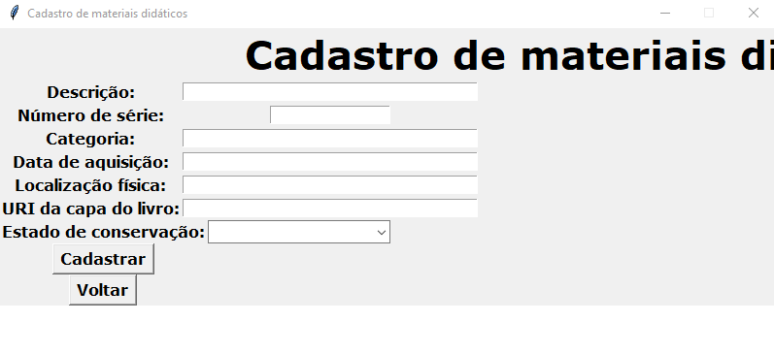
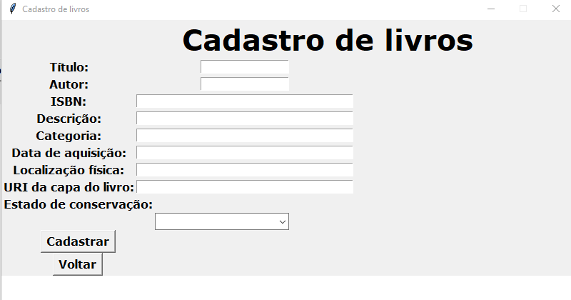
Implementação TELAS
Notes:
https://www.mongodb.com/pt-br/company
https://www.ibm.com/br-pt/topics/mongodb
https://www.youtube.com/watch?v=swlCK8lrtlU
https://intellipaat.com/blog/mongodb-vs-sql/#:~:text=In%20comparison%20to%20the%20SQL,of%20data%2C%20however%20MongoDB%20does.
https://github.com/mongodb/mongo

Slide 8
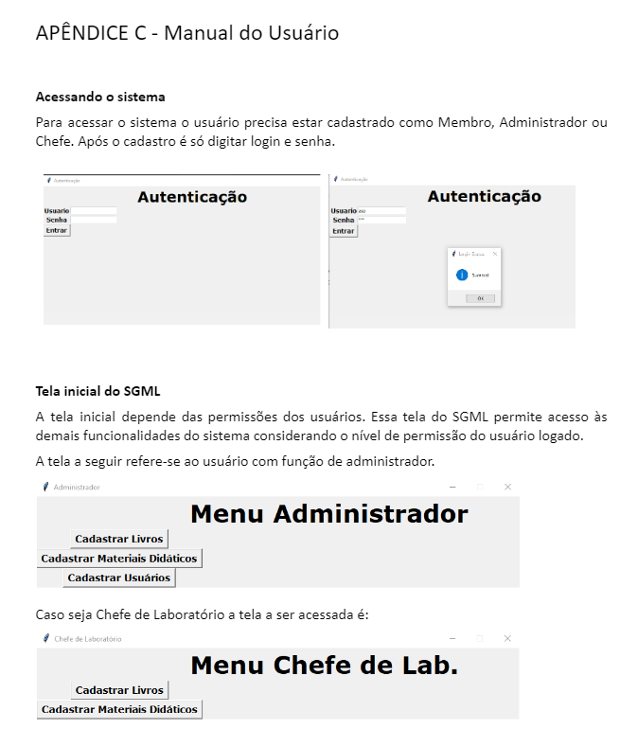
Implementação
MANUAL
Notes:
https://www.mongodb.com/pt-br/company
https://www.ibm.com/br-pt/topics/mongodb
https://www.youtube.com/watch?v=swlCK8lrtlU
https://intellipaat.com/blog/mongodb-vs-sql/#:~:text=In%20comparison%20to%20the%20SQL,of%20data%2C%20however%20MongoDB%20does.
https://github.com/mongodb/mongo

Slide 9
Dificuldades
Relacionamento BD e Interface
Retrabalho - uso de tecnologia que não se mostrou adequado (FIGMA)
Desenvolvimento em Persistência, porém não concretização de todo o CRUD na Interface.
Notes:
https://www.youtube.com/watch?v=swlCK8lrtlU
https://intellipaat.com/blog/mongodb-vs-sql/#:~:text=In%20comparison%20to%20the%20SQL,of%20data%2C%20however%20MongoDB%20does.
https://github.com/mongodb/mongo

Slide 10
Obrigado!

