Slide 1
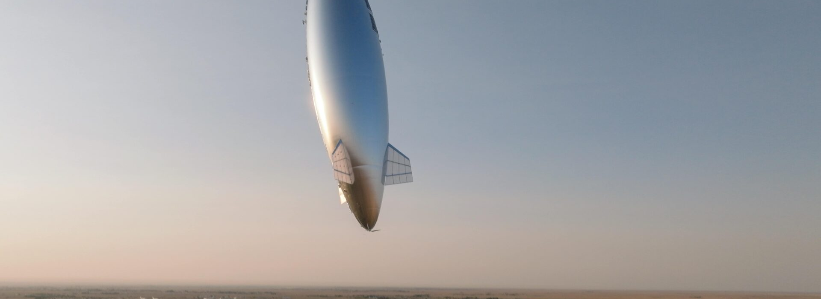
Thermal engineering for
Sceye’s stratospheric mission
Mohammadreza Khani, PhD
Independent public-reference demonstration
Open the study
Notes:
Sceye develops high-altitude platforms for connectivity and observation. This presentation applies my thermal-engineering approach to a representative vehicle assembled from public evidence. It is an independent interview demonstration, not work commissioned by Sceye. The linked website carries the assumptions, native models and full results.
Evidence and sources
https://sceye.com/platform/
https://sceye.com/press-releases/sceye-completes-record-us-japan-stratospheric-flight/
https://khanisolutions.com/AISolutions/sceye-thermal-interview.html
Photo: Sceye, ST1 launch, September 2026 release.
Scope: independent public-reference interview study. Internal geometry, losses, properties and limits are representative assumptions. No Sceye proprietary CAD, physical test or qualification claim.

Slide 2
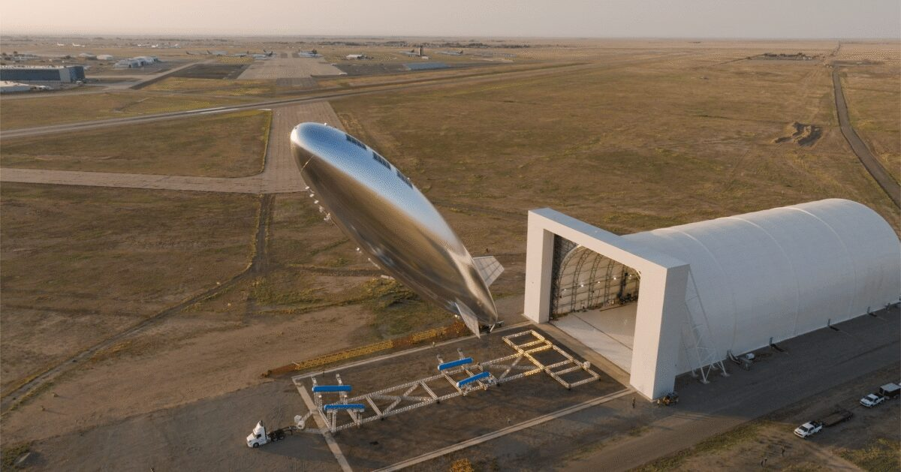
Sceye’s vehicle and day/night mission
30 days
Company-reported ST1 journey in 2026
Connectivity and edge computing
Earth observation payloads
Solar by day, batteries at night
Job environment: 18–21 km. Study basis: 20 km. ST1 reported 16.5–17 km.
Khani Solutions
Detailed evidence on the website
02 / 20
Notes:
The mission must maintain useful service through the solar cycle. Sceye’s September 9, 2026 release reports a month-long journey of nearly 30,000 km and more than seven days in Japanese-managed airspace. It mentions mobile broadband, emergency communications, drones and onboard edge computing. The 2024 flight describes optical, IR and radar payloads. Those historical payloads are not asserted to be the exact ST1 suite. Public platform descriptions identify daytime solar power and battery-supported night operation. The job’s 18–21 km environment and the independent model’s 20 km reference remain distinct from ST1’s reported 16.5–17 km flight.
Evidence and sources
https://sceye.com/platform/
https://sceye.com/press-releases/sceye-completes-record-us-japan-stratospheric-flight/
https://sceye.com/press-releases/the-future-of-non-terrestrial-infrastructure-sceye-demonstrates-breakthrough-diurnal-flight-in-the-stratosphere-with-renewable-energy/
Photo: Sceye, September 2026 ST1 release.
Scope: independent public-reference interview study. Internal geometry, losses, properties and limits are representative assumptions. No Sceye proprietary CAD, physical test or qualification claim.

Slide 3
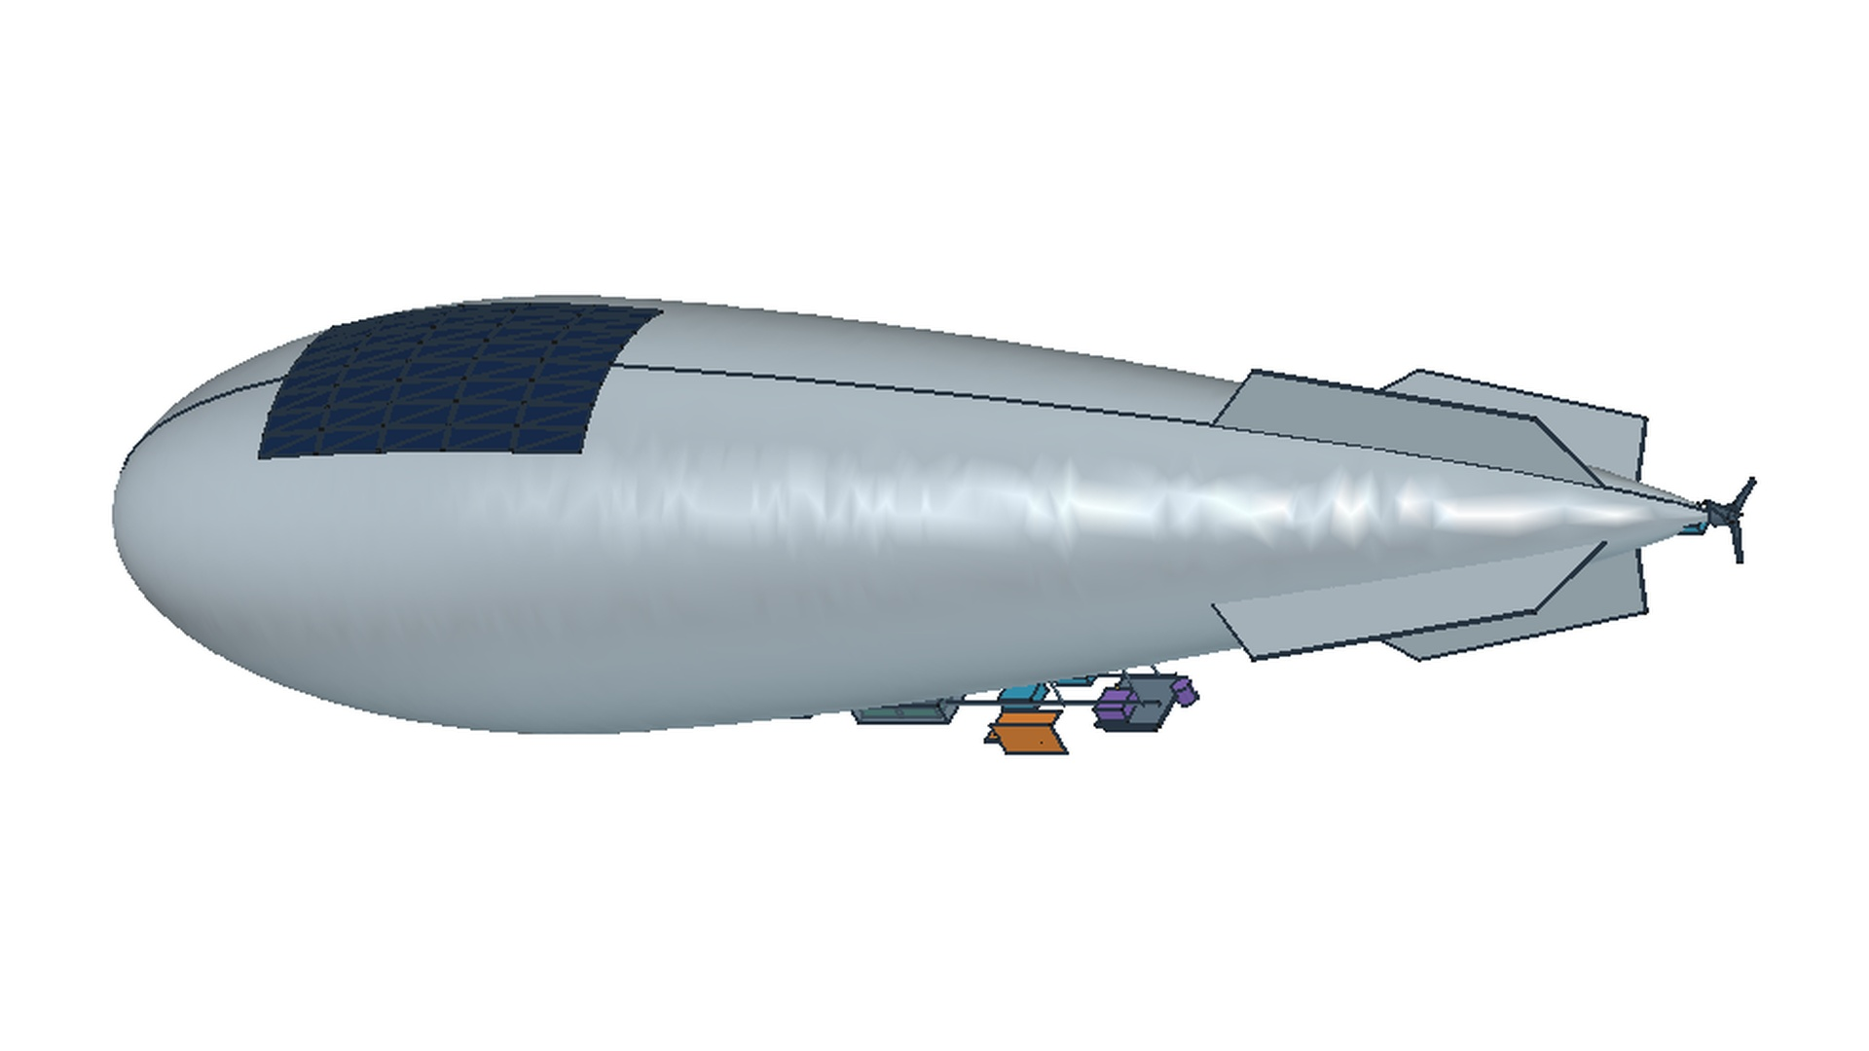
Public references became a component-level CAD model
12 seconds
Exterior
Proposed cutaway
Electronics
Stern propulsion
CAD tour starts automatically
Khani Solutions
Detailed evidence on the website
03 / 20
Notes:
I reconstructed an exterior and proposed internal equipment layout in FreeCAD from public photographs and references. The embedded clip uses saved CAD views with camera zooms, pans and transitions. It is not a manufacturing sequence or a new 3D orbit. Internal packaging, component dimensions and thermal equipment locations remain explicit study assumptions. Click the website for interactive views and CAD downloads.
Evidence and sources
https://khanisolutions.com/AISolutions/sceye-haps-thermal.html#vehicle
Stage-01-Evidence-CAD-R1/review/vehicle-isometric.png
Stage-01-Evidence-CAD-R1/review/vehicle-cutaway.png
Interview Deck/assets/videos/Sceye_Representative_CAD_Tour_12s.mp4
Scope: independent public-reference interview study. Internal geometry, losses, properties and limits are representative assumptions. No Sceye proprietary CAD, physical test or qualification claim.

Slide 4
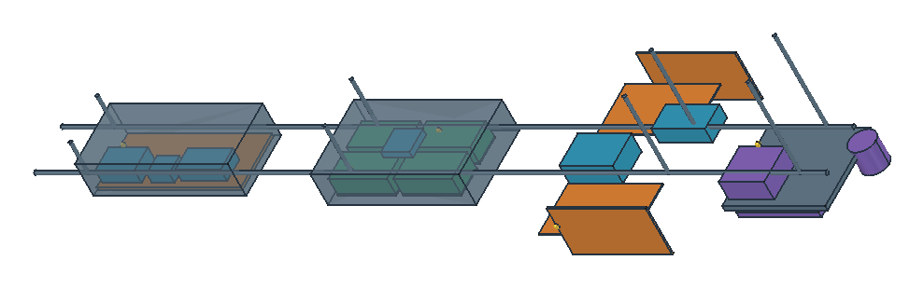
Avionics, batteries, power conversion and payloads
Avionics
Battery modules
Radiators and power
RF, antenna and optics
Different heat paths and limits drive separate subsystem models.
Khani Solutions
Detailed evidence on the website
04 / 20
Notes:
The left pod contains avionics and navigation/communications blocks. The middle contains four battery blocks and the BMS. Outboard orange panels represent candidate radiators. Nearby MPPT and DC–DC blocks represent power conversion. The purple assembly at the right represents RF/antenna and optional optics. The motor controller sits near the stern, not in that purple payload assembly. I model each subsystem separately because dissipation, interfaces, cold-start constraints and mission criticality differ. The detailed telecom model later adds RF power amplification, beamforming, baseband, edge server and payload DC power. All ratings are assumptions, not disclosed Sceye part data.
Telecom means telecommunications: In our model, it includes the RF transmitter, antenna beamforming electronics, network electronics and power supply. These consume electricity and generate heat, so they need thermal management.
The three blue boxes inside the transparent enclosure on the far left are, from left to right:
Flight computer: processes sensor information and calculates vehicle-control commands.
Navigation / IMU: measures orientation, rotation and acceleration.
Command and telemetry electronics: receives ground commands and transmits vehicle status.
The brown plate underneath is the mounting baseplate, which also spreads heat. The outer enclosure is shown transparent so you can see inside.
The two turquoise boxes farther right, near the orange radiators, represent the MPPT and DC–DC power converters.
Evidence and sources
https://khanisolutions.com/AISolutions/sceye-haps-thermal.html#vehicle
Interview Deck/assets/cad/component-callout-guide.json
Stage-02-Diurnal-Thermal-R1/inputs/component-nodes.json
Scope: independent public-reference interview study. Internal geometry, losses, properties and limits are representative assumptions. No Sceye proprietary CAD, physical test or qualification claim.

Slide 5
One OpenModelica model connects the thermal system
28
Thermal states in the expanded mission
Environment
Heat paths
Electrical power
Heater control
24-state baseline shown. The telecom extension has 28 states. Source-derived native connection map.
Khani Solutions
Detailed evidence on the website
05 / 20
Notes:
The integrated mission connects the environment, hull/solar system, avionics, battery, payload, propulsion, structure and power manager. The initial model has 24 lumped thermal nodes. The Stage 06 telecom extension carries 28 states and five detailed case terminals. Source-derived connection diagrams map actual model instances and connect equations, but are not OMEdit screenshots. Finite heat capacity, conservative thermal ports, radiation, convection, power losses, heater control and battery energy storage interact in the full model. The detailed website opens the subsystems and time histories.
Evidence and sources
https://khanisolutions.com/AISolutions/sceye-haps-thermal.html#mission-explorer
https://khanisolutions.com/AISolutions/sceye-thermal-interview.html#integrated-explorer
Stage-02-Diurnal-Thermal-R1/source/HAPSDiurnal.mo
Stage-06-Interview-Evidence-R1/results/engineering/summary.json
Scope: independent public-reference interview study. Internal geometry, losses, properties and limits are representative assumptions. No Sceye proprietary CAD, physical test or qualification claim.

Slide 6
Mission results connect temperatures and energy
61.8 °C
Peak telecom case temperature
53.0%
Minimum modeled battery SOC
2.63 kWh
Daily heater energy
Selected representative design. Thermal and service constraints pass this nominal simulated mission.
Khani Solutions
Detailed evidence on the website
06 / 20
Notes:
This plot uses the settled selected-design mission. Five telecom terminals share the spatially derived heat paths. The maximum case surrogate is 61.832°C, minimum case surrogate 7.14°C, minimum SOC 53.04%, total DC energy 69.01 kWh/day and all-heater energy 2.631 kWh/day. Modeled full-workload availability is 100% under the chosen temperature and SOC screen. It does not represent measured throughput or vehicle qualification. This architecture has changed from the early aggregate payload, so daily energy cannot be compared across all stages as if loads were unchanged.
outside air temperature, we assumed a smooth daily variation at the 20 km study altitude:
Average: −56.5°C
Coldest: −60.5°C at 3 a.m.
Warmest: −52.5°C at 3 p.m.
Evidence and sources
https://khanisolutions.com/AISolutions/sceye-thermal-interview.html#integrated-explorer
Stage-06-Interview-Evidence-R1/results/engineering/explorer.json
Scope: independent public-reference interview study. Internal geometry, losses, properties and limits are representative assumptions. No Sceye proprietary CAD, physical test or qualification claim.

Slide 7
Active and passive thermal-control design
JD-01: Simulation evidence
54.0%
Less heater energy in the matched combined case
Reducing night heat loss outperformed heater capacity alone in this comparison.
Khani Solutions
Detailed evidence on the website
07 / 20
Notes:
Design, analyze, and optimize active and passive thermal control systems for high-altitude aerospace platforms
I held the mission and useful loads fixed while comparing heater caps and cold radiator coupling. The original case uses 5.263 kWh/day of heater energy. Larger caps alone use 7.288. Reducing cold radiator coupling alone uses 2.029. The combined path/control case uses 2.420, a 54.0% reduction relative to the matched original. The combined case still misses the motor’s chosen −5°C target, which motivates the PI-control study. Actual switch, insulation and interface products still need selection and test.
BaselineFixed radiator connections and original heaters5.26 kWh/day
Larger heatersIncrease avionics, payload and motor heater capacity7.29 kWh/day
Night isolationTemperature-controlled radiator connections; original heaters2.03 kWh/day
CombinedSame isolation plus motor heater capacity increased from 100 to 300 W2.42 kWh/day
Evidence and sources
https://khanisolutions.com/AISolutions/sceye-haps-thermal.html#night-explorer
https://khanisolutions.com/AISolutions/sceye-haps-thermal.html#motor-explorer
https://khanisolutions.com/AISolutions/sceye-thermal-interview.html#integrated-explorer
https://khanisolutions.com/assets/studies/sceye-haps/stage-06/documents/Design-Decision-Record.md
Scope: independent public-reference interview study. Internal geometry, losses, properties and limits are representative assumptions. No Sceye proprietary CAD, physical test or qualification claim.

Slide 8
Steady-state and transient thermal analysis
JD-02: Simulation evidence
153.7 min
Cold-start band acquisition at 300 W
180.4 min
Acquisition with a 30 W reserve
Separate fixed-boundary hot/cold equilibria complement the full mission transients.
Khani Solutions
Detailed evidence on the website
08 / 20
Notes:
Perform steady-state and transient thermal analyses using analytical and numerical methods
The motor begins at −40°C. The delayed 300 W case reaches and holds the chosen −5±0.5°C band after 153.7 minutes and spends about 2.61 hours near capacity. A 270 W ceiling leaves 30 W hardware reserve but extends acquisition to 180.4 minutes. This is a warmup-time trade, not an efficiency gain. The isolated payload equilibria yield a 67.31°C hot peak and 22.51°C cold peak under fixed external power, solar hour, mounts and hull. These are not indefinite full-mission energy equilibria.
Evidence and sources
https://khanisolutions.com/AISolutions/sceye-haps-thermal.html#startup-explorer
https://khanisolutions.com/AISolutions/sceye-thermal-interview.html#integrated-explorer
Stage-05-Cold-Startup-Delays-R1/results/summary.json
Stage-06-Interview-Evidence-R1/results/engineering/summary.json
Scope: independent public-reference interview study. Internal geometry, losses, properties and limits are representative assumptions. No Sceye proprietary CAD, physical test or qualification claim.

Slide 9
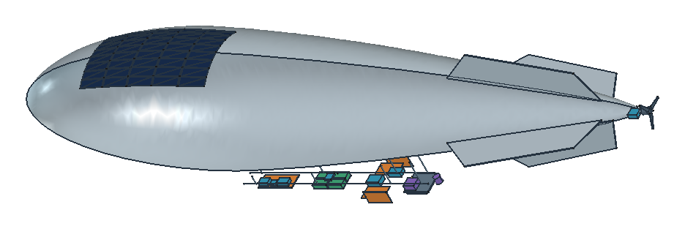
Mission model development and maintenance
JD-03: Simulation evidence
Model level | Saved evidence
System | Diurnal mission and SOC
Subsystem | Battery, payload, avionics, motor
Component | Case, plate, pad and radiator
Versioned inputs, controlled variants and repeatable numerical checks
Khani Solutions
Detailed evidence on the website
09 / 20
Notes:
Develop, validate, and maintain thermal models predicting system behavior across stratospheric and mission-specific operating conditions
I retain model hierarchy, source files, parameters, case overrides, solver outputs and numerical checks. The same classes support the baseline, control changes, startup delays, payload detail and faults. A 17 km case isolates pressure/convection sensitivity against the 20 km design basis. It is not a replay of Sceye’s actual trajectory. Maintaining this model means replacing selected assumptions with approved equipment and environment data while keeping configuration and verification traceable.
Evidence and sources
https://khanisolutions.com/assets/studies/sceye-haps/stage-06/documents/Study-Requirements.md
https://khanisolutions.com/AISolutions/sceye-thermal-interview.html#integrated-explorer
https://khanisolutions.com/assets/studies/sceye-haps/stage-05/source/HAPSDiurnal.mo
https://khanisolutions.com/AISolutions/sceye-haps-thermal.html#startup-checks
Scope: independent public-reference interview study. Internal geometry, losses, properties and limits are representative assumptions. No Sceye proprietary CAD, physical test or qualification claim.

Slide 10
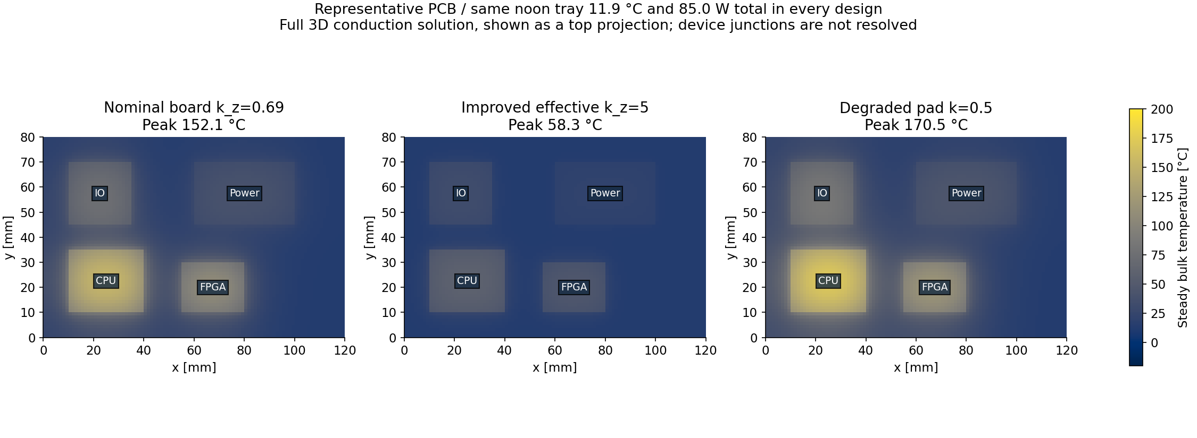
Materials, insulation, radiators and interfaces
JD-04: Simulation evidence
152.1 °C nominal CPU surrogate 58.3 °C with an improved assumed path
Khani Solutions
Detailed evidence on the website
10 / 20
Notes:
Support selection, qualification, and trade studies for materials, insulation, coatings, radiators, and thermal interfaces
This is the earlier 120×80 mm, 85 W FEM board, with a one-way frozen tray boundary of 11.944°C. The nominal CPU bulk surrogate reaches 152.11°C, the improved effective through-board path reaches 58.31°C, and degraded pad conductivity produces 170.54°C. Those are study inputs and case-like bulk temperatures, not semiconductor junctions or qualified material performance. The later 240×180 mm telecom board is a different model. Contact pressure, pad aging, optical properties, moisture and assembly repeatability remain hardware questions.
The PCB in slide 10 was 2 mm thick, with overall dimensions of 120 × 80 mm.
Underneath it, we modeled a 0.5 mm thermal pad with Thermal conductivity: 3 W/m·K, connecting the board to the tray.
Evidence and sources
https://khanisolutions.com/AISolutions/sceye-haps-thermal.html#pcb-spatial
Stage-03-Night-Control-Spatial-R1/review/pcb-thermal-comparison.png
https://khanisolutions.com/AISolutions/sceye-haps-thermal.html#night-inputs
https://khanisolutions.com/AISolutions/sceye-haps-thermal.html#night-explorer
https://khanisolutions.com/AISolutions/sceye-thermal-interview.html#spatial-explorer
https://khanisolutions.com/assets/studies/sceye-haps/stage-06/documents/Design-Decision-Record.md
https://khanisolutions.com/assets/studies/sceye-haps/stage-06/documents/Interface-Control.md
Scope: independent public-reference interview study. Internal geometry, losses, properties and limits are representative assumptions. No Sceye proprietary CAD, physical test or qualification claim.

Slide 11
Thermal requirements, margins and operating limits
JD-05: Simulation evidence
8.2 K
Nominal hot margin to the chosen 70°C screen
2.7 K
Hot isolated-equilibrium margin
Chosen telecom case screen: −10 to 70°C. These limits require actual part approval.
Khani Solutions
Detailed evidence on the website
11 / 20
Notes:
Define thermal requirements, margins, and operating limits for avionics, batteries, payloads, and structural components
I distinguish operating, startup, survival and analysis validity. In the Stage 06 screen, telecom cases must remain between −10 and 70°C. The selected 4.5 m² radiator with a 60 W/K effective attachment gives 61.83°C nominal maximum and 67.31°C in the isolated hot equilibrium. The fixed-link improved board still reaches 124.31°C and only 53.57% full-workload availability. The original ordinary-PCB model exceeds the 125°C analysis-validity guard and is rejected. It is not a credible 425°C hardware prediction. The selected radiator adds 3.93 kg of assumed panel mass relative to the 3.12 m² reference. Structural allowables and thermoelastic performance remain unallocated.
Case Radiator area Hot-state conductance Cold-state conductance
Fixed link 3.12 m²1 5 W/K 15 W/K—always connected
4.0 m² radiator 4.0 m² 60 W/K 1.8 W/K
4.5 m² radiator 4.5 m² 60 W/K 1.8 W/K
Evidence and sources
https://khanisolutions.com/assets/studies/sceye-haps/stage-06/documents/Study-Requirements.md
https://khanisolutions.com/AISolutions/sceye-thermal-interview.html#integrated-explorer
https://khanisolutions.com/AISolutions/sceye-haps-thermal.html#startup-explorer
Scope: independent public-reference interview study. Internal geometry, losses, properties and limits are representative assumptions. No Sceye proprietary CAD, physical test or qualification claim.

Slide 12
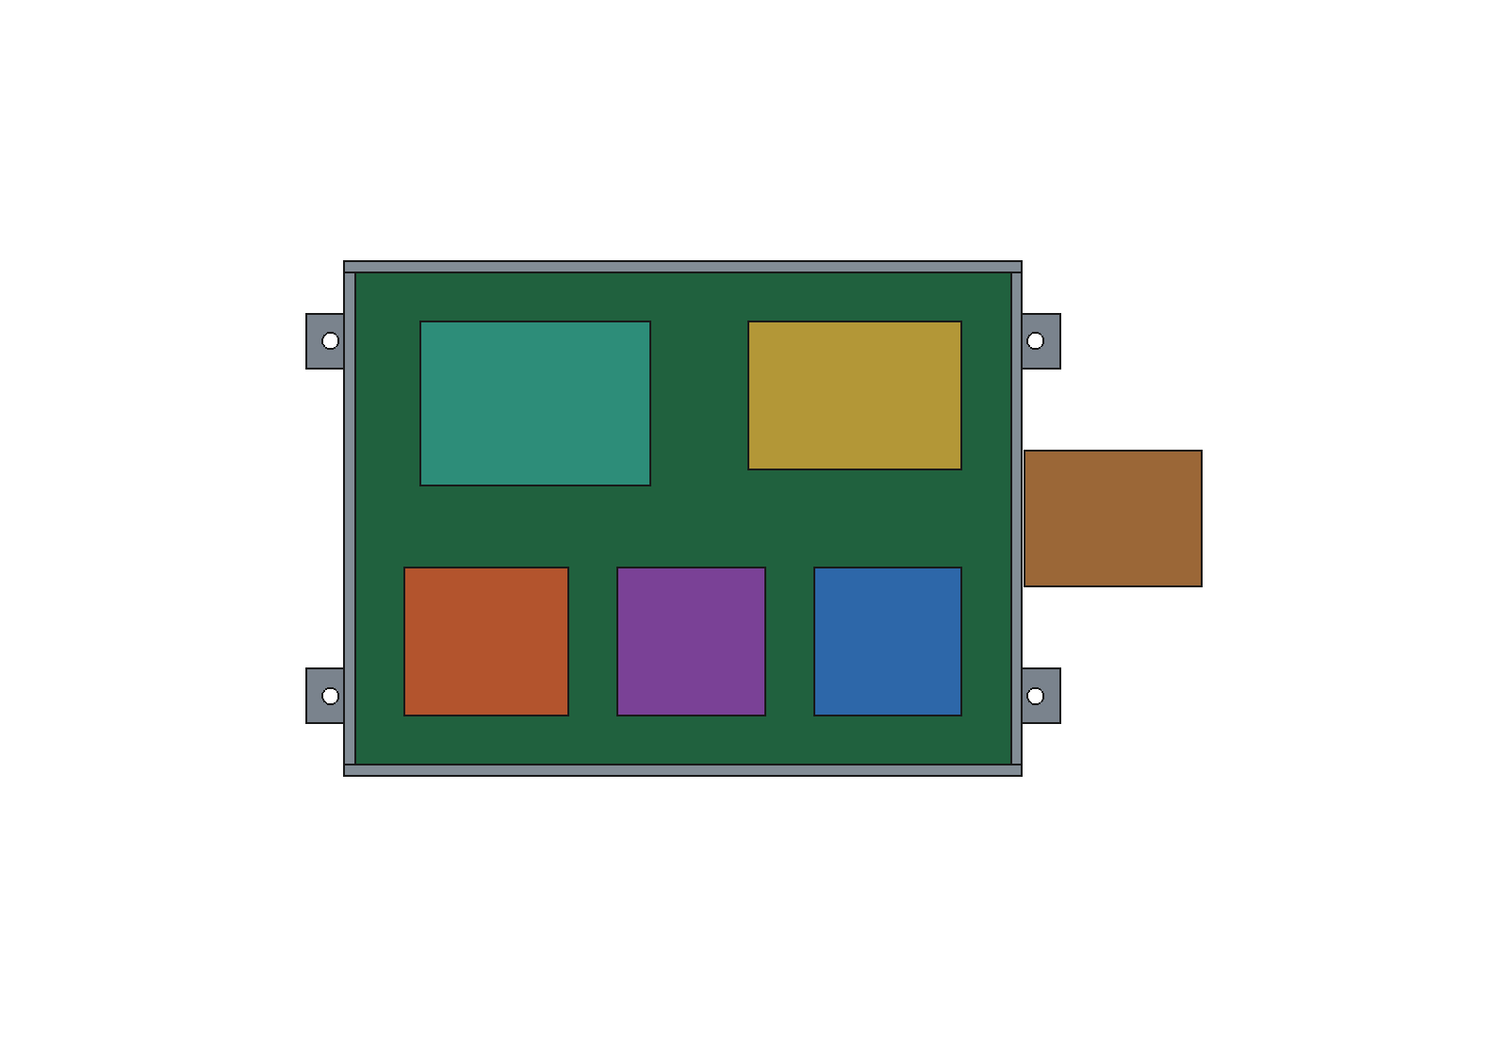
Thermal-vacuum, altitude and cycling test planning
JD-06: Test planned
Test phase | Measured inputs / outputs
Room pressure | Power pulses, case and plate T
Altitude chamber | 17/20 km pressure, gas flow, wall T
Thermal cycling | Startup, soak, recovery and faults
Held-out run | Frozen parameters, new conditions
Sensor locations, raw-data templates and acceptance planning are prepared. Tests remain unexecuted.
Khani Solutions
Detailed evidence on the website
12 / 20
Notes:
Support environmental testing, including thermal vacuum, altitude simulation, and temperature cycling tests
The planned article uses separate heater blocks, plate sensors, a strap/sink sensor, shielded gas measurement, shroud temperature, chamber pressure and individual electrical power channels. The matrix starts with offset/time checks and room-temperature calibration, then reassembly repeatability, cold/hot operation, altitude pressure cases, radiation changes and guarded faults. Low-pressure air and thermal vacuum have different convection, so pressure, gas flow and wall radiation must be measured separately. No physical test, chamber operation or thermal cycling has been performed. The CAD image shows the representative Stage 06 telecom assembly proposed as the basis for an instrumented article, not completed hardware.
Evidence and sources
https://khanisolutions.com/assets/studies/sceye-haps/stage-06/documents/Test-and-Correlation-Plan.md
https://khanisolutions.com/assets/studies/sceye-haps/stage-06/documents/Test-Matrix.csv
https://khanisolutions.com/assets/studies/sceye-haps/stage-06/documents/Sensor-Map.csv
https://khanisolutions.com/assets/studies/sceye-haps/stage-06/documents/Test-Data-Template.csv
https://khanisolutions.com/assets/studies/sceye-haps/stage-06/documents/Standards-Applicability.md
Scope: independent public-reference interview study. Internal geometry, losses, properties and limits are representative assumptions. No Sceye proprietary CAD, physical test or qualification claim.

Slide 13
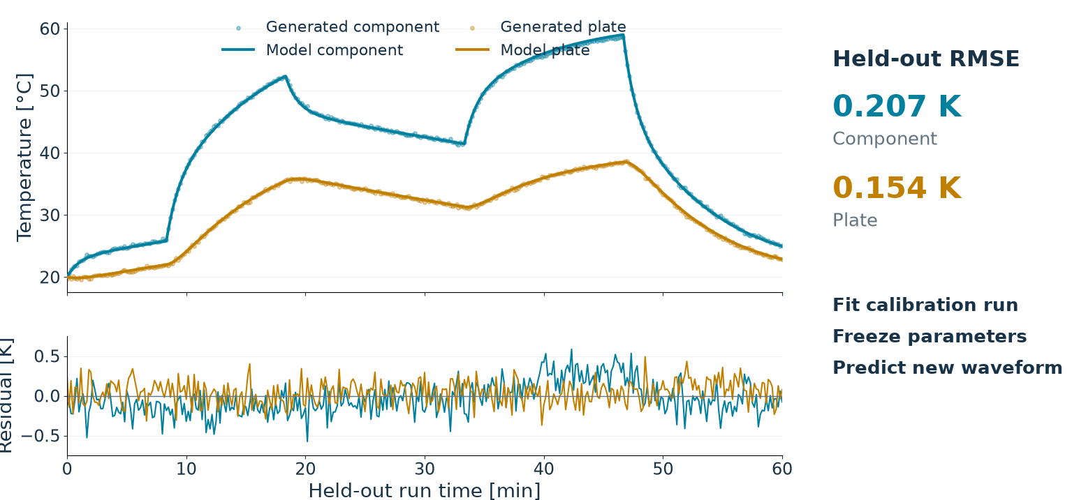
Test correlation and design updates
JD-07: Synthetic workflow
Generated data. No physical measurements.
Khani Solutions
Detailed evidence on the website
13 / 20
Notes:
Analyze test data, correlate results with thermal models, and drive design updates as needed
This exercise demonstrates calibration, parameter freezing and held-out prediction using generated observations. It uses all 361 held-out samples. Component RMSE is 0.207 K and plate RMSE is 0.154 K. No held-out retuning occurs. Shared model topology limits independence. These numbers demonstrate a correlation workflow, not hardware validation. A real campaign must replace generated data with calibrated measurements and include uncertainty, repeatability and model inadequacy.
Evidence and sources
https://khanisolutions.com/AISolutions/sceye-thermal-interview.html#step-5
https://khanisolutions.com/assets/studies/sceye-haps/stage-06/results/correlation/summary.json
https://khanisolutions.com/assets/studies/sceye-haps/stage-06/documents/Uncertainty-Budget.csv
https://khanisolutions.com/assets/studies/sceye-haps/stage-06/documents/Design-Decision-Record.md
Scope: independent public-reference interview study. Internal geometry, losses, properties and limits are representative assumptions. No Sceye proprietary CAD, physical test or qualification claim.

Slide 14
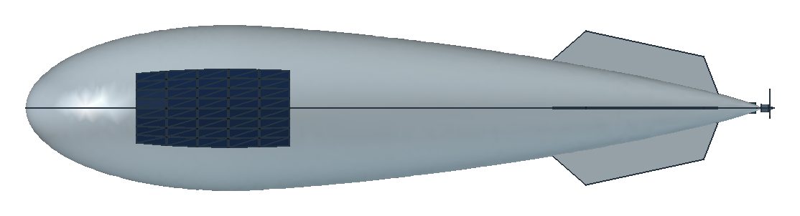
Mechanical, electrical, systems and manufacturing interfaces
JD-08: Test planned
Mechanical
Contact, clamp and torque
Electrical
Power maps and protection
Systems / manufacturing
Sensing and repeatability
Interface records identify the decisions and owners needed before an assembly review.
Khani Solutions
Detailed evidence on the website
14 / 20
Notes:
Collaborate with mechanical, electrical, systems, and manufacturing teams to resolve real-world thermal challenges
The interface-control record separates mechanical contact and preload, material stackup, harness and venting routes, power maps, heater protection, sensor behavior and system mode logic. Those decisions affect the thermal model and manufacturing repeatability. This slide demonstrates preparation for cross-functional review. No Sceye production team sign-off or real collaboration is claimed. A representative CAD assembly supports the interface discussion.
Team Information or decisions needed
Mechanical Mounting locations, contact area, clamp force, materials and thermal straps
Electrical Equipment power losses, operating modes, heater power and sensor interfaces
Systems Mission profiles, temperature limits, startup rules and fault responses
Manufacturing Pad compression, assembly tolerances, surface preparation and repeatability
Evidence and sources
https://khanisolutions.com/assets/studies/sceye-haps/stage-06/documents/Interface-Control.md
https://khanisolutions.com/assets/studies/sceye-haps/stage-06/documents/Design-Review-Checklist.csv
https://khanisolutions.com/assets/studies/sceye-haps/stage-06/documents/Risk-Register.csv
Scope: independent public-reference interview study. Internal geometry, losses, properties and limits are representative assumptions. No Sceye proprietary CAD, physical test or qualification claim.

Slide 15
Documented analysis and standards applicability
JD-09: Simulation evidence
Evidence record | What it controls
Requirements and assumptions | Limits, provenance and model boundaries
Native source and raw outputs | Reproducibility and configuration
Design decisions and risks | Why a configuration changed
Standards applicability | Authority, edition, tailoring and acceptance
Candidate references: DO-160, GEVS and NIST uncertainty guidance
Applicability reviewed. No compliance or qualification declaration.
Khani Solutions
Detailed evidence on the website
15 / 20
Notes:
Document designs, analyses, test results, and compliance with applicable engineering standards
Every major decision links assumptions, model source, raw outputs, numerical checks and open verification actions. The standards record treats DO-160 and GEVS as candidate frameworks subject to the actual vehicle authority’s edition, category and tailoring decisions. NIST TN 1297 supports uncertainty vocabulary. None supplies an automatic HAPS test level or a compliance determination. An analysis report and a synthetic fit do not replace the physical verification program.
DO-160 — environmental testing for aircraft equipment.
Published by RTCA, it defines test conditions and procedures for airborne electronics, including temperature, altitude and electromagnetic environments. For our project, it helps frame questions such as: Will the electronics operate through cold, low-pressure flight conditions? RTCA overview
GEVS — General Environmental Verification Standard.
This is NASA Goddard’s framework for verifying spaceflight payloads, subsystems and components through testing and analysis. It provides useful verification practices, but it is not automatically applicable to Sceye’s airship. NASA’s GEVS description
NIST uncertainty guidance — how confidently can we trust a measurement?
NIST Technical Note 1297 explains how to combine uncertainty from sources such as sensor calibration, data acquisition and repeatability, then report a result with a justified uncertainty interval. For example, a temperature measurement should include its uncertainty—not just a precise-looking number. NIST guidance
Evidence and sources
https://khanisolutions.com/assets/studies/sceye-haps/stage-06/documents/Study-Requirements.md
https://khanisolutions.com/assets/studies/sceye-haps/stage-05/source/HAPSDiurnal.mo
https://khanisolutions.com/assets/studies/sceye-haps/stage-06/documents/Design-Decision-Record.md
https://khanisolutions.com/assets/studies/sceye-haps/stage-06/documents/Standards-Applicability.md
https://khanisolutions.com/assets/studies/sceye-haps/stage-06/documents/Design-Review-Checklist.csv
Scope: independent public-reference interview study. Internal geometry, losses, properties and limits are representative assumptions. No Sceye proprietary CAD, physical test or qualification claim.

Slide 16
Design reviews, risk assessment and improvement
JD-10: Simulation evidence
Temperature compliance and useful mission service require separate acceptance checks.
Khani Solutions
Detailed evidence on the website
16 / 20
Notes:
Support design reviews, risk assessments, and continuous improvement initiatives
The fault cases link thermal results to mission service. The selected nominal case delivers 100% modeled full-workload availability. The stuck-on 240 W payload heater raises the peak to 74.94°C and reduces minimum SOC to 48.08%. The biased sensor and failed heater prevent startup service in these examples. Reserve-driven shedding keeps temperatures permissive but delivers only 76.75% full workload. Startup permission currently uses ideal true case temperatures, so a validated distributed sensor/observer and independent protection remain open. Qualitative risk records are not failure probabilities.
When a fault occurs—or we deliberately reduce power—how much of the mission still supports full payload operation?”
Case What we simulated
What the bar means
Nominal — 100% Selected design: 4.5 m² radiator, controlled thermal connection and functioning heaters
Full workload meets the checks throughout the day. Peak case temperature is 61.8°C.
Heater stuck on — 91.36% Payload heater continuously produces 240 W, even when heating is unnecessary
Peak temperature reaches 74.9°C. Full workload meets the checks for about 21.9 hours, but temperatures exceed the chosen limit during the remaining time.
Sensor bias — 0% Payload starts at −40°C, and the heater sensor reads 10°C too warm
The heater backs off too early. Actual equipment temperatures remain too cold to satisfy the −5°C startup requirement, so full workload never starts.
Heater failed — 0% Payload starts at −40°C, with its heater producing no heat
Standby equipment heat is insufficient to reach startup temperature. Full workload remains inhibited.
Reserve shedding — 76.75% The controller reduces payload workload to 40% when battery charge falls below 65%; thermal derating is also enabled
Full workload is available for about 18.4 hours. Reduced service can continue during other periods.
At midnight, battery charge starts at approximately 75.4%.Overnight, it supplies the vehicle because solar power is unavailable.Around 3.2 hours after midnight, charge falls below 65%.The controller reduces the telecom/edge-computing payload to 40% of its requested workload.Once solar charging brings SOC back above 65%, full workload can resume, provided temperatures also permit
Evidence and sources
https://khanisolutions.com/assets/studies/sceye-haps/stage-06/documents/Design-Decision-Record.md
https://khanisolutions.com/AISolutions/sceye-thermal-interview.html#step-6
https://khanisolutions.com/assets/studies/sceye-haps/stage-06/documents/Risk-Register.csv
https://khanisolutions.com/assets/studies/sceye-haps/stage-06/documents/Design-Review-Checklist.csv
Scope: independent public-reference interview study. Internal geometry, losses, properties and limits are representative assumptions. No Sceye proprietary CAD, physical test or qualification claim.

Slide 17
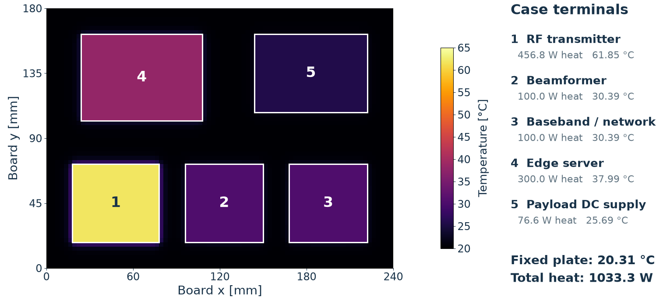
Conduction, convection and radiation in thin air
JD-11: Simulation evidence
3D conduction snapshot. The mission model adds radiation and prescribed thin-air convection.
Khani Solutions
Detailed evidence on the website
17 / 20
Notes:
Strong, applied understanding of heat transfer principles (conduction, convection, radiation), particularly in low-density, high-altitude environments
I separate solid conduction, pressure-dependent convection and surface radiation. This physical steady 3D snapshot is at 13.5 h with a 20.31°C fixed plate and 1033.3 W imposed dissipation. The PCB top face and five isothermal case terminals come from the saved 38,400-cell finite-volume model. The RF case snapshot is 61.85°C, distinct from the native dynamic mission maximum of 61.832°C. Semiconductor junctions and actual Sceye ECAD are not represented. A 17 km pressure/convection-only sensitivity gives 58.38°C peak versus 61.83°C at the 20 km basis. It does not establish actual flight behavior. Contact, gas and radiative boundary measurements remain necessary.
FreeCAD geometry → 3D conduction solver → temperature map
FreeCAD: creates the board, components and mounting geometry.
OpenModelica: supplies the mission heat loads and mounting-plate temperature.
Python finite-volume solver: calculates heat conduction and component temperatures.
Python plotting: produces the colored map.
Evidence and sources
https://khanisolutions.com/AISolutions/sceye-thermal-interview.html#spatial-explorer
Stage-06-Interview-Evidence-R1/results/engineering/spatial-surface.json
Interview Deck/assets/plots/scientific-figure-provenance.json
Scope: independent public-reference interview study. Internal geometry, losses, properties and limits are representative assumptions. No Sceye proprietary CAD, physical test or qualification claim.

Slide 18
Equivalent open thermal-modeling tools and verification
JD-12: Simulation evidence
1.65%
Maximum selected heat-path matrix change on mesh refinement
FreeCAD geometry OpenModelica mission Spatial conduction Python checks
Numerical verification is complete for the declared checks. Physical accuracy remains open.
Khani Solutions
Detailed evidence on the website
18 / 20
Notes:
Experience developing, validating, and correlating thermal models using industry-standard tools (e.g., ANSYS, Thermal Desktop, COMSOL, or equivalent)
This study uses an equivalent open workflow rather than proprietary vehicle inputs. FreeCAD supplies representative geometry. Native OpenModelica solves mission thermal and electrical coupling. The earlier PCB uses 3D FEM; the detailed telecom board uses a 38,400-cell finite-volume conduction model and returns a five-terminal heat-path matrix to the mission. Independent Python calculations, conservation residuals, refined runs and a spatial transient comparison test numerical consistency. The selected board RF self-resistance changes from0.09237453to0.09094805K/W between4,800and38,400cells. The maximum matrix change is1.648%, below the chosen3% mesh screen. The ordinary-board case changes4.099% and fails that screen. Those checks do not establish physical accuracy. Device selection, material characterization and measured correlation remain separate gates.
Evidence and sources
https://khanisolutions.com/assets/studies/sceye-haps/stage-05/source/HAPSDiurnal.mo
https://khanisolutions.com/AISolutions/sceye-haps-thermal.html#pcb-spatial
https://khanisolutions.com/AISolutions/sceye-haps-thermal.html#startup-checks
https://khanisolutions.com/AISolutions/sceye-thermal-interview.html#step-5
Stage-06-Interview-Evidence-R1/results/engineering/conduction-reduction.json
Scope: independent public-reference interview study. Internal geometry, losses, properties and limits are representative assumptions. No Sceye proprietary CAD, physical test or qualification claim.

Slide 19
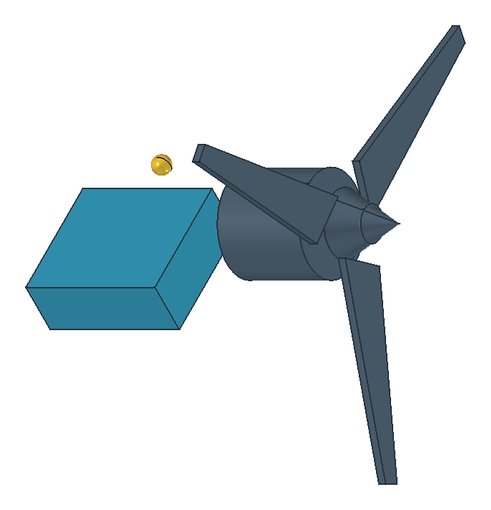
Hardware integration and operational readiness
JD-13: Physical evidence open
Gate | Current evidence
Design and simulation | Models, CAD, trades and faults
Test preparation | Sensor map and chamber matrix
Hardware correlation | Physical measurements required
Flight readiness | Integration and qualification open
0 physical tests in this portfolio study
Khani Solutions
Detailed evidence on the website
19 / 20
Notes:
Experience supporting hardware through design, test, integration, and operational readiness, not solely academic or theoretical work
This portfolio demonstrates analysis and test planning. It does not establish hardware support through qualification or operational readiness. Next gates are a real assembly with approved parts, repeatable interfaces, calibrated environmental tests, held-out correlation, independent protection and a controlled design review. The job also asks relevant hands-on industry experience. Discuss substantiated prior aerospace and battery-system work separately from this independent exercise. Do not imply the Sceye study itself provides flight-campaign experience.
Evidence and sources
https://khanisolutions.com/assets/studies/sceye-haps/stage-06/documents/Test-and-Correlation-Plan.md
https://khanisolutions.com/assets/studies/sceye-haps/stage-06/documents/Interface-Control.md
https://khanisolutions.com/assets/studies/sceye-haps/stage-06/documents/Design-Review-Checklist.csv
https://khanisolutions.com/assets/studies/sceye-haps/stage-06/documents/Completion-Boundaries.md
Scope: independent public-reference interview study. Internal geometry, losses, properties and limits are representative assumptions. No Sceye proprietary CAD, physical test or qualification claim.

Slide 20
Job requirements linked to the evidence
Requirement | Status
01 Active / passive control | Simulated
02 Steady / transient analysis | Simulated
03 Mission model maintenance | Simulated
04 Materials and interfaces | Simulated
05 Requirements and margins | Simulated
06 Environmental testing | Planned
07 Model correlation | Synthetic
Requirement | Status
08 Cross-functional integration | Planned
09 Documentation / standards | Simulated
10 Risk and design review | Simulated
11 Low-density heat transfer | Simulated
12 Equivalent thermal tools | Simulated
13 Hardware readiness | Open
9 simulated areas + 1 synthetic workflow 2 planned areas 1 open gate
Khani Solutions
Detailed evidence on the website
20 / 20
Notes:
Each requirement label links directly to its main evidence. The full website matrix links multiple artifacts, individual gaps and closeout actions. Counts are 10 demonstrated in simulation, two test planned, one unresolved and zero physically tested. Every simulated row has partial coverage. The correlation row uses generated data only. The matrix is a guide to an interview discussion, not a declaration that all job duties have been completed or that hardware has been qualified.
Evidence and sources
https://khanisolutions.com/AISolutions/sceye-thermal-interview.html
Stage-06-Interview-Evidence-R1/inputs/requirements-matrix.json
Scope: independent public-reference interview study. Internal geometry, losses, properties and limits are representative assumptions. No Sceye proprietary CAD, physical test or qualification claim.

