Slide 1
CodeForces Contest 1374 Problem E2
@mrkhosravian

Slide 2
Problem
Summer vacation has started so Alice and Bob want to play and joy, but... Their mom doesn't think so. She says that they have to read exactly 𝑚m books before all entertainments. Alice and Bob will read each book together to end this exercise faster.
There are n books in the family library. The i-th book is described by three integers: t_{i} — the amount of time Alice and Bob need to spend to read it, a_{i} (equals 11 if Alice likes the i-th book and 0 if not), and b_{i} (equals 11 if Bob likes the i-th book and 0 if not).
So they need to choose exactly 𝑚m books from the given n books in such a way that:
Alice likes at least k books from the chosen set and Bob likes at least k books from the chosen set;
the total reading time of these 𝑚m books is minimized (they are children and want to play and joy as soon a possible).
The set they choose is the same for both Alice an Bob (it's shared between them) and they read all books together, so the total reading time is the sum of ti over all books that are in the chosen set.
Your task is to help them and find any suitable set of books or determine that it is impossible to find such a set.

Slide 3
Input
The first line of the input contains three integers n, m and k (1 ≤ k ≤ m ≤ n ≤ 2 * 10⁵).
The next n lines contain descriptions of books, one description per line: the i-th line contains three integers t_{i}, a_{i} and b_{i} (1 ≤ t_{i} ≤ 10⁴, 0 ≤ a_{i}, b_{i} ≤ 1), where:
t_{i} — the amount of time required for reading the i-th book;
a_{i} equals 1 if Alice likes the i-th book and 0 otherwise;
b_{i} equals 1 if Bob likes the i-th book and 0 otherwise.

Slide 4
Output
If there is no solution, print only one integer -1.
If the solution exists, print T in the first line — the minimum total reading time of the suitable set of books. In the second line print 𝑚m distinct integers from 11 to 𝑛n in any order — indices of books which are in the set you found.
If there are several answers, print any of them.

Slide 5
Example 1
Input:
6 | 3 | 1
6 | 0 | 0
11 | 1 | 0
9 | 0 | 1
21 | 1 | 1
10 | 1 | 0
8 | 0 | 1
Output:
24
6 | 5 | 1

Slide 6
Solve example 1
Alice
Bob
1
06:00
There are 6 books
Alice and Bob both likes 1 books
2
11:00
3
There are four types of book:
0 0 - both Alice and Bob doesn't like these books books { 1 }
1 0 - only Alice likes these books books { 5, 2 }
0 1 - only Bob likes these books books { 6, 3 }
1 1 - both Alice and Bob like these books books { 4 }
Now sort these groups by time:
{ 06:00 }
{ 10:00, 11:00 }
{ 08:00, 09:00 }
{ 21:00 }
09:00
4
21:00
5
10:00
6
08:00

Slide 7
Solve example 1
Alice
Bob
1
06:00
First we create BOOKS set.
Then for total k we add books to our BOOKS set.
Here k is 1. Then we just add one book for each of them or add a mutual book for both.
Now we check if we should add a book that is mutual with both of them or add separate books for each one ( alice and bob ).
Check which one is smaller.
Mutual book = 21:00
Alice = 10:00 , Bob 08:00
So 10:00 + 08:00 < 21:00 , then we add separate books for each one. # 10 + 8 = 18
Final BOOKS set will be:
BOOKS = { 10:00, 08:00 } # not important to be sorted.
Now we fixed books that alice and bob likes, but BOOKS set has 2 books and we need 3 books to read.
2
11:00
3
09:00
4
21:00
5
10:00
6
08:00

Slide 8
Solve example 1
Alice
Bob
1
06:00
So we must add 1 other book to make BOOKS size 3.
There 4 possible ways to add a book to our BOOKS set.
Add a book that none of them like it.
Add a book that just Alice likes it.
Add a book that just Bob likes it.
Remove A book that both likes it from BOOKS set and add 2 book for alice and bob separately.
We must choose the one that is smallest. If There wasn’t any, there is no answer then return -1.
Here book 1 has the smallest time and we add it to BOOKS set.
BOOKS set is now = { 10:00, 08:00, 06:00 }
The Answer is the sum of BOOKS set time and their index.
# 10 + 8 + 6 = 24
# indexes = 5 , 6 , 1
2
11:00
3
09:00
4
21:00
5
10:00
6
08:00

Slide 9
Now go to code

Slide 10
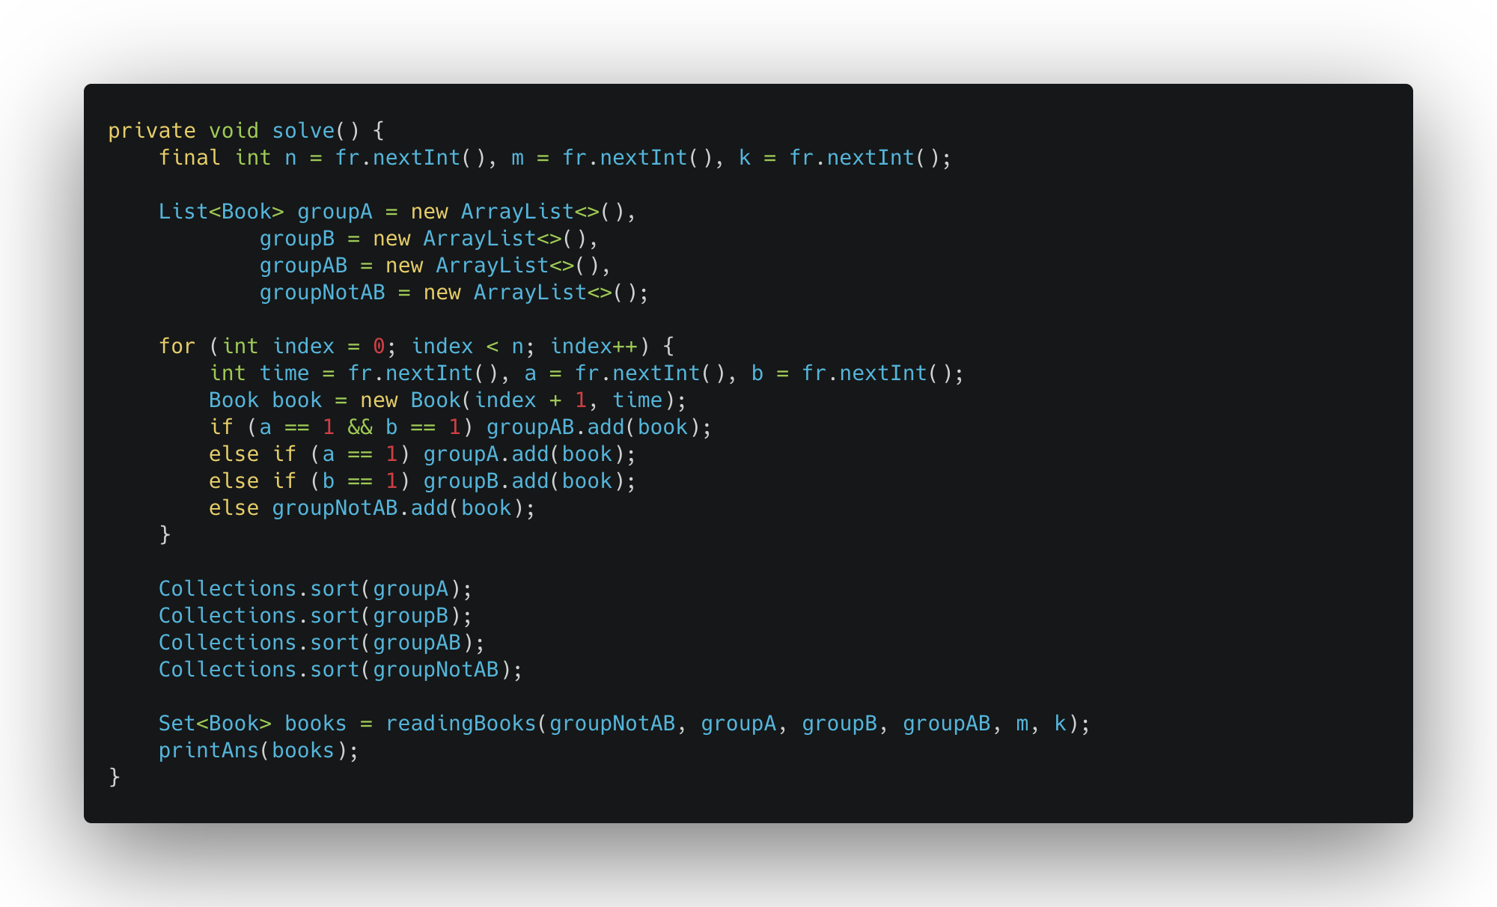
Initializing
* fr ( fast reader ) is a custom scanner that uses Java BufferedReader

Slide 11
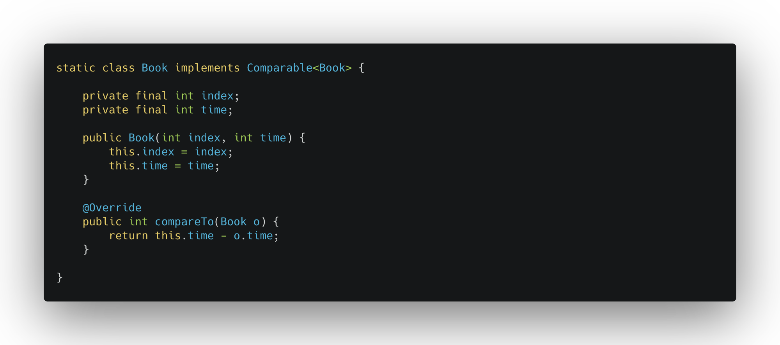
Create Books class

Slide 12
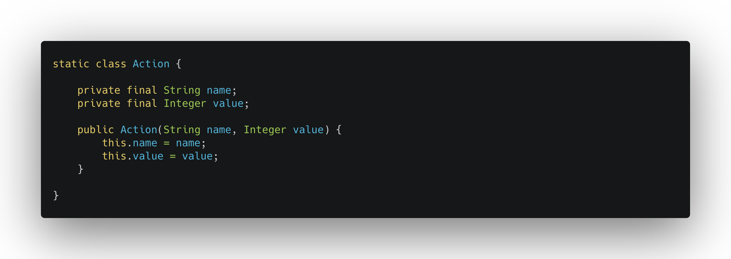
Create Action class

Slide 13
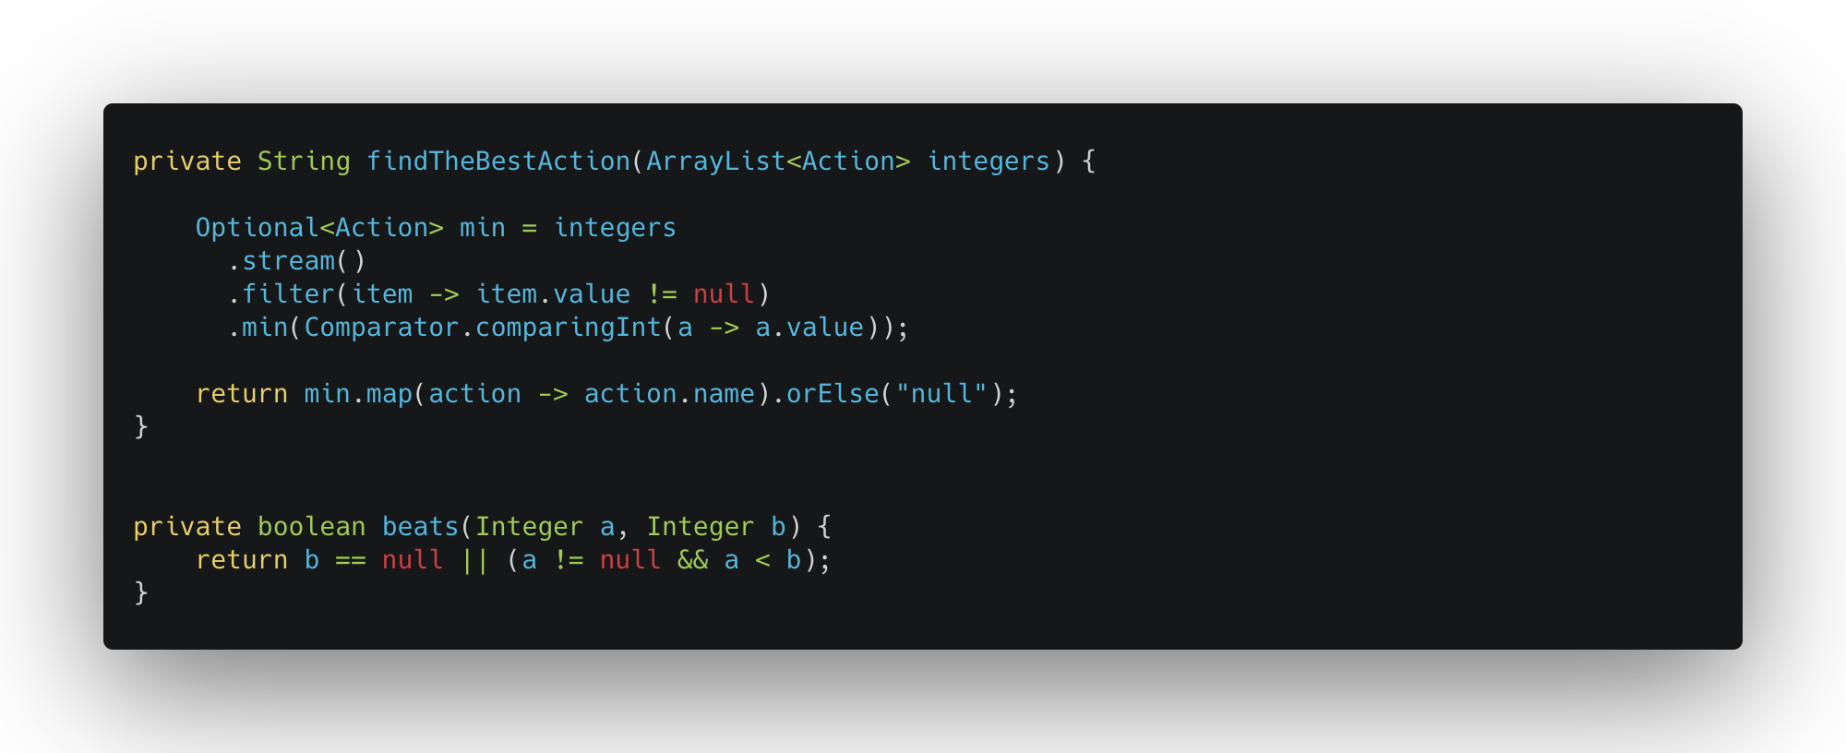
Find the best action and beats method

Slide 14
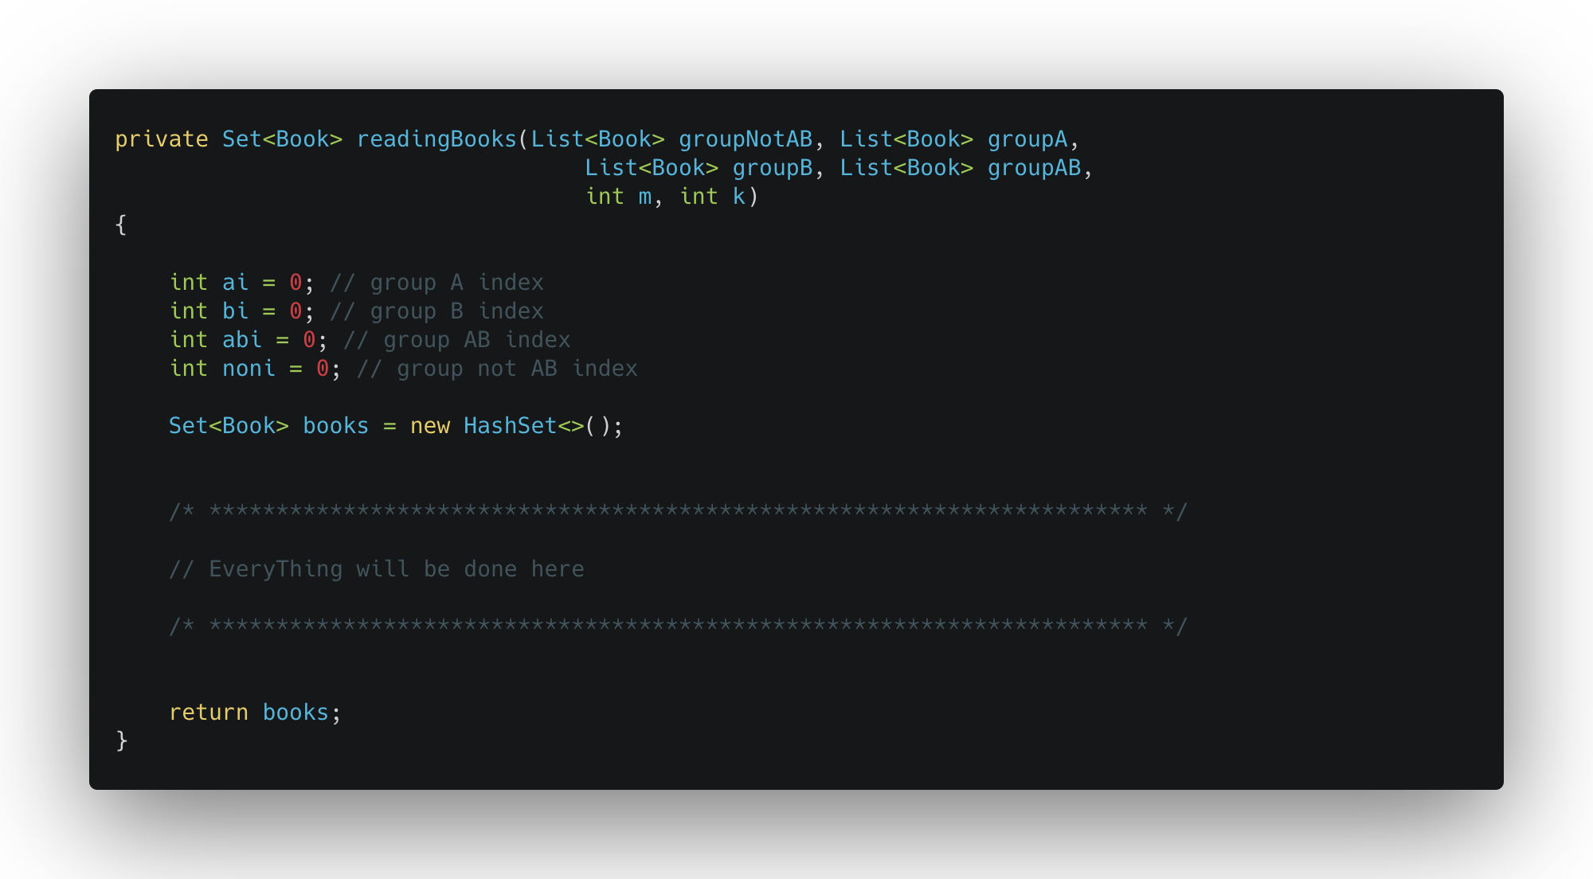
Reading Books Algorithm 1/5

Slide 15
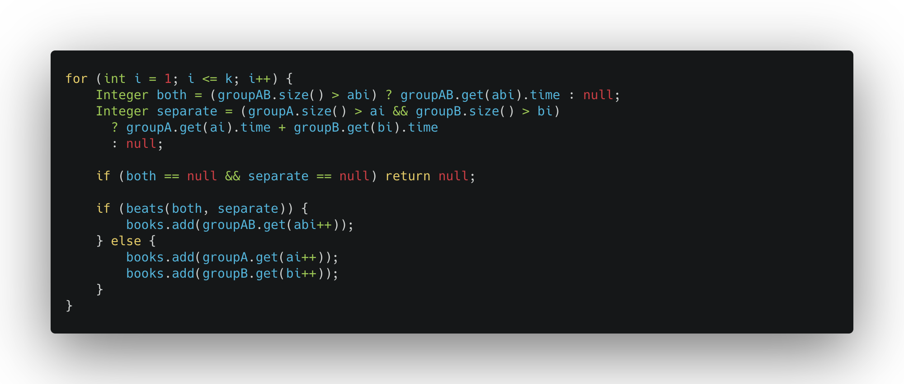
Reading Books Algorithm 2/5

Slide 16
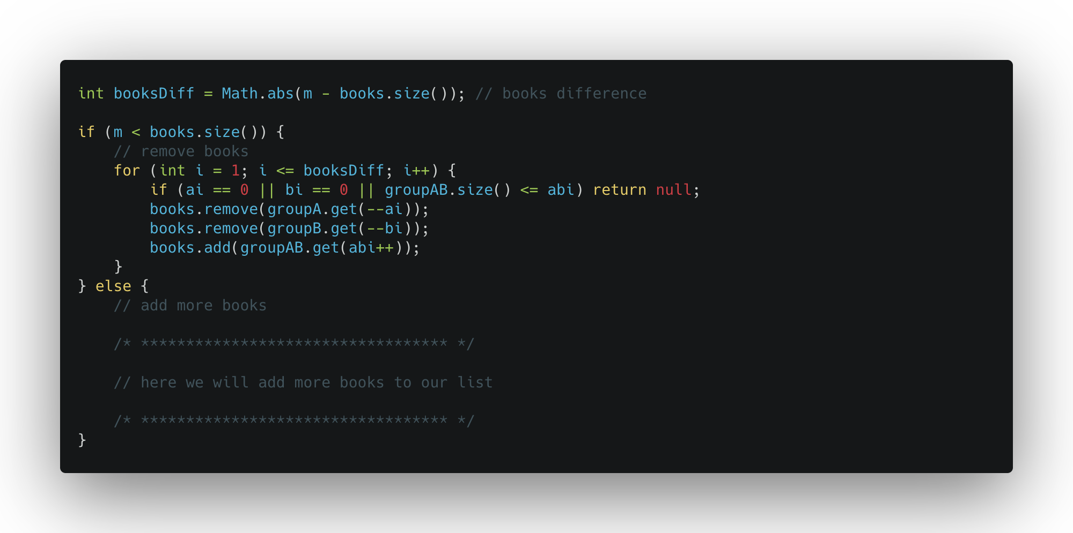
Reading Books Algorithm 3/5

Slide 17
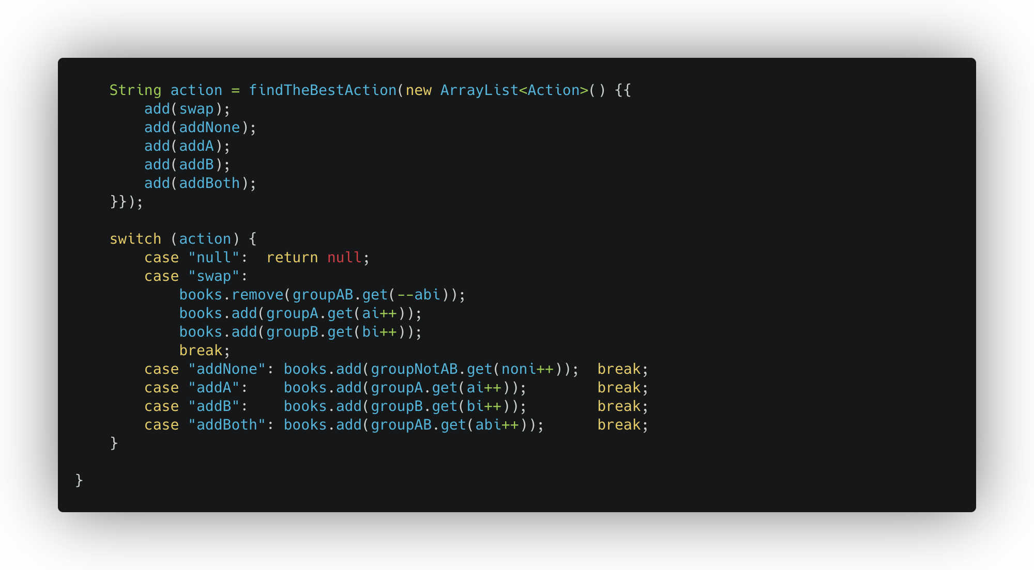
Reading Books Algorithm 5/5

Slide 18
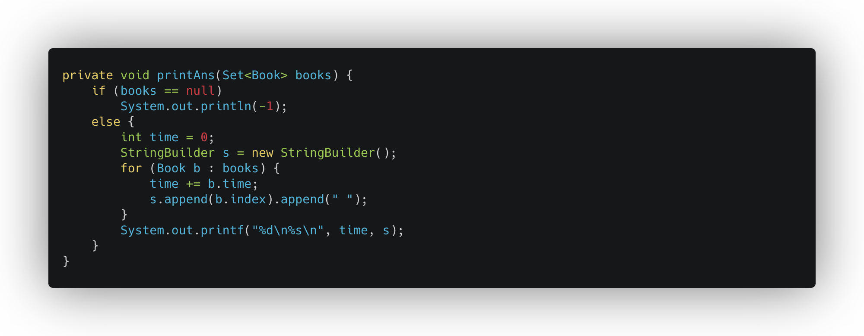
Finally Print the answer

Slide 19
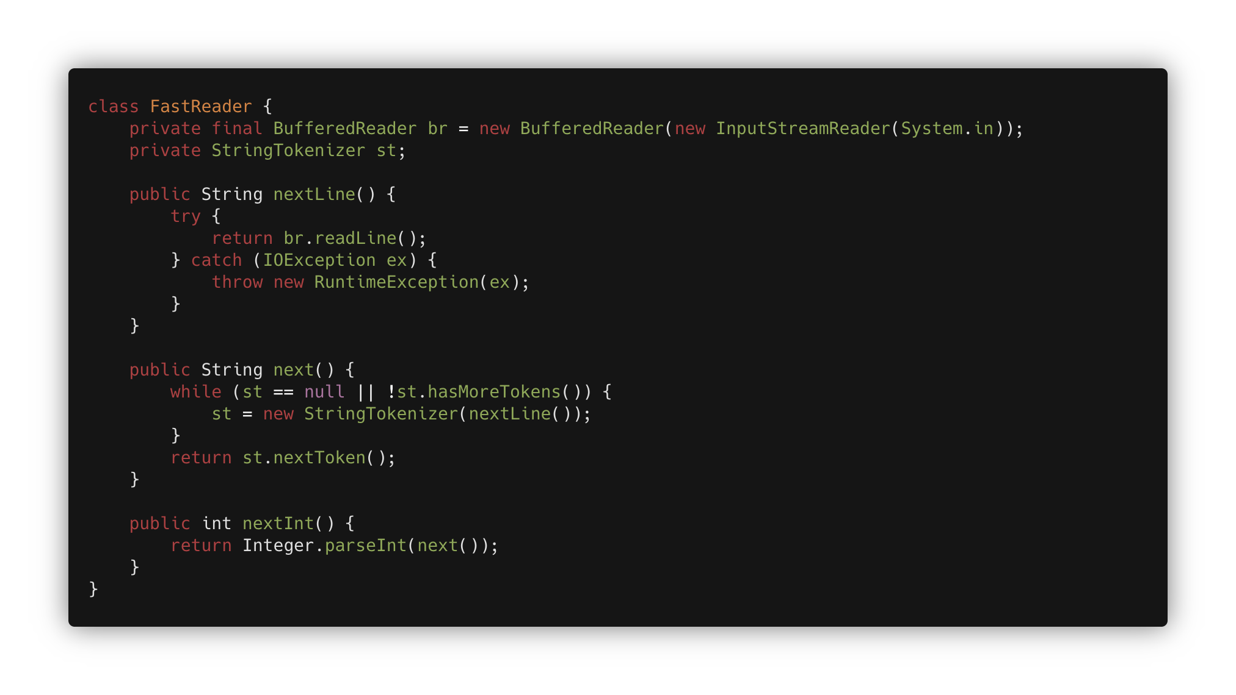
Fast Reader – (skip if you just use java.util.Scanner)

Slide 20
Now You can solve the problem

Slide 21
FINISHED
I hope u enjoyed.
@mrkhosravian
Code Images: carbon.now.sh
Slides: slidesgo.com

