Slide 1
CodeForces Contest 1374 Problem E1
@mrkhosravian

Slide 2
Problem
Summer vacation has started so Alice and Bob want to play and joy, but... Their mom doesn't think so. She says that they have to read some amount of books before all entertainments. Alice and Bob will read each book together to end this exercise faster.
There are 𝑛n books in the family library. The i^{th} book is described by three integers: t_{i} — the amount of time Alice and Bob need to spend to read it, 𝑎𝑖ai (equals 11 if Alice likes the i^{th} book and 00 if not), and b_{i} (equals 11 if Bob likes the i^{th} book and 00 if not).
So they need to choose some books from the given 𝑛n books in such a way that: Alice likes at least 𝑘k books from the chosen set and Bob likes at least 𝑘k books from the chosen set;
the total reading time of these books is minimized (they are children and want to play and joy as soon a possible).
The set they choose is the same for both Alice an Bob (it's shared between them) and they read all books together, so the total reading time is the sum of t_{i} over all books that are in the chosen set.
Your task is to help them and find any suitable set of books or determine that it is impossible to find such a set.

Slide 3
Input
The first line of the input contains two integers n and k (1 ≤ 𝑘 ≤ 𝑛 ≤ 2⋅1051 ≤ k ≤ n ≤ 2⋅105).
The next n lines contain descriptions of books, one description per line: the i^{th} line contains three integers t_{i}, 𝑎𝑖ai and b_{i} (1 ≤ 𝑡𝑖 ≤ 1041 ≤ t_{i} ≤ 104, 0 ≤ 𝑎_{i}, 𝑏_{i} ≤10≤ a_{i} ,b_{i} ≤ 1), where:
t_{i} — the amount of time required for reading the i^{th} book;
𝑎𝑖ai equals 11 if Alice likes the i^{th} book and 00 otherwise;
𝑏𝑖bi equals 11 if Bob likes the i^{th} book and 00 otherwise.

Slide 4
Output
If there is no solution, print only one integer -1. Otherwise print one integer T — the minimum total reading time of the suitable set of books.

Slide 5
Example 1
Input:
8 | 4
7 | 1 | 1
2 | 1 | 1
4 | 0 | 1
8 | 1 | 1
1 | 0 | 1
1 | 1 | 1
1 | 0 | 1
3 | 0 | 0
Output:
18

Slide 6
Solve example 1
There are 8 books
Alice and Bob both likes 4 books
Alice
Bob
1
07:00
2
There are four types of book:
0 0 - both Alice and Bob doesn't like these books books { 8 }
1 0 - only Alice likes these books books { }
0 1 - only Bob likes these books books { 3, 7 }
1 1 - both Alice and Bob like these books books { 1, 2, 4, 6 }
Now sort these groups by time:
{ 03:00 }
{ }
{ 01:00, 04:00 }
{ 01:00, 02:00, 07:00, 08:00 }
Make a total sum of these arrays ( start from zero ) :
{ 00:00, 03:00 }
{ 00:00 }
{ 00:00, 01:00, 05:00 }
{ 00:00, 01:00, 03:00, 10:00, 18:00 }
02:00
3
04:00
4
08:00
5
01:00
6
01:00
7
01:00
8
03:00

Slide 7
Solve example 1
There are 8 books
Alice and Bob both likes 4 books
Alice
Bob
1
07:00
2
02:00
Now we check for every possible cnt value:
Possible cnt values: 0..4 # from 0 to min( k, total books in group 4 )
If cnt = 0 then there should be 4 book that only alice likes it and 4 books that bob likes it.There no books that just alice likes it -> cnt = 0 is not a good choice
If cnt = 1 then there should be 3 books that only alice likes it and 3 books that bob likes it. There no books that just alice likes it -> cnt = 1 is not a good choice
If cnt = 2 then there should be 2 books that only alice likes it and 2 books that bob likes it. There no books that just alice likes it -> cnt = 2 is not a good choice
If cnt = 3 then there should be 1 books that only alice likes it and 1 books that bob likes it. There no books that just alice likes it -> cnt = 3 is not a good choice
If cnt = 4 -> this is the best condition because alice and bob can read all of their books together
3
04:00
4
08:00
5
01:00
6
01:00
7
01:00
8
03:00

Slide 8
Solve example 1
There are 8 books
Alice and Bob both likes 4 books
Alice
Bob
1
07:00
2
02:00
Finally after we found the best cnt value:
Answer is:
cnt^{th} element of sums 4 + ( k – cnt )^{th} element of the sums 1 + ( k – cnt )^{th} element of sums 2
Or
4th element of group 4 + 0th element of group 1 + 0th element of group 2
Or
18:00 + 00:00 + 00:00 = 18:00
3
04:00
4
08:00
5
01:00
6
01:00
7
01:00
8
03:00

Slide 9
Now go to code

Slide 10
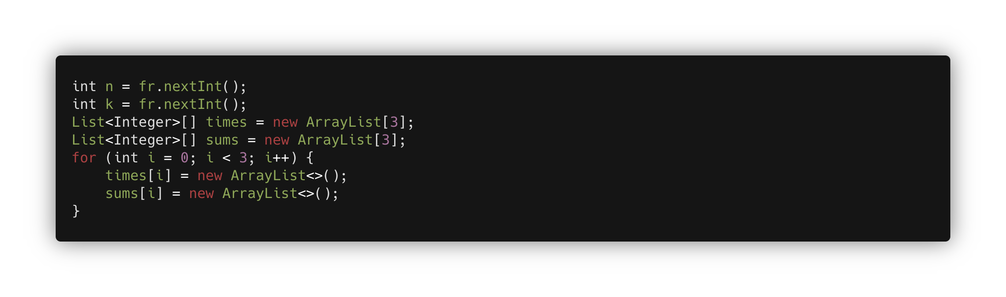
Initializing
* fr ( fast reader ) is a custom scanner that uses Java BufferedReader

Slide 11
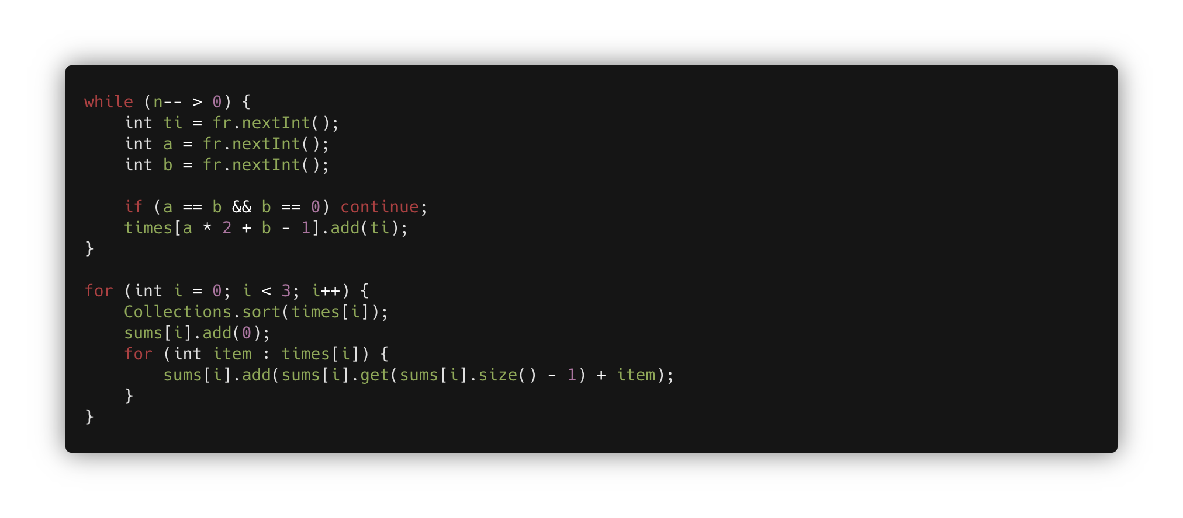
Create Books groups And create sum array
What is ( a * 2 + b – 1 ) ?
By this we can generate numbers from 0 to 2, that are groups indexes
Notice that -1 is because we don’t need 0 0 group at all!

Slide 12
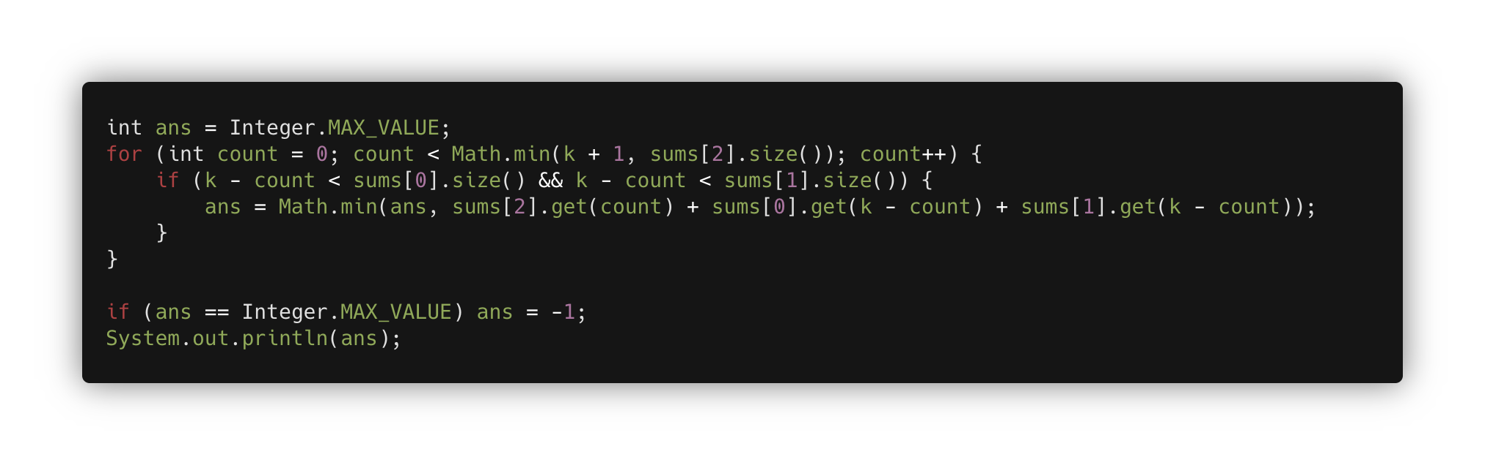
Find the best cnt value
We calculate all cnt values and find the minimum answer.
If the ans variable has changed we can assume that there is an answer, otherwise, we print -1

Slide 13
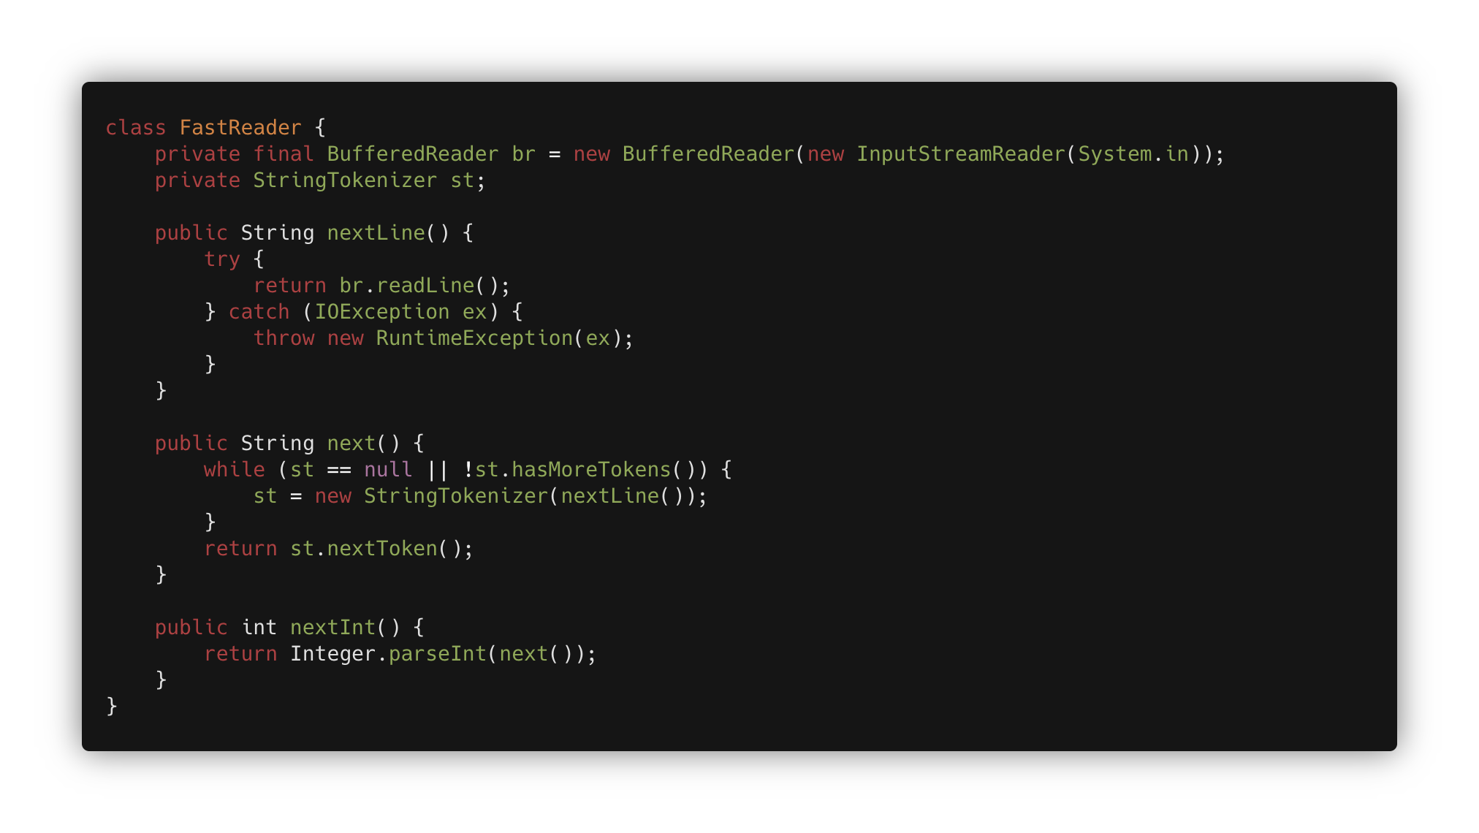
Fast Reader – (skip if you just use java.util.Scanner)

Slide 14
Now You can solve the problem

Slide 15
FINISHED
I hope u enjoyed.
@mrkhosravian

