Slide 1

Department of Computer Science and Engineering
Jawaharlal Nehru Engineering College, Aurangabad
( Affiliated to Dr. Babasaheb Ambedkar Technical University Lonere )
( Year 2021-2022 )
B. Tech Project:
DISEASE PREDICTION SYSTEM
Presented by
Ankush Kawale (20213220181124210045)
Kunal Mate (20213220181124210046)
Under Guidance of
Mr. Sandip Kharat

Slide 2
Content
Introduction
Objective
Approach to Build ML Model
Workflow
Technologies used
Folder Structure
Result
Project Summary
References

Slide 3
Introduction
It might have happened so many times that you or someone yours need doctors help immediately, but they are not available due to some reasons.
So to solve this problem we have implemented the Disease Prediction System web based application that will facilitate the patient to get instant guidance on their symptoms.
This system used to predict the diseases based on the input symptoms provided by user and help mankind or society people to analyze and understand their health status.
People can self-analyze their health state and can take precautions as per the results

Slide 4

Objective
The objective of this project entitled “Disease Prediction using Machine Learning” is to provide a user friendly and easily understandable GUI to users to easily get instant prediction through machine learning algorithms using dataset. The main objective of the System is to predict disease according to symptoms .

Slide 5
Approach to Build ML Model
Gathering the Data: Data preparation is the primary step for any machine learning problem. We have used dataset from Kaggle for this problem. This dataset consists of two CSV files one for training and one for testing. There is a total of 133 columns in the dataset out of which 132 columns represent the symptoms and the last column is the prognosis.
Cleaning the Data: Cleaning is the most important step in a machine learning project. The quality of our data determines the quality of our machine learning model. So it is always necessary to clean the data before feeding it to the model for training. In our dataset all the columns are numerical, the target column i.e. prognosis is a string type and is encoded to numerical form using a label encoder.
Model Building: After gathering and cleaning the data, the data is ready and can be used to train a machine learning model. We have used this cleaned data to train the Decision Tree Classifier and Random Forest Classifier.
Inference: After training the two models we will be predicting the disease for the input symptoms by combining the predictions of all two models. This makes our overall prediction more robust and accurate.

Slide 6
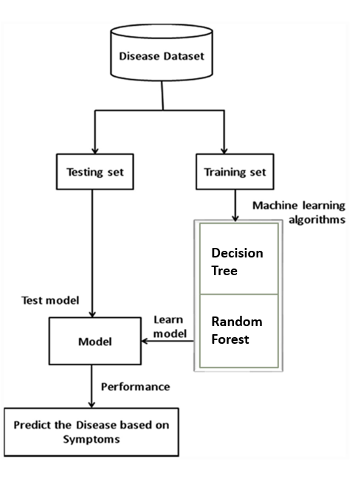
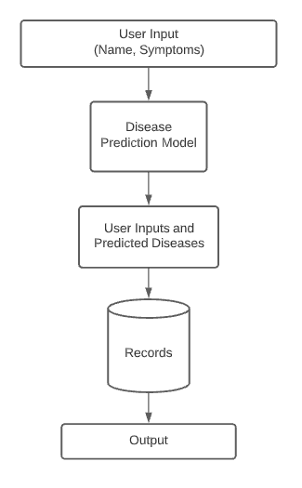
Workflow
Workflow of Disease Prediction Model
Workflow of System

Slide 7
Technologies used
Software used-
1. Visual Studio Code
2. Google Chrome
Frontend-
HTML
CSS
Backend-
Python
Flask
Database-
MYSQL using Xampp Server

Slide 8
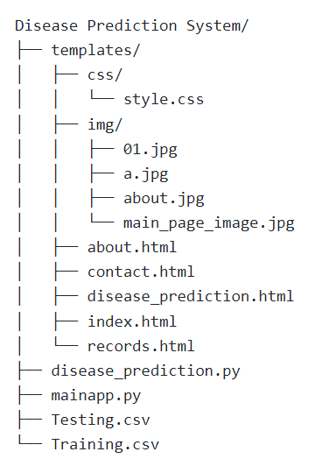
Folder Structure

Slide 9
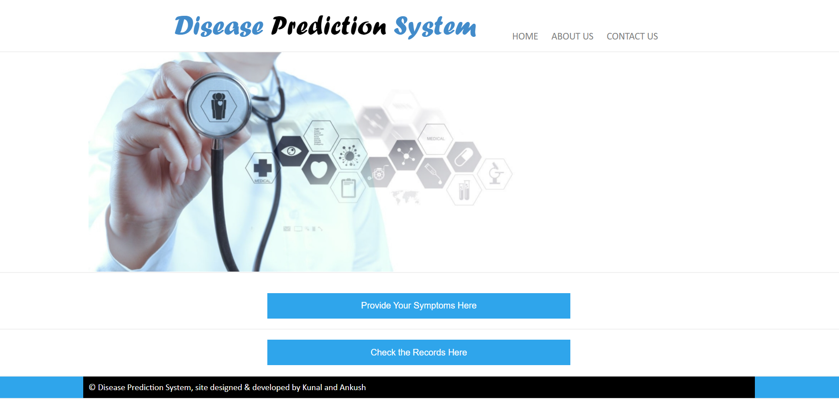
Result
Home Screen

Slide 10
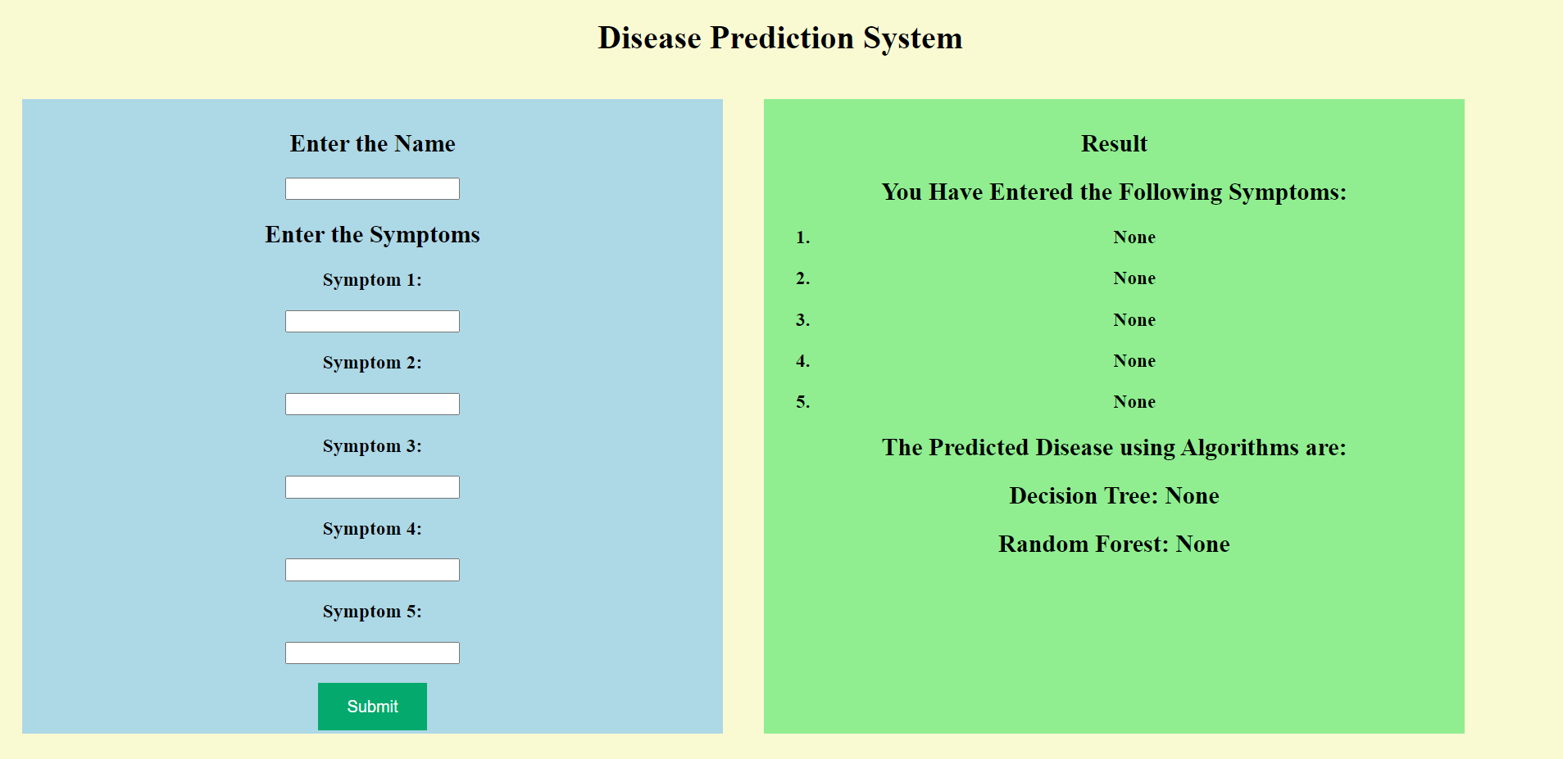
User Input and Output

Slide 11
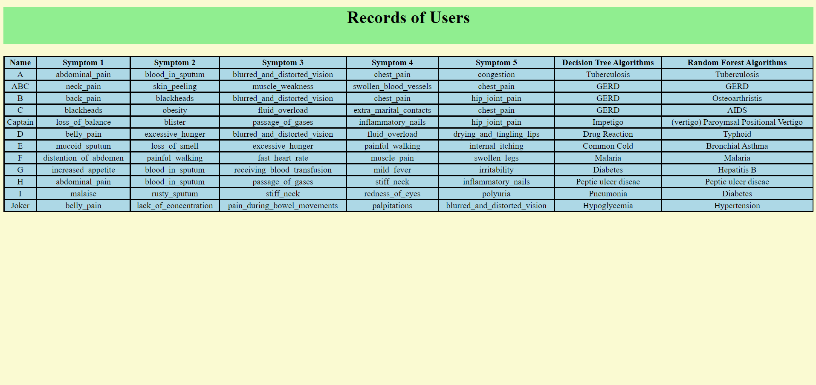
Records

Slide 12
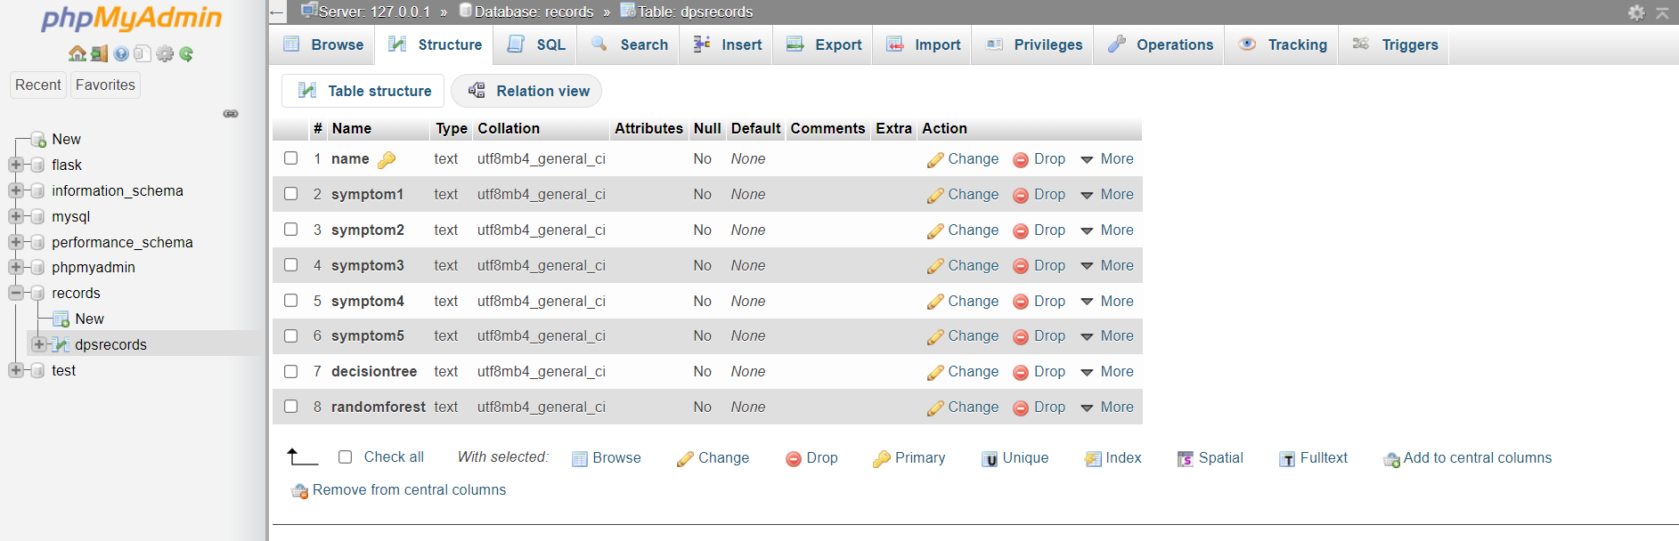
Database

Slide 13
Project Summary
The core idea behind the project is to propose a system that allows users to get instant guidance on their health issues .This system is fed with various symptoms and the disease/illness associated with those symptoms. This system allows user to share their symptoms. It then processes user’s symptoms to check for various illnesses that could be associated with it using Decision Tree and Random Forest Algorithms. Then the user inputs and predicted results get stored in the database. User can check the previous records.

Slide 14
References
https://www.geeksforgeeks.org/disease-prediction-using-machine-learning/
https://slideplayer.com/slide/13462995/
Analysis of Data Mining Techniques for Heart Disease Prediction, “Marjia Sultana, Afrin Haider and Mohammad Shorif Uddin”.

Slide 15
THANK YOU….!!

