Slide 1
UBIFS file system
  Adrian Hunter (Адриан Хантер)
  Artem Bityutskiy (Битюцкий Артём)

Slide 2
Plan
Introduction (Artem)
MTD and UBI (Artem)
UBIFS (Adrian)
Notes:
First of I define the scope of UBIFS, the area it is designed for, and the area it is not designed for. This is very important because people are often confused about where they can use UBIFS.

Slide 3
UBIFS scope
UBIFS stands for UBI file system (argh...)
UBIFS is designed for raw flash devices
UBIFS is not designed for SSD, MMC, SD, Compact Flash, USB sticks, and so on
  I call them “FTL devices”
  They have raw flash inside, but they are block devices
  They are very different to raw flash devices

Slide 4
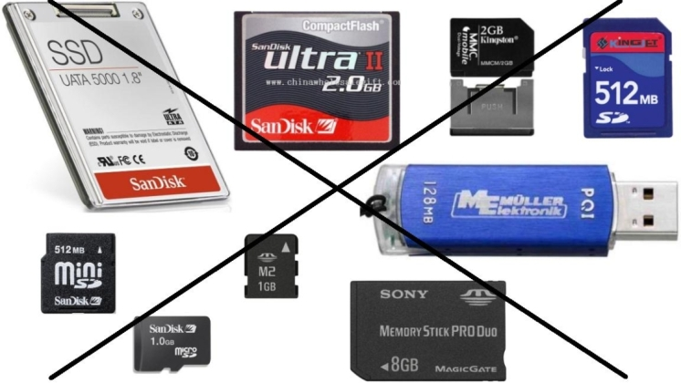
UBIFS scope

Slide 5
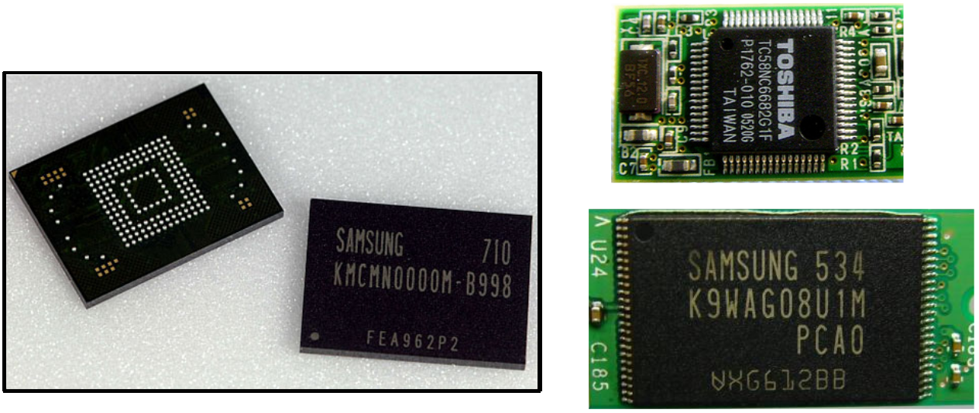
UBIFS scope
UBIFS is designed for raw flash devices
E.g. NAND, NOR, OneNAND, etc

Slide 6
FTL device vs. Raw flash
Raw flash and block device are completely different

Slide 7
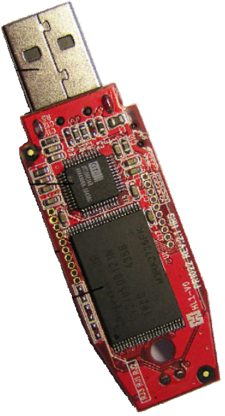
FTL devices
FTL stands for “Flash Translation Layer”
FTL devices have raw flash plus a controller
Controller runs FTL firmware
FTL firmware emulates block device
Block I/O interface
(USB mass storage, MMC, etc)
FTL
NAND array

Slide 8
FTL devices – cons and pros
One may run trusted traditional software (e.g., ext3)
Standardized
Black box, FTL algorithms are trade secrets
Fast wear-out and death reports
Data corruption reports
Historically designed for FAT FS
Optimized for FAT

Slide 9
UBIFS goals
Fix JFFS2 scalability issues
  Faster mount
  Fast opening of big files
  Faster write speed
But preserve cool JFFS2 features
  On-the-flight compression
  Tolerance to power cuts
  Recoverability

Slide 10
Plan
Introduction (Artem)
MTD and UBI (Artem)
UBIFS (Adrian)
Notes:
I'm going to talk about MTD and UBI a little, because UBIFS depends on.

Slide 11

UBI/UBIFS stack
UBIFS
(fs/ubifs)
UBI
(drivers/mtd/ubi)
MTD
(drivers/mtd)
NAND
NOR
OneNAND
etc
Flash hardware
(NAND, NOR, etc)

Slide 12

MTD
MTD stands for “Memory Technology Devices”
Provides an abstraction of MTD device
Hides many aspects specific to particular flash
Provides uniform API to access various types of flashes
E.g., MTD supports NAND, NOR, ECC-ed NOR, DataFlash, OneNAND, etc
Provides partitioning capabilities

Slide 13
MTD API
In-kernel API (struct mdt_device) and user-space API (/dev/mtd0)
  Information (device size, min. I/O unit size, etc)
  Read from and write to eraseblocks
  Erase an eraseblock
  Mark an eraseblock as bad
  Check if an eraseblock is bad
Does not hide bad eraseblocks
Does not do any wear-leveling

Slide 14
UBI
Stands for “Unsorted Block Images”
Provides an abstraction of “UBI volume”
Has kernel API (include/mtd/ubi-user.h) and user-space API (/dev/ubi0)
Provides wear-leveling
Hides bad eraseblocks
Allows run-time volume creation, deletion, and re-size
Is somewhat similar to LVM, but for MTD devices

Slide 15
UBI/UBIFS stack
UBIFS
(fs/ubifs)
UBI
(drivers/mtd/ubi)
MTD
(drivers/mtd)
NAND
NOR
OneNAND
etc
Flash hardware
(NAND, NOR, etc)

Slide 16
UBI volume vs. MTD device

Slide 17
Main idea behind UBI
Maps LEBs to PEBs
Any LEB may be mapped to any PEB
Eraseblock headers store mapping information and erase count
LEB
UBI volume
MTD device
PEB
Bad PEB

Slide 18
UBI operation example
1. Write data to LEB0
a) Map LEB0 to PEB1
b) Write the data
2. Write data to LEB1
, LEB4
3. Erase LEB1
a) Un-map LEB1 ...
return
b) Erase PEB4 in background
4. Write data to LEB1
LEB0
LEB1
LEB2
LEB3
LEB4
LEB5
UBI volume
MTD device
PEB0
PEB1
PEB2
PEB3
PEB4
PEB5
PEB6

Slide 19
UBI bad eraseblock handling
1% of PEBs are reserved for bad eraseblock handling
If a PEB becomes bad, corresponding LEB is re-mapped to a good PEB
I/O errors are handled transparently

Slide 20
Write error handling example
1. User writes data to LEB0 ...
a) Select a good PEB to recover the data to ...
PEB4
b) Recover the data by copying it to PEB4
c) Re-map LEB0 to PEB4
d) Write new data again
e) Recovery is done! Return from UBI
f) Erase, torture and check PEB1 in background ...
and mark it as bad
LEB0
UBI volume
Write error!
MTD device
PEB1
PEB4

Slide 21
Other
Handle bit-flips by moving data to a different PEB
Configurable wear-leveling threshold
Volume update operation
Volume rename operation
Suitable for MLC NAND
Performs operations in background
Works on NAND, NOR and other flash types
Tolerant to power cuts
Simple and robust design

Slide 22
Atomic LEB change
Very important for UBIFS
Suppose LEB0 has to be atomically updated
a) Select a PEB ...
PEB0
b) Write new data to PEB0
c) Re-map LEB0 to PEB0
d) Done! Return from UBI
e) Erase PEB2 in background
LEB0
UBI volume
MTD device
PEB0
PEB2

Slide 23
UBI Scalability issue
Unfortunately, UBI scales linearly
UBI reads all eraseblock headers on initialization
Initialization time grows with growing flash size
But it scales considerably better than JFFS2
May be improved
UBI2 may be created, UBIFS would not change
Suitable for 1-16GiB flashes, depending on I/O speed and requirements

Slide 24
Plan
Introduction (Artem)
MTD and UBI (Artem)
UBIFS (Adrian)

Slide 25
UBIFS relies on UBI
UBIFS does not care about bad eraseblocks and relies on UBI
UBIFS does not care about wear-leveling and relies on UBI
UBIFS exploits the atomic LEB change feature

Slide 26
Requirements
Good scalability
High performance
On-the-flight compression
Power-cut tolerance
High reliability
Recoverability
Notes:
I do not give details on what UBIFS is doing to fulfill the requirements now. But the requirements pretty much defined the UBIFS design. At the end of the presentation, I'll come back to this list of requirements and comment on each of them some more.

Slide 27
File System Index
Index allows to look-up physical address for any piece of FS data
File “foo”
File “bar”
A
B
C
A
B
Index
UBI volume
B
A
A
C
B
MTD device

Slide 28
JFFS2 index
JFFS2 does not store the index on flash
On mount JFFS2 fully scans the flash media
Node headers are read to build the index in RAM
JFFS2 node
Header
Data
MTD device

Slide 29

UBIFS index
UBIFS index is a B+ tree
Leaf level contains data
Tree fanout is configurable, default is 8
Index
.............................................................................
Leaf level contains FS data

Slide 30
UBIFS Index
UBIFS index is stored and maintained on flash
Full flash media scanning is not needed
Only the journal is scanned in case of power cut
Journal is small, has fixed and configurable size
Thus, UBIS mounts fast
................................................................
Journal
UBIFS

Slide 31
Out-of-place updates
Flash technology and power-cut-tolerance require out-of-place updates
Change “foo” (overwrite A, B, C)
File “/foo”:
A
B
C
1. Write “A” to a free space
2. Old “A” becomes obsolete
3. Write “B” to free space
.........................................................................................
4. Old “B” becomes obsolete
I
5. Write “C” to free space
6. Old “C” becomes obsolete
A
B
C
Index
Data
Obsolete
But how about the index?
Obsolete
Obsolete
A
B
C
A
A
B
B
I
C
UBIFS
C
Notes:
Show the idea of out-of-place updates. Tell that this is fine for JFFS2, but UBIFS has the index.
Prepare ground to introduce wandering trees.

Slide 32

Wandering trees

Slide 33
Wandering trees
A
1. Write data node “D”
A
A
2. Old “D” becomes obsolete
3. Write indexing node “C”
4. Old “C” becomes obsolete
5. Write indexing node “B”
6. Old “B” becomes obsolete
B
7. Write indexing node “A”
B
B
6. Old “A” becomes obsolete
C
C
C
D
D
D
How to find the root of the tree?
D
A
A
B
B
A
D
D
C
UBIFS
C
C
B
Notes:
Explain wandering tree mechanisms. At the end ask logical question – how to find the root of the tree on mount?

Slide 34
Master node
Stored at the master area (LEBs 1 and 2)
Points to the root index node
2 copies of master node exist for recoverability
Master area may be quickly found on mount
Valid master node is found by scanning master area
1. Suppose “R” is changed
6. LEBs 1 and 2 become full
R
2. Then “M” is updated
7. LEB 1 is erased
3. Old “M” becomes obsolete
8. “M” is written
4. The same is done to the 2nd copy
9. The same for the 2nd copy
................................................................
5. and so on ...
LEB 0
M
M
M
M
M
M
M
M
M
M
M
M
R
R
R
R
UBIFS
R
R
Master area (LEBs 1 and 2)
Root index node

Slide 35
Superblock
Situated at LEB0
Read-only for UBIFS
May be changed by user-space tools
Stores configuration information like indexing tree fanout, default compression type (zlib or LZO), etc
Superblock is read on mount
Superblock
Master area
UBIFS
LEB0
LEB1
LEB2

Slide 36
Journal
All FS changes go to the journal
Indexing information is changed in RAM, but not on the flash
Journal greatly increases FS write performance
When mounting, journal is scanned and re-played
Journal is roughly like a small JFFS2 inside UBIFS
Journal size is configurable and is stored in superblock
Notes:
It would be extremely inefficient to change whole path up to the root of the indexing tree on every FS change. UBIFS journal allows us to avoid doing this very often.

Slide 37
TNC
Stands for Tree Node Cache
Caches indexing nodes
Is also a B⁺-tree, but in RAM
Speeds up indexing tree lookup
May be shrunk in case of memory pressure

Slide 38
Journal and TNC
Suppose “A”, “B”, ... “H” have to be changed
Tree Node Cache
(in RAM)
1. Change leaf node “A”
I1
2. Look up the index and populate TNC
3. Write “A” to the journal
... and amend TNC
I2
I3
4. Similarly for “B” and “C”
5. And so on for “D”, “E”, “F”, “G”, and “H”
6. Journal is full - commit
I4
I5
I6
I7
Excuse me, but the journal is still full
I1
Indexing tree
(on Flash)
I2
I3
I4
I5
I6
I7
A
A
B
B
C
C
D
D
E
E
F
F
G
G
H
H
A
B
C
D
E
F
G
H
I1
I1
I2
I2
I3
I3
I4
I4
I4
I4
I6
I6
I7
I7
A
A
B
B
C
C
D
D
E
E
F
F
G
H
I1
I2
I3
I4
I4
I6
I7
Journal LEBs

Slide 39

Journal is also wandering
After the commit we pick different LEBs for the journal
Do not move data out of the journal
Instead, we move the journal
Journal changes the position all the time

Slide 40
More about the Journal
Journal has multiple heads
  This improves performance
Journal does not have to be continuous
  Journal LEBs may have random addresses
  LEBs do not have to be empty to be used for journal
  This makes journal very flexible and efficient

Slide 41
Garbage collection
At some point UBIFS runs out of free space
Garbage Collector (GC) is responsible to turn dirty space to free space
One empty LEB is always reserved for GC
Obsolete data (Dirty space)
Valid FS data
Valid indexing data
Reserved for GC

Slide 42
How GC works
GC copies valid data to the journal (GC head)
1. Pick a dirty LEB ...
LEB1
TNC
2. Copy valid data to LEB6
3. LEB1 may now be erased
4. Pick another dirty LEB ...
LEB7
5. Copy valid data to LEB 6
6. LEB 7 now may be erased
8. LEB 1 is reserved for GC, LEB7 is available
I1
I2
I3
I4
9. How about the index?
10. Indexing nodes are just marked as dirty in TNC
Dirty
11. But what if there is no free space for commit?
I1
I2
I4
I3
LEB0
LEB1
LEB2
LEB3
LEB4
LEB5
LEB6
LEB7

Slide 43
Commit
Commit operation is always guaranteed to succeed
For the index UBIFS reserves 3x as much space
In-the-gaps commit method is used
Atomic LEB change UBI feature is used
Index
Reserved

Slide 44
LEB properties
UBIFS stores per LEB-information of flash
  LEB type (indexing or data)
  Amount of free and dirty space
Overall space accounting information is maintained on the media
  Total amount of free space
  Total amount of dirty space
  Etc
Used e.g., when
  A free LEB should be found for new data
  A dirty LEB should be found for GC

Slide 45
LPT
Stands for LEB Properties Tree
Is a B⁺-tree
Has fixed size
Is much smaller than the main indexing tree
Managed similarly to the main indexing tree

Slide 46
Requirements
Good scalability
  Data structures are trees
  Only journal has to be replayed
High performance
  Write-back
  Background commit
  Read/write is allowed during commit
  Multi-head journal minimizes amount of GC
  TNC makes look-ups fast
  LPT caches make LEB searches fast

Slide 47
Requirements
On-the-flight compression
Power-cut tolerance
  All updates are out-of-place
  Was extensively tested
High reliability
  All data is protected by CRC32 checksum
  Checksum may be disabled for data
Recoverability
  All nodes have a header which fully describes the node
  The index may be fully re-constructed from the headers

