Slide 1


Slide 2
Don’t worry about getting people’s contact info, just match and share!

Slide 3
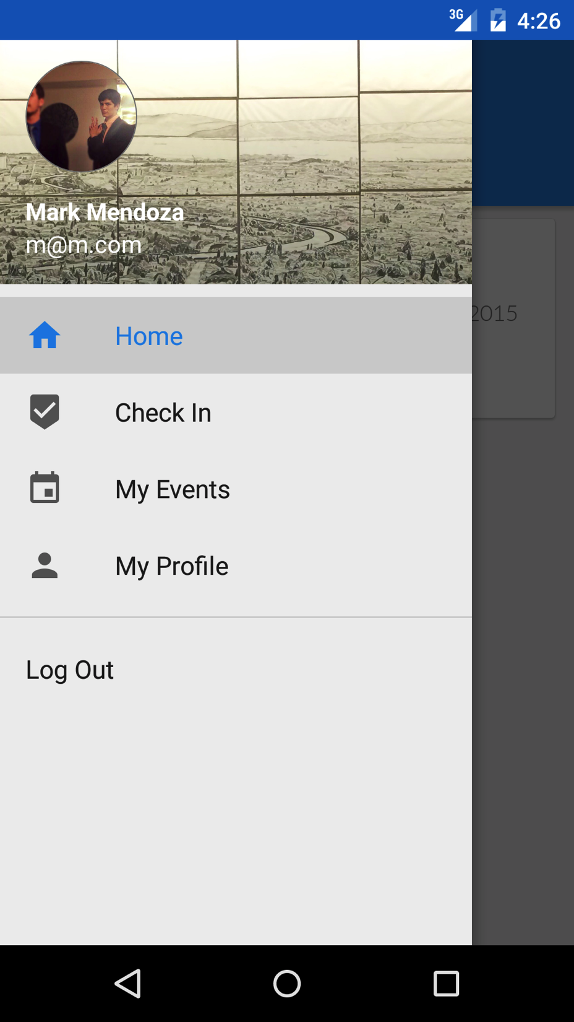

Slide 4
Make a profile with your professional contact information, sharing only what you want to share!

Slide 5
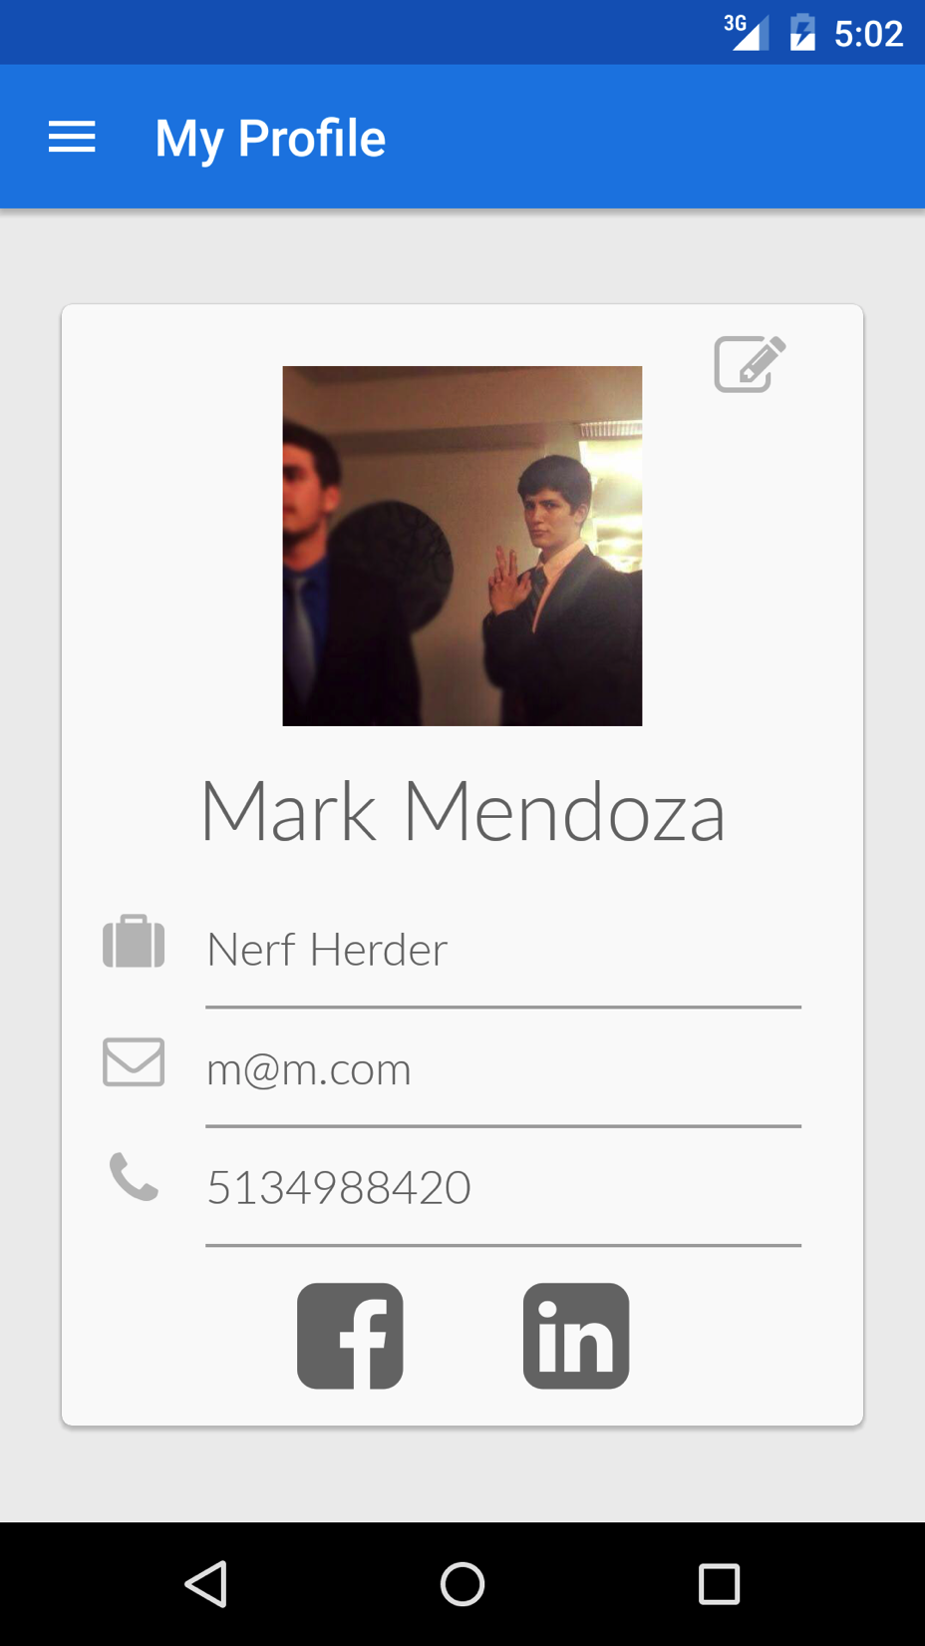

Slide 6
Register your networking event or conference with only a few taps!

Slide 7
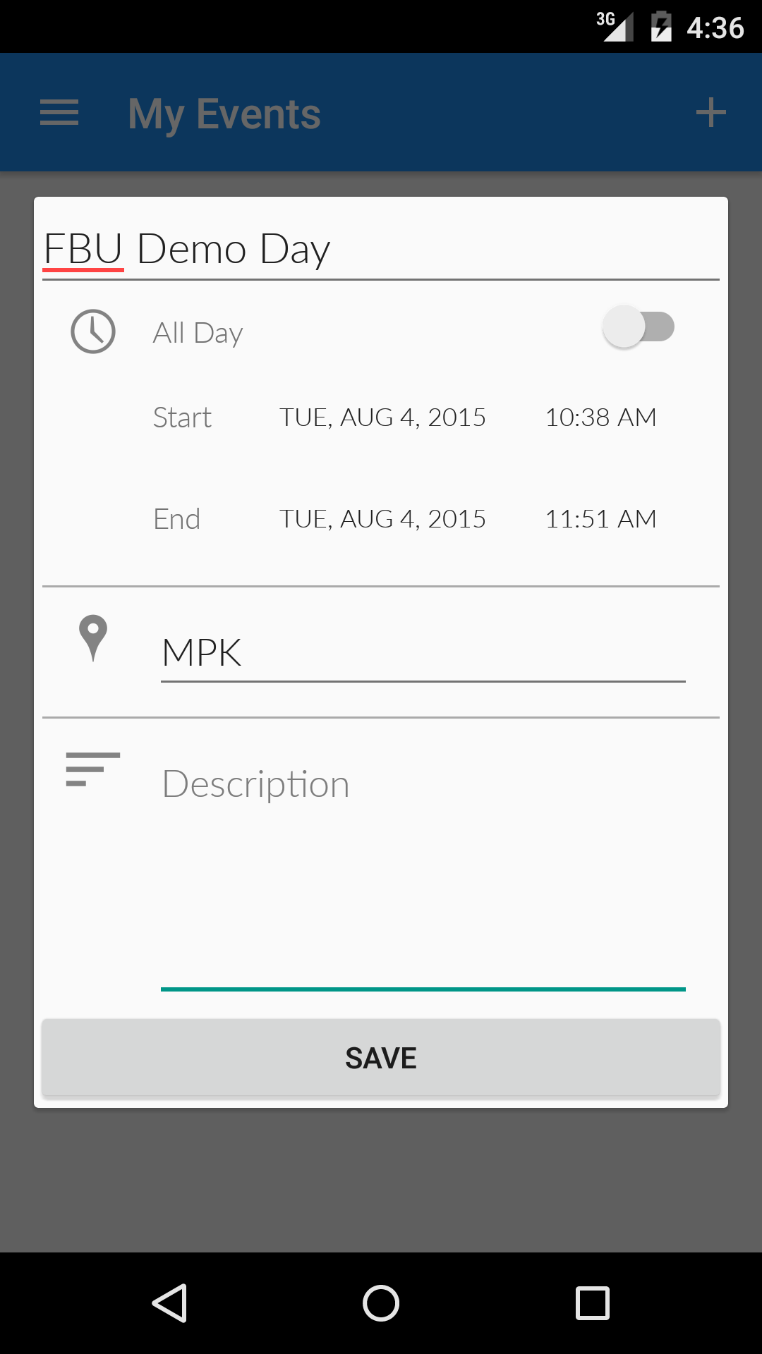

Slide 8
Your attendees can then easily find and join ongoing events from a list of nearby events

Slide 9
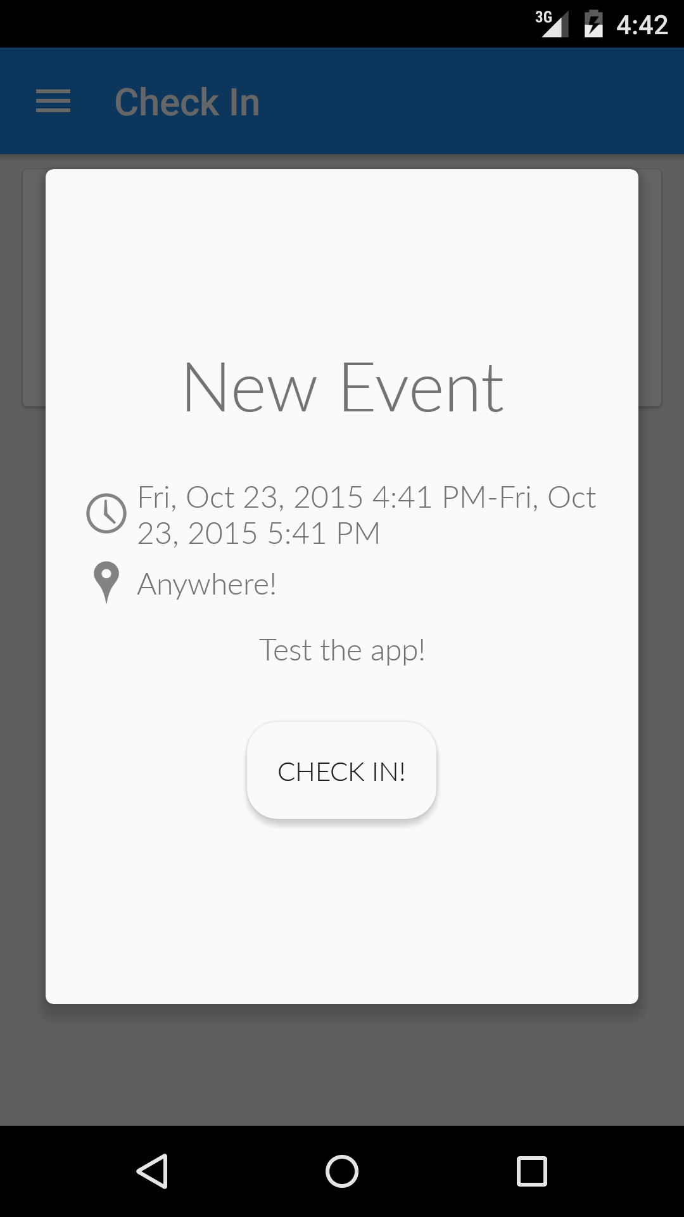

Slide 10
Once someone checks in, location based technologies including short-range Bluetooth pinging detect which other attendees they have probably met

Slide 11
After the event, its time to go through the contact card deck!

Slide 12
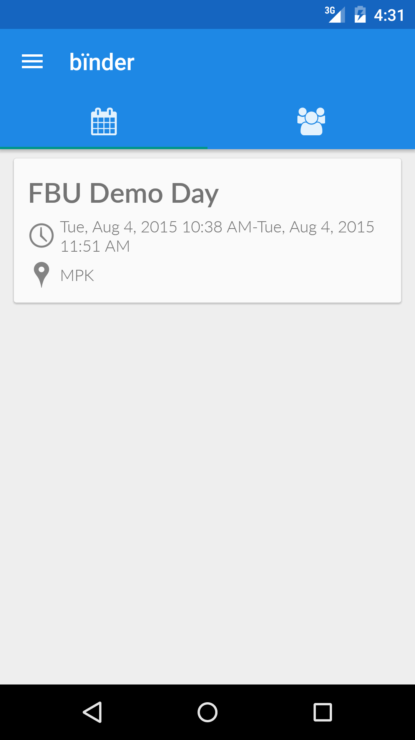

Slide 13
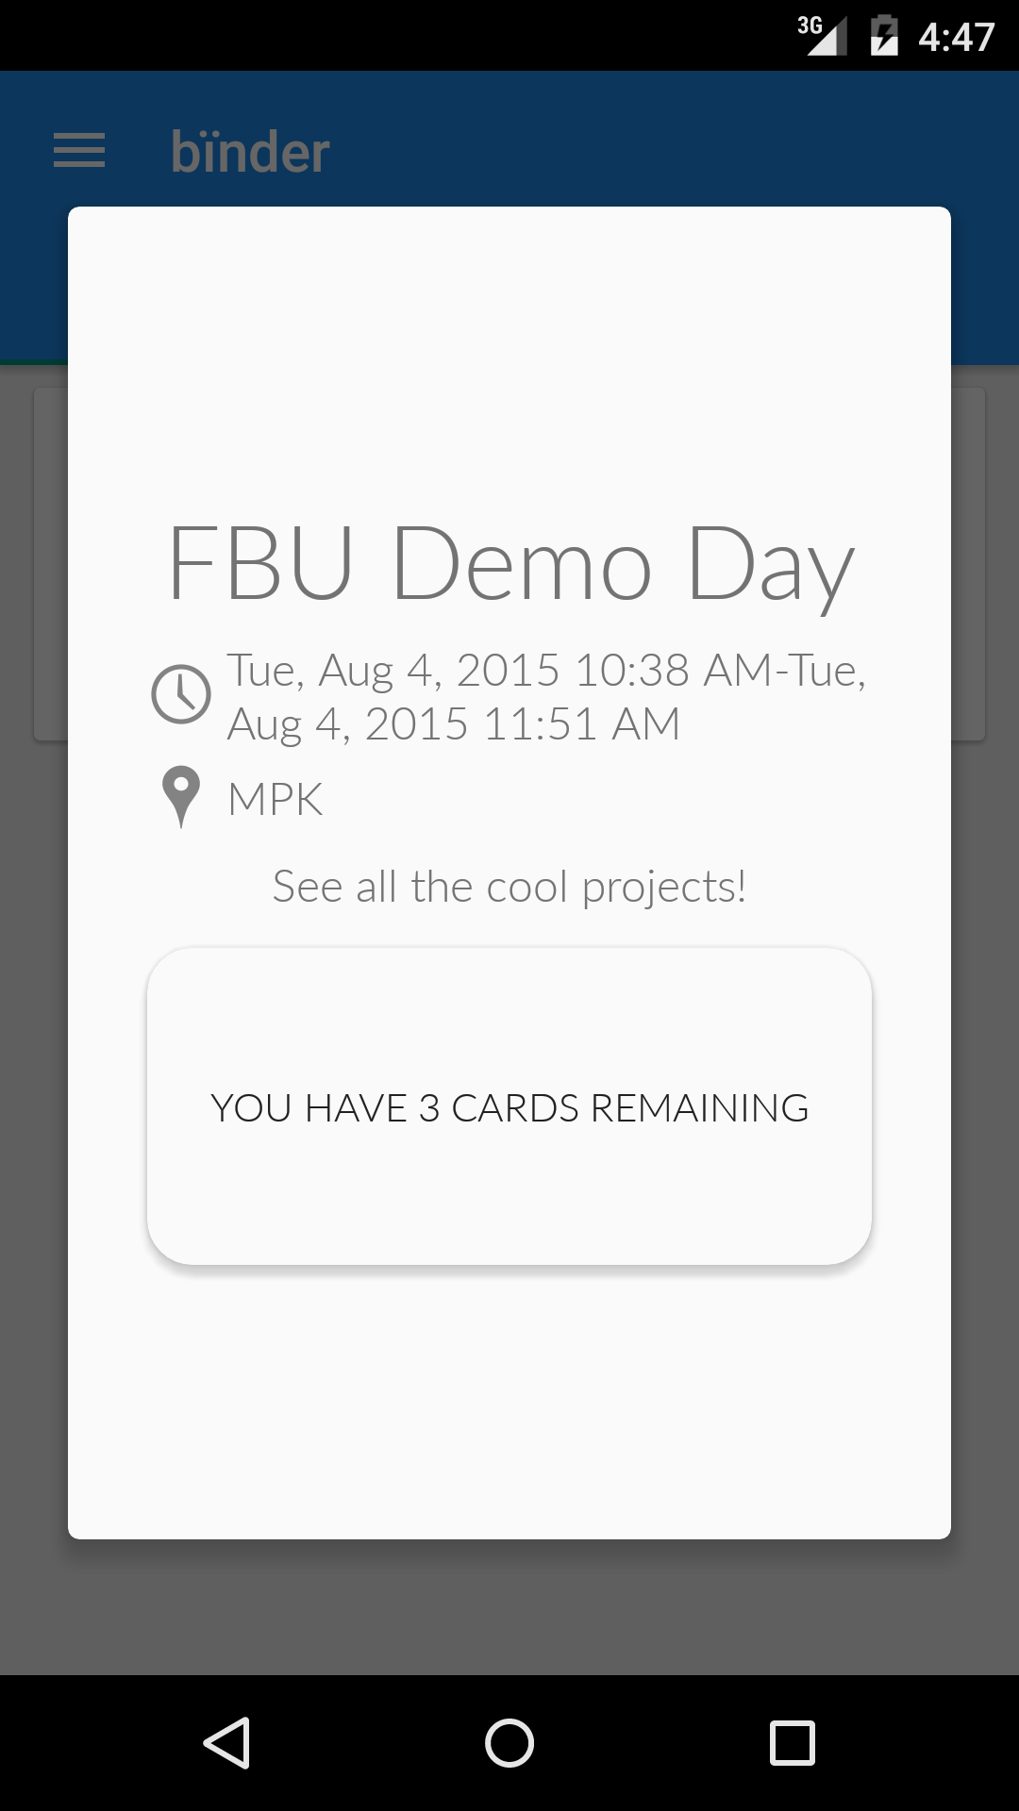

Slide 14
The contact deck is sorted intelligently based off of proximity data so you can easily find your connections at even the largest events!

Slide 15
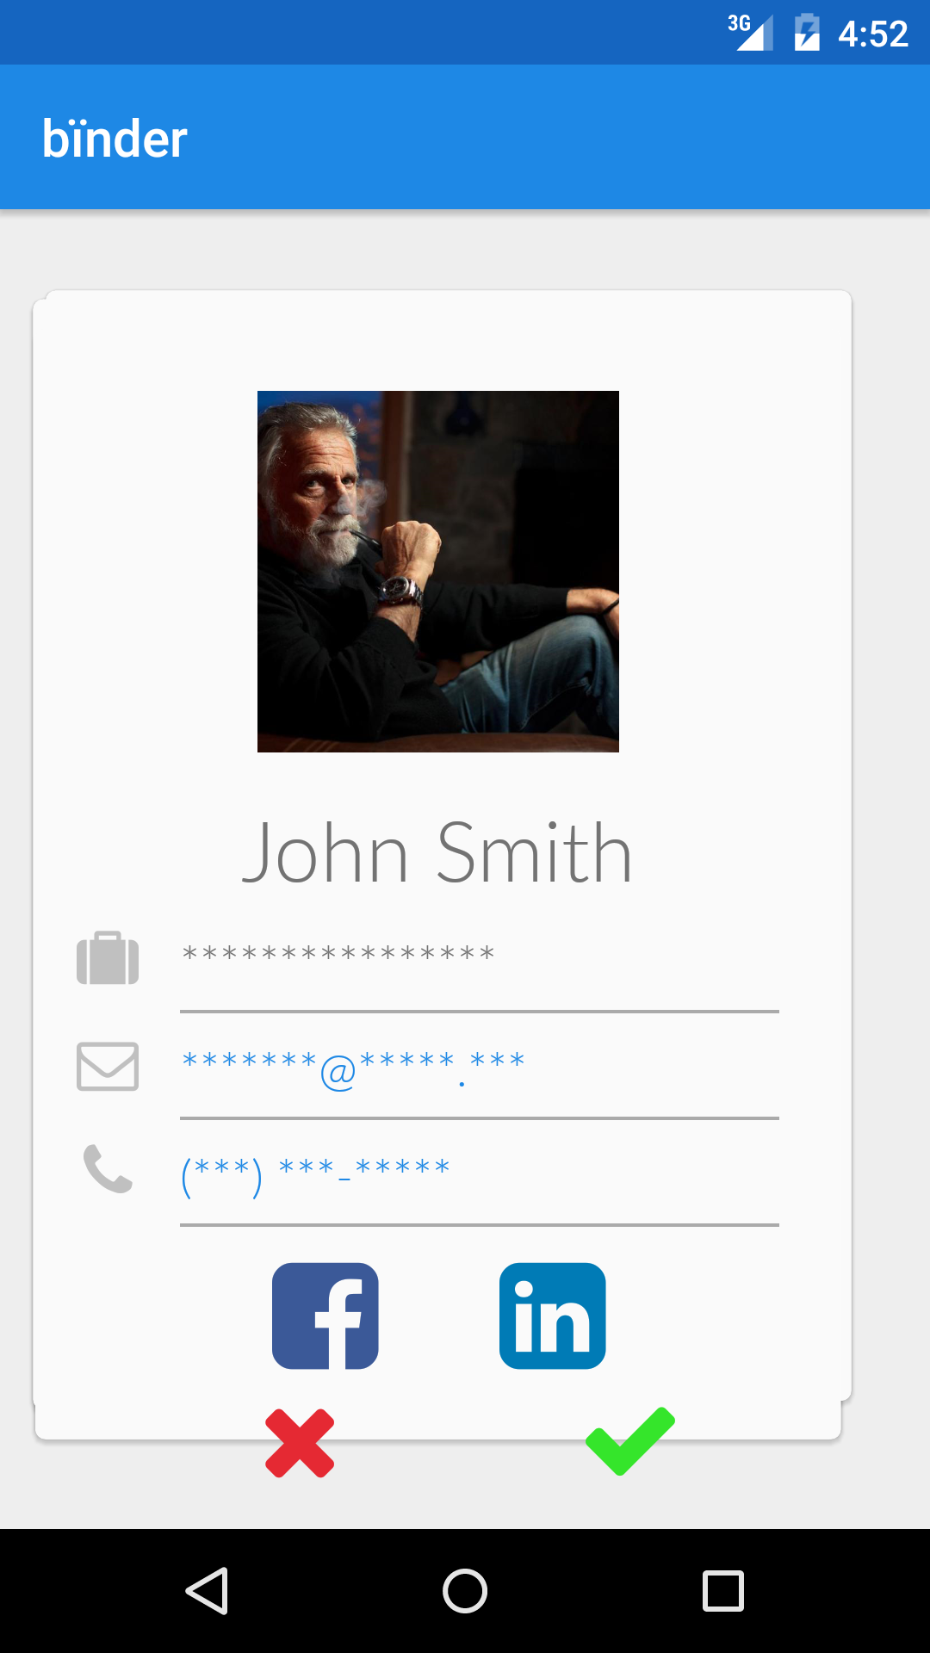

Slide 16
Once you match with one of your connections, get instant notification that you now have swapped your contact info!

Slide 17
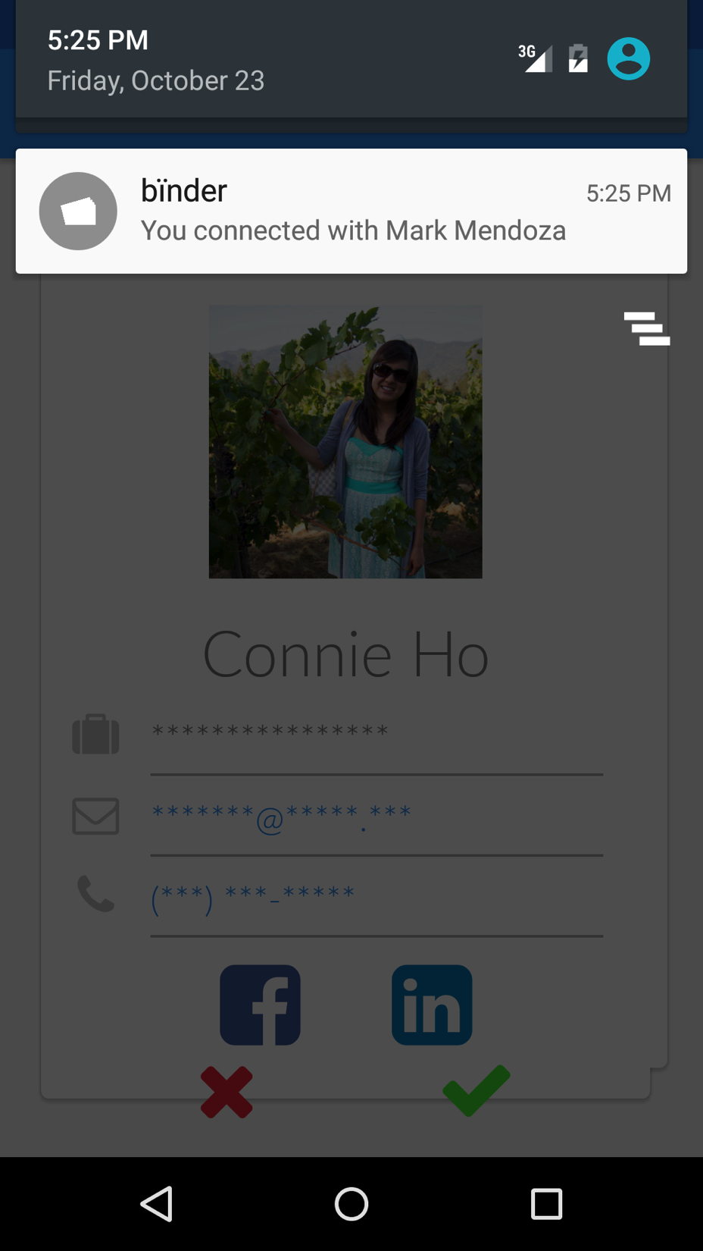

Slide 18
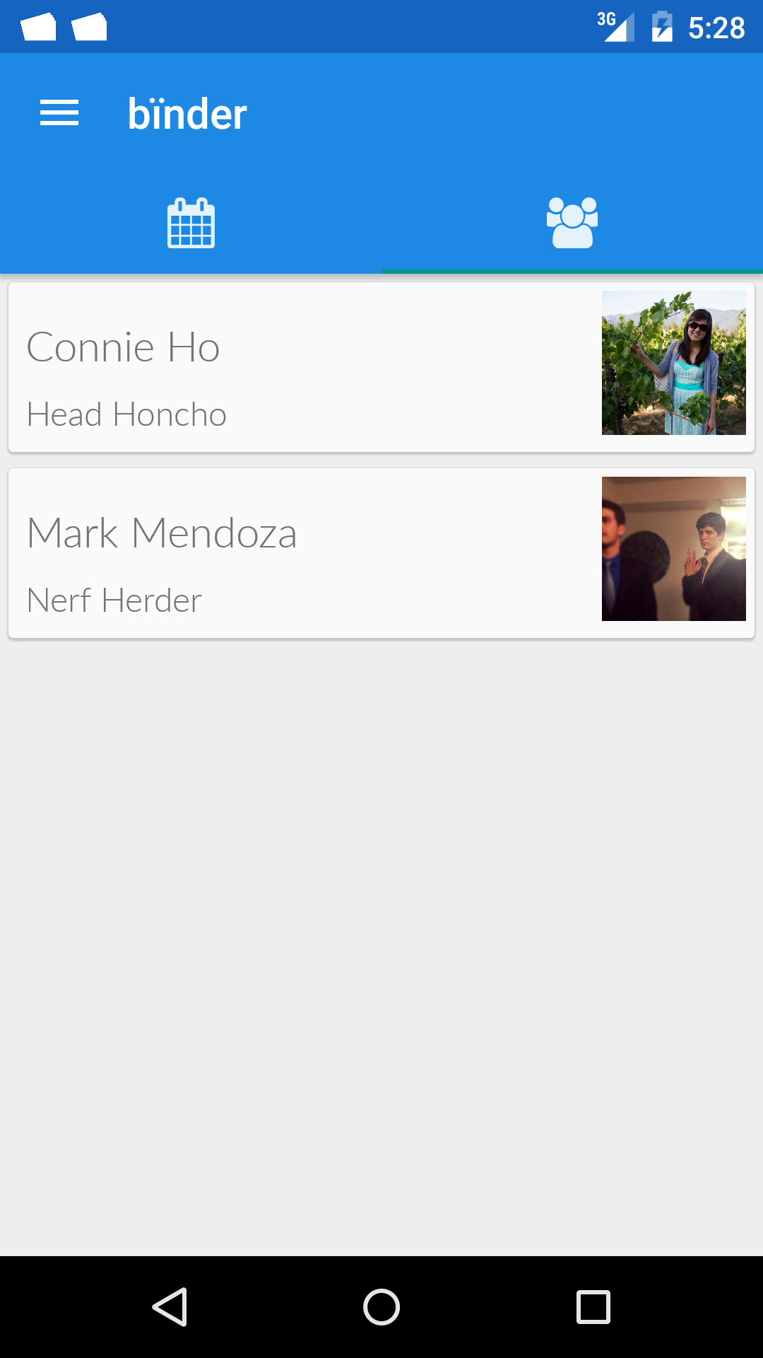

Slide 19
