Slide 1
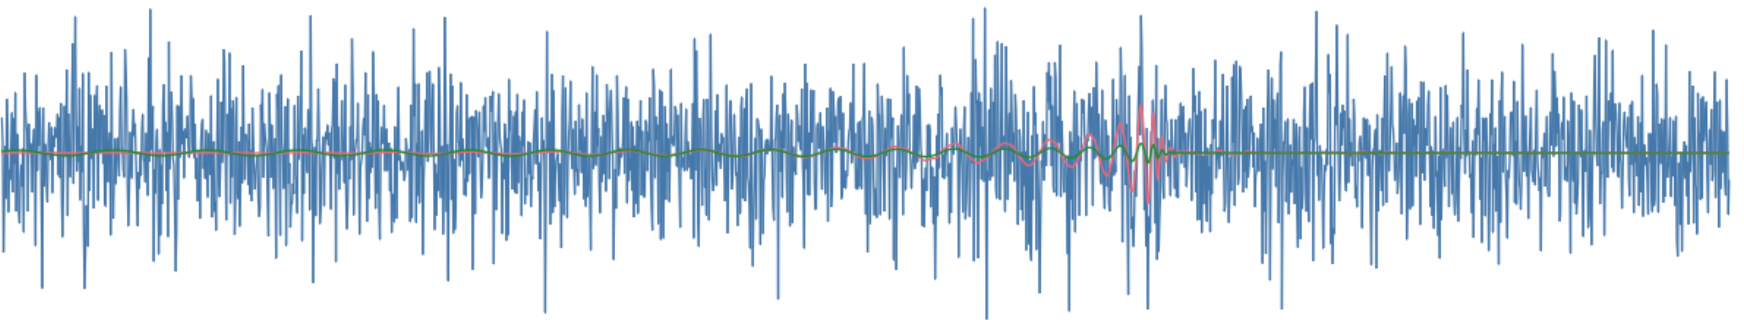
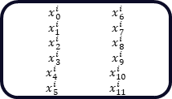
“The quick brown fox jumped over the lazy dog.”
Text
“string”
tokenisation
some elements are discarded: “The, .”
i
23
78
45
34
12
38
20
6
Tokens
associated substring
quick
brown
fox
jump
ed
over
lazy
dog
embedding
lookup table to learned weights or other vectorization methods like Word2Vec
i
23
78
45
34
12
38
20
6
Vectors
$x_{0}^{i}$ $x_{6}^{i}$
$x_{1}^{i}$ $x_{7}^{i}$
$x_{2}^{i}$ $x_{8}^{i}$
$x_{3}^{i}$ $x_{9}^{i}$
$x_{4}^{i}$ $x_{10}^{i}$
$x_{5}^{i}$ $x_{11}^{i}$
0.5446 0.6679
0.4814 0.9332
0.6221 0.8440
0.6403 0.9711
0.9261 0.3278
0.2621 0.3681
0.1660 0.4589
0.1973 0.6684
0.8747 0.0237
0.7229 0.1623
0.1442 0.4404
0.0070 0.3745
0.7132 0.1282
0.7833 0.3686
0.8558 0.9723
0.8204 0.4679
0.1613 0.0244
0.4087 0.3585
0.1445 0.5856
0.4687 0.4792
0.9671 0.7281
0.5734 0.5548
0.4082 0.2718
0.9920 0.6451
0.3075 0.8467
0.9888 0.5707
0.5423 0.6203
0.9109 0.7555
0.7406 0.8921
0.9395 0.3346
0.4273 0.0575
0.3114 0.0993
0.6153 0.5046
0.6968 0.4094
0.4542 0.8116
0.1967 0.5827
0.3883 0.1872
0.3771 0.8268
0.4399 0.3673
0.1768 0.1270
0.0260 0.7454
0.4660 0.1302
0.4273 0.0575
0.3114 0.0993
0.6153 0.5046
0.6968 0.4094
0.4542 0.8116
0.1967 0.5827
NLP Model
(e.g., transformer)
chunking
cut into equal length segments
N convolutional filters
convolutional embedding
extract feature maps with N learned filters

Slide 2
chunking
cut into equal length segments
N convolutional filters
convolutional embedding
extract feature maps with N learned filters
dense embedding
input chunks, min size 1, embedded with dense layer(s)
0.5446 0.6679
0.4814 0.9332
0.6221 0.8440
0.6403 0.9711
0.9261 0.3278
0.2621 0.3681
0.1660 0.4589
0.1973 0.6684
0.8747 0.0237
0.7229 0.1623
0.1442 0.4404
0.0070 0.3745
0.7132 0.1282
0.7833 0.3686
0.8558 0.9723
0.8204 0.4679
0.1613 0.0244
0.4087 0.3585
0.1445 0.5856
0.4687 0.4792
0.9671 0.7281
0.5734 0.5548
0.4082 0.2718
0.9920 0.6451
0.3075 0.8467
0.9888 0.5707
0.5423 0.6203
0.9109 0.7555
0.7406 0.8921
0.9395 0.3346
0.4273 0.0575
0.3114 0.0993
0.6153 0.5046
0.6968 0.4094
0.4542 0.8116
0.1967 0.5827
0.3883 0.1872
0.3771 0.8268
0.4399 0.3673
0.1768 0.1270
0.0260 0.7454
0.4660 0.1302
0.4273 0.0575
0.3114 0.0993
0.6153 0.5046
0.6968 0.4094
0.4542 0.8116
0.1967 0.5827

