Slide 1

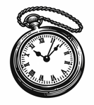

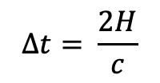
$$∆t= \frac{2H}{c}$$
$$H$$
The observer on the train measures the time it takes for a photon to travel from mirror A to B and back again.

Slide 2
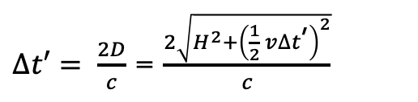


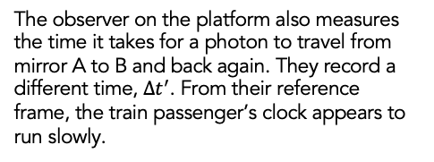
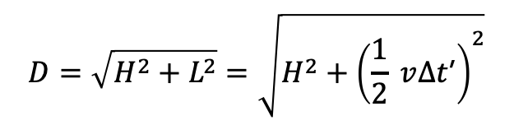
$$v$$
$$D=\sqrt{H^{2}+L^{2}}=\sqrt{H^{2}+{\left(\frac{1}{2} v∆t\text{’}\right)}^{2}}$$
$∆t′= \frac{2D}{c}$ = $\frac{2\sqrt{H^{2}+{\left(\frac{1}{2} v∆t\text{’}\right)}^{2}}}{c}$
$$H$$
$$v$$
The observer on the platform also measures the time it takes for a photon to travel from mirror A to B and back again. They record a different time, $∆t^{′}$. From their reference frame, the train passenger’s clock appears to run slowly.
$L=\frac{1}{2} v∆t$’

Slide 3





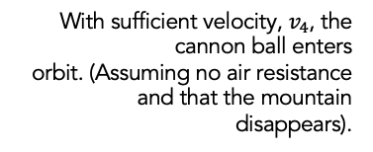

$$v_{1}$$
$$v_{2}$$
With sufficient velocity, $v_{4}$, the cannon ball enters
orbit. (Assuming no air resistance and that the mountain disappears).
$$m$$
$$v_{3}$$
$$v_{4}$$

Slide 4


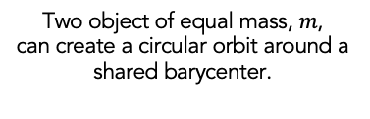

$$v$$
Two object of equal mass, $m$,
can create a circular orbit around a shared barycenter.
$$m$$
$$m$$
$$v$$

Slide 5



Plus polarization, $+$
$$t$$
Cross polarization, $×$

Slide 6
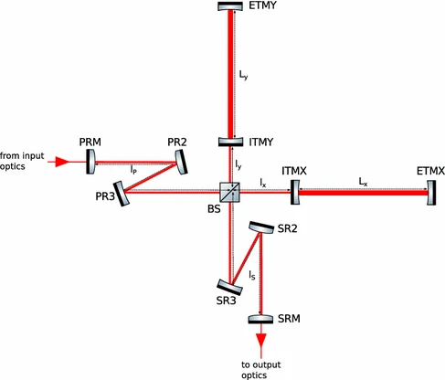
How do we detect gravitational waves?
End mirror
Power Recycling Mirror
Input mirror
From Input Optics
End mirror
Beam Splitter
Input mirror
Beam Splitter
Signal Recycling Mirror
Photodetector
Output Data
Photodetector

Slide 7

GEO600
LIGO Hanford
Virgo
LIGO Livingston
KAGRA

