Slide 1
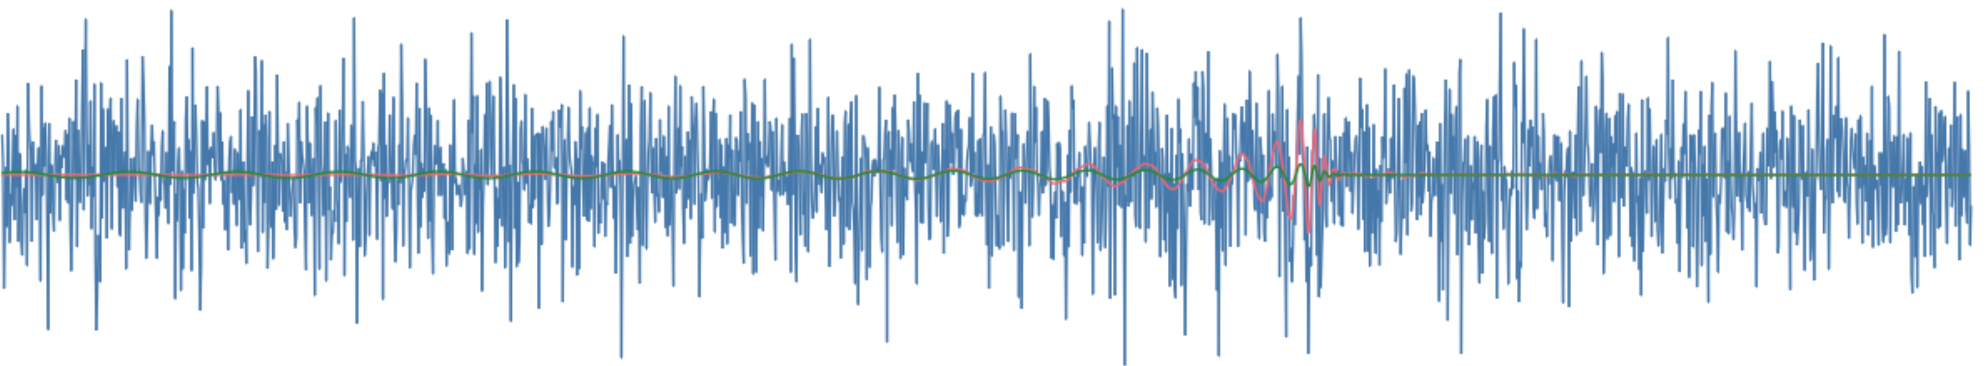
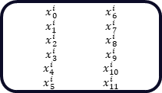
“The quick brown fox jumped over the lazy dog.”
Text
“string”
tokenisation
some elements are discarded: “The, .”
i
23
78
45
34
12
38
20
6
Tokens
associated substring
quick
brown
fox
jump
ed
over
lazy
dog
embedding
lookup table to learned weights or other vectorization methods like Word2Vec
i
23
78
45
34
12
38
20
6
Vectors
$x_{0}^{i}$ $x_{6}^{i}$
$x_{1}^{i}$ $x_{7}^{i}$
$x_{2}^{i}$ $x_{8}^{i}$
$x_{3}^{i}$ $x_{9}^{i}$
$x_{4}^{i}$ $x_{10}^{i}$
$x_{5}^{i}$ $x_{11}^{i}$
0.5446 0.6679
0.4814 0.9332
0.6221 0.8440
0.6403 0.9711
0.9261 0.3278
0.2621 0.3681
0.1660 0.4589
0.1973 0.6684
0.8747 0.0237
0.7229 0.1623
0.1442 0.4404
0.0070 0.3745
0.7132 0.1282
0.7833 0.3686
0.8558 0.9723
0.8204 0.4679
0.1613 0.0244
0.4087 0.3585
0.1445 0.5856
0.4687 0.4792
0.9671 0.7281
0.5734 0.5548
0.4082 0.2718
0.9920 0.6451
0.3075 0.8467
0.9888 0.5707
0.5423 0.6203
0.9109 0.7555
0.7406 0.8921
0.9395 0.3346
0.4273 0.0575
0.3114 0.0993
0.6153 0.5046
0.6968 0.4094
0.4542 0.8116
0.1967 0.5827
0.3883 0.1872
0.3771 0.8268
0.4399 0.3673
0.1768 0.1270
0.0260 0.7454
0.4660 0.1302
0.4273 0.0575
0.3114 0.0993
0.6153 0.5046
0.6968 0.4094
0.4542 0.8116
0.1967 0.5827
NLP Model
(e.g., transformer)
chunking
cut into equal length segments
N convolutional filters
convolutional embedding
extract feature maps with N learned filters

Slide 2
chunking
cut into equal length segments
N convolutional filters
convolutional embedding
extract feature maps with N learned filters
dense embedding
input chunks, min size 1, embedded with single non-overlapping kernel
0.5446 0.6679
0.4814 0.9332
0.6221 0.8440
0.6403 0.9711
0.9261 0.3278
0.2621 0.3681
0.1660 0.4589
0.1973 0.6684
0.8747 0.0237
0.7229 0.1623
0.1442 0.4404
0.0070 0.3745
0.7132 0.1282
0.7833 0.3686
0.8558 0.9723
0.8204 0.4679
0.1613 0.0244
0.4087 0.3585
0.1445 0.5856
0.4687 0.4792
0.9671 0.7281
0.5734 0.5548
0.4082 0.2718
0.9920 0.6451
0.3075 0.8467
0.9888 0.5707
0.5423 0.6203
0.9109 0.7555
0.7406 0.8921
0.9395 0.3346
0.4273 0.0575
0.3114 0.0993
0.6153 0.5046
0.6968 0.4094
0.4542 0.8116
0.1967 0.5827
0.3883 0.1872
0.3771 0.8268
0.4399 0.3673
0.1768 0.1270
0.0260 0.7454
0.4660 0.1302
0.4273 0.0575
0.3114 0.0993
0.6153 0.5046
0.6968 0.4094
0.4542 0.8116
0.1967 0.5827

Slide 3
The input vector is dotted with each learned matrix to create k, q, and v vectors.
Input
Query
Matrix
Query
1
1
Input
Input
Input
Key
Matrix
Key
N
i
1
1
Input
Value
Matrix
Value
1
1
The process is repeated for each element of the input series until there are N k, q, and v vectors

Slide 4
quick
quick
quick
q
v
k
brown
brown
brown
q
v
k
fox
fox
fox
q
v
k
jump
jump
jump
q
v
k
ed
ed
ed
q
v
k
over
over
over
q
v
k
lazy
lazy
lazy
q
v
k
dog
v

