Slide 1

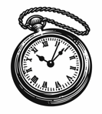

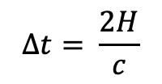
$$∆t= \frac{2H}{c}$$
$$H$$
The observer on the train measures the time it takes for a photon to travel from mirror A to B and back again.

Slide 2

$$∆t= \frac{2H}{c}$$
$$H$$
The observer on the train measures the time it takes for a photon to travel from mirror A to B and back again.

