Slide 1

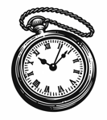

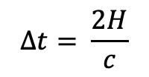
$$∆t= \frac{2H}{c}$$
$$H$$
The observer on the train measures the time it takes for a photon to travel from mirror A to B and back again.

Slide 2
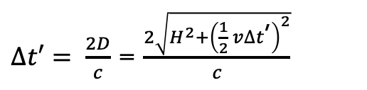


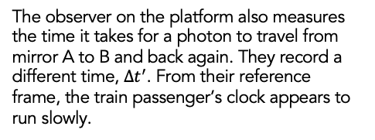
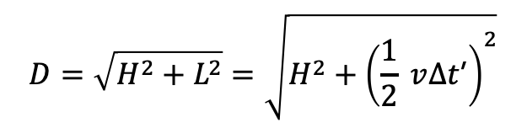
$$v$$
$$D=\sqrt{H^{2}+L^{2}}=\sqrt{H^{2}+{\left(\frac{1}{2} v∆t\text{’}\right)}^{2}}$$
$∆t′= \frac{2D}{c}$ = $\frac{2\sqrt{H^{2}+{\left(\frac{1}{2} v∆t\text{’}\right)}^{2}}}{c}$
$$H$$
$$v$$
The observer on the platform also measures the time it takes for a photon to travel from mirror A to B and back again. They record a different time, $∆t^{′}$. From their reference frame, the train passenger’s clock appears to run slowly.
$L=\frac{1}{2} v∆t$’

Slide 3





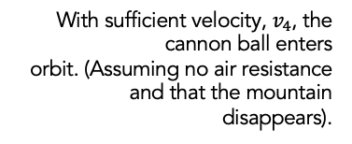

$$v_{1}$$
$$v_{2}$$
With sufficient velocity, $v_{4}$, the cannon ball enters
orbit. (Assuming no air resistance and that the mountain disappears).
$$m$$
$$v_{3}$$
$$v_{4}$$

Slide 4


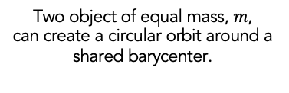

$$v$$
Two object of equal mass, $m$,
can create a circular orbit around a shared barycenter.
$$m$$
$$m$$
$$v$$

Slide 5



Plus polarization, $+$
$$t$$
Cross polarization, $×$

Slide 6
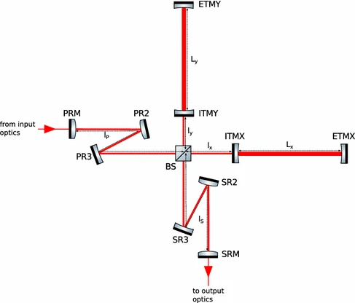
How do we detect gravitational waves?
End mirror
Input mirror
End mirror
Beam Splitter
Input mirror
Photodetector

Slide 7

GEO600
LIGO Hanford
Virgo
LIGO Livingston
KAGRA

