Slide 1
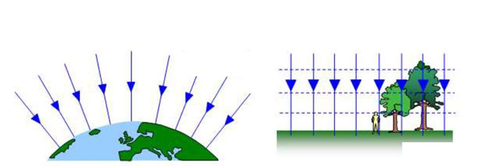
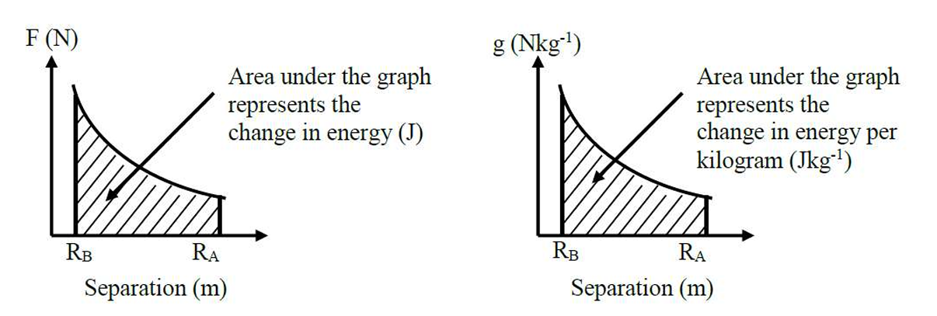
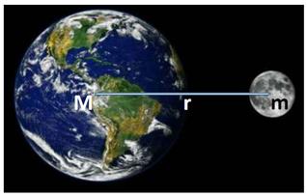
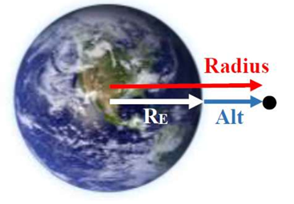
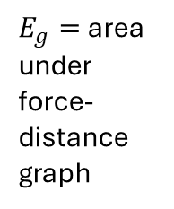
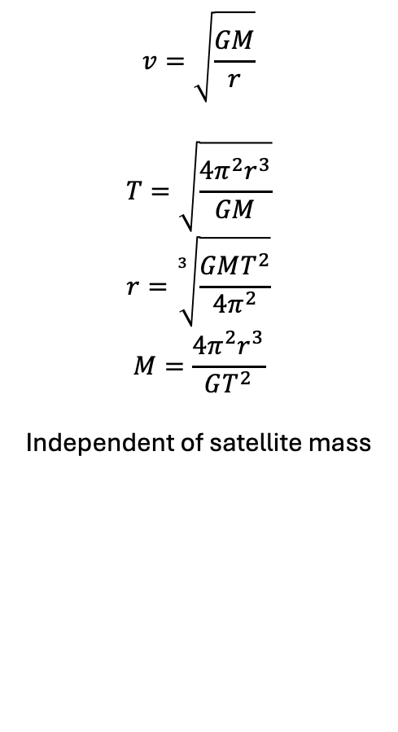
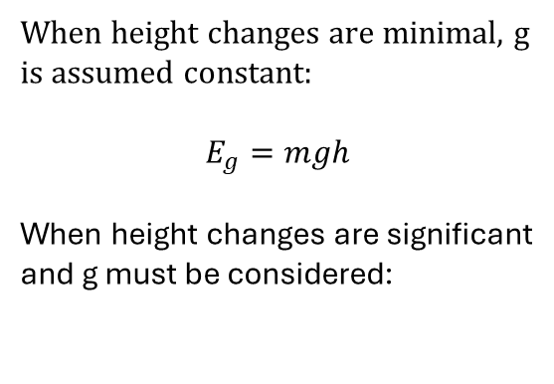
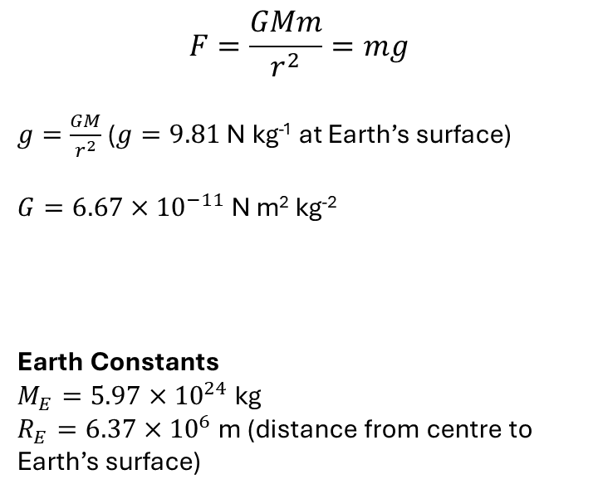
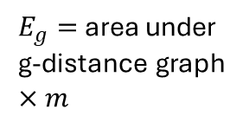
Gravitational Field Lines
Circular Orbits
Gravitational Potential Energy
$$v=\sqrt{\frac{GM}{r}}$$
$$T=\sqrt{\frac{4π^{2}r^{3}}{GM}}$$
$$r=\sqrt[3]{\frac{GMT^{2}}{4π^{2}}}$$
$$M=\frac{4π^{2}r^{3}}{GT^{2}}$$
Independent of satellite mass
When height changes are minimal, g is assumed constant:
$$E_{g}=mgh$$
When height changes are significant and g must be considered:
Gravitational Force
$$F=\frac{GMm}{r^{2}}=mg$$
$g=\frac{GM}{r^{2}}$ ($g=9.81$ N kg⁻¹ at Earth’s surface)
$G=6.67×{10}^{−11}$ N m² kg⁻²
Earth Constants
$M_{E}=5.97×{10}^{24}$ kg
$R_{E}=6.37×{10}^{6}$ m (distance from centre to Earth’s surface)
$E_{g}=$ area under force-distance graph
$E_{g}=$ area under g-distance graph $×m$
Gravitational Fields
Conventions
M = mass of the larger object
m = mass of the smaller object

Slide 2
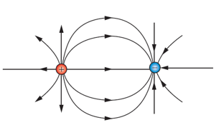
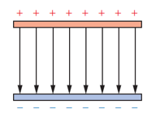
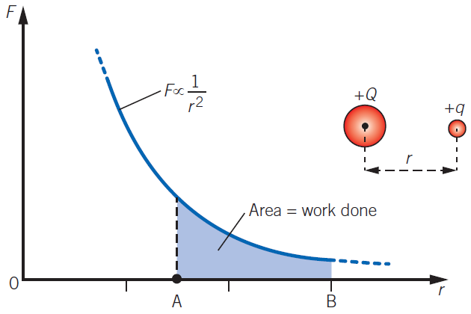
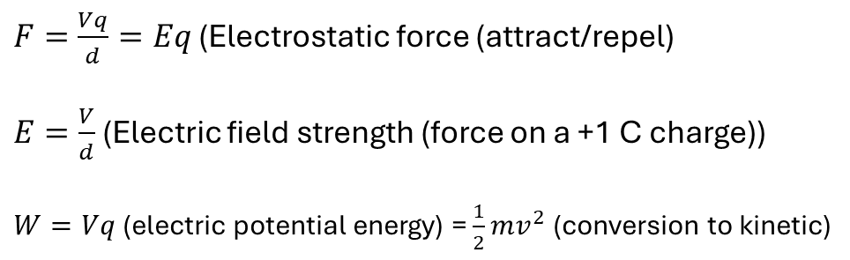
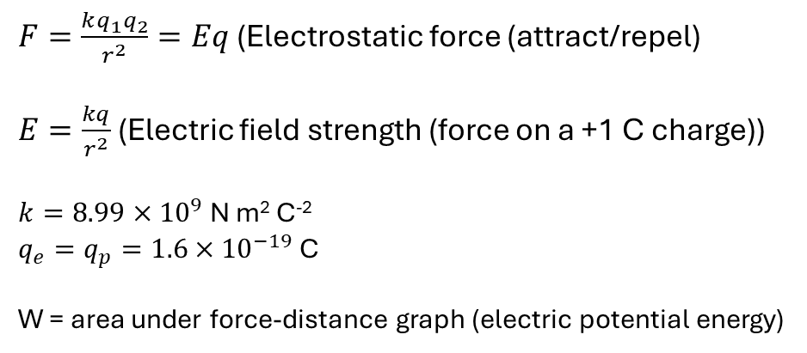
Non-uniform electric field
(Non-constant field strength and direction)
(Point charges)
Uniform electric field
(Constant field strength and direction)
(Plates)
$F=\frac{kq_{1}q_{2}}{r^{2}}=Eq$ (Electrostatic force (attract/repel)
$E=\frac{kq}{r^{2}}$ (Electric field strength (force on a +1 C charge))
$k=8.99×{10}^{9}$ N m² C⁻²
$q_{e}=q_{p}=1.6×{10}^{−19}$ C
W = area under force-distance graph (electric potential energy)
$F=\frac{Vq}{d}=Eq$ (Electrostatic force (attract/repel)
$E=\frac{V}{d}$ (Electric field strength (force on a +1 C charge))
$W=Vq$(electric potential energy) = $\frac{1}{2}mv^{2}$ (conversion to kinetic)
Electric Fields

Slide 3
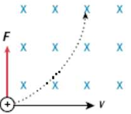
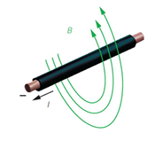
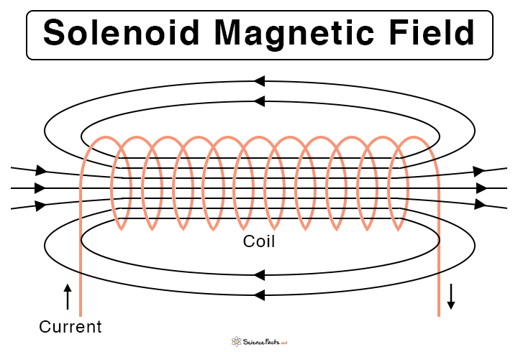
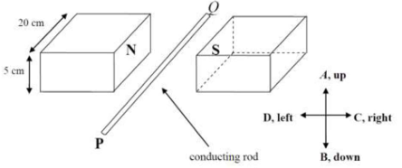
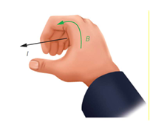
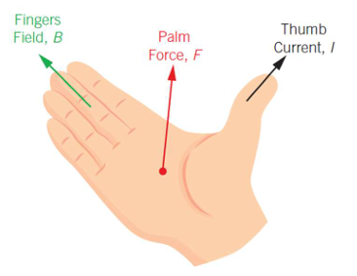
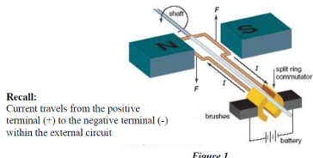
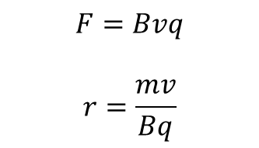
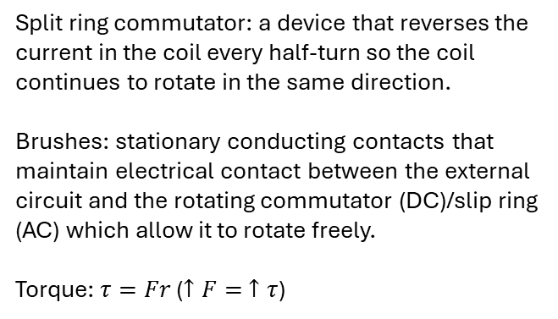

Moving Charges in a Uniform Magnetic Field
Moving Charges Creating a Magnetic Field
Charged Particle in Magnetic Field
Current-Flowing Wire
in Magnetic Field
Current-Flowing Wire
Current-Flowing Solenoid
$$F=nBIl$$
$$F=Bvq$$
$$r=\frac{mv}{Bq}$$
Right-hand slap rule
(conventional current)
Right-hand grip rule for wires (conventional current)
Right-hand grip rule for solenoids (conventional current)
DC Motors
Conventions
x = into the page
o = out of the page
| | Larger battery terminal is positive
Hand rules are for positive charges and conventional current
Split ring commutator: a device that reverses the current in the coil every half-turn so the coil continues to rotate in the same direction.
Brushes: stationary conducting contacts that maintain electrical contact between the external circuit and the rotating commutator (DC)/slip ring (AC) which allow it to rotate freely.
Torque: $τ=Fr$ ($↑F= ↑τ$)
Right-hand
slap rule
(for + charge)
(flip for – charge)
Magnetic Fields

