Slide 1
Generative Intelligent Tool
Optimizing Repositories and Automating Test Cases

Slide 2
Overview of the Tool
1. Refactor existing repositories to improve performance and maintainability.
2. Automate script generation and test case mapping using AI/ML.
3. Suggest improvements to code quality and test coverage.
4. Integrate with CI/CD pipelines for seamless deployment.

Slide 3
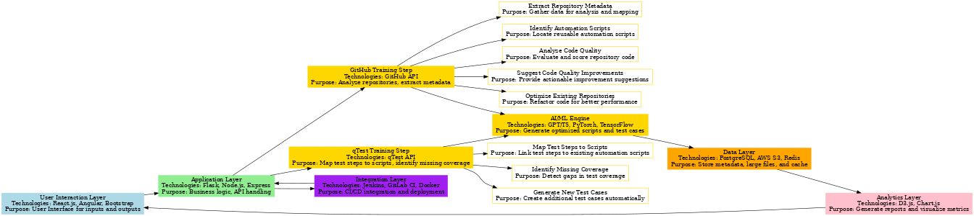
High-Level Architecture

Slide 4
Key Features
1. Repository Analysis:
- Extract metadata, identify automation scripts, and analyze code quality.
2. Test Case Automation:
- Map test steps to scripts, identify gaps, and generate new test cases.
3. AI-Powered Optimization:
- Refactor and suggest improvements to enhance performance.
4. Seamless Integration:
- CI/CD tools and test management integration.

Slide 5
Technologies Used
1. Frontend: React.js, Angular, Bootstrap.
2. Backend: Flask, Node.js, Express.
3. AI/ML: GPT, T5, PyTorch, TensorFlow.
4. Database: PostgreSQL, AWS S3, Redis.
5. Integration: GitHub API, qTest API, Jenkins, GitLab CI.

Slide 6
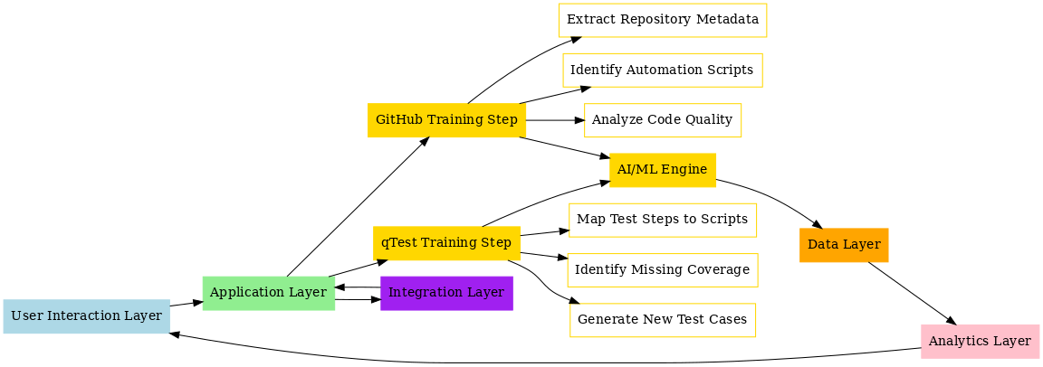
Workflow and Data Flow

