Slide 1
Generative Intelligent Tool
Revolutionizing Repository Management and Test Automation

Slide 2
Problem Statement
- Existing repositories often suffer from outdated code, inefficiencies, and technical debt.
- Test case mapping and automation scripts are manual and error-prone.
- Companies need optimized processes to save time, reduce costs, and enhance resource utilization.

Slide 3
Solution Overview
The Generative Intelligent Tool provides:
- Automated repository optimization for improved performance.
- AI-driven test case mapping and script generation.
- Real-time suggestions for code quality improvement.
- Seamless integration with CI/CD pipelines.

Slide 4
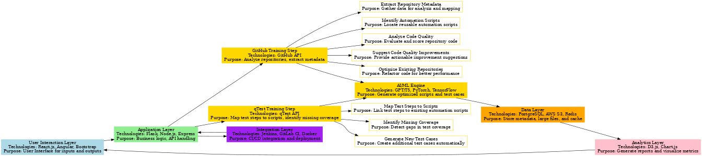
High-Level Architecture

Slide 5
Impact on Business
- **Resource Optimization**: Automates redundant tasks, freeing up valuable resources.
- **Cost Efficiency**: Reduces technical debt and streamlines test automation, lowering expenses.
- **Improved Productivity**: Speeds up deployment cycles with better test and code quality.
- **Scalability**: Enables teams to handle larger projects efficiently.

Slide 6
Key Features
1. **Repository Analysis**:
- Extract metadata, identify automation scripts, analyze and optimize code.
2. **Test Automation**:
- AI maps test steps to scripts and generates new test cases.
3. **Integration**:
- Works seamlessly with CI/CD pipelines and test management tools.
4. **Actionable Insights**:
- Provides suggestions for improving code quality and test coverage.

Slide 7
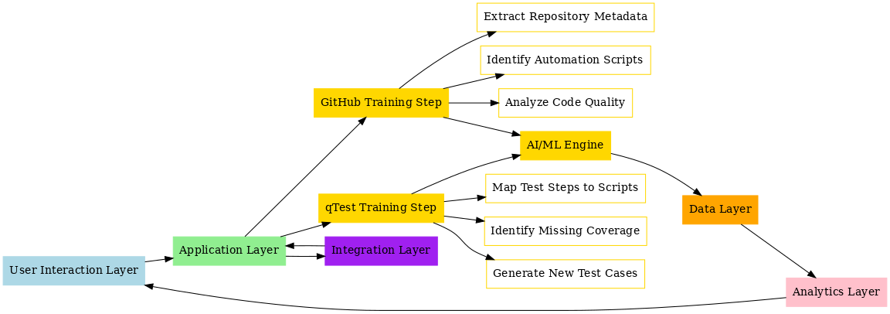
Workflow and Data Flow

Slide 8
Technologies Used
- **Frontend**: React.js, Angular, Bootstrap.
- **Backend**: Flask, Node.js, Express.
- **AI/ML**: GPT, T5, PyTorch, TensorFlow.
- **Database**: PostgreSQL, AWS S3, Redis.
- **Integration**: GitHub API, qTest API, Jenkins, GitLab CI.

Slide 9
Why This Tool?
- **Innovative Solution**: Combines repository optimization and test automation using AI.
- **Business Value**: Significant impact on cost, efficiency, and resource utilization.
- **Scalability**: Designed to adapt to any company's workflows and pipelines.
- **Hackathon Edge**: Practical implementation with clear deliverables and measurable outcomes.

