Slide 1
Design of a simple computer
From chapter 8 of Digital Logic and Computer Design by Morris Mano, 2004 revision

Slide 2
Registers
Symbol bits Name
MAR 8 Memory Address Register memory address
MBR 8 Memory Buffer Register memory word
A 8 A Register processor register
R 8 R Register processor register
PC 8 Program counter
IR 8 Instruction register current operation code
T 3 Timing counter Sequence generator

Slide 3
3-instructions
Operation code Mnemonics
00000001 MOV R A ←R
00000010 LDI OPRD A ← OPRD
00000011 LDA ADRS A ← M[ADRS]

Slide 4
Instruction fetch cycle
PC initialized to the first address of program in memory
An operation code whose address is in PC is read into MBR
PC is incremented
Operation code transfers from MBR to IR
Operation code is decoded by the control

Slide 5
Timing and control
Timing variables t0, t1, t2 are used as control function to sequence micro-operations for reading an op-code and placing to IR
t register is incremented every clock pulse and automatically produces next timing variable
Outputs qi i=1, 2, … in operation decoder are control actions after fetch. Control uses qi variables to determine the next micro-operation

Slide 6
FETCH cycle
t0: MAR ← PC transfer op-code address
t1: MBR ← M, PC ← PC +1 read op-code, increment PV
t2: IR ← MBR transfer op-code to IR

Slide 7
MOV (first instruction out of 3)
Control q1 is 1
q1t3: A ← R, T ← 0

Slide 8
LDI OPRD (second instruction out of 3)
When q2 = 1, the 3 timing variables read the operand and transfer to register A:
q2t3: MAR ← PC transfer operand address
q2t4: MBR ← M, PC ← PC + 1 read operand, increment PC
q2t5: A ← MBR, T=0 transfer operand, go to fetch cycle

Slide 9
LDA ADRS (third instruction out of 3)
LDA ADRS has an operation code which makes q3=1
q3t3: MAR ← PC next instruction
q3t4: MBR ← M, PC ← PC +1 read ADRS, increment PC
q3t5: MAR ← MBR transfer operand address
q3t6: MBR ← M read operand
q3t7: A ← MBR, T ← 0 transfer operand to A, go to fetch cycle

Slide 10
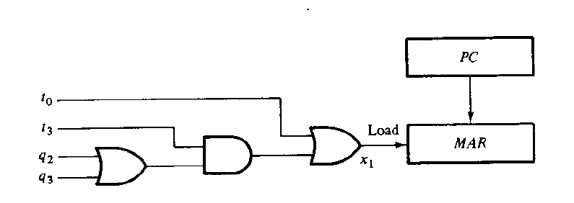
Design of computer
First step, combine all micro-operations ( total of 8) each into one statement, for example
x1 = t0 + q2t3 + q3t3 = t0 + (q2 + q3) t3 MAR ← PC

Slide 11
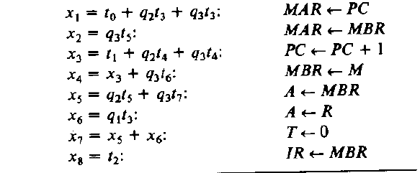
Hardware specification (8 micro-operations)

Slide 12
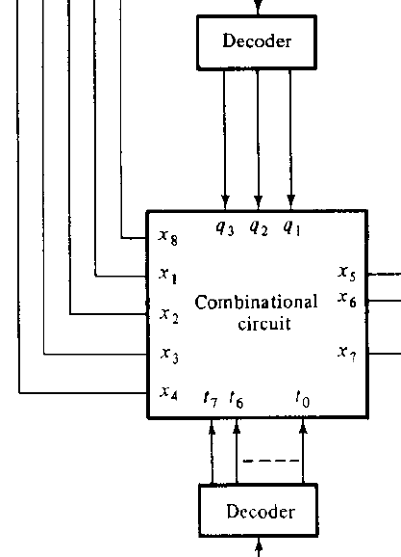
Combinational circuit
Combinational circuit shows
timings, controls, and functions.
Generates 8 control functions:

Slide 13
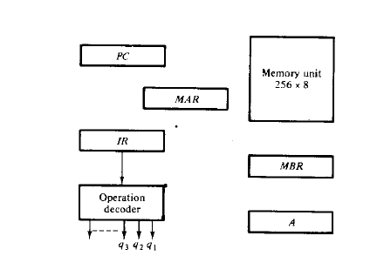
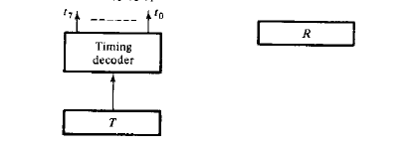
Components
Control functions enable load and increment
Multiplexer selects between two sources of information for a register
Decoder selects an control based on the instruction

Slide 14
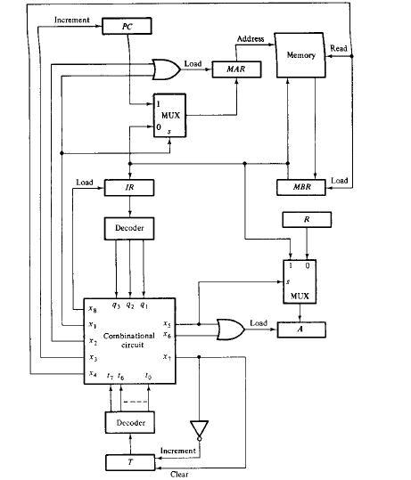
Design of a simple computer

