Slide 1
Movie Financial Success Predictor
Milind Kulkarni
March 1, 2017

Slide 2
Background
Hollywood movies involve huge upfront investments.
The return on these investments depends on the success of the movie at the box office.
Success of the movie is considered to be dependent on the quality of the movie which is an unknown feature at the beginning of production.
Thus a predictor which can estimate the financial success of a movie at the initial investment phase would be highly beneficial.

Slide 3
Objectives
The main aim of this project is to predict the financial success using features or variables which are known at the beginning of the production
Features like budget, director and actor names, genre, content rating, year of production are known so can be used for the analysis.
Features like IMDB score and gross of the movie are unknown so cannot be used.
The objectives are to get a high accuracy predictor with a high F1 score as well.
The Dataset used is the IMDB 5K found on kaggle.com (https://www.kaggle.com/tmdb/tmdb-movie-metadata)
We will also explore how much does the quality of a movie affect its financial performance. (we can assume that the IMDB score quantifies the quality of production)

Slide 4
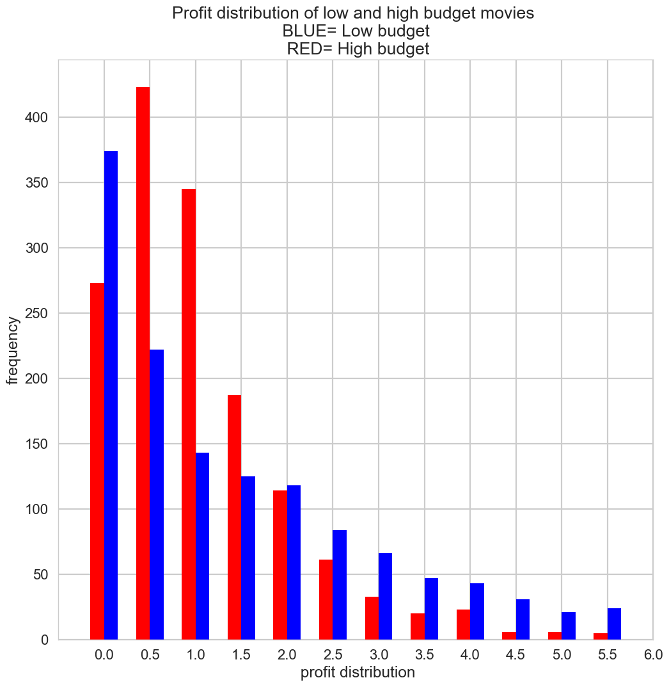
Data Cleanup and Exploratory Data Analysis
Data was analyzed for missing and incorrect entries. And those were removed.
Foreign movies did not have their budget and gross numbers in USD. So they had to be purged.
Movies with a very high profit ratio were to be removed. As they could confuse the classifier.
Data had to be analyzed to make sure there was a good distribution of release years, genres, content rating, imdb score etc.
The distribution in profit ratio between high and low budget movies was very different, so it made sense to split the dataset into two parts and run classification on it separately. Fig[1]
Convert the qualitative data like genre and content rating to quantifiable features.
Fig-1

Slide 5
Determine the objective for classification. Profit ratio was selected for financial success.
Median profit was around 20%
Movies with a ratio greater than 1.2 (20% profit) were considered to be profitable. Lesser than that were loss making.
Fig-2

Slide 6
Machine Learning Analysis
Fig 3
Applied Logistic Regression, SVM, Random Forest and Voting classifier on the dataset.
Used K-fold cross validation to reduce variance and bias.
Looped across various hyper-parameters to get the most optimal classifier.
Also used gridsearchCV as an alternative to manual looping across parameters
The Voting Classifier gave the best results with an accuracy of 73% and f1_score of .7 Fig[3,4]
Fig 4

Slide 7
Conclusion
The voting classifier was able to predict with a 73% accuracy.
The precision and recall were good as well with an F1 score of .7
Very small uptick in the performance of the predictor on adding the IMDB scores. Fig [5,6]
Does this mean that the financial success of the move is independent of the quality of the movie?
Fig5. Without IMDB scores
Fig6. With IMDB scores

