Slide 1
Neural Network as Opponent in Quoridor
Advisor: Peter Gergeľ
1. Brief overview of existing approaches to the production of agents playing board games
2. Program intelligent agent built based on neural networks, which will learn to play Quoridor
3. Test end evaluate the behaviour of the agent

Slide 2
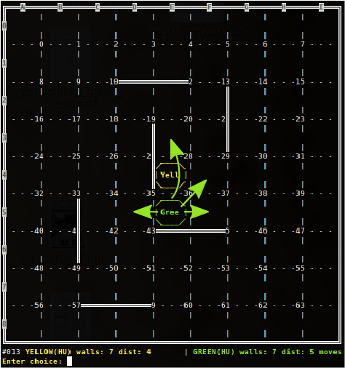
Neural Network as Opponent in Quoridor
2 player version
10 walls each
each starts in the middle of opposite sides
goal is opposite side

Slide 3
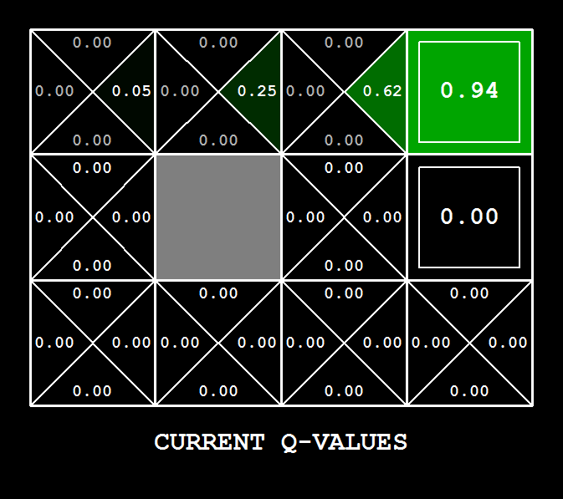
Neural Network as Opponent in Quoridor
Neural Network (NN) learns to estimate Q-value. NN's ability to generalize should help propagate Q-values faster to the early stage of the game.
Alpha is 1, NN handles learning rate
1. observe s_{t}
2. estimate Q(s_{t}, a_{i}) Vi using NN
3. choose min/max a_{t}
4. play a_{t}
5. estimate Q(s_{t+1}, a_{i}) Vi using NN
6. choose max/min a_{t+1}
7. back propagate ΔW = (reward + Q(s_{t+1}, a_{t+1}))

Slide 4
Neural Network as Opponent in Quoridor
To speed the process, I have created 'Heuristic' player following shortest path to goal or placing wall on the shortest path of the opponent.
Similar approach has been used when learning othello chess or go using Neural Network estimating Q-values.
www.ai.rug.nl/~mwiering/GROUP/ARTICLES/paper-othello.pdf
www.ai.rug.nl/~mwiering/GROUP/ARTICLES/learning-chess.pdf
www2.kobe-u.ac.jp/~ozawasei/pub/iconip02a.pdf

