Slide 1
Neural Network as an Opponent in Quoridor
Student: Michal Hoľa
Advisor: Peter Gergeľ
1. Brief overview of existing approaches to the production of agents playing board games
2. Program intelligent agent built based on neural networks, which will learn to play Quoridor
3. Test end evaluate the behaviour of the agent

Slide 2
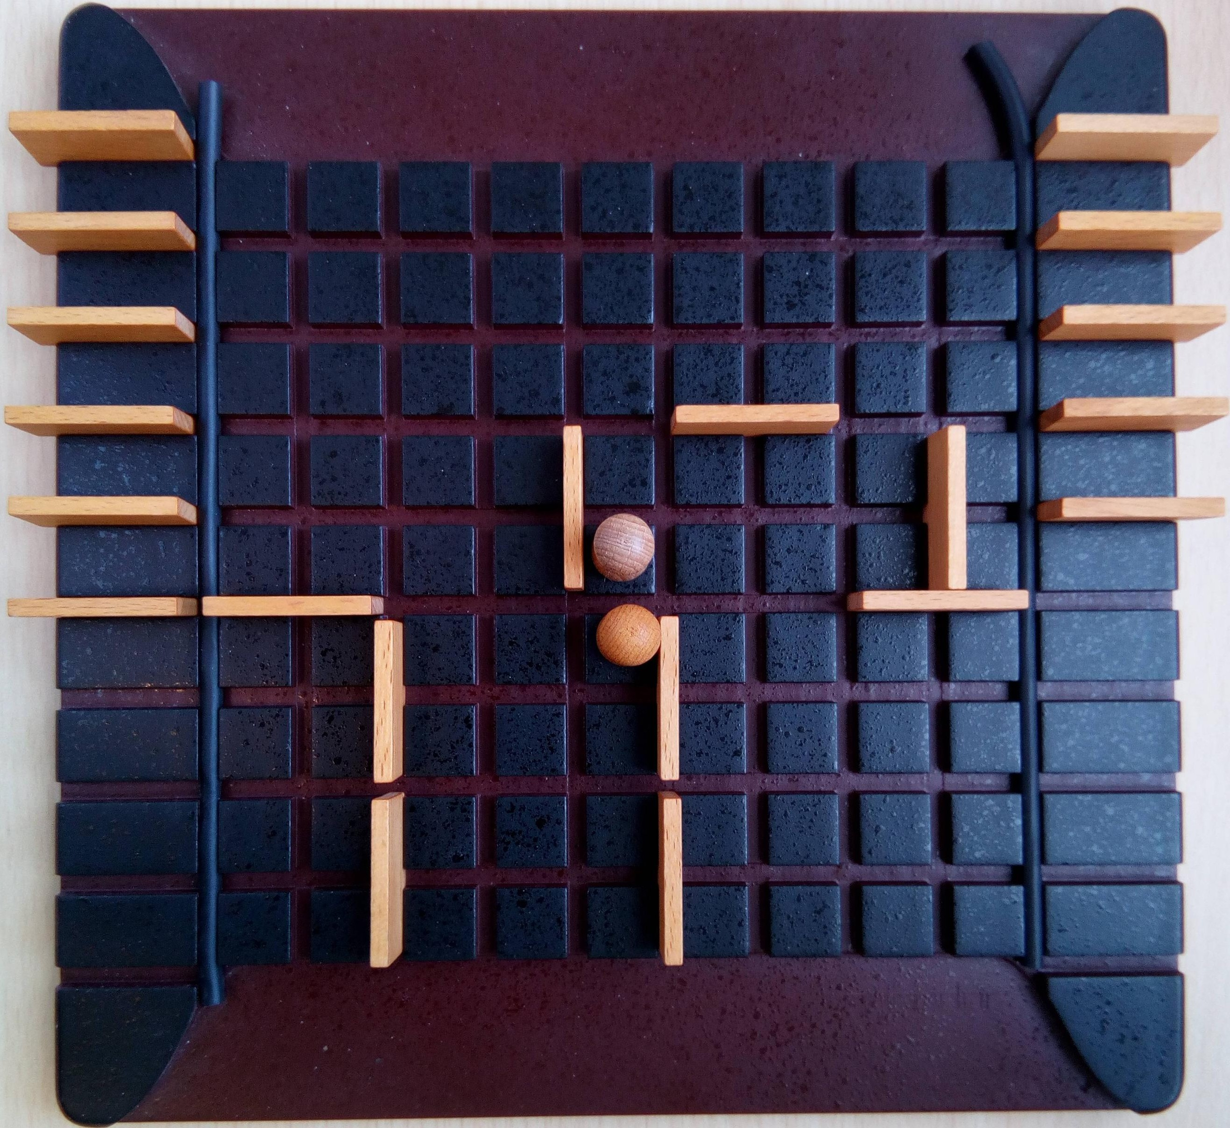
Neural Network as an Opponent in Quoridor
Mirko Marchesi 1995
9X9
4 or 2 player version
10 walls each
single pawn, each starts in the middle of the opposite sides
goal is opposite side

Slide 3
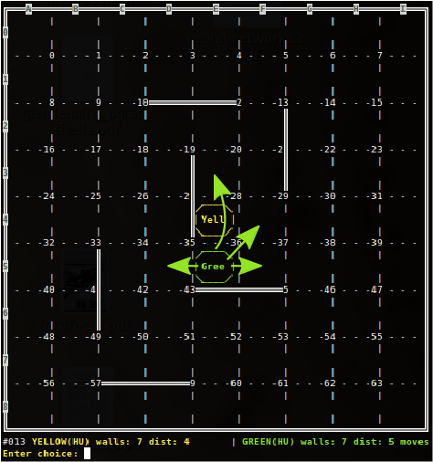
Neural Network as an Opponent in Quoridor
state complexity
P.J.Mertens 2006:

Slide 4
Neural Network as an Opponent in Quoridor
branching factor
L. Glendennig 2005:
game tree complexity
P.J.Mertens 2006:

Slide 5
Neural Network as an Opponent in Quoridor
State complexity
Branching factor
Game tree complexity

Slide 6
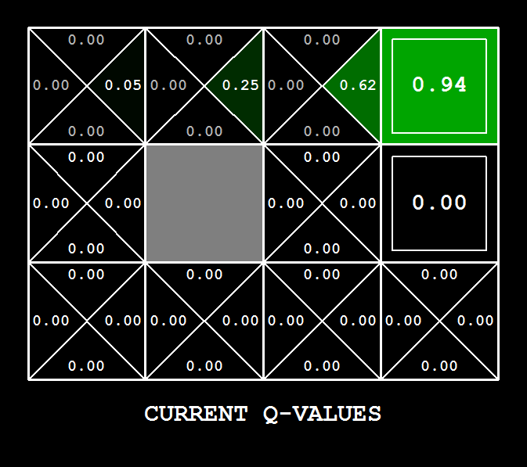
Neural Network as an Opponent in Quoridor
Reinforcement Learning, Q-Learning
t … time in game (move)
q … q-value goodness of action
Too many evaluations for Quoridor

Slide 7
Neural Network as an Opponent in Quoridor
Neural Network (NN) learns to estimate Q-value. NN's ability to generalize should help propagate Q-values faster to the early stage of the game.
Inspired by work Michiel van der Ree and col. 2013 for game othello, University of Groningen, The Netherlands
Alpha is 1, NN handles learning rate
1. observe s_{t}
2. estimate Q(s_{t}, a_{i}) Vi using NN
3. choose min/max a_{t}
4. play a_{t}
5. estimate Q(s_{t+1}, a_{i}) Vi using NN
6. choose max/min a_{t+1}
7. back propagate ΔW = (reward + Q(s_{t+1}, a_{t+1}))

Slide 8

Neural Network as an Opponent in Quoridor
To speed up the process, I have created 'Heuristic' player following shortest path to goal or placing wall on the shortest path of the opponent.
State
Context
- shortest path, blockers, crossers
Tensorflow – python GIL, GPU

Slide 9
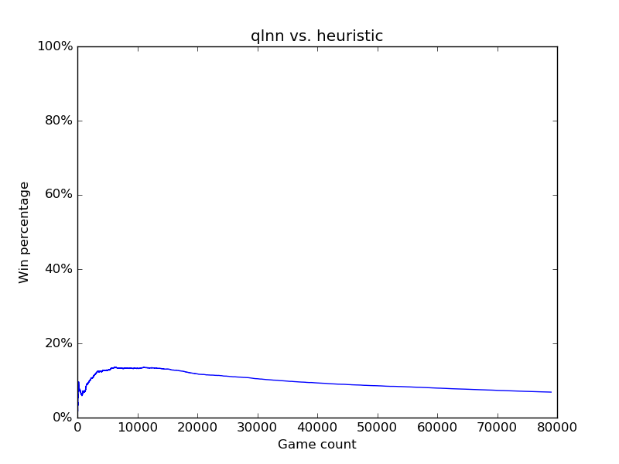
Neural Network as an Opponent in Quoridor
(133, 500, 140)

Slide 10
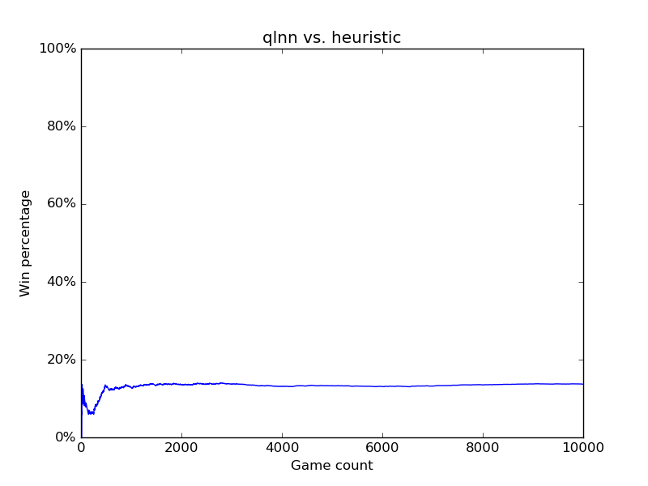
Neural Network as an Opponent in Quoridor
(133, 1000, 140)

Slide 11
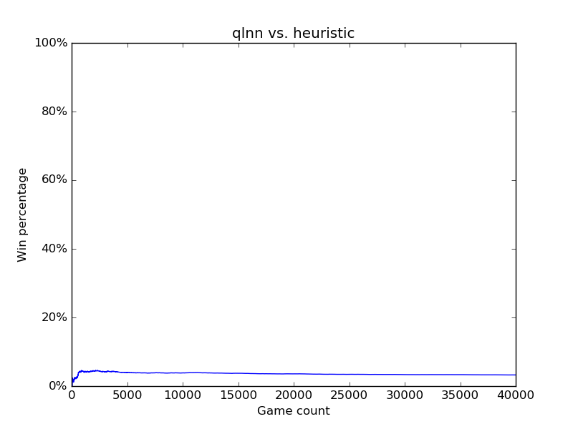
Neural Network as an Opponent in Quoridor
(133, 300, 300, 140)

Slide 12
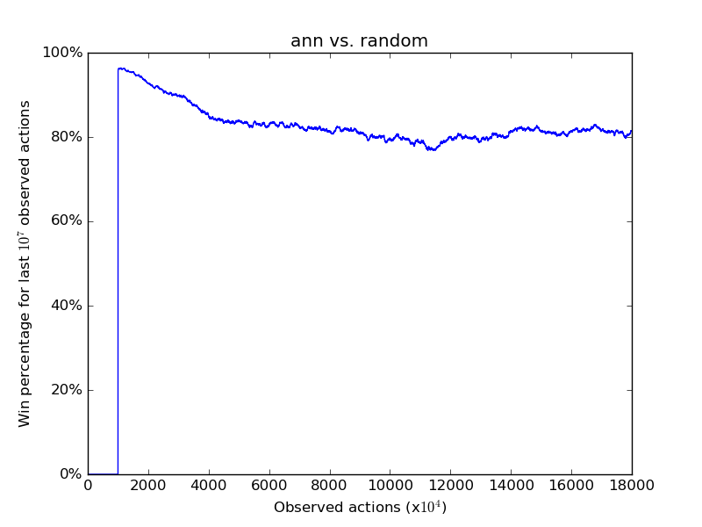
Neural Network as an Opponent in Quoridor

Slide 13
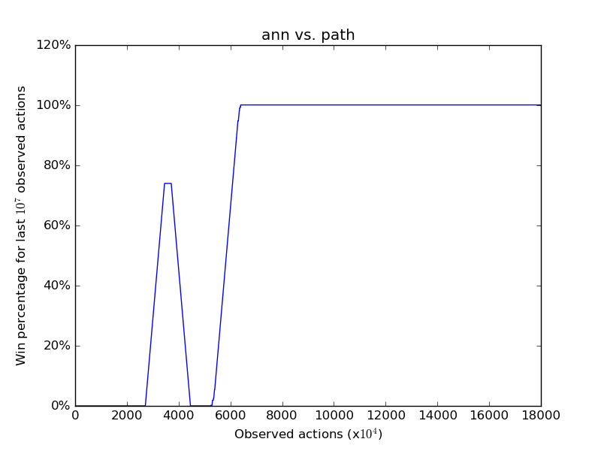
Neural Network as an Opponent in Quoridor

Slide 14
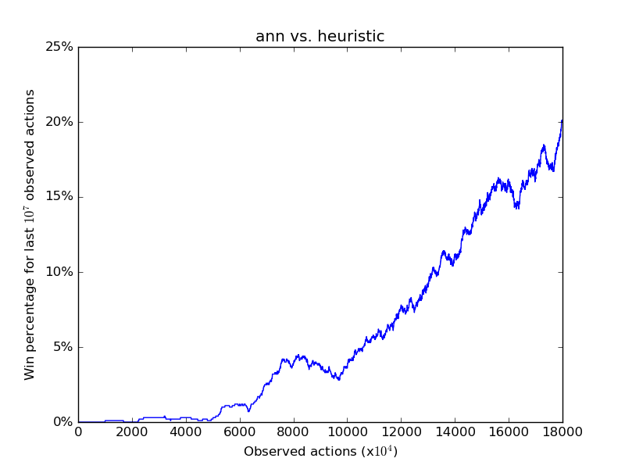
Neural Network as an Opponent in Quoridor

Slide 15
Neural Network as an Opponent in Quoridor
New state complexity, branching factor and game tree compexity
Heuristic player
Q-values estimated by Artificial Neural Network
Signs of improvement only by watching Heuristic player
Thank you for your attention

