Slide 1
Data Structures and Algorithms (DSA) in Java Day 2
by MG

Slide 2
Introduction to DSA
• DSA is the core of effective programming.
• Data Structures: organize and manage data.
• Algorithms: define logic to manipulate data.
Benefits:
- Improve performance
- Scalability
- Master coding interviews and real-world problem solving.

Slide 3

Could you tell me that you know on it?
Data structures
What data types are there and know?
Algorithms
which algorithms do you know a and use in your program or system?

Slide 4
What is data structure?
❑ A particular way of storing and organizing data in a computer so that it can be used efficiently and effectively.
❑Data Structures are the programmatic way of storing data so that data can be used efficiently. ❑Data structure is the logical or mathematical model of a particular organization of data.
❑ A group of data elements grouped together under one name. ▪ For example, an array of integers

Slide 5
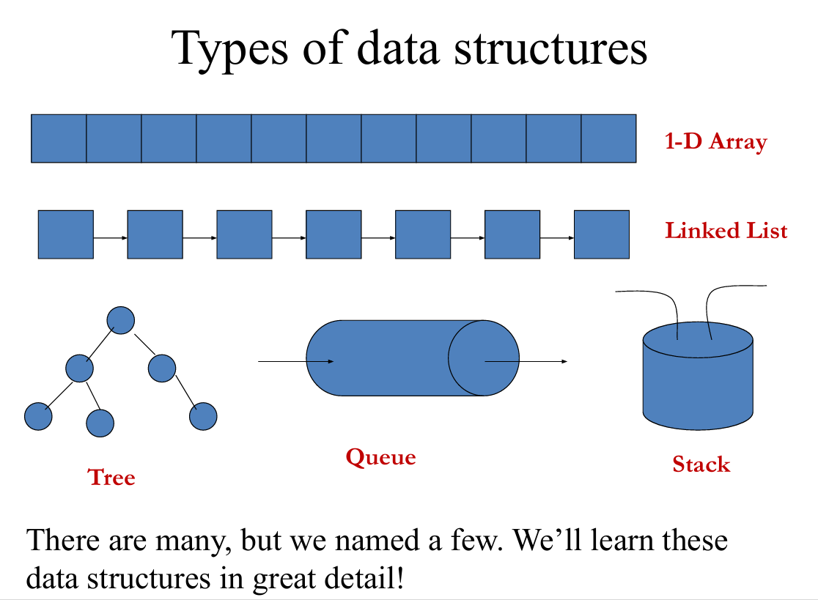

Slide 6
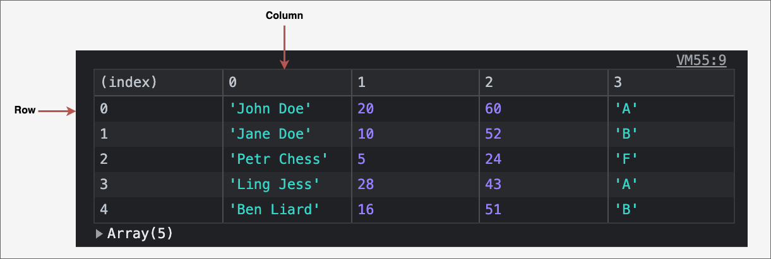
2D array

Slide 7
Arrays in Java
• Fixed-size container holding elements of the same type.
• Indexed access starting from 0.
Syntax:
int[] arr = new int[5];
Common Operations:
- Access: O(1)
- Search: O(n)
- Insert/Delete: O(n)
Use Cases:
- Lookup tables (master data setup)
- Image processing

Slide 8
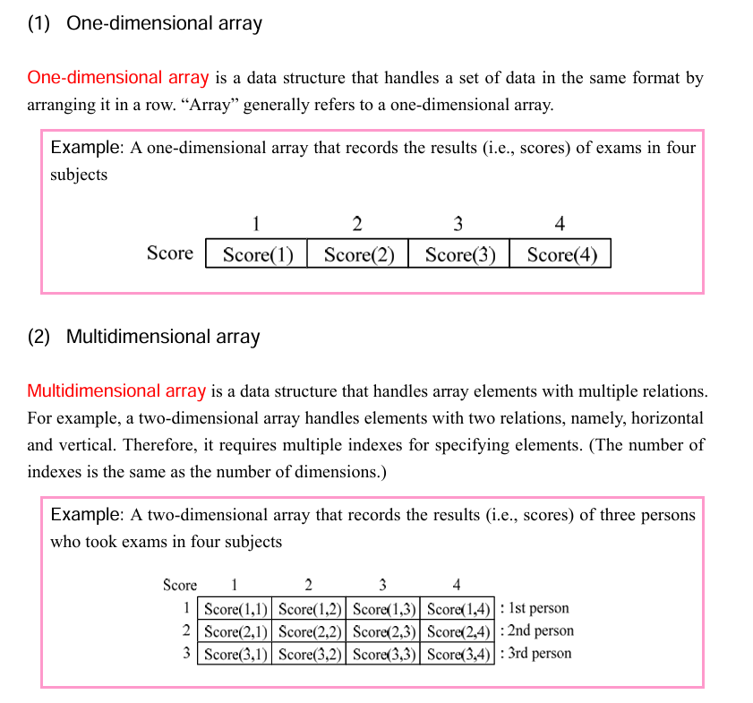
2 types of array in Programs

Slide 9
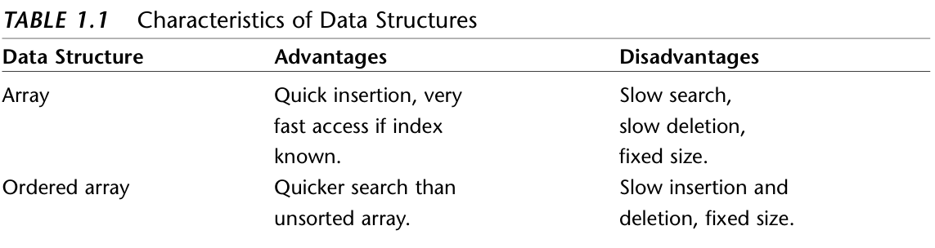
Characteristics of Data Structure

Slide 10
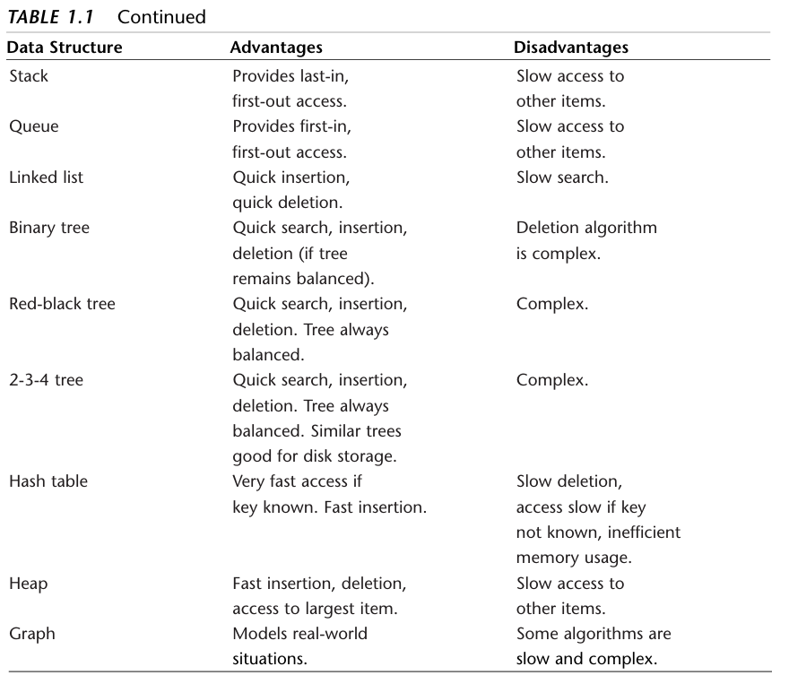

Slide 11

Stacks and Queues
• Stack: LIFO(Last-In-First-Out)
- Methods: push(), pop(), peek(),isEmpty(),isFull()
- Example: Call stack, Undo feature
• Queue: FIFO
- Methods: offer(), poll(), peek()
- Example: Job scheduling, Messaging
Use Java's Stack and LinkedList classes to implement.

Slide 12
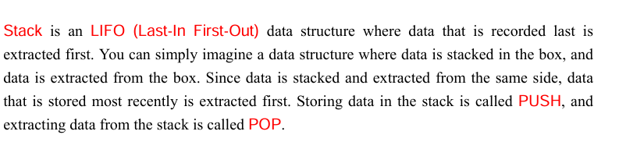
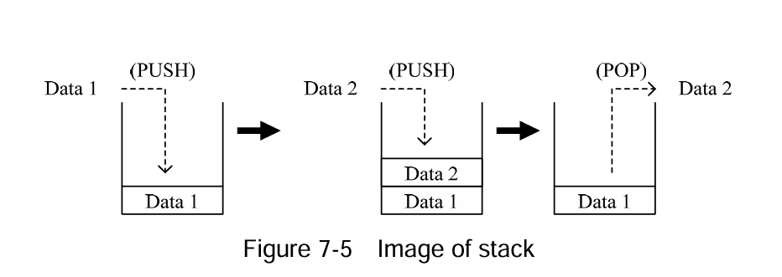
Stack

Slide 13
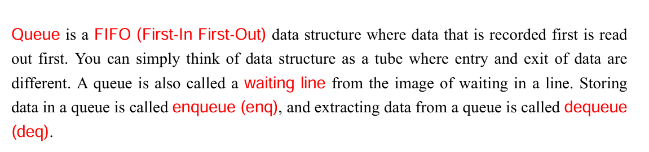
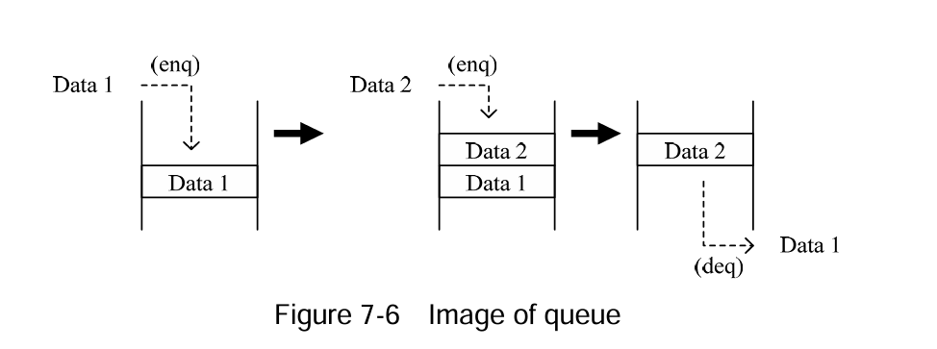
Queue

Slide 14
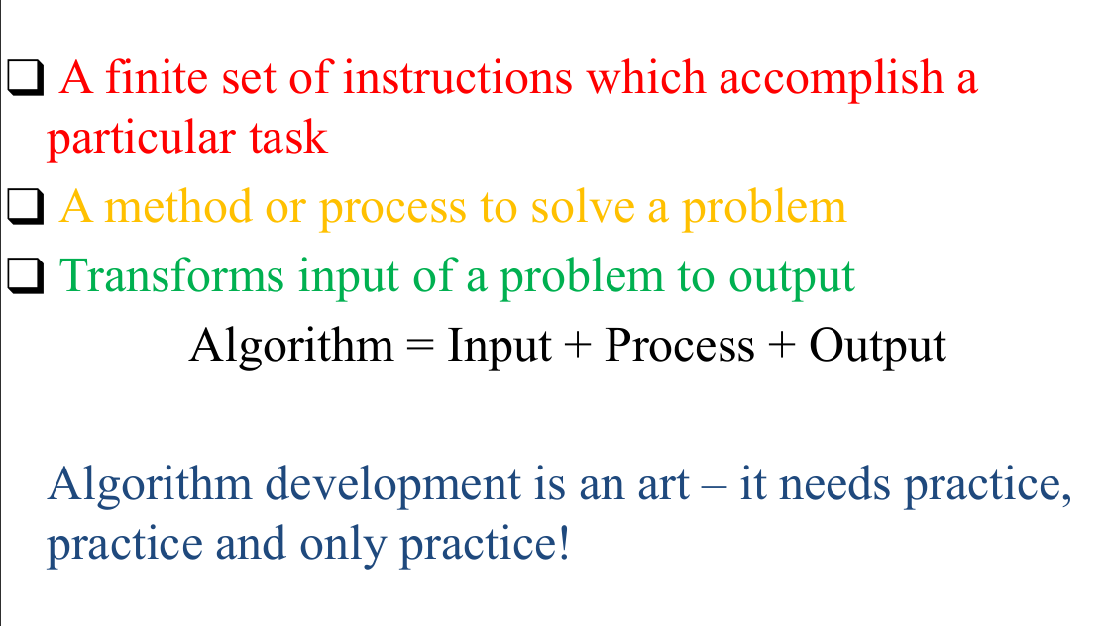
What is algorithm?

Slide 15
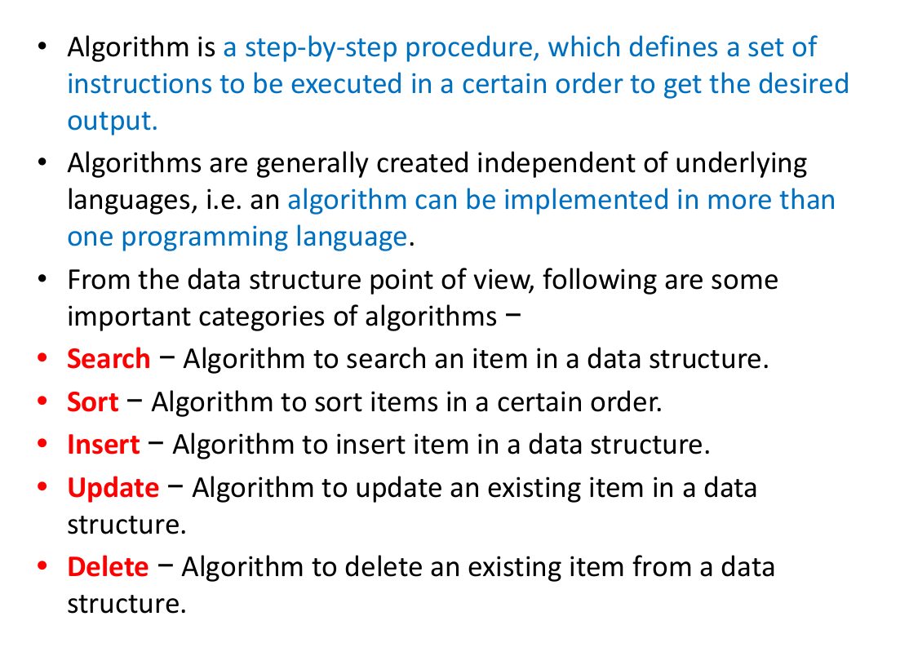
What is algorithm? continued

Slide 16
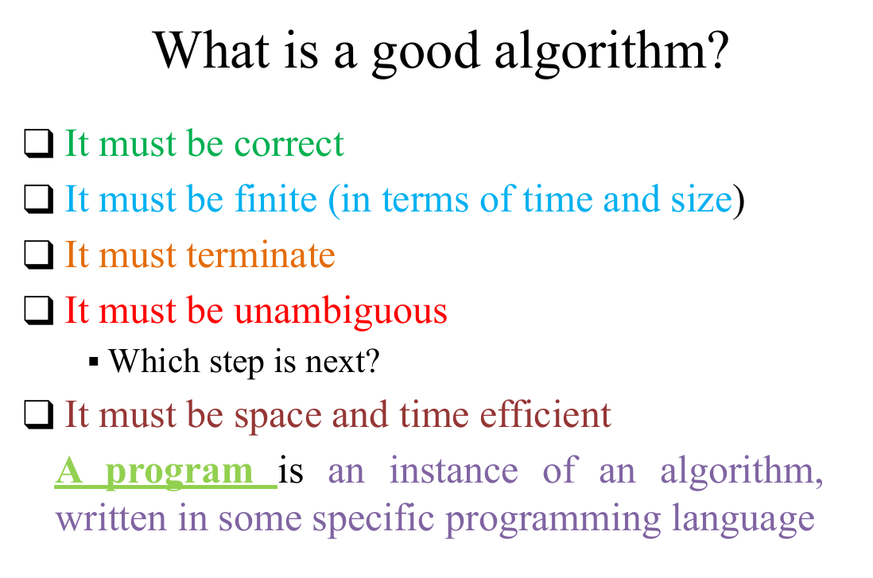

Slide 17
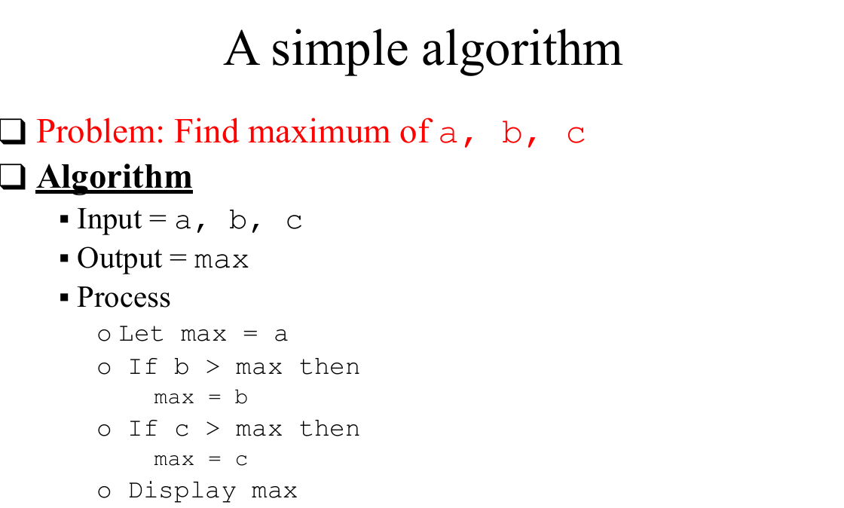

Slide 18
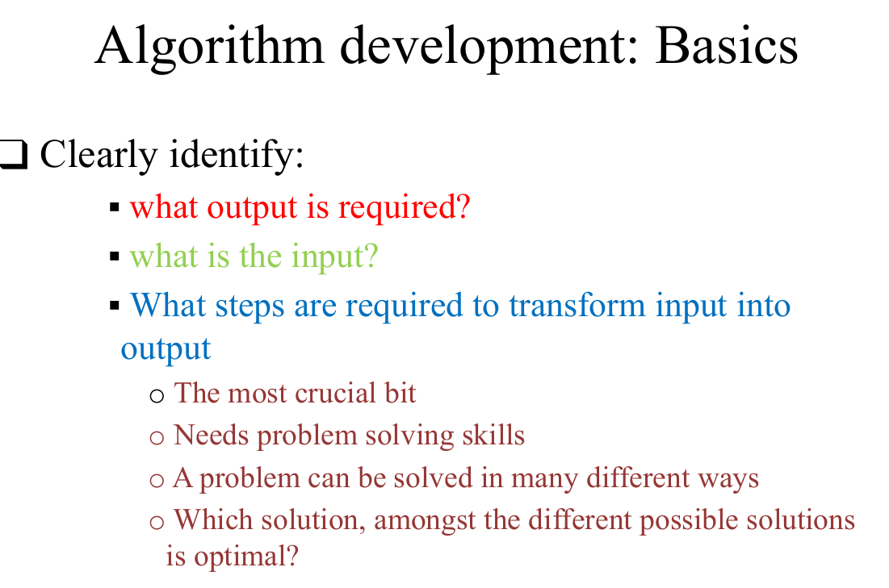

Slide 19
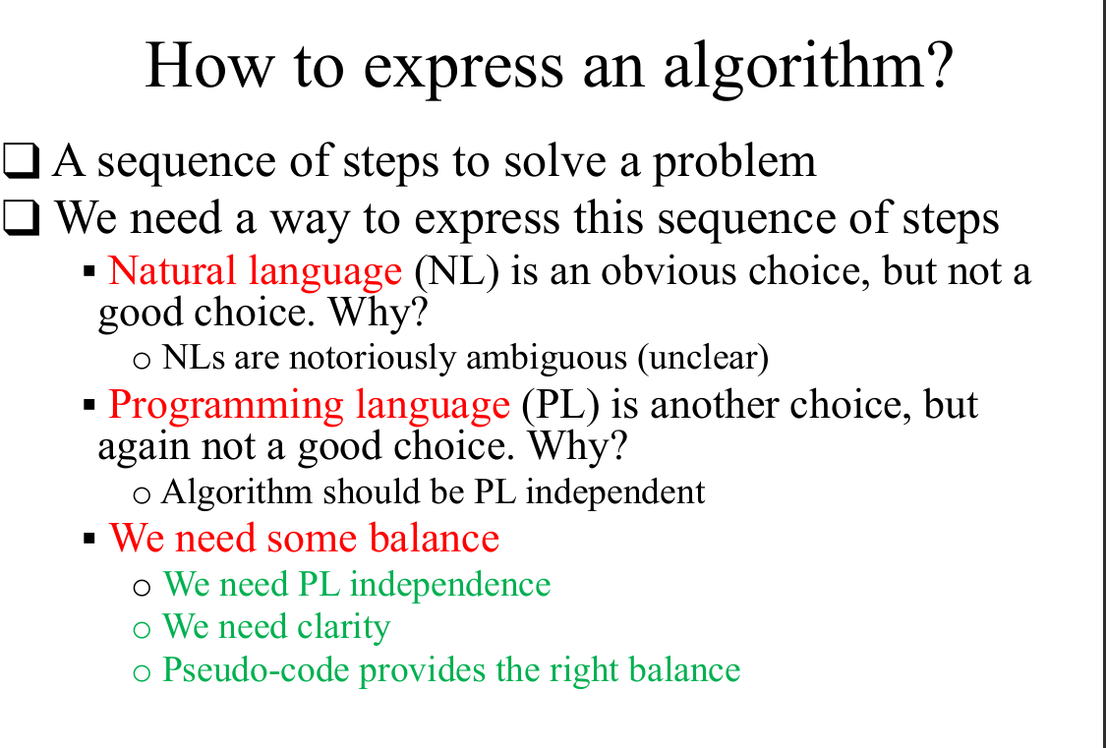

Slide 20
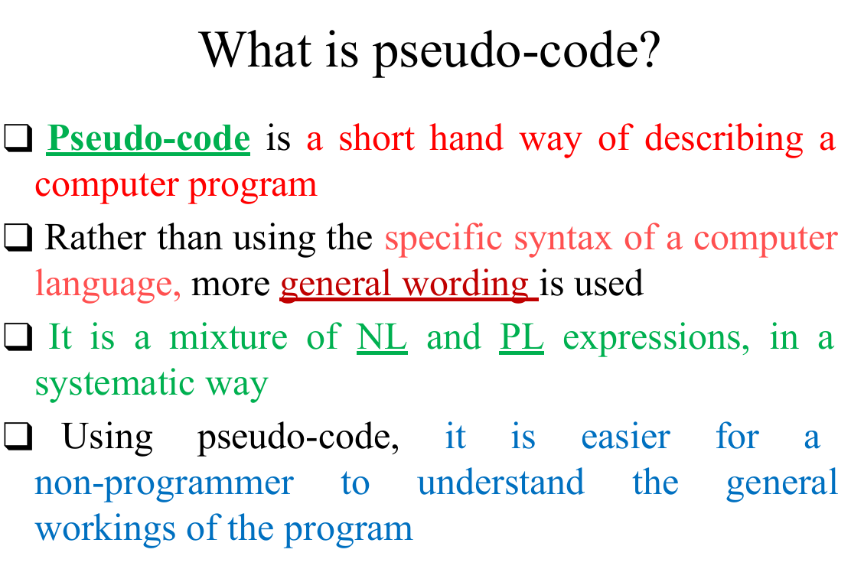

Slide 21

Sorting Algorithms
• Bubble Sort: O(n²), simple but slow.
• Merge Sort: O(n log n), stable.
• Quick Sort: O(n log n), fast but not stable.
Use Cases:
- Preparing data for search
- Efficient display
- Analytics and processing

Slide 22
Searching Algorithms
Linear Search: O(n), unsorted data.
Binary Search: O(log n), sorted arrays only.
Code Example (Binary Search):
while (low <= high) {
int mid = (low + high) / 2;
if (arr[mid] == key) return mid;
...
}
Use Cases:
- Name lookups
- ID verification

Slide 23
HashMap and HashSet
• HashMap: Key-Value pairs.
• HashSet: Unique values only (internally uses HashMap).
Java:
Map<String, Integer> map = new HashMap<>();
Set<String> set = new HashSet<>();
Use Cases:
- Caching
- Fast data access
- Removing duplicates

Slide 24
Singly Linked List
• Linear data structure where elements (nodes) point to the next.
Node Example:
class Node {
int data;
Node next;
Node(int d) { data = d; next = null; }
}
Operations:
- Insert, Delete, Search
- Traversal using loops
Use Cases:
- Dynamic memory
- Undo/Redo features

Slide 25
Binary Search Tree (BST)
Tree where left < root < right.
Node:
class Node {
int key;
Node left, right;
}
Operations:
- Insertion, Search, Deletion
- Inorder Traversal = Sorted Order
Use Cases:
- Indexing in databases
- Auto-complete

Slide 26

Graphs in Java
• Set of vertices connected by edges.
• Directed/Undirected, Weighted/Unweighted.
Representations:
- Adjacency Matrix
- Adjacency List
Use Cases:
- Navigation systems
- Social networks
- Recommendations

Slide 27

Conclusion
• Mastering DSA improves coding, logic, and design.
• Helps in interviews, system development, and optimization.
Recommended Practice Platforms:
- LeetCode
- HackerRank
- GeeksforGeeks
Keep coding, keep learning!

