Slide 1
Application Insights in Modern Apps
Matteo Emili
Microsoft MVP – Visual Studio ALM
matteo.emili@live.com
http://mattvsts.blogspot.com || http://twitter.com/MattVSTS

Slide 2
Who am I?
Systems Engineering Advisor @ Dell Software
MVP for Visual Studio ALM
MCTS on Team Foundation Server
Professional Scrum Master 1
Community enthusiast!
London ALM User Group || Taunton Developers Meetup

Slide 3
Modern Business Demands for Applications
Reach any device, platform or customer wherever they are
Deliver top performance at scale, with high reliability and efficiency
Extend to cloud for development, test, production and operations
Value delivery

Slide 4
A practical example, from a user’s PoV
Ecommerce, with companion application. It would fail – regardless of the true value delivery – if…
…the app is not multi-device I would get complaints from a part of my userbase (“why platform X and Y can have this app while Z cannot?”)
…it exposes issues (“something doesn’t work”, “the app is not loading on my low-end device”, “it’s slow! (even if it’s a temporary, transient backend issue)”) it would get low reviews on the respective stores, so users won’t be excited to use your application or won’t try it at all, causing a business loss in the longer term
…it lacks features (“CompetitorA saves the invoices in my Dropbox account, while instead you don’t!”) there would be a competitor who won’t, plus point 2
Users are essentially spoiled by today’s technology

Slide 5
Continuous Improvement
REQUIREMENTS
BACKLOG
Plan
Monitor and Learn
Build
Operate
RELEASE
Develop
Release
WORKING SOFTWARE

Slide 6
Know before your customers know…

Slide 7







The Visual Studio ALM Family
Build Service | Load Testing Service | Continuous Deployment to Azure | Application Insights | Code Editing
Lab Management | Release Management | Load Testing | SharePoint | Project Server | System Center
Source Repos
Agile Planning
Team Rooms
Test Case Management
Feedback Management
Build and Continuous Integration
Team Foundation Server
Visual Studio Online

Slide 8
Visual Studio Online Application Insights
Lightweight monitoring technology, part of Visual Studio Online
Cloud-based, but it can be used against on-premise applications with an agent
Technology agnostic
Provides several degrees of information, depending on the context
Health
Availability
Usage
Development information

Slide 9
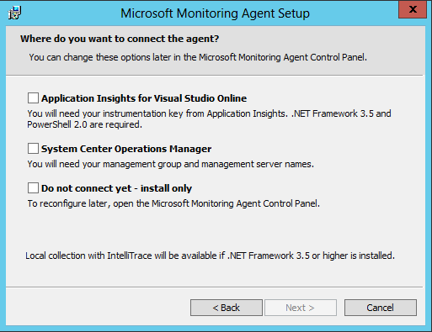
Microsoft Monitoring Agent
The new MMA combines the System Center Operations Manager agent and the standalone IntelliTrace Collector
It is the cornerstone of the monitoring dashboard, and it provides actionable information like the IntelliTrace files
You can target the same application with both SCOM and AI
Real-time collection, deferred composition
Usually 5-15m delay

Slide 10
Monitor everything, everywhere
Application Insights is a standalone component
No specific need for VSO, TFS, or Microsoft technologies
It currently supports a variety of technologies
ASP.NET
Azure – Web Sites and Cloud Services
Windows Phone and Windows Store Applications
Windows Services
Java Web Applications hosted on JBoss and Tomcat, running on Windows and Linux

Slide 11
How?
There are several choices of techniques, but the most prominent separation is between an obtrusive one and an unobtrusive one
The obtrusive monitoring implies you must inject some custom code into your application
The unobtrusive monitoring is a technique based on using existing tools to create a consistent data model from the monitored application

Slide 12
Monitoring techniques
Availability
Usage
Diagnostics
Health

Slide 13
The right tool for the right job…
The MMA itself provides unobtrusive monitoring for on-premise applications
Monitoring can be unobtrusive and agentless, if running on Azure
Javascript code can be integrated into applications for specific information
Telemetry SDKs available on NuGet
Windows Services
Windows Store
Windows Phone

Slide 14
Synthetic Monitors
They are built on the same technology of the Visual Studio Web Tests
You can build your own availability pattern
Core solution for availability monitoring
I can use a OOB Synthetic Monitor if the pattern I am monitoring is simple enough

Slide 15
DEMO
Unobtrusive monitoring techniques

Slide 16
Monitoring techniques
Availability
Usage
Diagnostics
Health

Slide 17
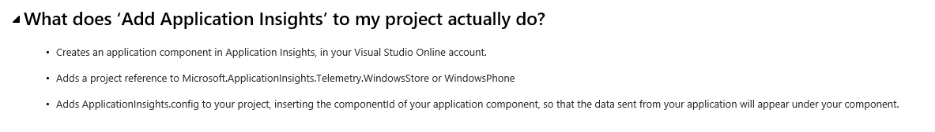
Usage and diagnostics
Obtrusive monitoring techniques which adds probes via a script
Transparent to you, thanks to the Application Insights wizard
Alternatively, you can just add some snippets
They are provided in the Application Insights portal

Slide 18
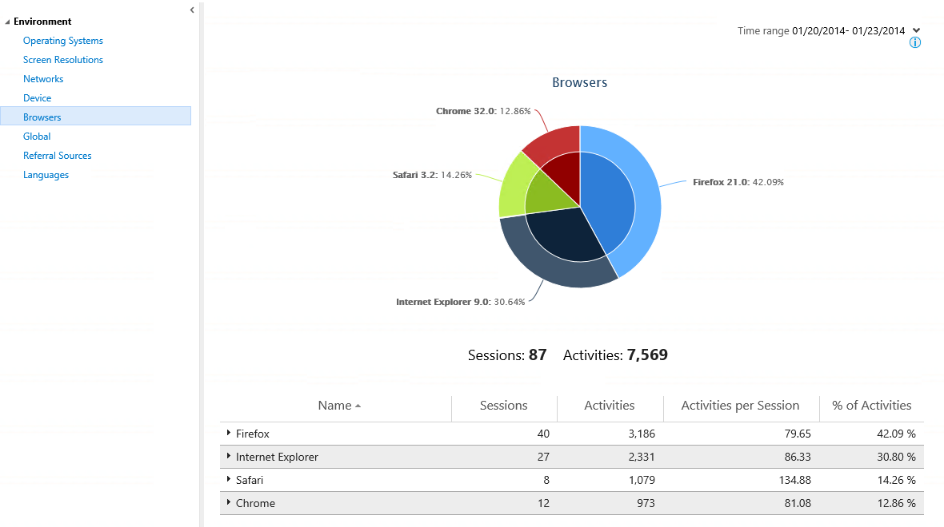
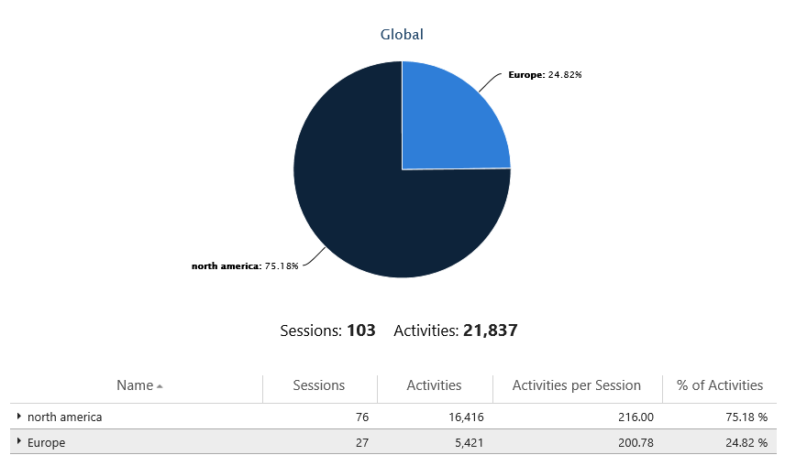
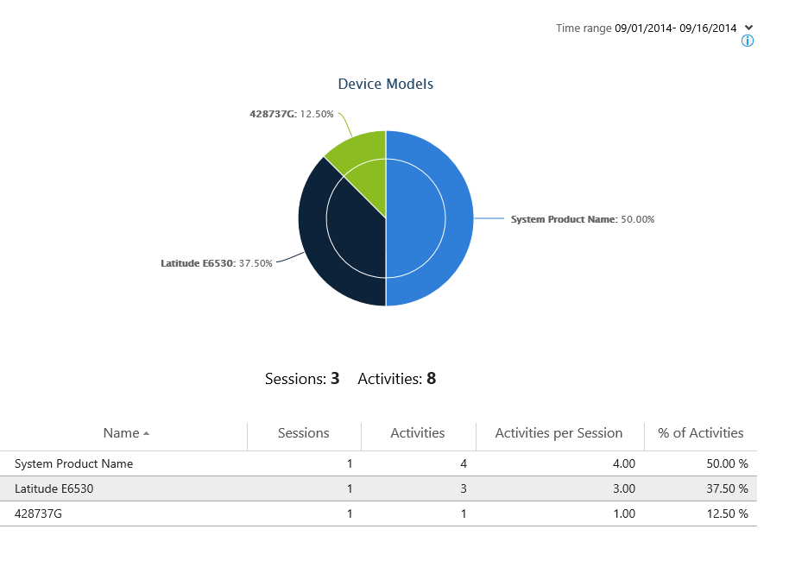
Why is it so invaluable?

Slide 19
DEMO
What data can you gather?

Slide 20
Windows Store and Windows Phone
Since a few updates Windows Store and Windows Phone applications are supported by Application Insights
Same monitoring techniques as the Web Application
Except for the availability, which on a Windows Phone/Store App is not needed
NuGet packages and code snippets are available for easy implementation

Slide 21
Developer Dashboard
Real-time dashboard presenting all the application’s events
AnyCPU is not supported – please select an architecture ☺
It requires your advertising ID for identifying the machine
Great aid in inspecting behaviours and bottlenecks while debugging
It it the only real-time component of Application Insights
Low bandwidth task

Slide 22
DEMO
Developer Dashboard for Windows Store Apps

Slide 23
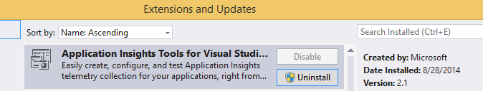
The future…
With Visual Studio 2013 Update 3 you get by default Application Insights 2.1
It’s not just a version change: Application Insights is being rewritten in order to be part of Microsoft Azure
It adds support for Windows Phone
If you want to revert to the old 1.x, you can uninstall the 2.1 package and reinstall the previous package…
…but you cannot revert from the 1.x to the 2.1 without a full Visual Studio repair

Slide 24
DEMO
Application Insights 2.0

Slide 25


Slide 26
Thanks!

