Slide 1
Building a better User experience
FOR WINDOWS PHONE USERS

Slide 2
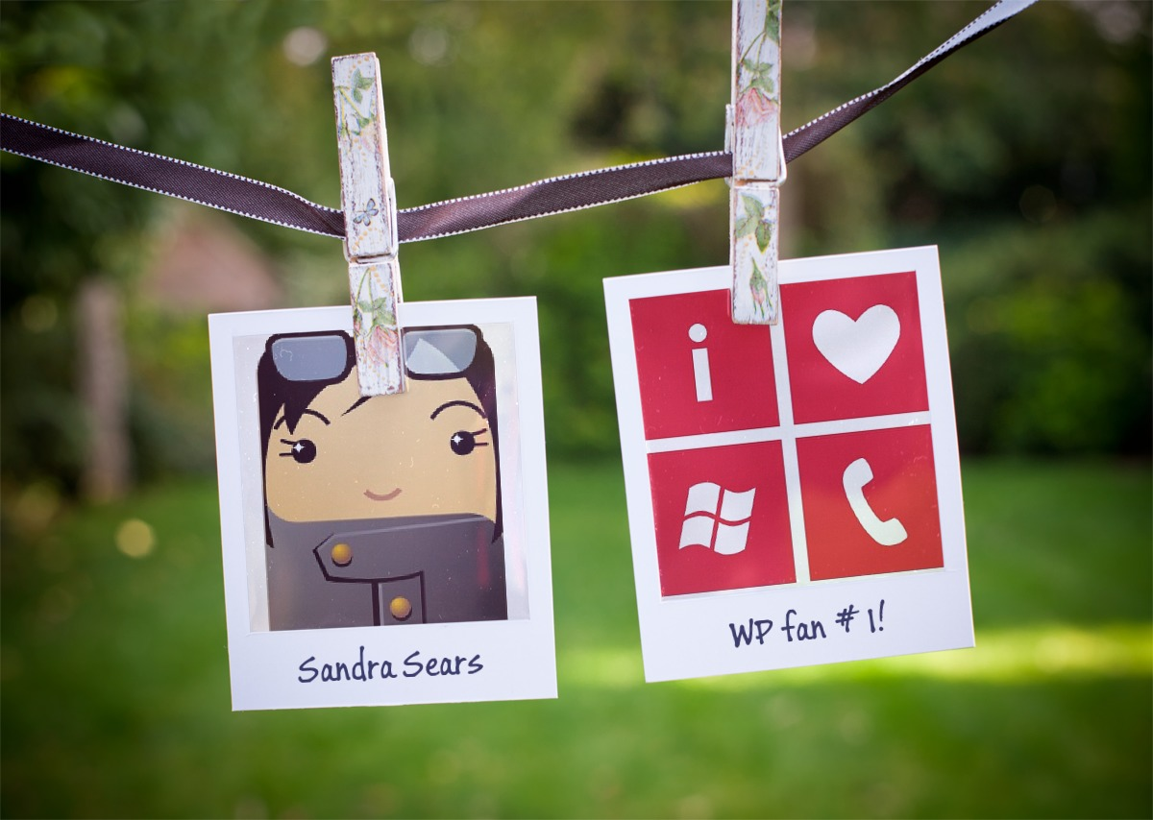
…a little bit about me

Slide 3
Why I think WP is awesome
Personally
Professionally
As a busy mom:
Great for planning my day to day life
Love all the customization features
Lots of apps for my two kids
As a UX Professional:
Thrilled about Metro Design Principles
Great developer community
Enjoy being part of a community and platform with such great potential

Slide 4
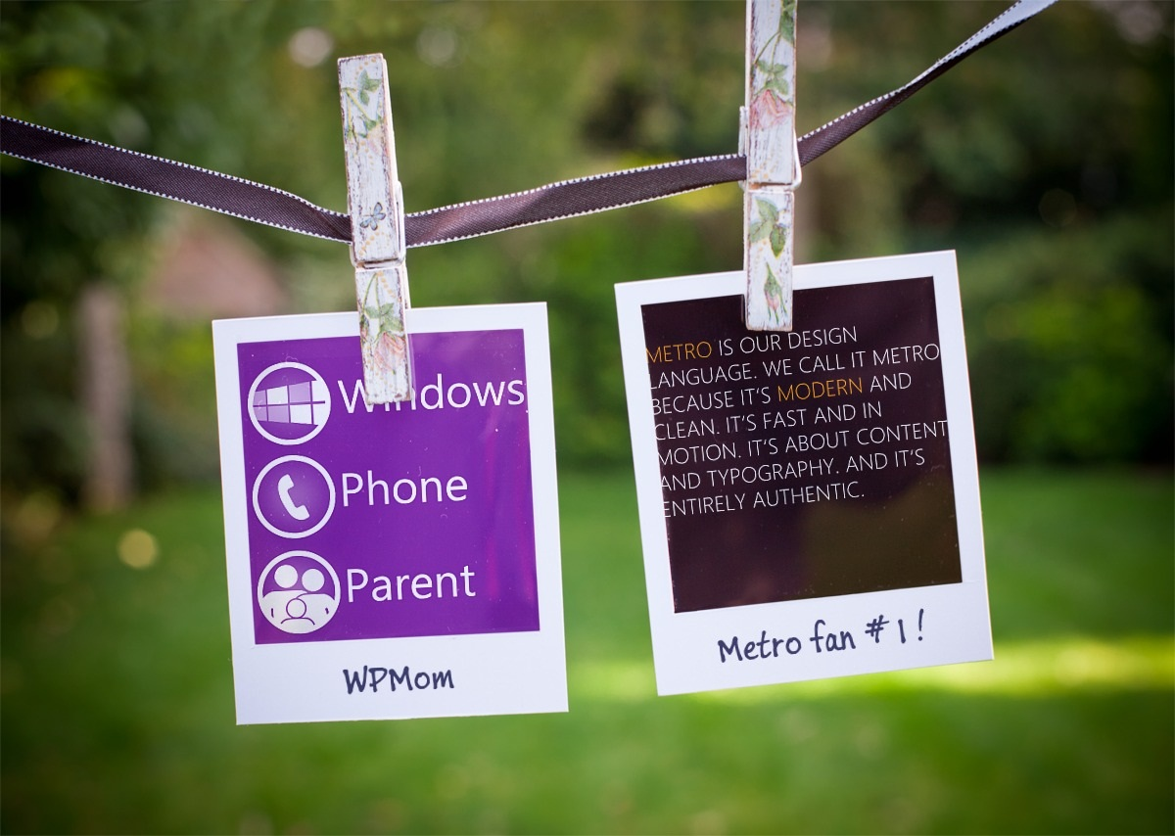
…a little bit about me & WP ecosystem

Slide 5
My contribution to the WP ecosystem
I’m a WP app reviewer
I’m a Metro Design advocate
I’m committed to find the best WP apps for kids and parents
I keep a WP presence in cross-platform app forums
I work closely with developers on ways to improve their family-friendly apps
I provide clear guidelines as to how we rate WP apps
I set up individual sessions with devs to help them improve their apps’ user experience
I give talks… like today!

Slide 6
4 things to think about
When creating a Windows Phone app

Slide 7
4 Things to think about
Look & Feel
Ease of Use
Does as it promises
Specialize

Slide 8
Look & feel
Metro Design Guidelines and more

Slide 9
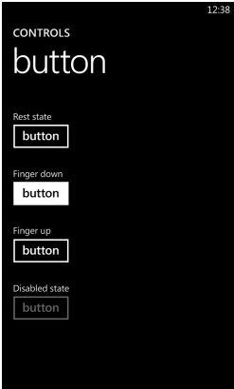
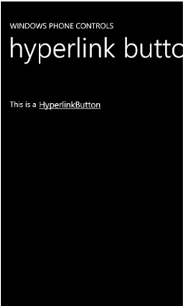
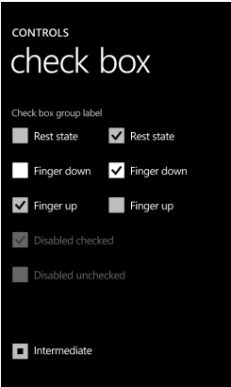
Look & Feel
Metro Design Static Elements
Control Design Guidelines for Windows Phone
http://msdn.microsoft.com/en-us/library/hh202879(v=vs.92).aspx

Slide 10
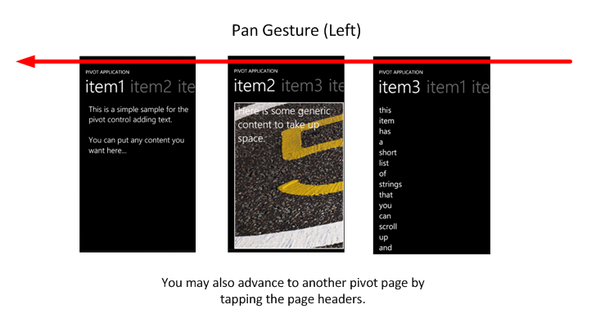
Look & Feel
Metro Design Dynamic Elements
Pivot control
Provides a quick way to manage the navigation of views within an application.
It should be used only to display items or data of similar type

Slide 11
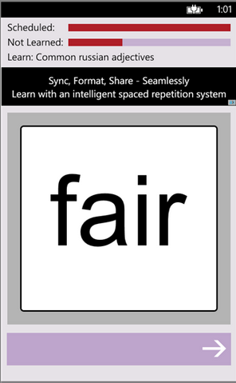
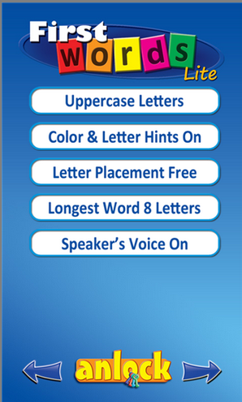
Look & Feel
Pivot Control missed opportunities

Slide 12
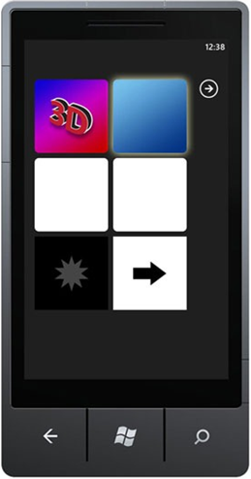
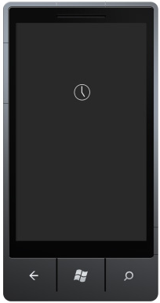
Look & Feel
Every dev needs to think of these WP design elements
Essential Graphics, Visual Indicators, and Notifications for Windows Phone
http://msdn.microsoft.com/en-us/library/hh202879(v=vs.92).aspx

Slide 13
Look & Feel
A few thoughts on app’s visual design
Do not work in isolation. Find a designer to bounce ideas off of.
Take a look at other applications.
Windows Phone’s platform is growing. Many iOS and Android app developers are crossing over:
Many of their apps have been designed with the help of visual designers
Corporate apps are a good example

Slide 14
Ease of Use
Thinking About The User Experience

Slide 15
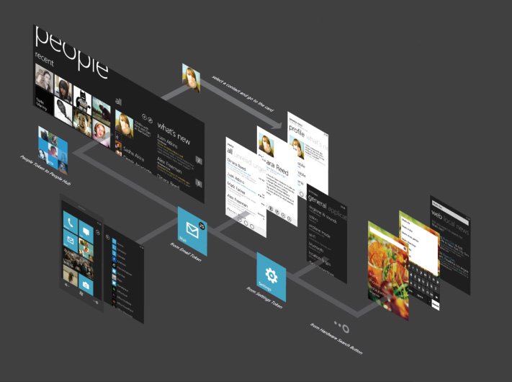
Ease of Use
Spoke and Hop Navigation System
The system tracks each page that a user has visited and places it in what is called the “back stack”. When a user pushes the Back button, the last saved page in the back stack is served.*

Slide 16
Ease of Use
Follow platform conventions
Familiarize yourself with the guidelines
Navigation, Orientation, and Gestures for Windows Phone http://msdn.microsoft.com/en-us/library/hh202911(v=vs.92).aspx
Interactions and Usability with Windows Phone
http://msdn.microsoft.com/en-us/library/hh202889(v=vs.92).aspx
Helps the user have a consistent experience from one action to another (from one app to another app)
Do not underestimate the user’s ability to understand the platform’s paradigms
For example, the use of a “Home” button in a WP app is unnecessary since users understand that “back” will get them there.
Remember the spoke and hop navigations system?

Slide 17
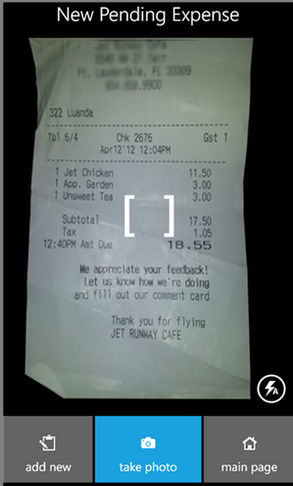
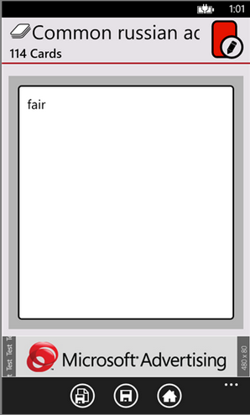
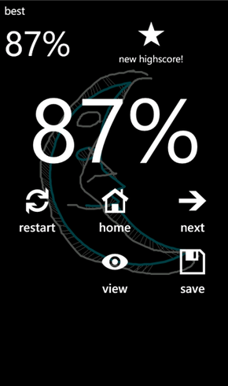

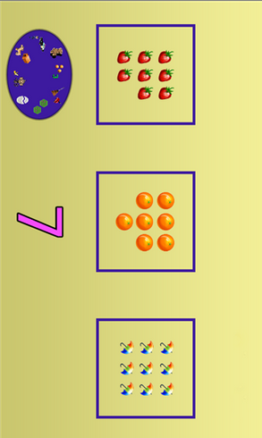
What convention is not being followed on all of these five apps?

Slide 18
Ease of Use
Home Buttons and the Back Stack*
Placing a Home button in your user interface deviates from the Windows Phone navigation model.
It changes the expected interaction model of the platform and it can confuse users.
The user can get stuck in an infinite (or near infinite) loop when using both your Home button and the hardware Back button to navigate.`
*from msdn.microsoft.com

Slide 19
Ease of Use
Test your apps for usability
Usability testing opportunities are all around us!
So what is usability testing anyway? Usability testing generally involves setting a series of tasks for people to complete and noting any problems they encounter – It’s as simple as that!*
*http://www.slideshare.net/andybudd/guerilla-usability-testing

Slide 20
Does as it promised
It’s a trust thing!

Slide 21
Does as promised
It’s a trust thing!
When a user downloads your app, the user is trusting your app to do what the descriptions says.
Users should read descriptions carefully and not expect miracles
About your app’s description:
Do not rush it!
Add contact info
Make a sales pitch in the first paragraph

Slide 22
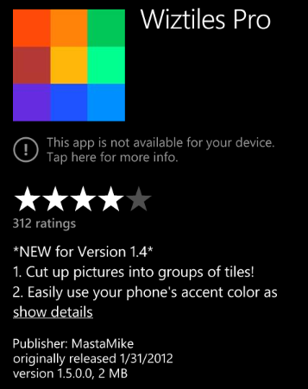
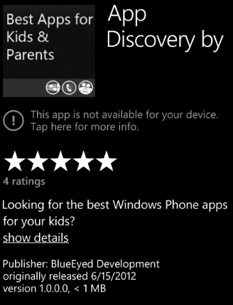
Does as promised
Example of a bad intro
Example of a good intro

Slide 23
Specialize
Make sure your app does one thing well and is the best of its kind

Slide 24
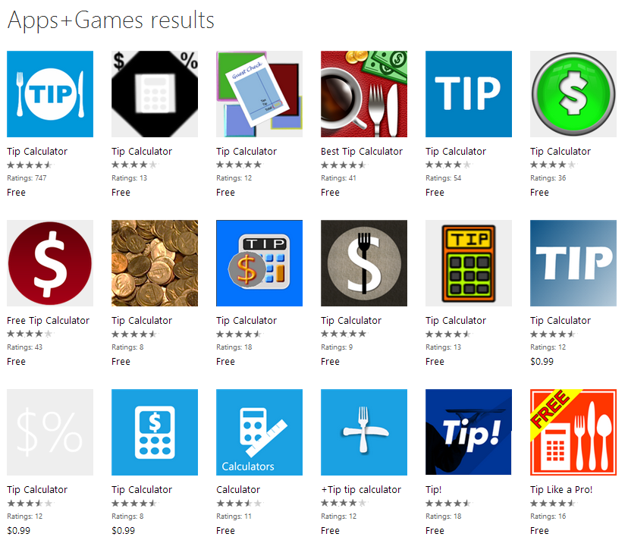
Specialize
Every app specializes in something
In many cases there are hundreds of the same type of app available in the Windows Phone App Store:

Slide 25
Specialize
Download as many similar apps as possible
Make a list of unique features
Think about how is your app going to be unique among the others
Highlight in the description how your app is different from the rest.
Try to test it with common users of your app
i.e an immunization records app should be tested by a mother of small children
Do some research on how other markets would use your app
i.e we say “six thirty” in American English but in European English we say “Half past six” or “Half six”

Slide 26
Any questions?

Slide 27
Windows Phone Parent Dev Services
Visit us at: http://dev.windowsphoneparent.com
View our review guidelines
Add your family-friendly app to our catalog
Request an app review
Promote your app in Spanish-speaking markets via our Spanish sister site FamiliaWindowsPhone.com (currently 17 Spanish-speaking markets)
Future Service:
Localization services
Beta testing
Usability testing

Slide 28
Keep in touch…
Windows Phone Parent
Professional Networks
WindowsPhoneParent.com
@WPParent
Facebook.com/WindowsPhoneParent
info@windowsphoneparent.com
Download our app at:
http://bit.ly/WPPApp
MetroWise.info
@metrowiseux
LinkedIn.com/in/sandracsears
sandracsears@gmail.com

