Slide 1
United States Election Prediction and Analysis
Amit Makashir
Chaitanya Patil
Mahesh Latnekar

Slide 2
Abstract
United States has two Houses of Congress – Senate and The House of Representatives
The Senate has the powers to approve/disapprove of the President’s appointments.
The House has financial powers like passing the Federal Budget.
Both the houses are responsible for Legislature i.e. making and amending laws.
The House and one third of the Senate are elected ever two years.
The candidates for both the Houses start campaigning well in advance of the election year. Large sums of money are spent on campaigns, advertisements, polling etc.
The candidates usually receive funding from their Individual Supporters, their respective Political Parties and other Committees like the various PACs, Labor Unions and Lobbyists.

Slide 3
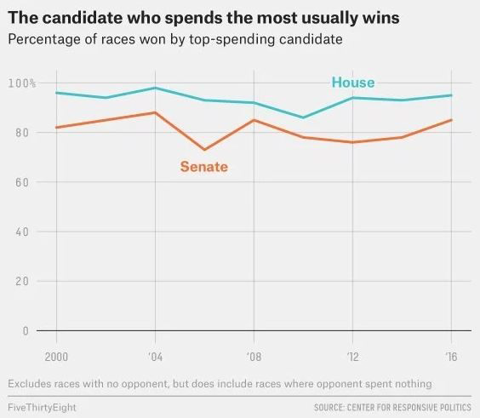
The candidates don’t receive funding from the government and are dependent only on campaign contributions for their campaign.
We predict and analyze how Campaign Finance affects the election results to both the Houses of Congress.

Slide 4
Introduction
In our project we model the importance of money in United States elections to the Senate and the House of Representatives.
Important Financial features: Total Disbursements, Total Receipts, Individual Contributions, Committee Contributions and Political Party Contributions to Individual Candidates.
Other features considered: Candidates State, District, Incumbent/Challenger/Open status, Party Affiliation and In-State/Out-of-State.
Election data for years: 2008 to 2016.
We intend to explore this data and generate features that will predict winners for 2018 elections.
We have used data of House elections from 1998 to calculate the accuracy of our model, which in turn will reflect how the influence of money has changed in the United States over the last two decades.

Slide 5
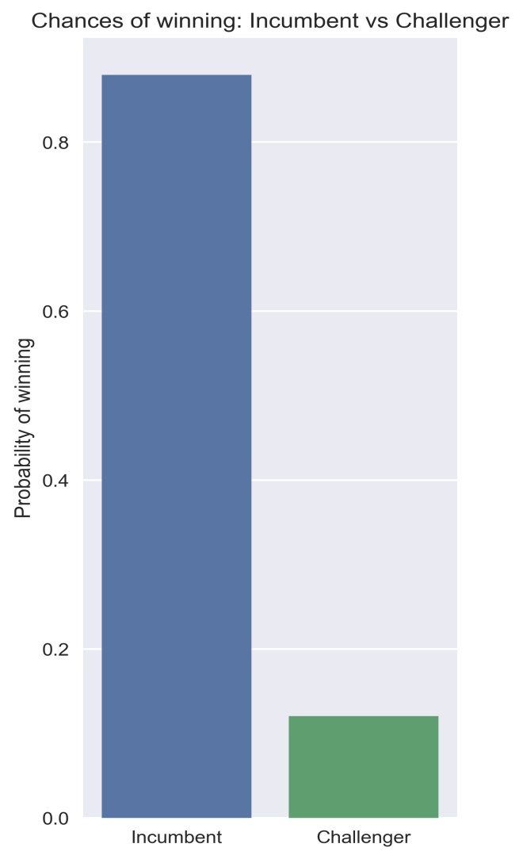
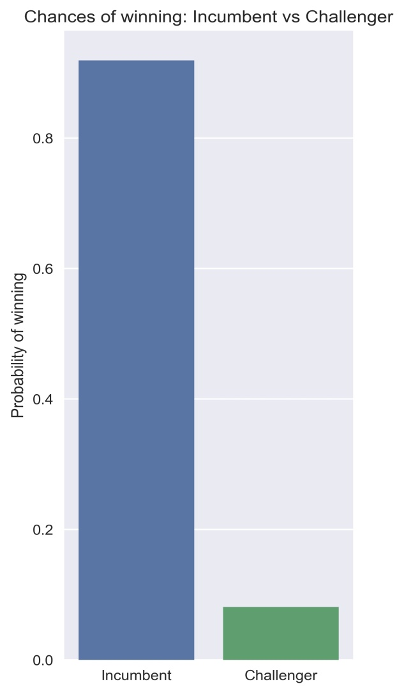
Incumbents vs. Challengers
Senate
House

Slide 6
The purpose of a campaign is to spread awareness among voters about the candidates, their policies and ideology.
An incumbent has higher chance of winning an election than the challenger.
This is because the voters already know who their sitting representative is, what his/her policies are and what his/her ideological inclinations are.

Slide 7
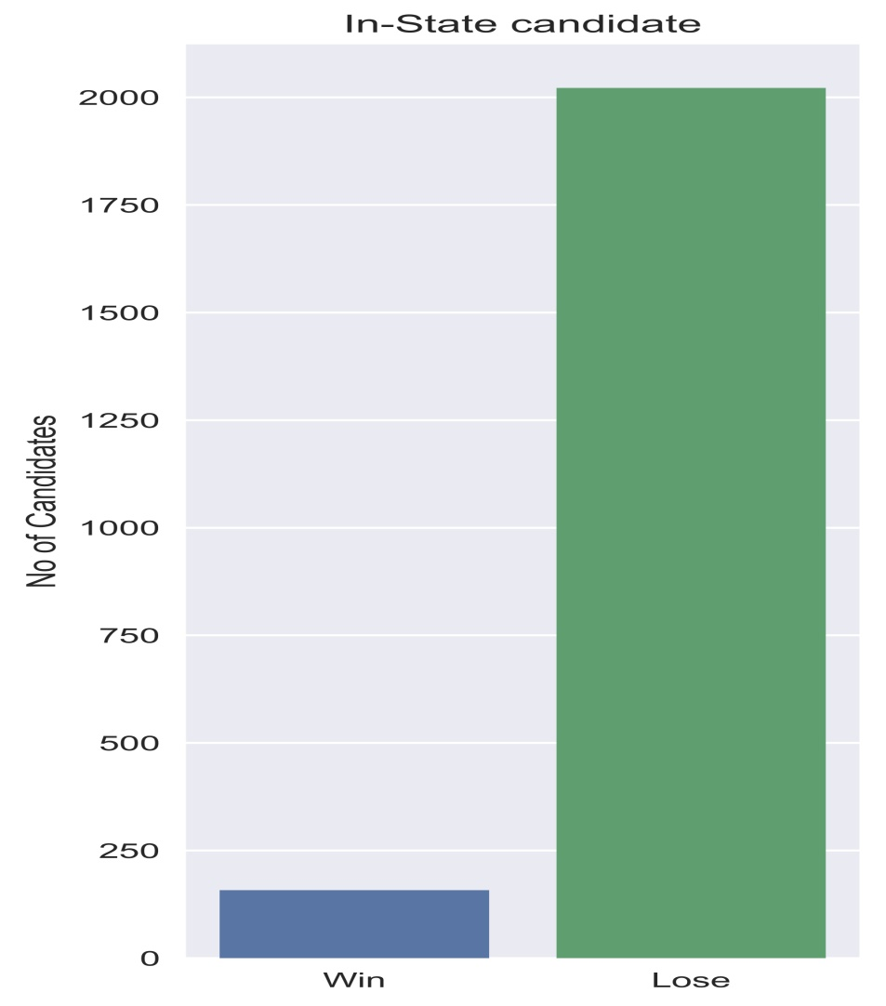
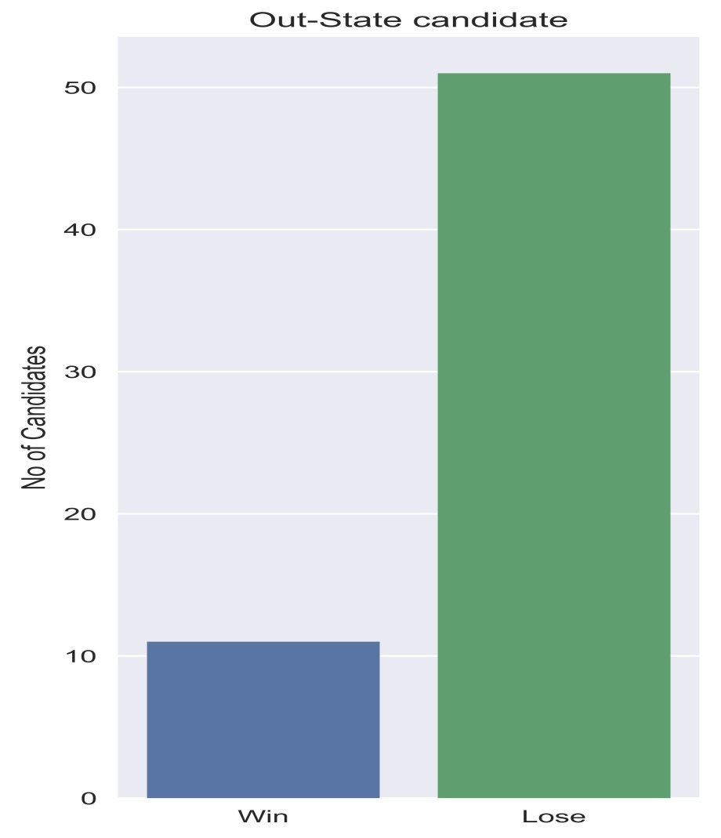
In-State vs. Out-State Candidates

Slide 8
The chances that a candidate who doesn’t reside in the State he/she is contesting from is, will win is higher than In-State candidates.
This is because of the biased nature of the data, as the number of In-State candidates is a lot higher than Out-State candidates.
Another reason might be that the Out-State candidate is fighting from a seat which is a strong hold of his/her party.

Slide 9
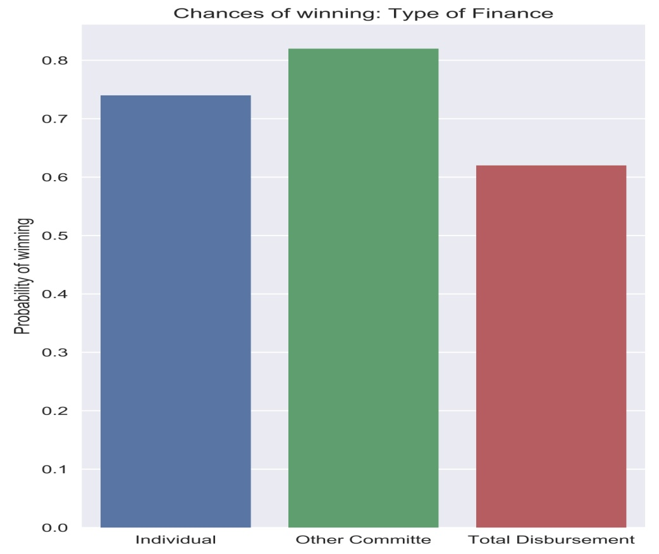
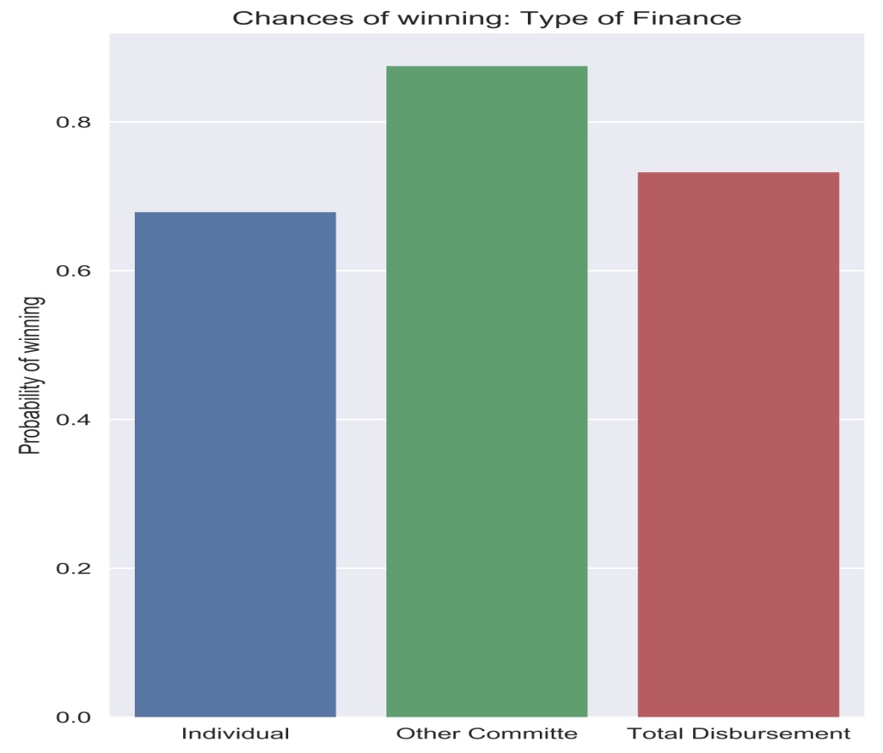
Chances of winning for the Highest Receiver and Spender
Senate
House

Slide 10
The candidate which spends the most amount of money has a 60% chance of winning the election.
If the candidate gets the highest contributions from Individual supporters of all candidates in a particular race, he has a 74% chance of winning the election. This also reflects the popularity of the candidate among voters, as the voters put their money where their vote is.
On the other hand, if the candidate gets the highest contributions from Other Committees, of all candidates in a particular race, he has a 80% chance of winning the election.

Slide 11
Size of the training data vs. Accuracy
We have collected data for house and senate elections from 2008 to 2018. To find the right size of the training data, we have calculated accuracy on different sizes of datasets. The size of the training data and the accuracy given by Random forest model built on the data is given below:
House | SimpleAcc | Precision | Recall | F1 | ROC_AUC
2016() | 0.96 | 0.84 | 0.94 | 0.87 | 0.9866
2014-2016() | 0.965 | 0.85 | 0.90 | 0.87 | 0.98706
2012-2016() | 0.964 | 0.85 | 0.885 | 0.869 | 0.988075
2010-2016() | 0.964 | 0.856 | 0.882 | 0.863 | 0.988775
2008-2016() | 0.966 | 0.874 | 0.87 | 0.866 | 0.987266
Senate | SimpleAcc | Precision | Recall | F1 | ROC_AUC
2016() | 0.977 | 0.794 | 0.818 | 0.805 | 0.987
2014-2016() | 0.966 | 0.794 | 0.818 | 0.805 | 0.988
2012-2016() | 0.971 | 0.764 | 0.787 | 0.776 | 0.985
2010-2016() | 0.962 | 0.794 | 0.818 | 0.805 | 0.985
2008-2016() | 0.971 | 0.823 | 0.848 | 0.835 | 0.985

Slide 12
There can be only one winner in any election and multiple losers and hence our data is highly skewed, with less than 25% of candidates winning.
To evaluate whether skewness has any negative effect on the accuracy of our models, we used different sampling methods like SMOTE, Undersampling (removing the losing candidates) with replacement and Oversampling (adding new winners) with replacement, to make the data even.
SMOTE (Synthetic Minority Oversampling Technique) generates new sample of the minority class instead of just duplicating the minority samples.

Slide 13
As can be seen in the below tables, there is no notable difference in the accuracy metrics between sampled and non-sampled data. This can be attributed to the fact that our data is stochastic, i.e. both train and test sets have similar proportion of wins and losses. So sampling isn’t required to get a good accuracy.
House | SimpleAcc | Precision | Recall | F1 | ROC_UAC
SMOTE | 0.95895 | 0.796 | 0.94 | 0.863 | 0.98634
Undersampling | 0.95895 | 0.77902 | 0.9696 | 0.8639 | 0.9878
Oversampling | 0.95895 | 0.77 | 0.97 | 0.86 | 0.98721
No Sampling
Senate | SimpleAcc | Precision | Recall | F1 | ROC_UAC
SMOTE | 0.973 | 0.823 | 0.848 | 0.835 | 0.984
Undersampling | 0.950 | 0.823 | 0.848 | 0.835 | 0.987
Oversampling | 0.968 | 0.794 | 0.818 | 0.805 | 0.984
No Sampling | 0.973 | 0.823 | 0.848 | 0.835 | 0.985

Slide 14
Evaluation of our Models
Evaluating the Best Classification Model:
Comparison of accuracy with different models will help evaluate the best model for given data.
We have designed experiments to evaluate the performance of different classification algorithms Logistic Regression, Random Forest, Support Vector Machines and K- Nearest Neighbors.

Slide 15
The tables below indicate that Logistic Regression is not a good model for predicting House results. Rest of the models have similar values for various accuracy metrics.
House | Logistic Regression | Random Forest | K- Nearest Neighbors
SimpleAcc | 0.90 | 0.96 | 0.96
Precision | 0.59 | 0.87 | 0.87
Recall | 0.84 | 0.87 | 0.87
F1 | 0.69 | 0.87 | 0.87
ROC_UAC | 0.98726 | 0.987266 | 0.98726
Senate | Logistic Regression | Random Forest | Support Vector Machines | K- Nearest Neighbors
SimpleAcc | 0.971 | 0.973 | 0.971 | 0.975
Precision | 0.79 | 0.82 | 0.79 | 0.79
Recall | 0.81 | 0.84 | 0.81 | 0.81
F1 | 0.80 | 0.83 | 0.80 | 0.80
ROC_UAC | 0.985 | 0.985 | 0.988 | 0.928

Slide 16
Evaluation of our Models
Evaluating our Models on 1998 House elections.
We trained our models for recent elections and tested them on recent as well as older elections and calculate their accuracy.
We can see there isn’t a big change in the accuracy metrics between the two years. We can conclude that Money, Party Affiliation and Incumbent/Challenger Status played a big role in US politics even two decades ago.
House | SimpleAcc | Precision | Recall | F1 | ROC_UAC
1998 | 0.9207 | 0.9671 | 0.79147 | 0.87053 | 0.9863
2018 | 0.966165 | 0.8741 | 0.8741 | 0.8741 | 0.98726

Slide 17
Importance of different contributions
 | Individual_coef | Other_coef | Party_coef
Houses | 0.295 | 0.6569 | -0.024
Senate | 0.375 | 0.483 | 0.010

Slide 18
Our predictions for House elections 1998
 | Candidates actual wins | Candidates predicted wins
Democratic | 234 | 235
Republican | 201 | 189

Slide 19
Summary
Most important features:
states, districts, contributions, disbursement, party affiliation
The model has correctly predicted majority winners for recently held elections i.e. Democrats have won the election.
The model accurately 210 out of 235 democrats and 162 out of 189 republicans which won.

