Slide 1
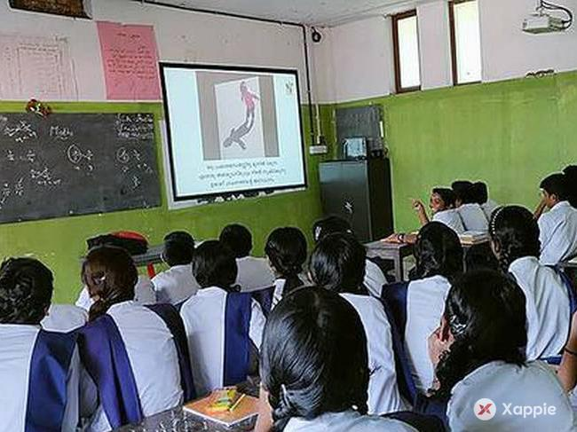

POETIC DEVICES

Slide 2
POETIC DEVICES
FIGURE OF SPEECH
What is?
Which are?
IMAGERY
What is?
Which are?

Slide 3
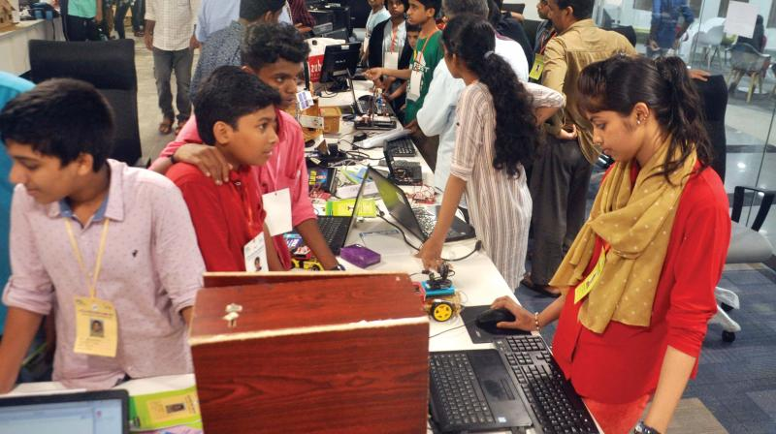
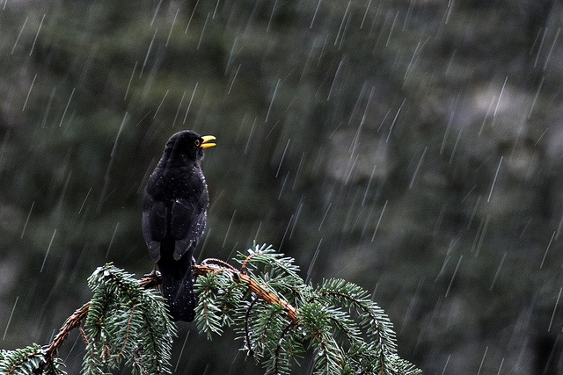
FIGURE OF SPEECH
POETIC DEVICES
CONTENT

Slide 4
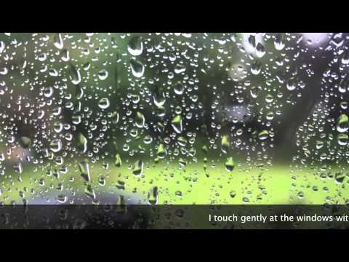
Read the lines
When I cry the hills laugh.
I cure the ailment.
Poetic devices
content
content

Slide 5
personification
A figure of speech in which an inanimate object or abstraction is endowed with human qualities or abilities.
Poetic divices
content

Slide 6
Metaphor
POETIC DEVICES
CONTENT
content

Slide 7
Read the lines?
I am dotted silver threads.
I am the sigh of sea
POETIC DEVICES
CONTENT
content

Slide 8
Metaphor
A figure of speech in which an implied comparison is made between two unlike things that actually have something in common
POETIC DEVICES
CONTENT
content

Slide 9
SIMILE
POETIC DEVICES
content
CONTENT

Slide 10
Read the lines
I am like earthly life’
She is like a lion.
POETIC DEVICES
CONTENT
content

Slide 11
Simile
A stated comparison (usually formed with ‘like’ or ‘as’) between two fundamentally dissimilar things that have certain qualities in common.
POETIC DEVICES
CONTENT
content

Slide 12
Alliteration
POETIC DEVICES
CONTENT
content

Slide 13
Read the lines
I am beautiful pearls plucked
I am a messenger of mercy
POETIC DEVICES
ഉള്ളടക്കം
CONTENT
content

Slide 14
Alliteration
The repetition of an initial consonant sound in the same line
POETIC DEVICES
CONTENT
content

Slide 15
MORE
CLICK HERE FOR IMAGERY
POETIC DEVICES
CONTENT

