Slide 1





Linux Fundamental Training

Slide 2
Introduction to Linux
What is Linux?
- Open-source operating system
- Powers servers, desktops, and mobile devices (Android)
History and Evolution
- Created by Linus Torvalds in 1991
- Community-driven development
Differences from Other OS
- Free and open-source vs proprietary (Windows/macOS)
- More stable and secure
Open Source vs Proprietary
- Open-source: Anyone can modify (Linux)
- Proprietary: Restricted modification (Windows, macOS)
Popular Linux Distributions
- RHEL (Enterprise, requires subscription)
- CentOS (Community-supported RHEL version)
- Ubuntu (User-friendly, desktop and server use)
- Debian (Stable and lightweight)

Slide 3
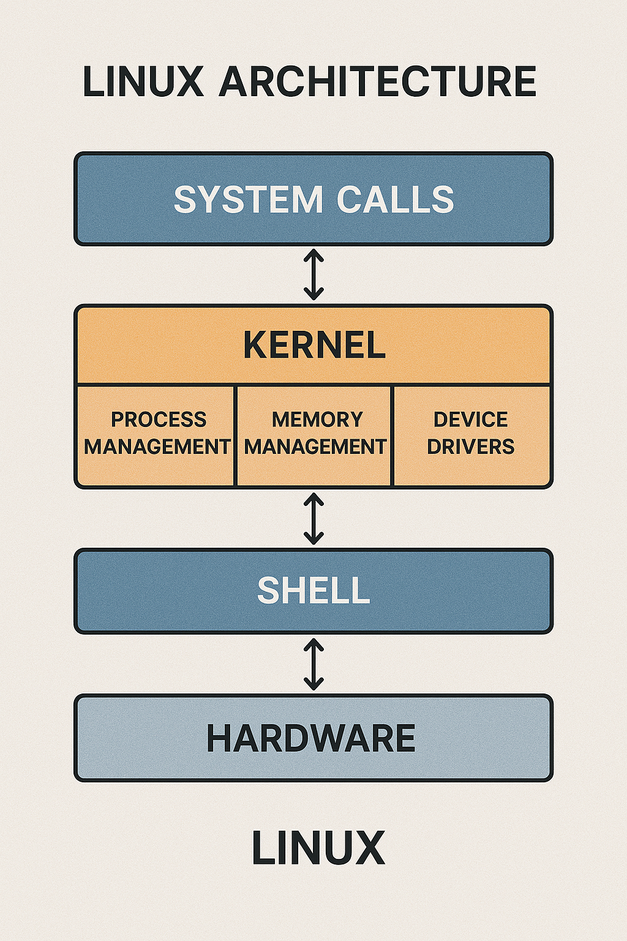
How It Works Together:
The user interacts with the Shell.
The Shell communicates with the Kernel using System Calls.
The Kernel manages hardware and resources to execute tasks.

Slide 4
Linux Architecture
Linux is a multi-layered operating system that manages hardware and software interactions. The architecture consists of the following key layers:
Hardware:
The physical components of the computer (CPU, RAM, Hard Disk, etc.).
It provides the raw resources needed for running applications.
Shell:
Acts as an interface between the user and the Kernel.
Accepts user commands (e.g., Bash, Tcsh) and sends them to the kernel for execution.
Kernel:
The core of the Linux OS that directly interacts with the hardware.
Performs key tasks:
Process Management: Controls running applications.
Memory Management: Allocates memory efficiently.
Device Drivers: Manages input/output devices like keyboards, printers, and USB drives.
System Calls:
Provides an interface for applications to request services from the kernel.
Examples: File operations, process creation, and network communication.

Slide 5
Linux Boot Process
1. BIOS/UEFI Initialization: Hardware check and hand over to bootloader.
2. Boot Loader: GRUB loads the kernel.
3. Kernel Initialization: Loads drivers and mounts root filesystem.
4. Initramfs: Temporary root file system used during boot.
5. Init/systemd: First process started by kernel.
6. Runlevels/Targets: Determine system state (multi-user, graphical).
- SysVinit vs systemd: systemd offers parallel service loading and better performance.

Slide 6

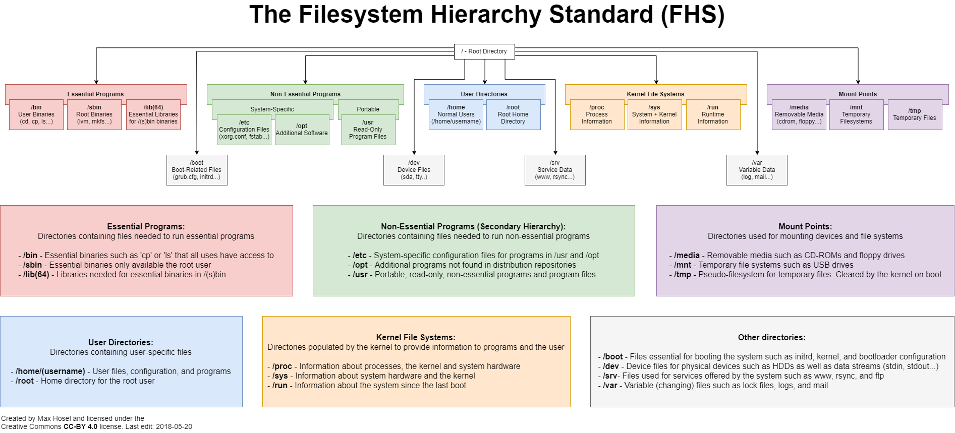

Slide 7
Basic Linux Commands
Navigating Filesystem
- ls - List files
- pwd - Show current directory
- cd - Change directory
File Operations
- cp - Copy files
- mv - Move/rename files
- rm - Remove files
- touch - Create empty files
Viewing Files
- cat - View file contents
- less/more - Read files page by page
- head/tail - Show first/last lines
File Permissions & Ownership
- ls -l - Show permissions
- chmod - Change permissions
- chown - Change file owner
- chgrp - Change group ownership

Slide 8

File Viewing & Filtering Commands
• less filename – View file content page by page (scrollable)
• more filename – View file content page by page (older tool)
• head filename – Show first 10 lines of a file
• tail filename – Show last 10 lines of a file
• grep pattern filename – Search specific patterns in a file
- grep 'error' /var/log/messages
- grep -i : Ignore case
- grep -v : Invert match
- grep -n : Show line numbers

Slide 9

File Search Utilities
• find / -name file.txt – Search by name
• locate passwd – Search using mlocate database
• which bash – Show binary path of command
• whereis ls – Locate binary, source, and man pages

Slide 10
Archiving and Compression
• tar -cvf file.tar dir/ – Create archive
• tar -xvf file.tar – Extract archive
• gzip file.txt – Compress a file
• gunzip file.txt.gz – Decompress a file
• zip file.zip file1 file2 – Create ZIP archive
• unzip file.zip – Extract ZIP archive

Slide 11
User and Group Management
Creating Users
- useradd username - Create user
- passwd username - Set user password
Managing Groups
- groupadd groupname - Create group
- usermod -aG groupname username - Add user to group
Switching Users
- su - username - Switch user
- sudo command - Run command as admin
Important Files
- /etc/passwd - User details
- /etc/shadow - Encrypted passwords
- /etc/group - Group details

Slide 12
File System & Directory Structure
Important Directories
- /etc - Configuration files
- /var - Logs & temp data
- /home - User directories
- /tmp - Temporary files
- /usr - Installed software
- /opt - Optional software
Mounting & Unmounting
- mount /dev/sdb1 /mnt - Mount disk
- umount /mnt - Unmount disk
Disk Usage & Storage Management
- df -h - Show disk space
- du -sh folder - Show folder size
- fdisk -l - Show partitions
- lsblk - Show block devices

Slide 13
Environment Variables - What and Why
• Environment variables are dynamic values used by the shell and applications.
• They store system-wide or user-specific configuration data.
Examples:
• $PATH – Tells the shell where to search for executable files
• $HOME – User’s home directory
• $USER – Current logged-in username
Usage:
• echo $PATH – View PATH variable
• export VAR=value – Set a new environment variable
• set – List all variables (shell-specific)
• env – Display current environment variables
Note: These variables influence system behavior, scripts, and application execution.

Slide 14
Basic Networking Commands
• ip a – Show IP addresses
• ip r – Show routing table
• ping hostname – Check connectivity
• netstat -tulnp – Show ports and connections
• ss -tuln – Faster alternative to netstat
• nmcli – Manage network settings

Slide 15
Summary
- Linux is open-source and widely used
- Architecture includes Kernel, Shell, and File System
- Mastering basic commands is key
- User and group management for security
- Understanding file system hierarchy is crucial
Free Lab Setup: https://labex.io/

