Slide 1
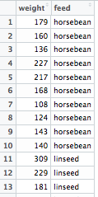
chickwts[ ROWS , COLUMNS ]
chickwts[ 6, 1]
chickwts[ 11, 2]

Slide 2
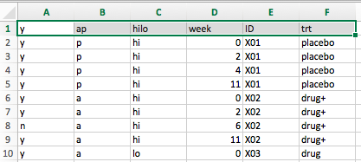
Excel (.xls / .xlsx)
Raw data file (.csv)
Import data into R
> File
> Save As…

Slide 3
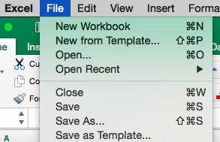
Excel (.xls / .xlsx)
Raw data file (.csv)
Import data into R
> File
> Save As…

Slide 4

Excel (.xls / .xlsx)
Raw data file (.csv)
Import data into R
> File Format
> Comma Separated Values (.csv)

Slide 5
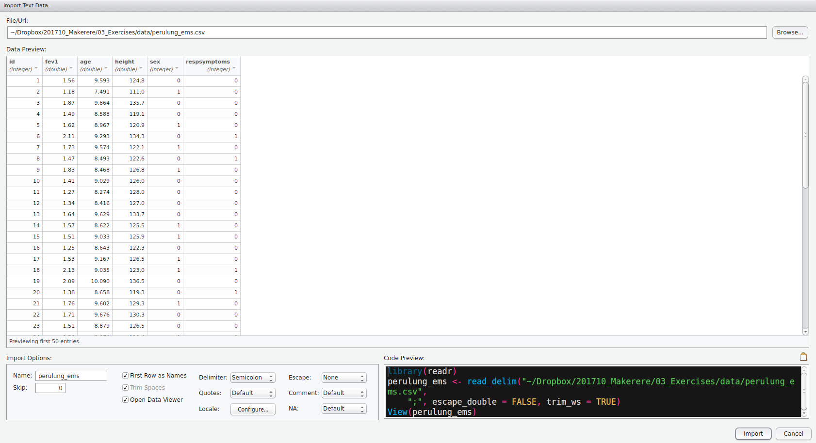
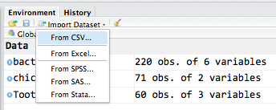
> Import Dataset
> From CSV …
> Browse
> Check “Import Options”
> Check “Data Preview”
> Copy / Paste “Code Preview”
Excel (.xls / .xlsx)
Raw data file (.csv)
Import data into R

Slide 6
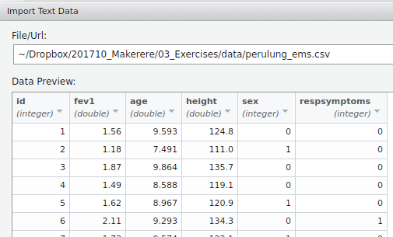
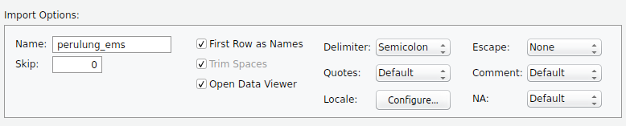
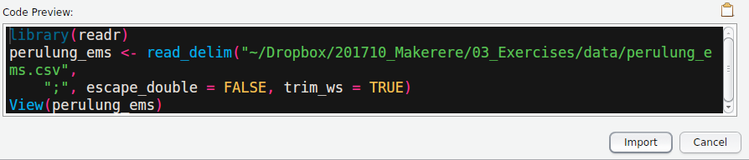
> Import Dataset
> From CSV …
> Browse
> Check “Import Options”
> Check “Data Preview”
> Copy / Paste “Code Preview”
Excel (.xls / .xlsx)
Raw data file (.csv)
Import data into R

Slide 10
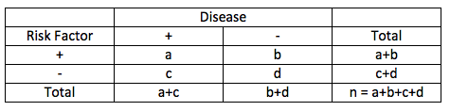


To test independence of rows and columns
Assumptions: a, b, c, d must have at least 5 observations!
Test statistic chi-square
$$χ^{2 }= Σ \frac{{(O −E)}^{2}}{E^{2}}$$

