Slide 1
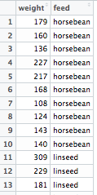
chickwts[ ROWS , COLUMNS ]
chickwts[6, 1]
chickwts[11, 2]

Slide 2
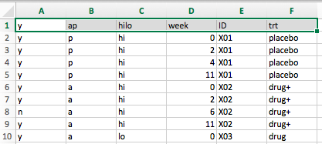
> File
> Save As…
Excel (.xls / .xlsx)
Raw data file (.csv)
Import data into R

Slide 3
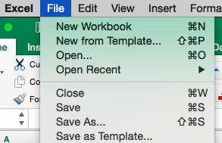
> File
> Save As…
Excel (.xls / .xlsx)
Raw data file (.csv)
Import data into R

Slide 4

> File Format
> Comma Separated Values (.csv)
Excel (.xls / .xlsx)
Raw data file (.csv)
Import data into R

Slide 5
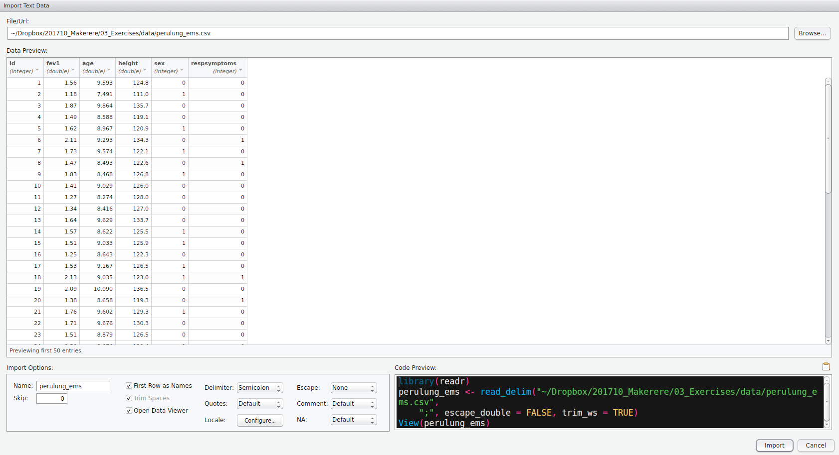
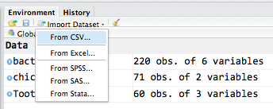
> Import Dataset
> From CSV …
> Browse
> Check “Import Options”
> Check “Data Preview”
> Copy / Paste “Code Preview”
Excel (.xls / .xlsx)
Raw data file (.csv)
Import data into R

Slide 6
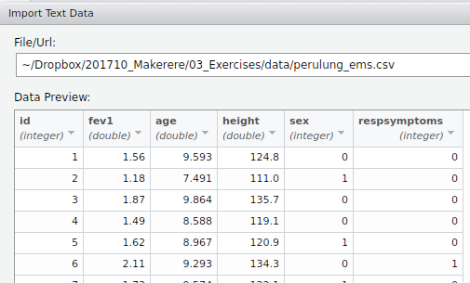
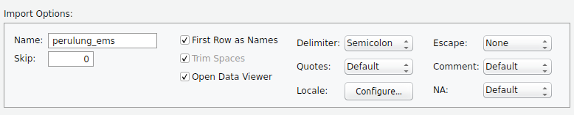
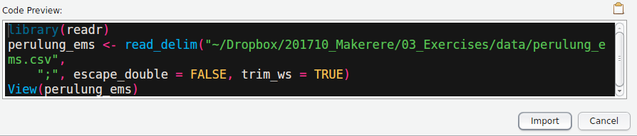
> Import Dataset
> From CSV …
> Browse
> Check “Import Options”
> Check “Data Preview”
> Copy / Paste “Code Preview”
Excel (.xls / .xlsx)
Raw data file (.csv)
Import data into R

Slide 10
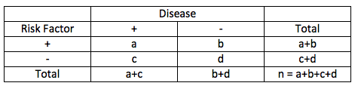

To test independence of rows and columns
Assumptions: a, b, c, d must have at least 5 observations!
Test statistic chi-square
$χ^{2}=Σ\frac{{\left(O−E\right)}^{2}}{E^{2}}$

