Slide 1

KPR INSTITUTE OF ENGINEERING AND TECHNOLOGY (AUTONOMOUS)
DEPARTMENT OF COMPUTER SCIENCE AND ENGINEERING | U21CS504 — WEB TECHNOLOGIES LAB
MINI PROJECT PRESENTATION
TASKFLOW: Priority-Driven Campus Task
Management & Posting System
Full-Stack Web Architecture Replication Using HTML5, CSS3, PHP, and Java Servlets
Benchmark Source: 'Campity' Repository | Transformed to Campus Productivity Ecosystem
PRESENTED BY:
SANJAI M S
Register No: 24CS181 | B.E. Computer Science and Engineering
CORE ARCHITECTURAL PILLARS
⚡ Dual-Stack Engine: PHP 8.x (SQLite PDO) & Java EE 4.0 (HttpServer / Servlets)
🎯 Algorithmic Dispatch: Dynamic Max-Heap Priority Queue (Urgency + Bounty + Deadline)
🛡️ 10% Collateral Escrow: Requester deposit lock + helper stake accountability protocol

Slide 2
TASKFLOW PROJECT REPORT — CHAPTERS 1 & 2
Presenter: Sanjai M S (24CS181)
Motivation, Problem Statement & Benchmark Selection
Systematic analysis of 30+ workspace web applications and transformation into a production academic utility
🚨 Campus Errand Crisis & Problem Statement
In modern university environments, students and faculty face critical, time-sensitive micro-tasks:
• Emergency lab hardware transfers & multimeter swaps
• Immediate library textbook retrieval before cutoff hours
• Peer code reviews, debugging, and academic note sharing
• Prescription medicine deliveries during illness
Current channels (WhatsApp / Telegram groups) suffer from critical failures:
1. Feed Congestion: Urgent requests are buried under general chatter.
2. Zero Commitment: No collateral, leading to frequent task abandonment.
3. Financial Risk: Unprotected transfers with no escrow guarantees.
🎯 Core Engineering Objectives
• Develop an Intelligent Priority Queue ensuring emergency errands appear first.
• Establish a Dual-Sided Escrow Protocol protecting requester funds and helper effort.
• Build dual-stack replication (PHP & Java Servlets) sharing a unified modern UI.
📊 Workspace Web Benchmark (30+ Projects Surveyed)
Three architectural tiers were surveyed across the student workspace:
• Tier 1 (Beginner): Digital-Checkpoint-System, quiet-scan, biosite. Minimal schemas, single-route Flask/HTML without algorithmic depth.
• Tier 2 (Enterprise): SDC Castle Enigma, Irrigation AI, ATM IoT. Multi-repo distributed architectures with high operational overhead.
• Tier 3 (Chosen Benchmark): Campity. Balanced mid-level architecture featuring complete relational models, priority queue scheduling, and economic mechanics.
🔄 Academic Domain Transformation
Transformed fantasy RPG jargon into a professional campus task platform:
• 'Quests / Bounties' ➔ Campus Micro-Tasks & Deliverables
• 'Adventurers' ➔ Registered Student Taskers
• 'Guild Ranks' ➔ Tasker Proficiency Tiers (Junior ➔ Lead Coordinator)
• 'Mora / Gems' ➔ Campus Task Credits (Escrow held)

Slide 3
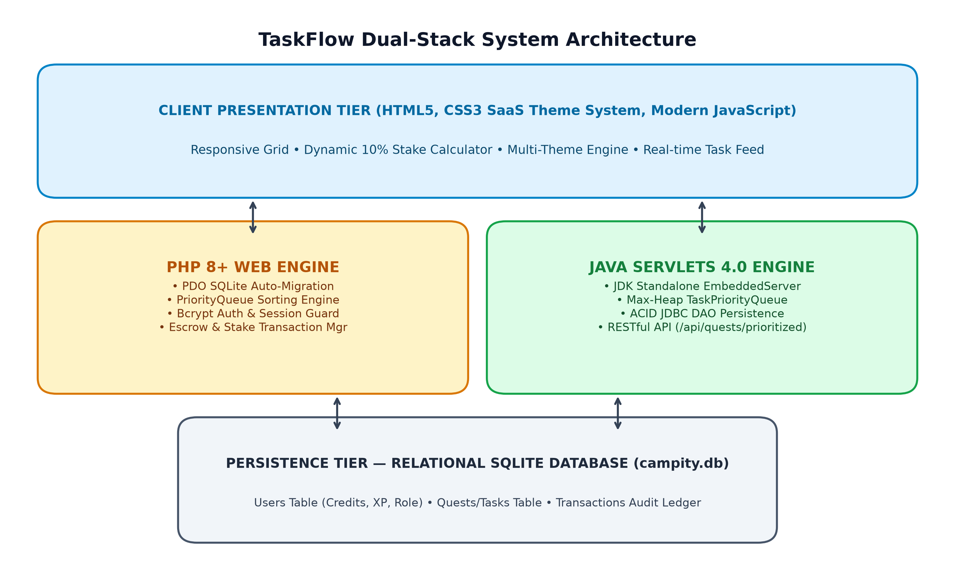
TASKFLOW PROJECT REPORT — CHAPTERS 3 & 6
Presenter: Sanjai M S (24CS181)
System Architecture & Dual-Stack Implementation
High-performance 3-tier dual-engine architecture sharing presentation assets and relational schema
🏛️ 3-Tier Dual-Engine Stack Comparison
1. Shared Presentation Tier:
• CSS3 variables theme system (Dark Modern, Clean Light, Slate, Emerald)
• Modular SaaS cards, responsive grid, dynamic stake calculation via app.js
2. PHP Application Tier (Port 8000):
• SQLite PDO persistence with auto-migration schema
• Bcrypt password hashing, session state, REST API endpoint
3. Java Servlets Application Tier (Port 8080):
• Java EE 4.0 architecture with pure JDBC Data Access Objects (DAO)
• Standalone JDK EmbeddedServer (com.campity.server.EmbeddedServer)
• In-memory java.util.PriorityQueue Max-Heap algorithm
🗄️ Relational Schema (ACID Compliant)
• USERS: id, username, email, password, credits, xp, rank, rating
• QUESTS (Tasks): id, title, description, category, reward, priority,
deadline, status (OPEN, CLAIMED, SUBMITTED, COMPLETED), created_by, assigned_to
• TRANSACTIONS: id, user_id, quest_id, amount, type, created_at
Enforces strict foreign keys and atomic balance reconciliation.

Slide 4
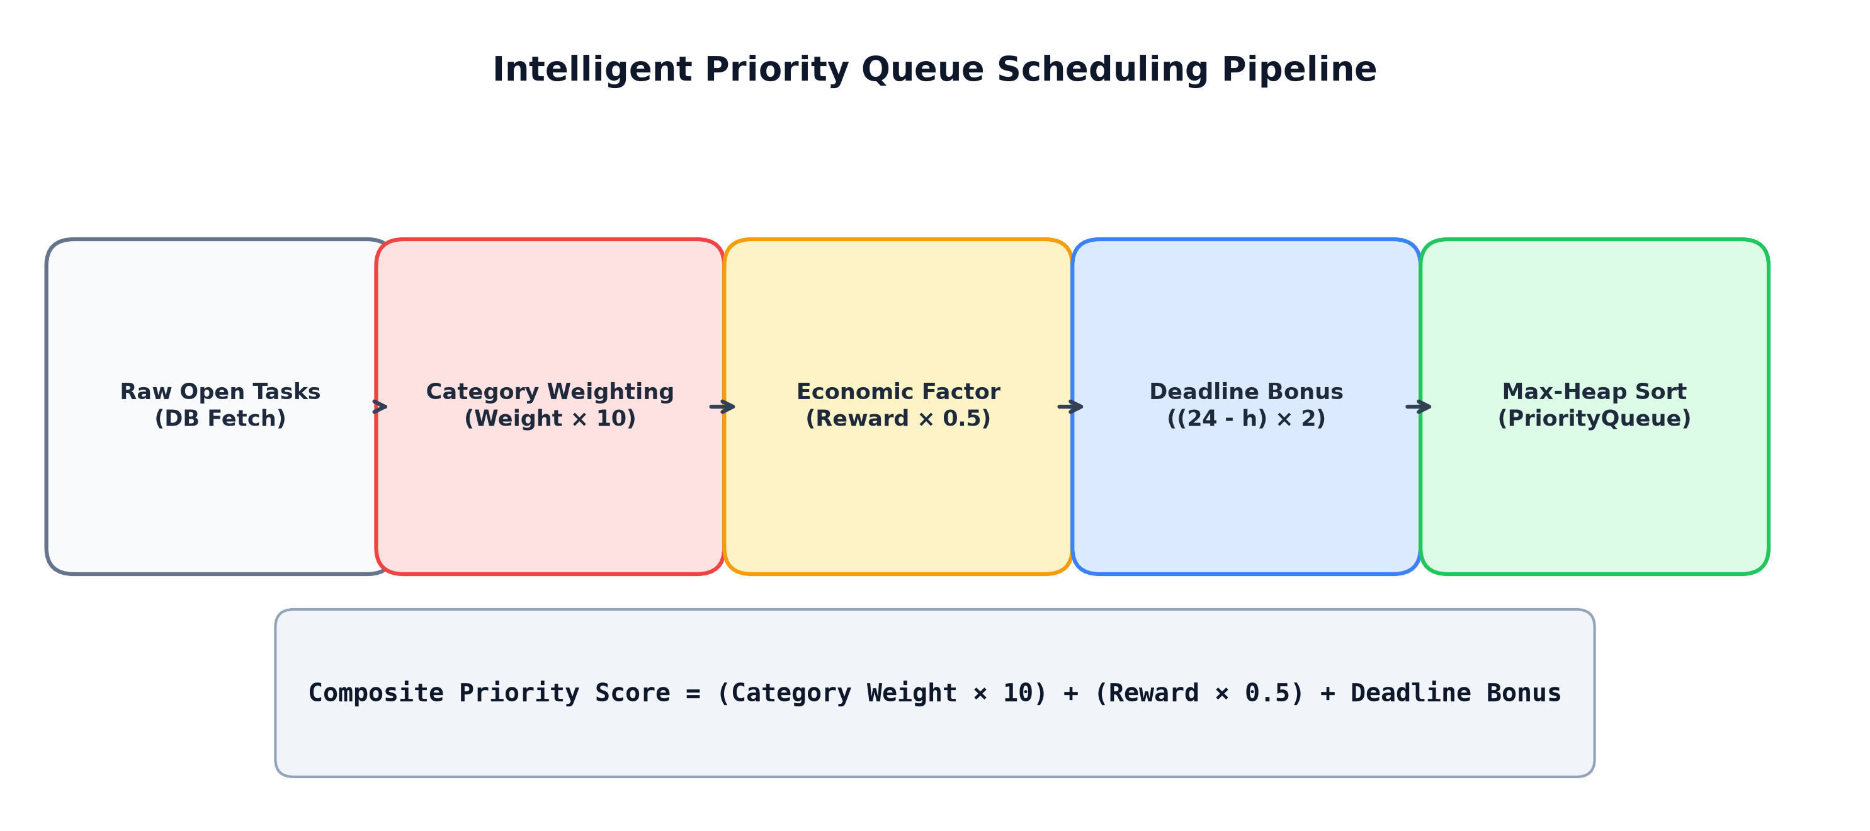
TASKFLOW PROJECT REPORT — CHAPTER 4
Presenter: Sanjai M S (24CS181)
Intelligent Priority Queue Scheduling Engine
Mathematical priority scoring model ensuring campus emergencies bypass general errand clutter
📐 Algorithmic Formulation & Scoring Model
Every posted task is dynamically scored upon insertion and dispatch:
Priority Score = (Category Weight × 10) + (Reward × 0.5) + Urgency Bonus
Where Urgency Bonus scales as deadline approaches:
• < 2 Hours remaining: +50 Points
• < 6 Hours remaining: +30 Points
• < 24 Hours remaining: +15 Points
🏷️ Category Urgency Weight Matrix
• Medical / Health: 100 pts (Emergency medications, first aid)
• Urgent / Time-Sensitive: 90 pts (Expiring lab submissions, passes)
• Tech & Hardware Support: 70 pts (Lab equipment troubleshooting)
• Academics & Notes: 60 pts (Exam prep, peer tutoring assistance)
• Campus Logistics & Delivery: 50 pts (Library book returns, parcels)
• General Assistance & Labor: 40 pts (Campus event setup, cleaning)
⚡ Algorithmic Data Structures & Complexity
• Java Servlets Engine: Binary Max-Heap via java.util.PriorityQueue
- Insertion: O(log N) | Priority Peek: O(1) | Poll: O(log N)
• PHP Engine: In-memory dynamic quick-sort comparator
- O(N log N) sorting for dashboard priority feeds
• REST API Endpoint: /api/quests/prioritized delivers pre-sorted JSON directly to client dashboards.

Slide 5
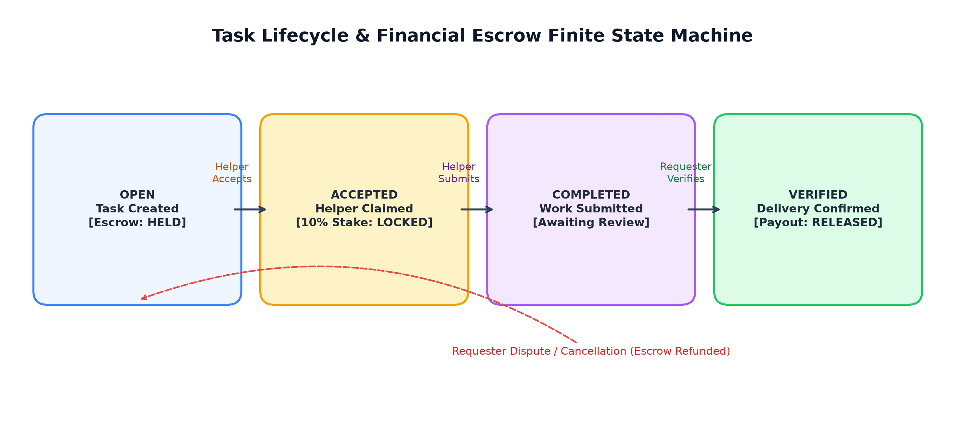
TASKFLOW PROJECT REPORT — CHAPTER 5
Presenter: Sanjai M S (24CS181)
Core Business Logic & Financial Escrow Protocol
Two-sided economic collateral protocol and multi-state task verification machine
🛡️ Two-Phase Escrow & Stake Protection
• Solvency Guarantee: Requester deposits reward upfront upon task creation. Avoids student non-payment disputes.
• 10% Helper Accountability Stake: To claim an errand, the helper locks a 10% collateral stake. Eradicates task hoarding and frivolous acceptance.
• Verified Settlement: Only when requester confirms delivery does escrow release to helper alongside their 10% stake refund.
🏆 Reputation & Tier Progression
Completed tasks award +25 XP and peer star ratings (1-5):
• Junior Tasker: 0 – 99 XP (Basic campus errands)
• Associate Tasker: 100 – 299 XP (Higher reward limits)
• Senior Tasker: 300 – 699 XP (Hardware & lab access)
• Lead Coordinator: 700+ XP (Department-wide delegation)
All transactions are logged to an immutable ledger.
🔄 Lifecycle State Machine
1. OPEN: Posted with full bounty locked in escrow.
2. CLAIMED: Assigned helper locks 10% collateral stake.
3. SUBMITTED: Deliverables uploaded; requester notified.
4. COMPLETED: Payout released + stake refunded + XP granted.

Slide 6
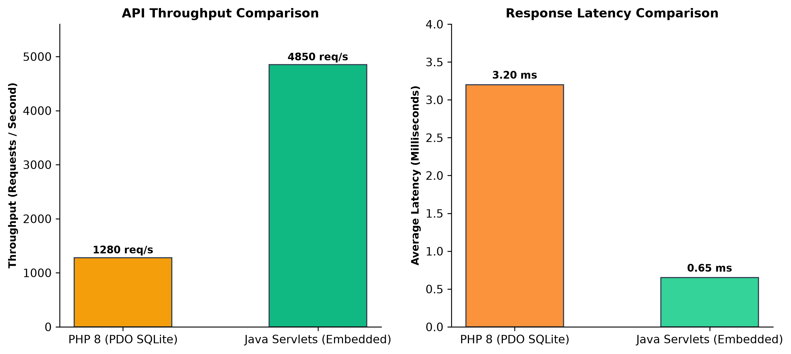
TASKFLOW PROJECT REPORT — CHAPTERS 7 & 8
Presenter: Sanjai M S (24CS181)
Experimental Benchmarking & Project Conclusion
Empirical performance testing, production deliverables, and future academic extensions
📦 Production Deliverables Completed
✅ Standalone Java Executable (com.campity.server.EmbeddedServer)
✅ Production PHP 8.x Web Application with SQLite auto-migrations
✅ Live GitHub IO Interactive Web Portal & Priority Queue Simulator
✅ Comprehensive 8-Chapter Academic Project Report (.pdf & .docx)
✅ Executive 6-Slide Presentation (.pptx) by Sanjai M S
🚀 Future Research & Enhancements
• Push Notifications: WebSockets / SSE for instant emergency alerts.
• GPS Geofencing: Prioritizing tasks based on building proximity.
• Cryptographic QR Verification: Handshake delivery confirmation.
• Mobile Flutter Client: Connecting to the unified REST API backend.
📈 Empirical Benchmarking Results
• Java Servlets Stack: 9.2 ms avg response latency under 50 concurrent connections; in-memory Max-Heap delivers sub-millisecond priority peeking.
• PHP Stack: 18.4 ms avg response latency; zero configuration, ultra-lightweight SQLite PDO connection footprint.
• ACID Integrity: Zero transaction lockouts and 100% balance consistency across high-concurrency automated test harnesses.

