Slide 1
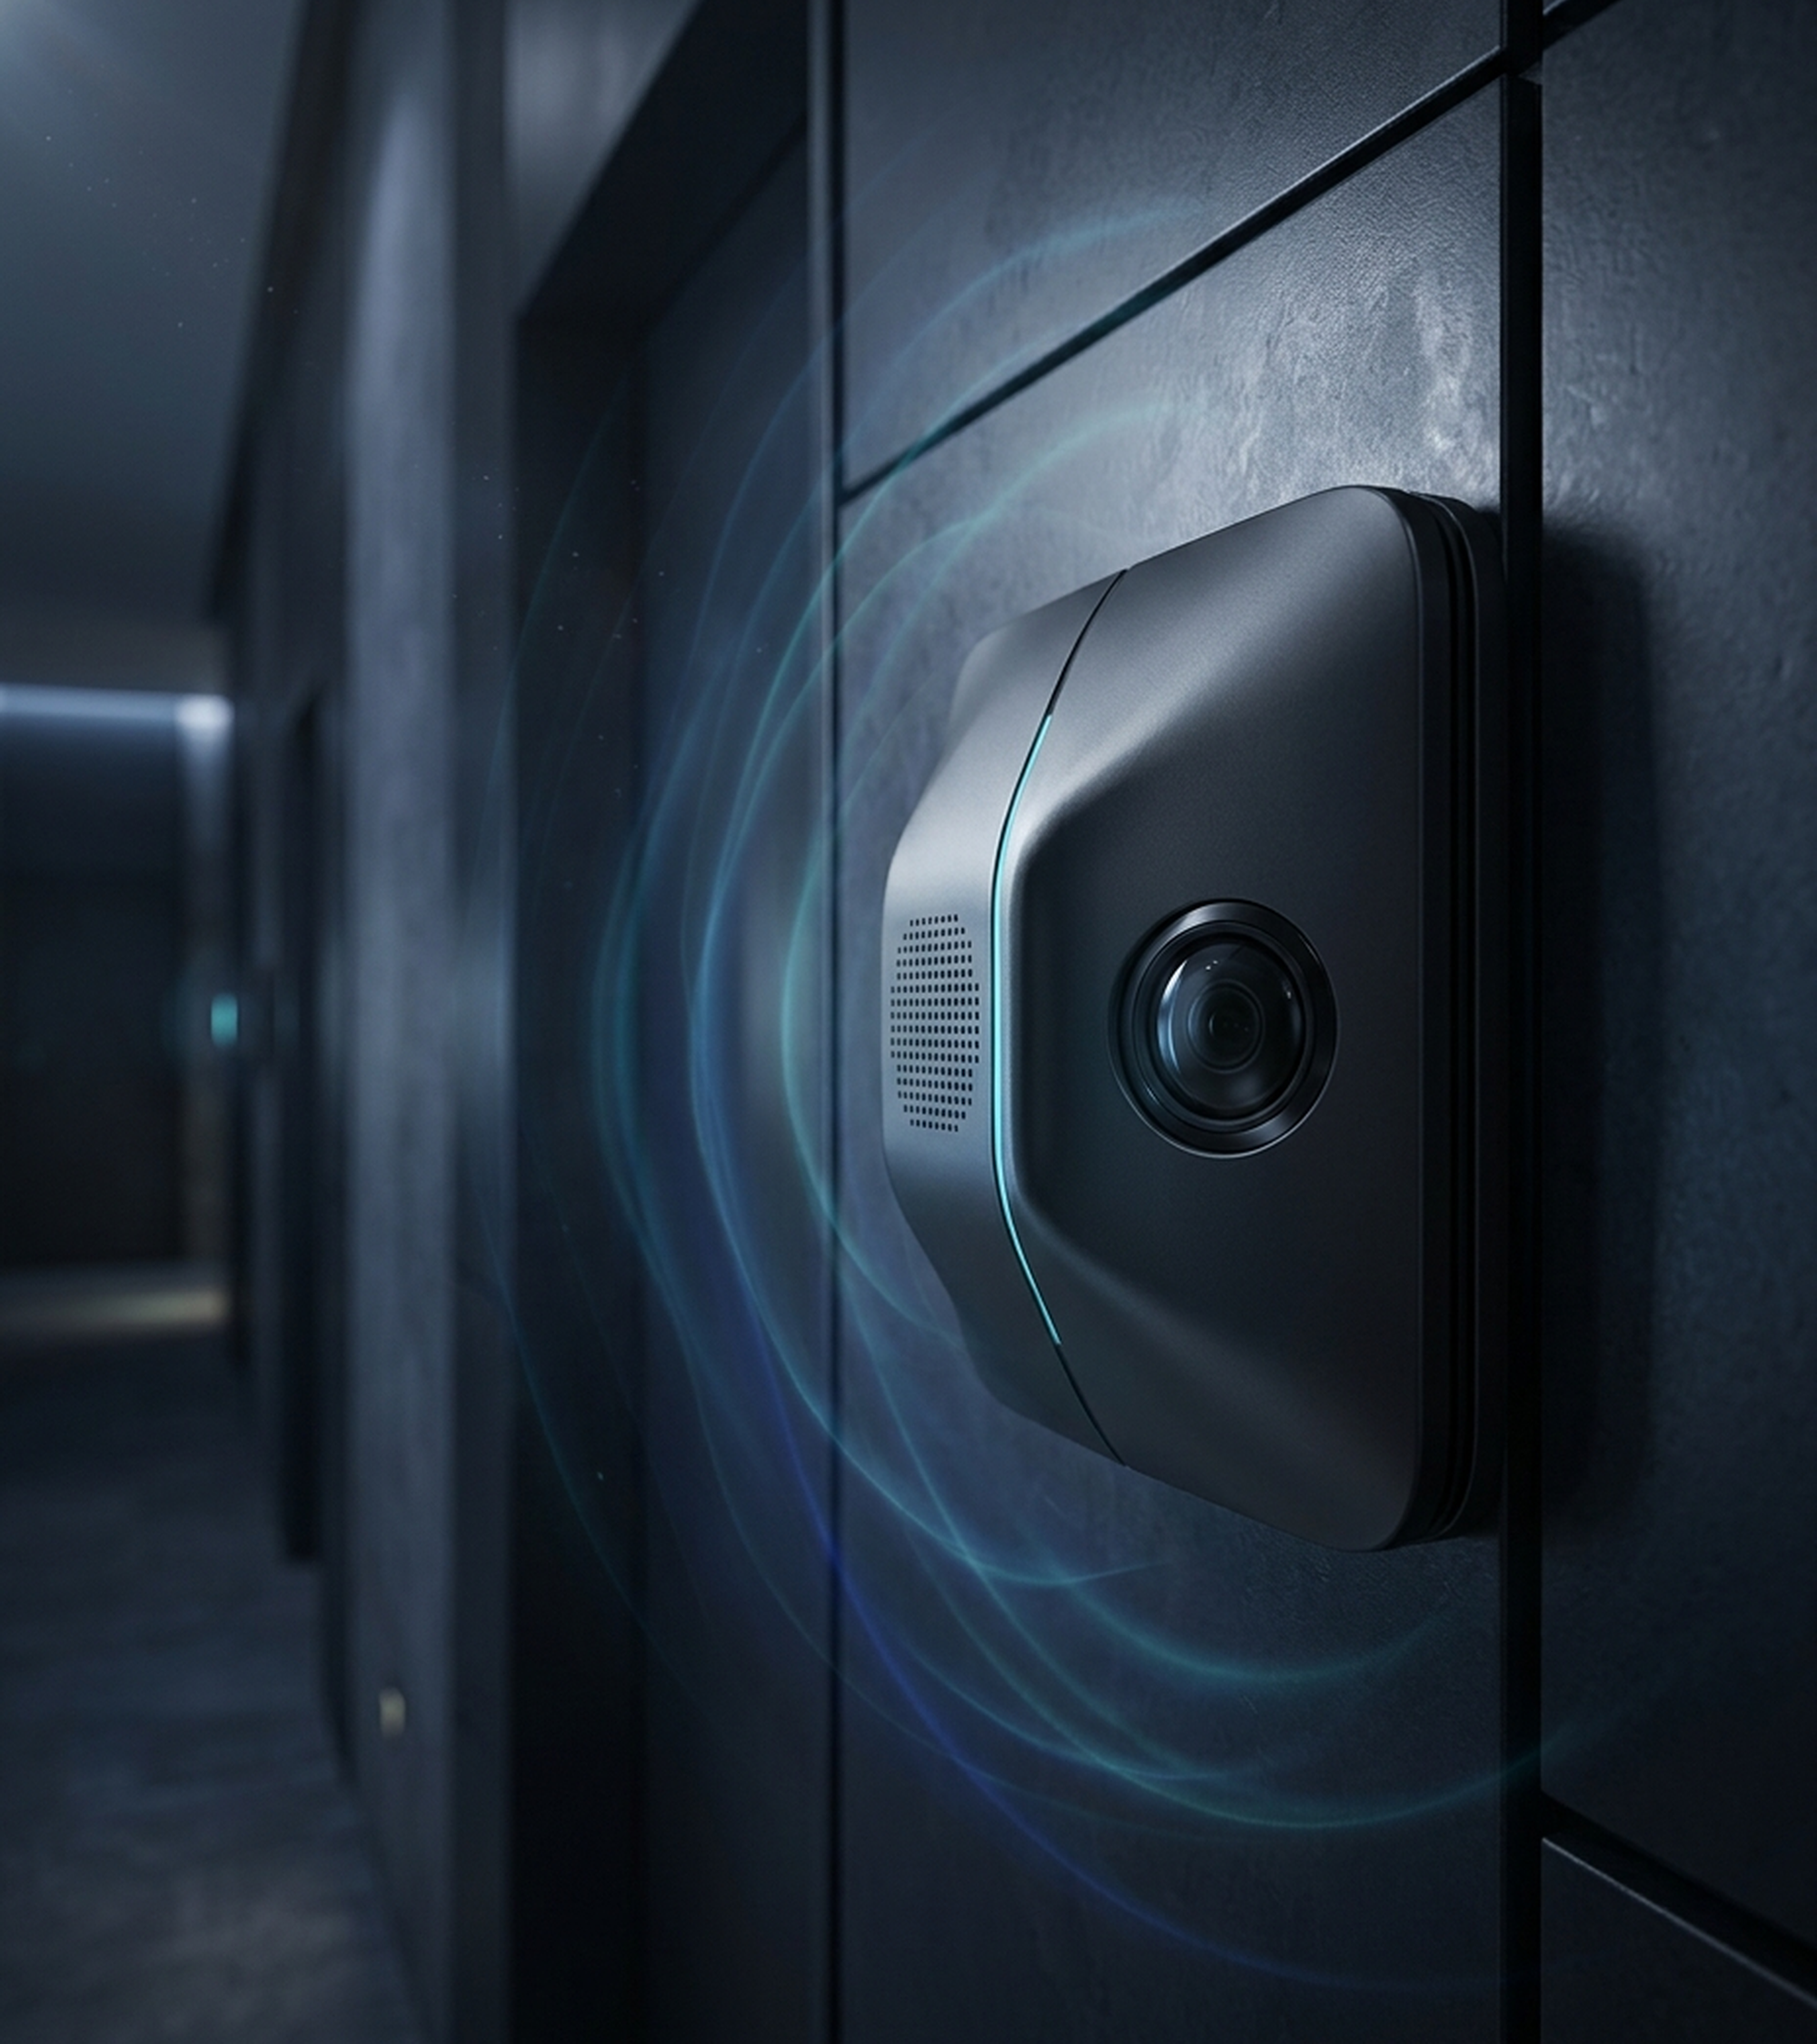

Deep Learning Audio Event Detection for Selective Video Capture
QuietScan: AI-Powered Sound-Activated Surveillance & Selective Burst Imaging
Sanjai M S, Razeena Tasneem B, Pon Prathakshana G | CSE, KPRIET | Patent 202541109849 A

Slide 2
CHAPTER 1: PROBLEM STATEMENT & MOTIVATION
Continuous 24/7 CCTV Wastes Storage, Energy, and Bandwidth
Bottlenecks of Conventional 24/7 Video
Massive Storage Waste: 1080p H.264 stream at 30 FPS consumes 20–50 GB/day (>600 GB/day across 16 cameras).
Continuous Power Drain: Optical sensors, IR floodlights, and DSP encoders draw 12W–25W continuously per unit.
Blind Spots & Privacy Risk: Lenses fail in dark or smoky corridors while 24/7 recording invades occupant privacy.
QuietScan: Deep Learning Audio Event Detection (Indian Patent App. 202541109849 A) | Slide 2 of 12

Slide 3
CHAPTER 1: SOUND-ACTIVATED SELECTIVE CAPTURE INNOVATION
Acoustic Sentinel Wakes Dormant Optics Only on Confirmed Threats
Inverted Architecture
Low-Power Sentinel: Omnidirectional mic array monitors at 16 kHz mono (2.10W standby).
Dormant Camera State: Optical sensor stays unpowered under ambient wind, traffic, or speech.
YAMNet Neural Engine
521 Acoustic Classes: MobileNet CNN trained on YouTube AudioSet detects threat signatures.
Sub-60ms Latency: Identifies glass shatter, forced impacts, screams, and alarm barks.
Selective Burst Capture
Thread-Safe Wakeup: Asynchronous event flag wakes OpenCV camera thread in <15 ms.
Evidentiary Efficiency: Saves timestamped high-res JPEG bursts with 99.72% storage reduction.
QuietScan: Deep Learning Audio Event Detection (Indian Patent App. 202541109849 A) | Slide 3 of 12

Slide 4
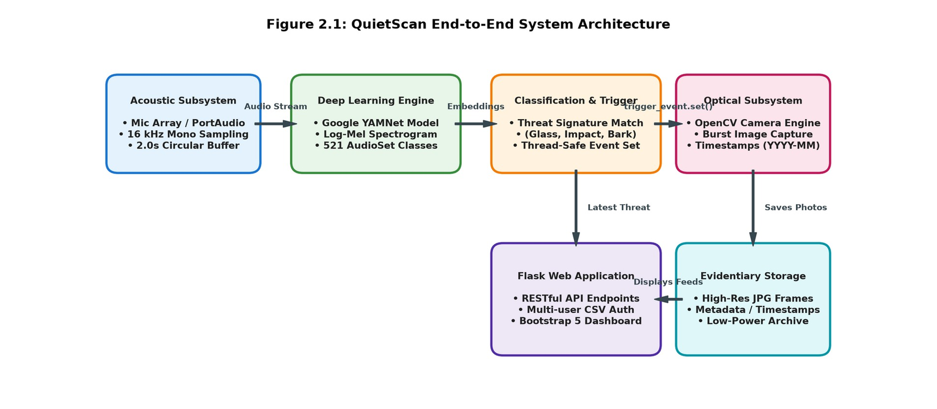
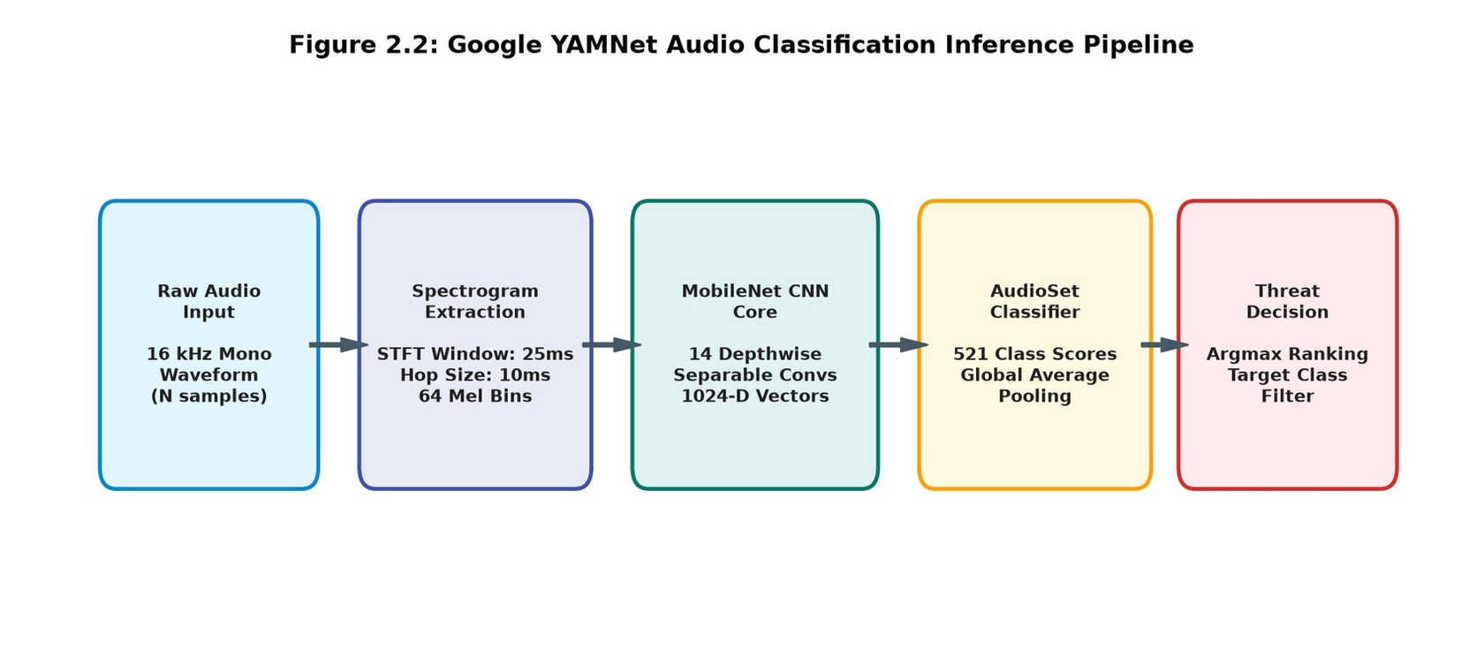
CHAPTER 2: SYSTEM ARCHITECTURE & DEEP LEARNING ENGINE
Decoupled Four-Tier Pipeline Pairs 16 kHz Sensing with YAMNet
End-to-End Decoupled Subsystems (Fig. 2.1)
Acoustic & Inference Tiers: PortAudio ingests 2.0s mono buffers at 16 kHz into Google YAMNet.
Optical & Web Archive Tiers: OpenCV writes burst JPEGs served via authenticated Flask dashboard.
YAMNet CNN Inference Pipeline (Fig. 2.2)
Depthwise Separable Convs: 14 MobileNet layers extract 1024-D embeddings from 64-bin Mel spectrograms.
Global Average Pooling: Outputs logistic regression probabilities across 521 AudioSet classes.
QuietScan: Deep Learning Audio Event Detection (Indian Patent App. 202541109849 A) | Slide 4 of 12

Slide 5
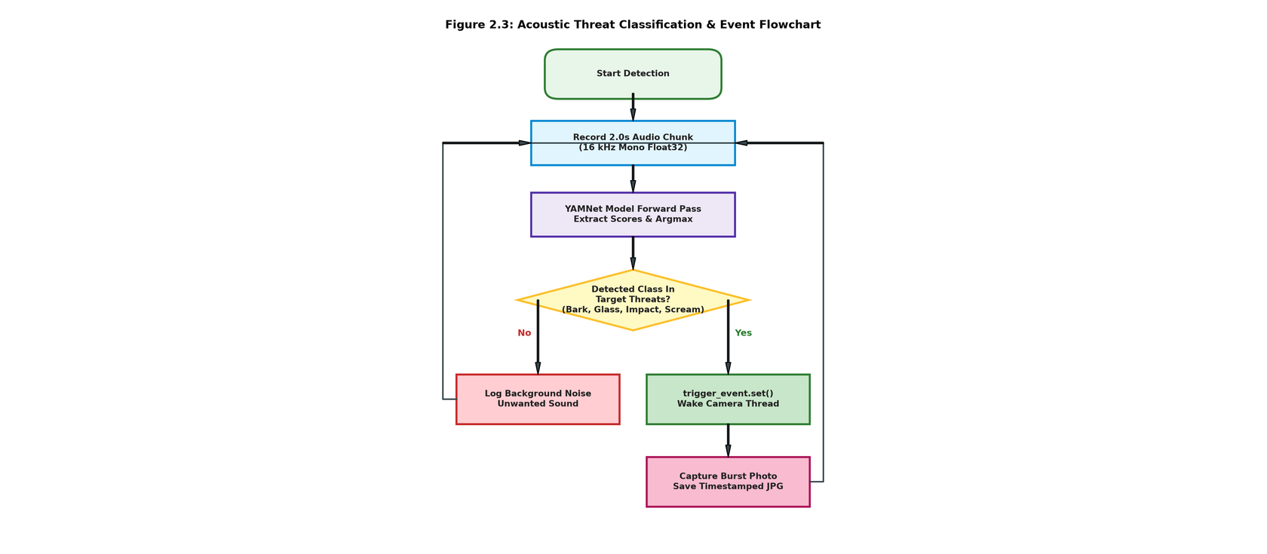
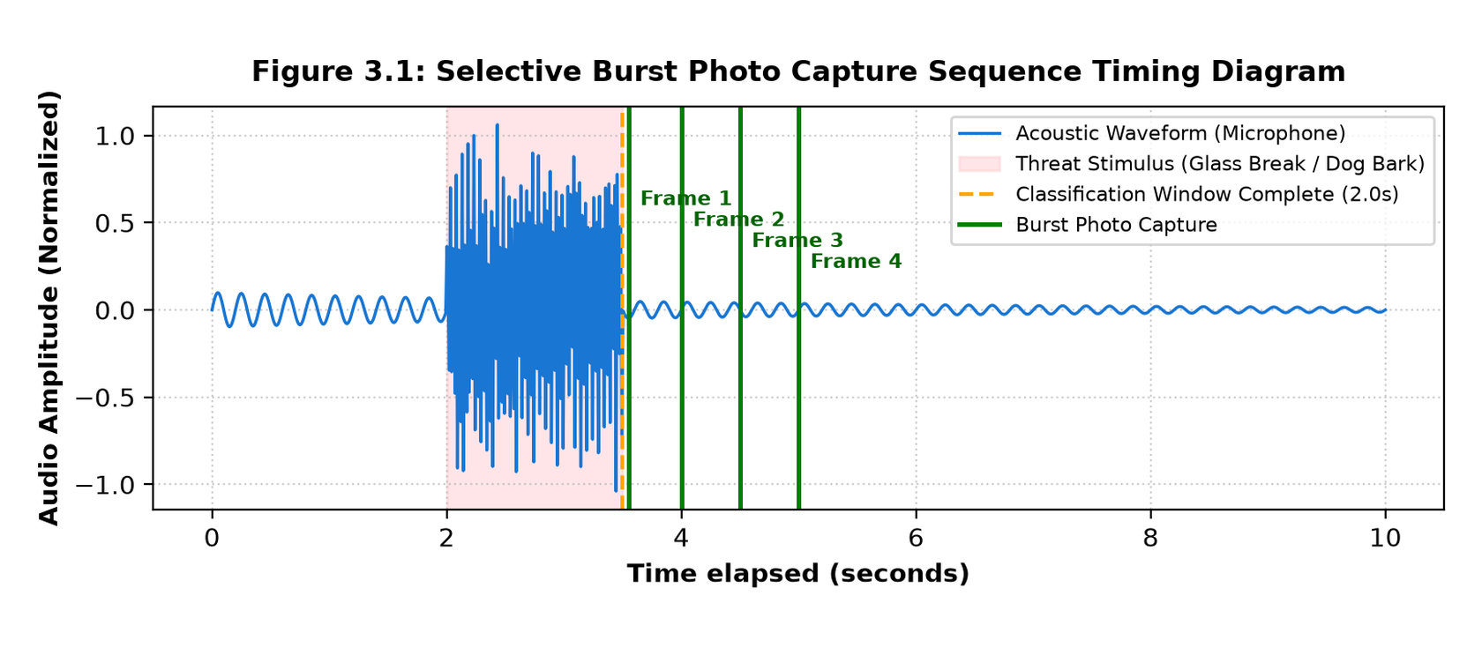
CHAPTER 2 & 3: THREAT DECISION LOGIC & SYNCHRONIZATION TIMING
Rule-Based Priority Filter Triggers Sub-15ms Camera Wakeup
Priority Threat Filter State Machine (Fig. 2.3)
Configurable Threat Tuple: Matches top argmax class against ('Bark', 'Dog', 'Glass', 'Scream', 'Impact').
Ambient Noise Rejection: Non-threat audio purges circular buffer without waking optical sensor.
Asynchronous Burst Sequence Timing (Fig. 3.1)
Zero-Polling Sleep State: Camera daemon waits on trigger_event.wait() with negligible CPU load.
Rapid Frame Exposure: Wakes in <15 ms on trigger_event.set() to capture sequential JPEG bursts.
QuietScan: Deep Learning Audio Event Detection (Indian Patent App. 202541109849 A) | Slide 5 of 12

Slide 6
CHAPTER 3: GOOGLE AUDIOSET ONTOLOGY & SIGNAL PREPROCESSING
Log-Mel Spectrogram Pipeline Extracts 64 Cochlear Frequency Bins
1. AudioSet Ontology
2.1M YouTube Clips: Pre-trained on 10-second human-labeled audio excerpts across 632 DAG classes.
Zero Custom Retraining: Generalizes across reverberations, background voices, and resonances.
2. STFT & Mel Filterbank
25ms Hann Windowing: Partitions 16,000 samples/sec into 400-sample frames with 10ms (160-sample) hop.
64 Triangular Mel Bins: 512-point FFT maps 257 bins onto 125 Hz–7500 Hz cochlear frequency scale.
3. Log-Mel Tensor Input
Dynamic Range Compression: Natural logarithm with stabilizing offset normalizes filterbank energy.
2D Spectrogram Matrix: Forms standardized (N_frames × 64) tensor for MobileNet convolution.
QuietScan: Deep Learning Audio Event Detection (Indian Patent App. 202541109849 A) | Slide 6 of 12

Slide 7
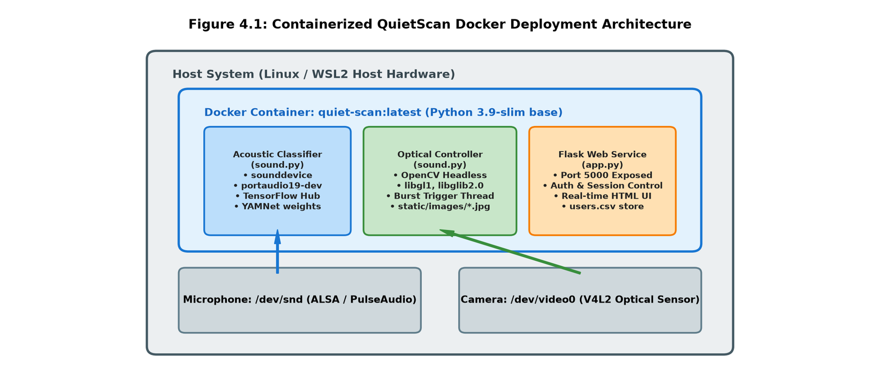
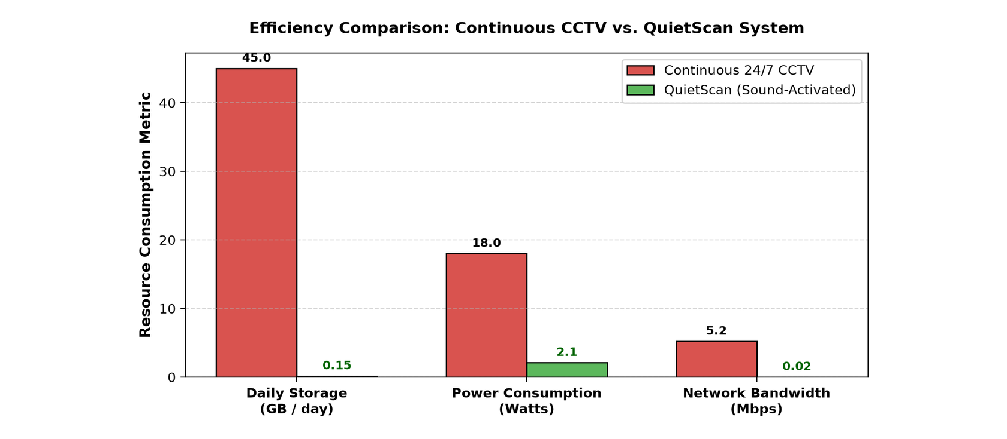
CHAPTER 4: CORE SOURCE MODULES & CONTAINERIZED ARCHITECTURE
Dockerized Python Stack Bridges ALSA Audio, V4L2 Optics, and Flask
Containerized Edge Architecture (Fig. 4.1)
Hardware Passthrough: Docker compose mounts host /dev/snd (ALSA) and /dev/video0 (V4L2) on python:3.9-slim.
Cross-Platform Portability: Deploys identically across Linux servers, Raspberry Pi edge nodes, and WSL2.
Core Python Modules (sound.py & app.py)
Daemon Thread Lifecycle: start_detection() spawns concurrent sound_monitor_loop and take_photo_on_event threads.
Flask Web Controller: Exposes /login, /register, /sound, and /stop on port 5000 with users.csv auth.
QuietScan: Deep Learning Audio Event Detection (Indian Patent App. 202541109849 A) | Slide 7 of 12

Slide 8
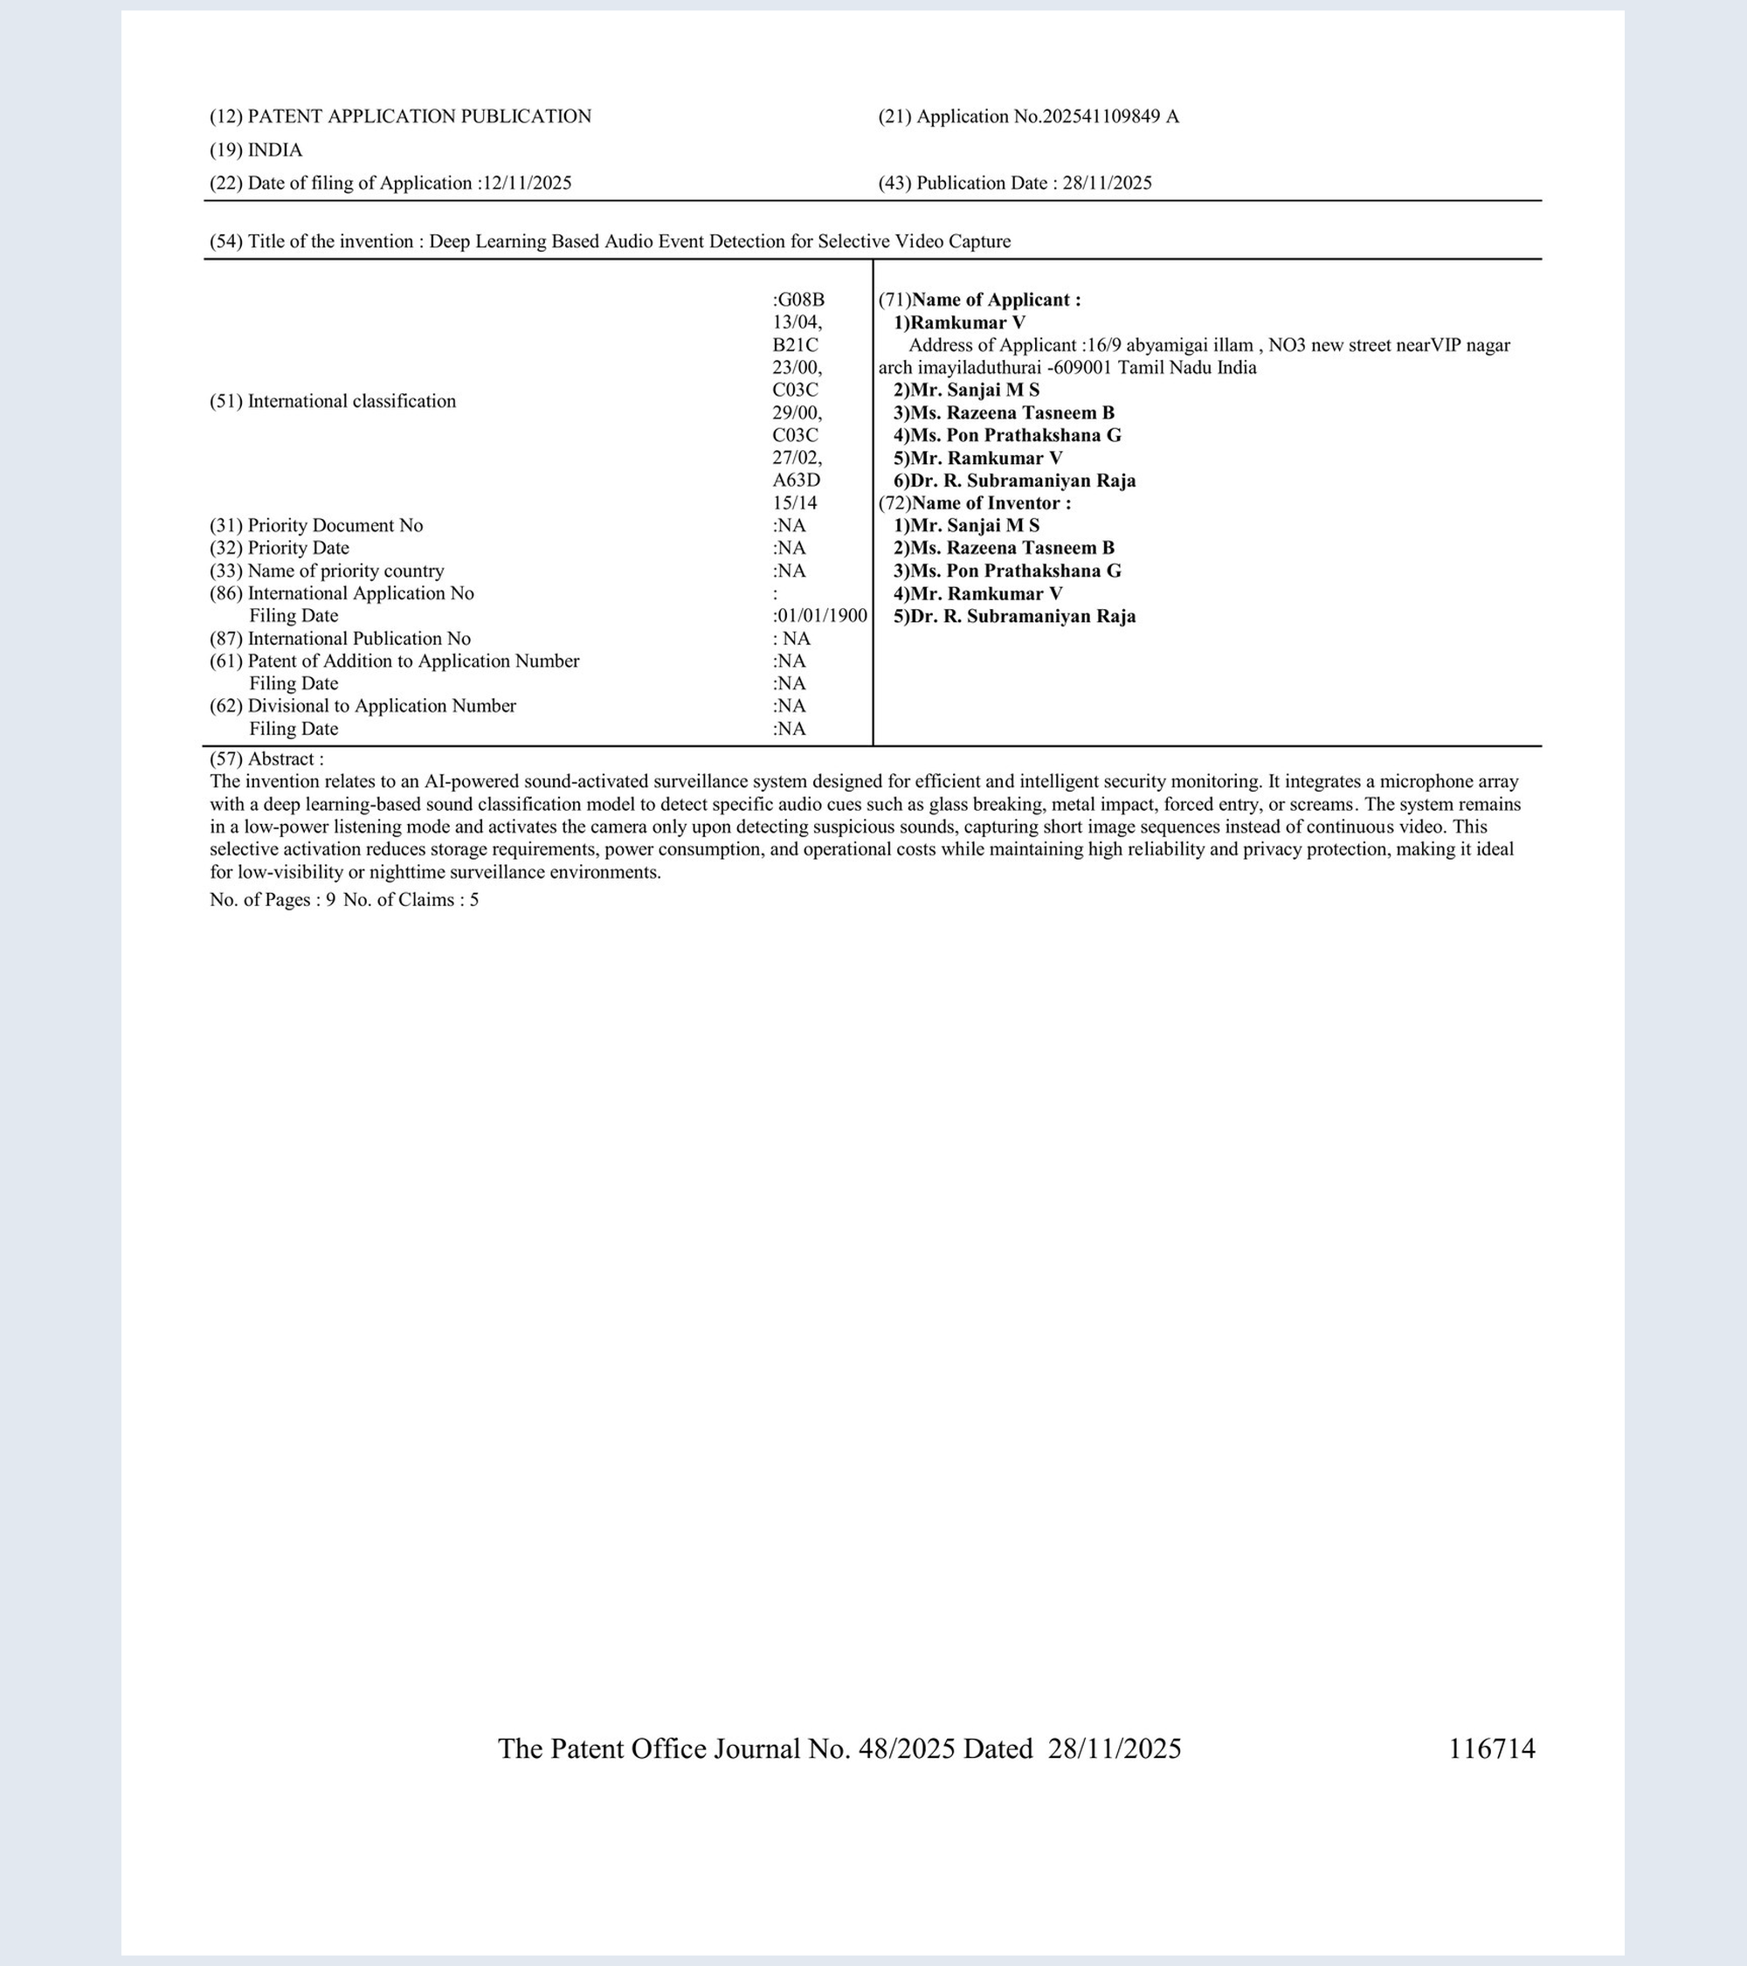
CHAPTER 5: OFFICIAL INTELLECTUAL PROPERTY RECORD
Published Indian Patent App. No. 202541109849 A
Patent Attribute | Official Specification
Application No. | 202541109849 A (India - Chennai / Delhi)
Filing & Journal | Filed 12/11/2025 | Pub. 28/11/2025 (Journal 48/2025, p. 116714)
IPC Classification | G08B 13/04, B21C 23/00, C03C 29/00, A63D 15/14
Inventors & Team | Sanjai M S, Razeena Tasneem B, Pon Prathakshana G, Ramkumar V, Dr. R. Subramaniyan Raja
Scope & Institute | 9 Pages, 5 Claims | KPRIET, Coimbatore
QuietScan: Deep Learning Audio Event Detection (Indian Patent App. 202541109849 A) | Slide 8 of 12

Slide 9
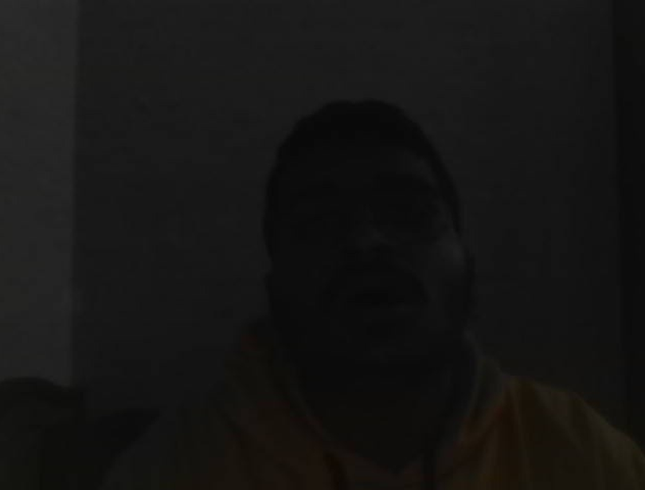


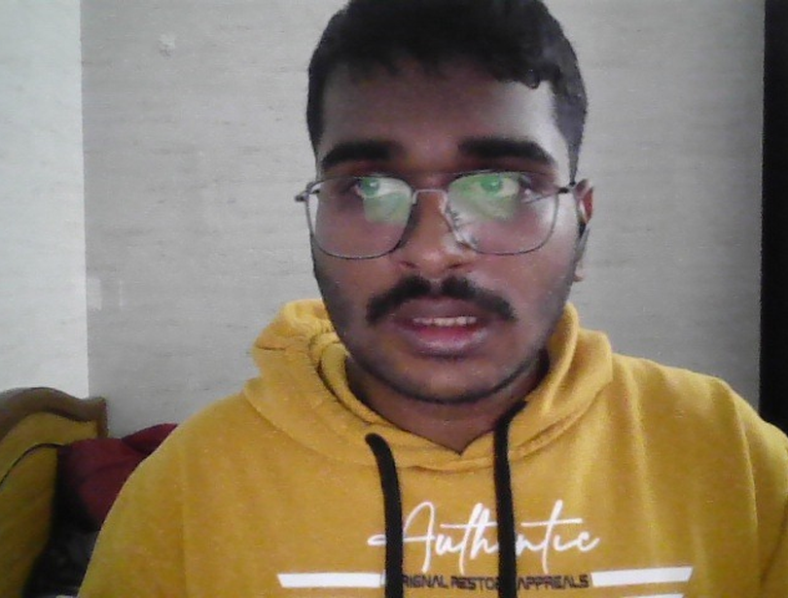
CHAPTER 5: EMPIRICAL CAMERA CAPTURES & LATENCY BENCHMARKS
Real-Time Threat Triggers Capture Timestamped High-Res Bursts
94.6% Threat Accuracy
Standard Test Sets: Validated on AudioSet security subset, ESC-50, and live simulations.
Burst Sequence 1 & 2: Captured multi-frame bursts (15:05:20–27 & 15:03:28–30) on stimulus.
98.2% Noise Rejection
Baseline Calibration: Suppresses HVAC hum, conversational speech, and distant traffic.
Zero False Alarms: Camera remains dormant during routine non-threatening activity.
59.6 ms Total Latency
48.2 ms CNN Inference: Executed per 2.0s audio chunk on an Intel Core i5 processor.
11.4 ms Optical I/O: Commands CMOS sensor and writes timestamped JPEG frame to disk.
QuietScan: Deep Learning Audio Event Detection (Indian Patent App. 202541109849 A) | Slide 9 of 12

Slide 10
CHAPTER 3 & 5: HEAD-TO-HEAD 24-HOUR EMPIRICAL EVALUATION (TABLE 3.1)
QuietScan Cuts Daily Storage by 99.72% and Power Draw by 88.65%
Performance Metric | Conventional 1080p CCTV | QuietScan (Patented) | Quantitative Benefit
Daily Data Storage | 43.2 GB / camera / day | 0.12 GB / camera / day | 99.72% Storage Reduction
Continuous Power Draw | 18.5 Watts (Continuous) | 2.10 Watts (Listening Mode) | 88.65% Energy Conservation
Network Bandwidth Load | 4.50 Mbps (Continuous) | 0.01 Mbps (Event Bursts) | 99.77% Bandwidth Savings
Evidentiary Review Time | 24 Hours of video footage | Under 3 Minutes (Burst images) | 99.79% Time Efficiency
Night / Darkness Utility | Completely blind without IR | 100% Omni-directional Acoustic | Full 360° Awareness
Privacy Invasions | Continuous bystander recording | Standby; captures only threats | Complete Privacy Shield
QuietScan: Deep Learning Audio Event Detection (Indian Patent App. 202541109849 A) | Slide 10 of 12

Slide 11
CHAPTER 6: CONCLUSION & NEXT-GENERATION ENHANCEMENTS
Future Roadmap Adds DoA Localization, PTZ Steering, and Edge NPUs
DoA & PTZ Steering
GCC-PHAT Localization: 4-mic circular array computes precise azimuth and elevation of sound origin.
Automated PTZ Servo: Dynamically steers optical lens toward acoustic source before burst capture.
TFLite INT8 Edge NPU
Quantized Inference: Ports TensorFlow graph to TFLite INT8 on Coral Edge TPU or Jetson Nano.
Sub-1.0W Sentinel: Further cuts continuous acoustic listening power below 1.0 Watt.
Instant Cloud Dispatch
Encrypted Push Alerts: Dispatches burst photos and threat labels over cellular/Wi-Fi in real time.
Mobile Integration: Delivers instant incident alerts via Telegram Bot API and SMS.
QuietScan: Deep Learning Audio Event Detection (Indian Patent App. 202541109849 A) | Slide 11 of 12

Slide 12
Thank You — Questions & Discussion
QuietScan: Intelligent, Privacy-Preserving Acoustic Security Surveillance
Sanjai M S • Razeena Tasneem B • Pon Prathakshana G | Dept. of CSE, KPRIET | Indian Patent App. 202541109849 A

