Slide 1
CURSOR
ADM
Package a Cursor leave-behind your customer can run
Deck Machine Studio · ADM enablement · 2026

Slide 2
This session is for you if:
You package customer demos and need a branded Cursor repo, not another slide template.
You want a repeatable room script: brief → PPTX → Lab 4 → handoff.
You teach Rules, Skills, and Agents through one concrete factory — decks are the proof.
Deck Machine Studio · ADM enablement · 2026

Slide 3
Today's
Agenda
What Deck Machine Studio is
1
2
Studio vs Cursor — two surfaces
3
How packaging works
4
What ships in the zip
5
The live demo loop
6
How ADMs should use it day-of
7
Teaching modules and next steps
Deck Machine Studio · ADM enablement · 2026

Slide 4
1
What it is

Slide 5
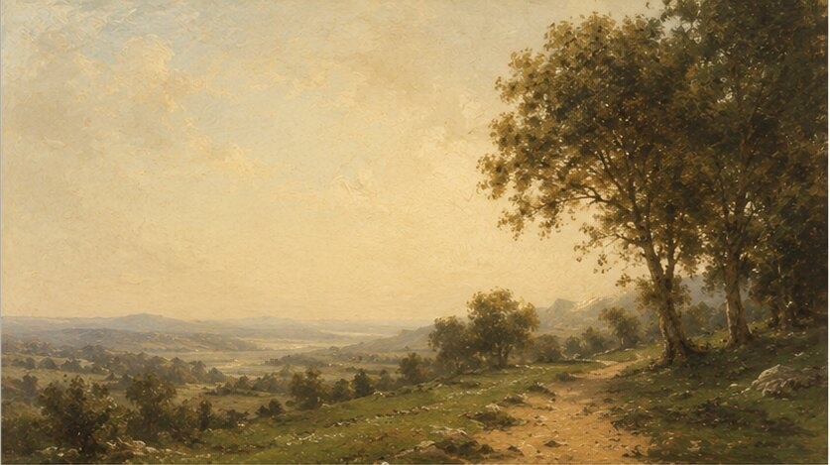
Studio packages. Cursor is where the demo runs.
One sentence positioning
Deck Machine Studio is an ADM tool that encodes a customer brand into a downloadable Cursor project. The customer opens that zip in Cursor and runs skills — brief in chat, branded PPTX out. You are not selling a PowerPoint SaaS.

Slide 6
The product is a repeatable Cursor factory
Proof, not the pitch
Rules stay on (brand). Skills are the buttons (/create-brief, /build-deck). Agents run the pipeline behind those skills. The PPTX proves those primitives work together — Lab 4 proves the champion learned them.

Slide 7
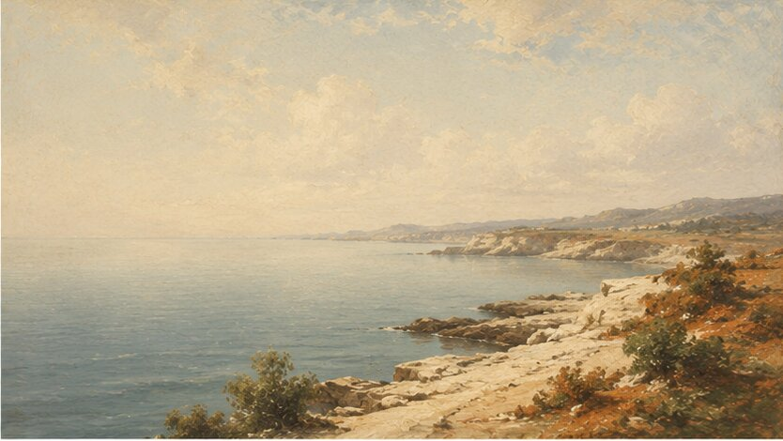
Two jobs ADMs hire this system for
Package and teach
Package — Find account → encode brand → download <slug>-deck-machine.zip. Teach — run the leave-behind live, then optional curriculum sidebars (CLI, tokens, privacy) from the field kit. Hub Studio can assemble blocks later; content comes first.

Slide 8
2
How it works

Slide 9

01
Package leave-behind

Slide 10
Find account → encode brand → download
Studio wizard
Find the account (Databricks when configured, or Brandfetch / manual). Encode palette, voice, logos, layout style. Download the zip. Mission control opens with the checklist — demo paste, slash commands, Lab 4, email handoff.

Slide 11

What the customer receives
Inside the zip
Brand pack + always-on brand rule. Deck workflow rule. Skills under / (create-brief, build-deck, brand-check, export-pptx, and more). Agents that run behind the skills. Bundled Office exporters — no npm install. Teaching docs: Lab 4, decision tree, after-the-demo.

Slide 12
02
Live demo loop

Slide 13
Talk or paste → brief → branded PPTX → Lab 4
In Cursor, together
Open the unzipped folder in Cursor. /create-brief with a real upcoming meeting. /build-deck brief.md — pick up output/*.pptx. Change one headline → /export-pptx. Required exit: Lab 4 in docs/primitives-lab.md (bad headline → /brand-check → fix).

Slide 14

Quality gates travel with the repo
Before anything leaves the room
/brand-check runs brand-guardian against the brand rule. /deck-score catches thin structure (CLI-friendly). Same story in the IDE or with agent -p. That is governance of their artifact — separate from vendor Privacy Mode.

Slide 15
3
How ADMs
should use it

Slide 16
Before the call
Night before or morning of
Package or resume the account in Studio. Optional: run Rehearse (~5 min). Keep Talk track open. If you will teach CLI, tokens, or privacy: npm run field-kit in this repo and open the matching talk-track.md — those modules are not in the zip picker.

Slide 17
In the room
Lead with primitives
Unzip → open in Cursor → narrate rules loading → /create-brief → /build-deck → Lab 4. Say: customers leave with a working Cursor repo tailored to their brand. Don't say: new AI tool, IT procurement, or learn the brief template by hand.

Slide 18
After download — Mission control
Checklist + email handoff
Work the Mission control steps live. Copy the email blurb for the champion (unzip, skills path, Lab 4, docs/after-the-demo.md). Prefer email over Slack paste — many customer accounts are not on Slack.

Slide 19

Teaching modules live in the field kit
Content blocks, not a Hub library
Versioned jobs under content-blocks/: Lab 4, brand tokens, scorecard, Cursor CLI, token budget, privacy + review. Assemble with npm run assemble:blocks or npm run assemble:standard. Day-of: docs/adm-field-kit.md. Studio Help → Teaching modules (field kit).

Slide 20
Regenerate vs edit — set expectations
Day 2 ownership
Champion owns the Git home. Brand or layout style changes → regenerate zip from Studio. One headline → /revise-deck → /export-pptx. Point them at docs/after-the-demo.md before you leave so ownership is clear.

Slide 21
Package the zip.
Run the factory.
Leave Lab 4.

