Slide 1




Data Science Capstone: The Best and safest Neighborhood in San Francisco for Opening a Coffee Shop
By: Marcos Cifuentes – mrmacisu@hotmail.com

Slide 2
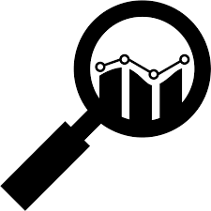
Introduction
Introduction
San Francisco is a cultural, commercial, and financial center in Northern California. San Francisco is the 16th most populous city in the United States, and the fourth most populous in California, with 881,549 residents as of 2019.
With its diverse culture , comes diverse alternatives business relationship with food items,beverages and cafe in safest Neighborhoods.
So as part of this project , we will list and visualize all options to create "businnes altenative safest" relations with cafe in San Francisco (CA).

Slide 3

Introduction
Objective
As a business idea, the goal is to open a coffee shop in a safe and central place in san francisco. Based on data science and data provided by the police department along with current business locations, optimal recommendations should be indicated to a set of investors before opening stores.

Slide 4
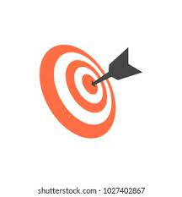
Introduction
Objectives
- Which all areas have more number of coffee shops or café ?
- Which all areas have less number of coffeeshops?
- Which districts have the neighborhoods safest ?
- Which districts Reveals The Most Unsafe Districts ?
- What places are have best place to stay if I want a coffee ?

Slide 5

Introduction
Data
1- For Crime Rate in San Francisco Section [San Francisco Crime Data]
https://data.sfgov.org/Public-Safety/Police-Department-Incident-Reports-2018-to-Present/wg3w-h783
pd.read_csv('Police_Department_Incident_Reports__2018_to_Present2.csv')
2- For Data Set with locations of businesses [San Francisco Registered Business Data]
with urllib.request.urlopen("https://data.sfgov.org/resource/wg3w-h783.json") as url:francisco = json.loads(url.read().decode())

Slide 6


Introduction
Approach
A) We can pull two datasets:
a) list of every business registered in San Francisco from the last couple of decades from the data SF website.
b) a list of date crime in San francisco (since 2018 - present)
B) Using FourSquare API to find all venues for each safe neighborhood.
C) Filter out all venues that are nearby by locality.
D) Using aggregative rating for each Coffee Shop to find the best places.
E) Visualize the Ranking of neighborhoods using folium library(python)
f) Apply Kmeans to find best candidates to open a new coffee shop.

Slide 7


Introduction
Results about Crime in San Francisco

Slide 8
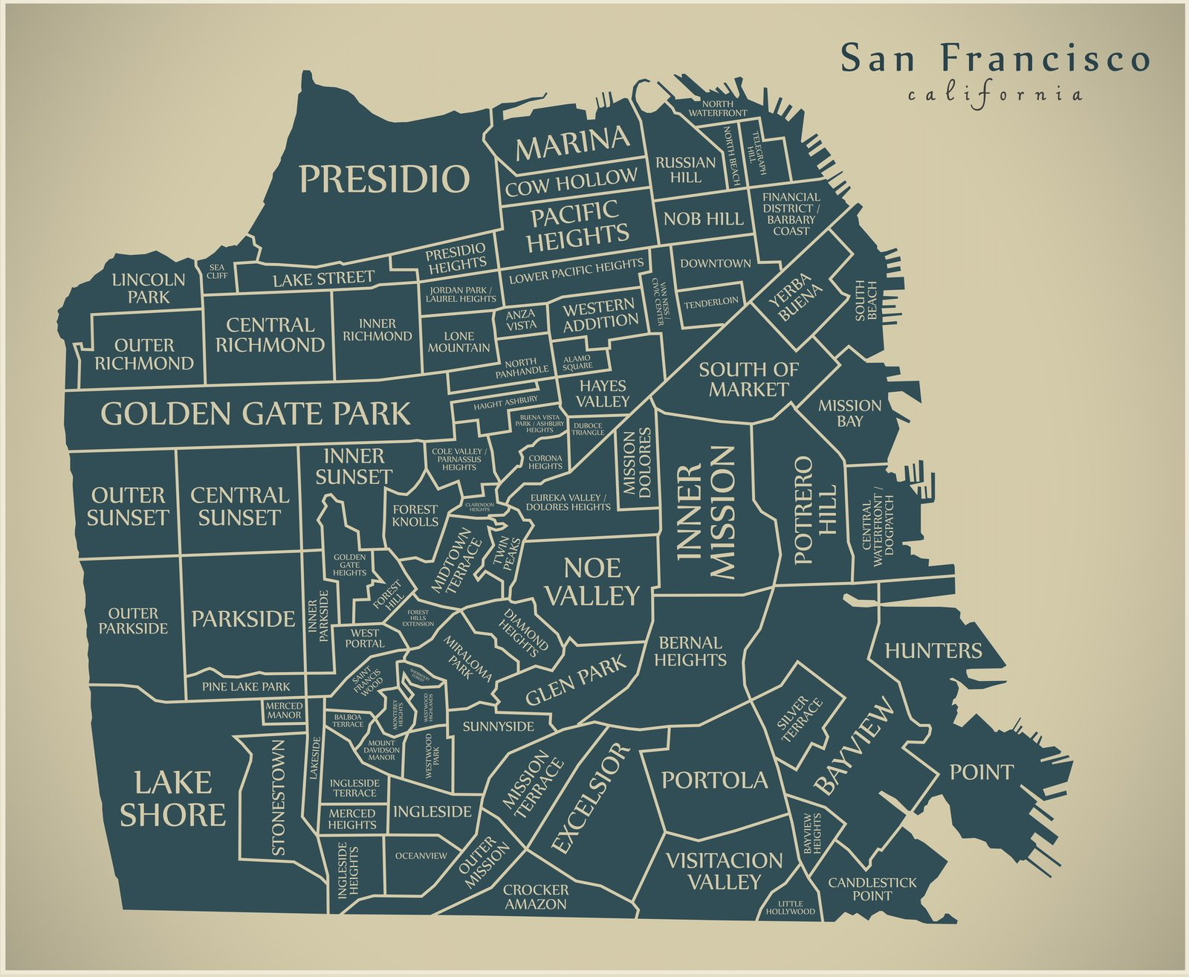

San Francisco Map
Introduction
The above Map is is for the next references

Slide 9
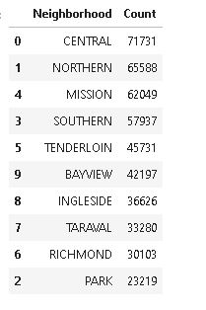
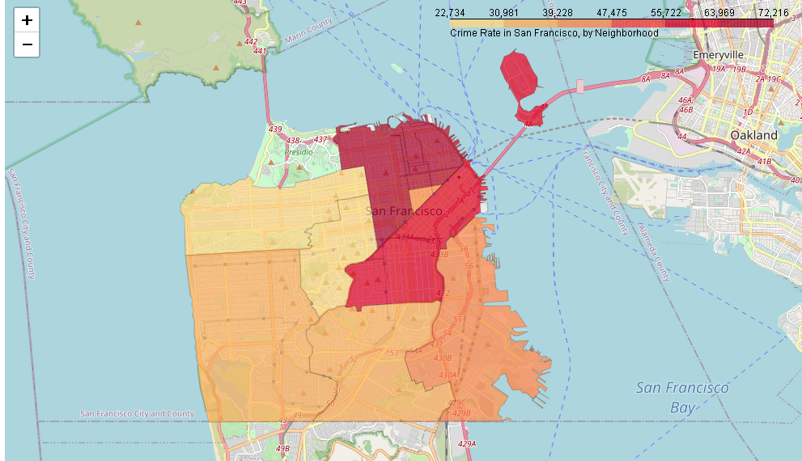
Information about Crime
Table and graphic
Introduction
The above table has a classification between districts and neighborhoods. We can see the least safe areas according to the statistics.
superimponing the locations of the crimes onto the map, Notice how the most dangerous areas are Central, Northern, Mission and Southern. likewise, the safest are Richmond and Park. Consequently, in these last two areas we will concentrate our exploration.

Slide 10
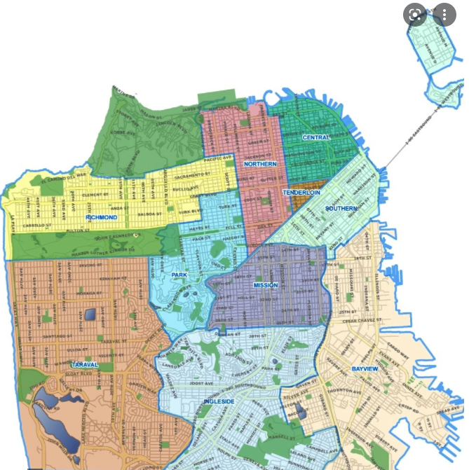
Information about Crime
Introduction
Northern
Central
Tenderloin
Richmond
Southern
Park
Mission
Taraval
Bayview
Ingleside
The table has a more distinctive classification about safest and dangerous areas.

Slide 11
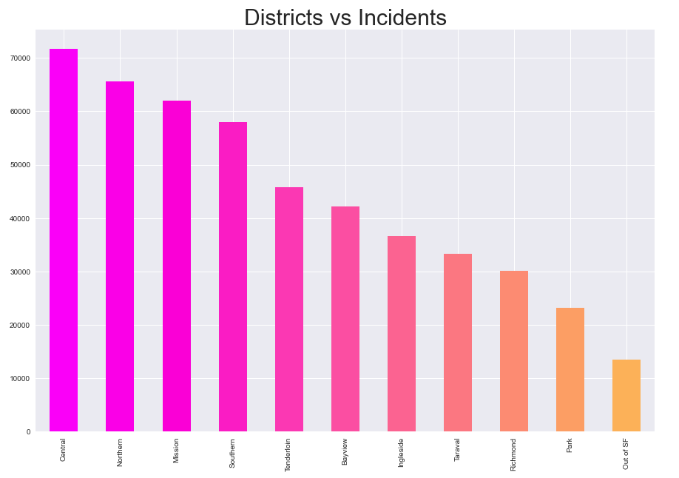
Distribution Crime
Introduction
We can check the Districts safest are: Park and RichMond, because their crime rates are lower than the rest. in deed, if the area is safe, the business is more likely to be sAccording to the incident report from 2018 to date, the safest districts and neighborhoods are Park and Richmond (with rates 23219 and 30103). For its part, the most insecure are Central an Northern with rates 71731 and 65588.
In fact, with these statistics the ideal places to have a "coffee shop" are: Park and Richmond for safety aspectsuccessful.

Slide 12
Introduction
Conclusion about Crime
According to the incident report from 2018 to date, the safest districts and neighborhoods are Park and Richmond (with rates 23219 and 30103). For its part, the most insecure are Central an Northern with rates 71731 and 65588.
In fact, with these statistics the ideal places to have a "coffee shop" are: Park and Richmond for safety aspects

Slide 13
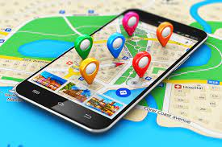
Introduction
Results about locations business
in Neighborhoods

Slide 14
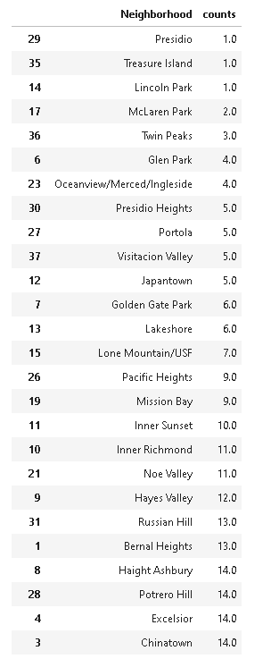

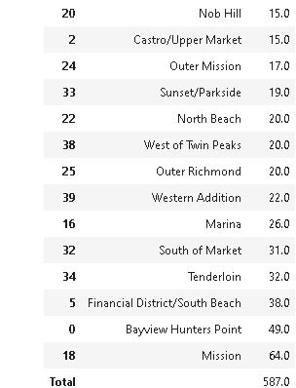
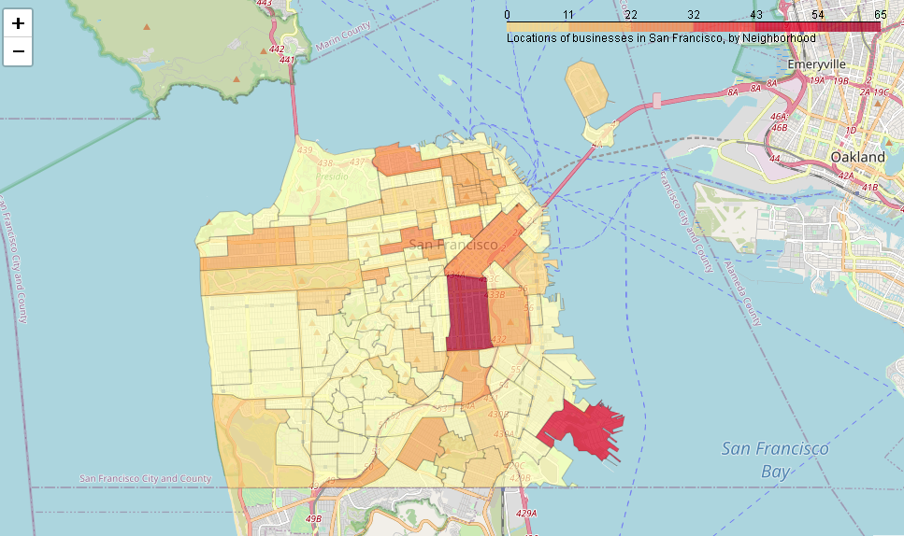

Map about counting Neigborhoods and locations business
The above table has counting about Neighborhoods and business locations in san francisco
More red means more quantity, while yellow means less

Slide 15
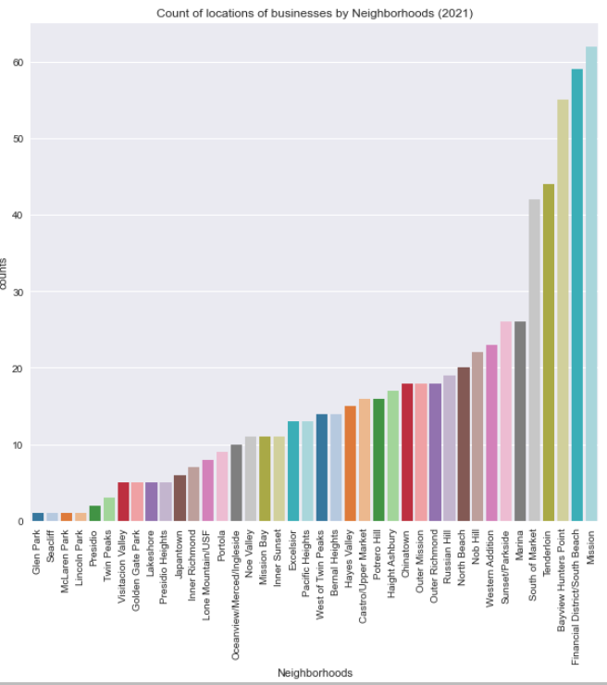
Count of locations of businesses and neighborhoods
The above table has counting about Neighborhoods and business locations in san francisco

Slide 16
Introduction
Conclusion about locations of business and neighborhoods
Despite there being more businesses in Mission, financial District and Bayview. we can appreciate that they are very unsafe areas. consequently, we are going to approach the data from security aspects.
Analyzing on the notebook Part 8.6 and Part 7.6 takes the Safest Neighborhoods by Park and Richmond Districts.

Slide 17

Introduction
Conclusion about Final Dataset
Followed, we will only show results from a single dataset with Park and Richmond data
1- Dataset For Crime Rate in San Francisco
+
2-Data Set with locations of businesses
[San Francisco Registered Business Data]
Dataset Safest locations of business in San Francisco

Slide 18
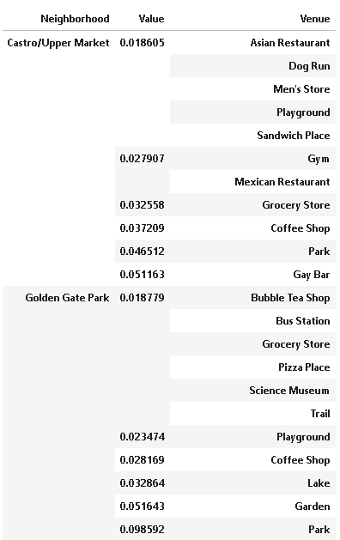
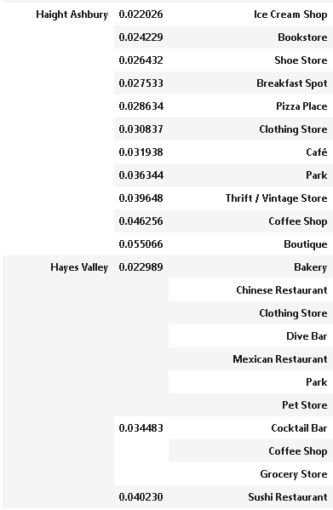
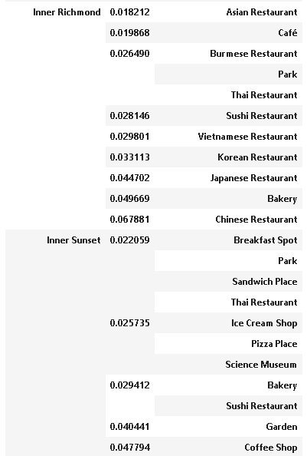
Top 10 Venues X neighborhoods filtered by Park and Richmond Districts - – part [1 -3]
Introduction

Slide 19
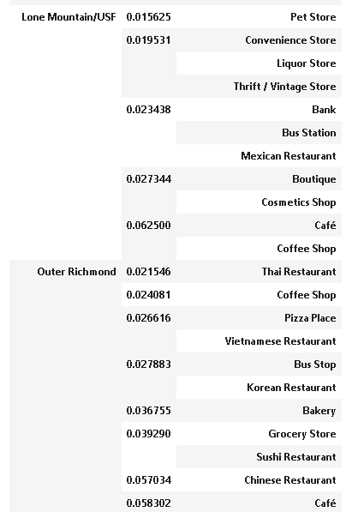
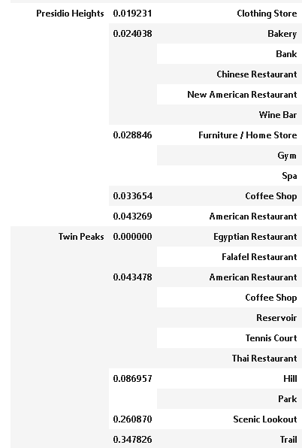
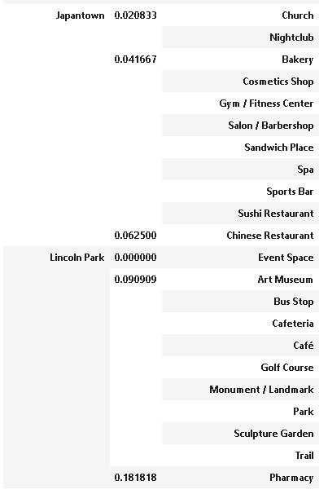
Top 10 Venues X neighborhoods filtered by Park and Richmond Districts – part [2 -3]
Introduction

Slide 20
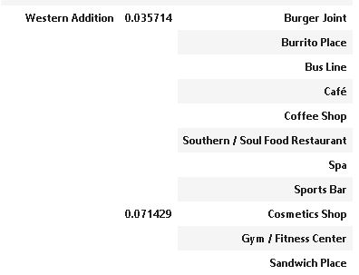
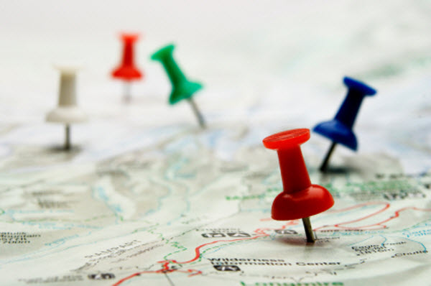
Top 10 Venues X neighborhoods filtered by Park and Richmond Districts – part [3 -3]
Introduction
Analyzing the top 10 reports by neighborhood can be determined the coffee shop is a frequent and common business in the majority the venues.

Slide 21
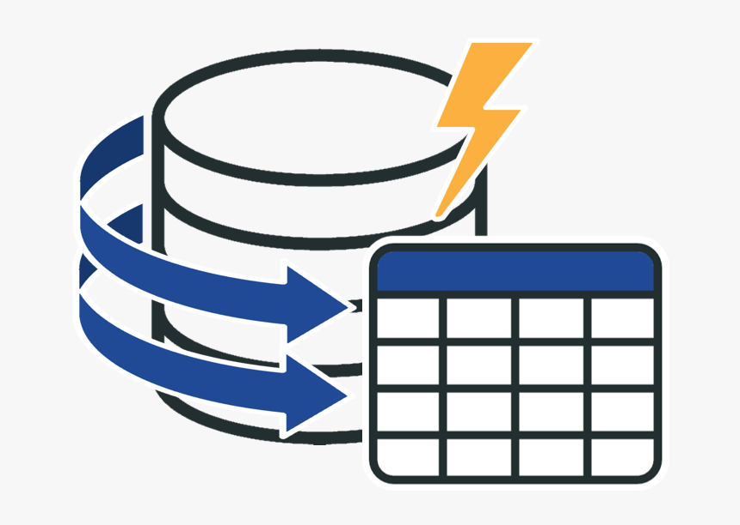
Clustering
K means
Introduction

Slide 22
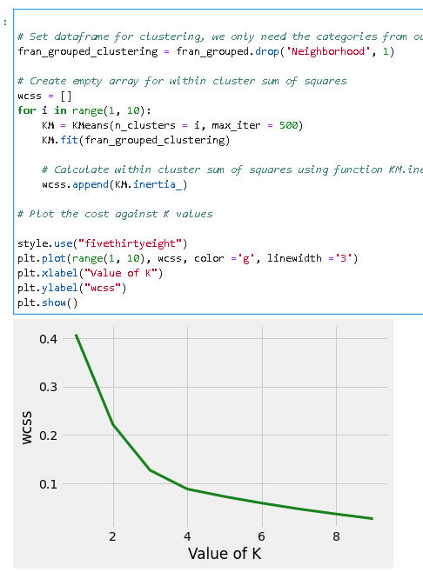
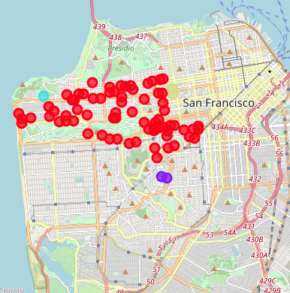
Clustering
Introduction
In cluster analysis, the elbow method shows a
good candidate k= 4

Slide 23

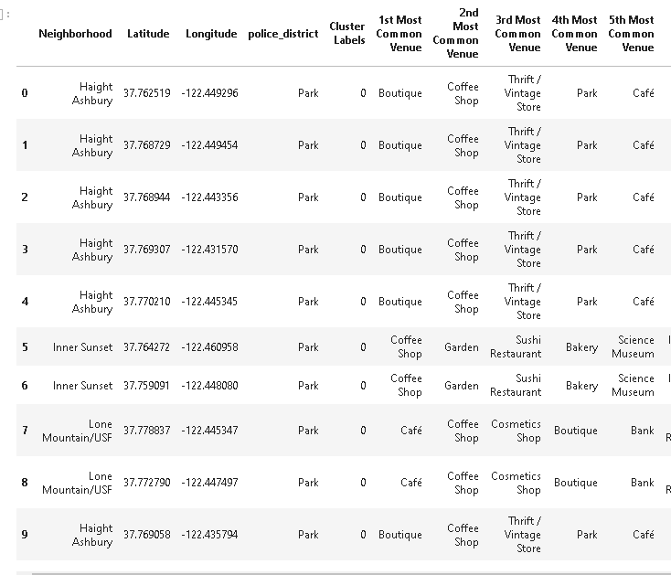
Cluster 0
Introduction
According to the results for the first group (labels=0)
The most popular categories are:
Boutique
Coffee Shop
Thrift / Vintage Store
Clothing Store
Chinese Rest.
Garden
Park
Café
Bakery
It is recommended to open a coffee shop

Slide 24
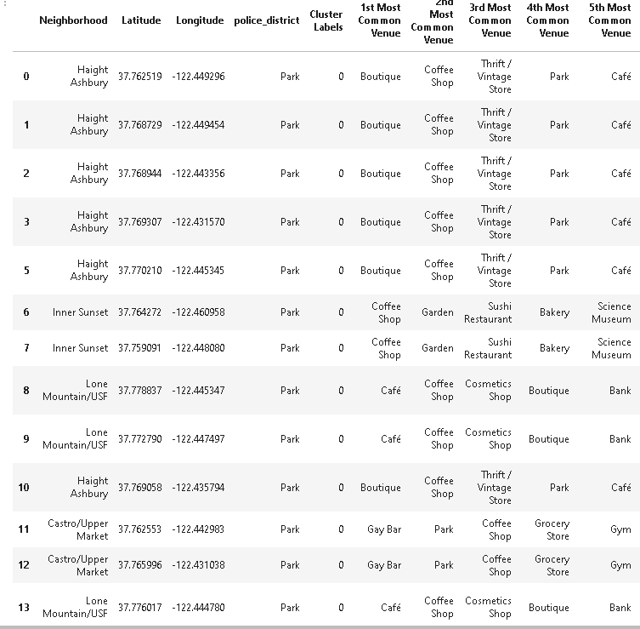
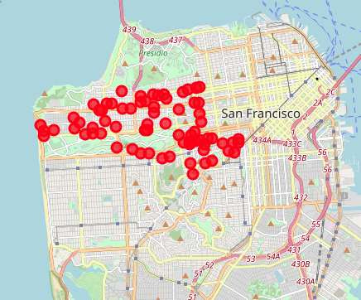
Cluster 0
Graphic and Table
Introduction
It is recommended to open a coffee shop

Slide 25

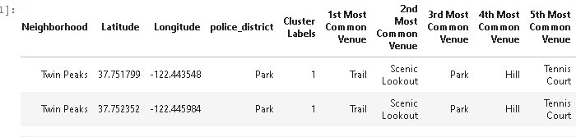
Cluster 1
Introduction
According to labels=1 The most popular categories are:
Trail
Scenic Lookout Prak
Park
Hill
Tennis Court
It is not recommended to open a coffee shop

Slide 26
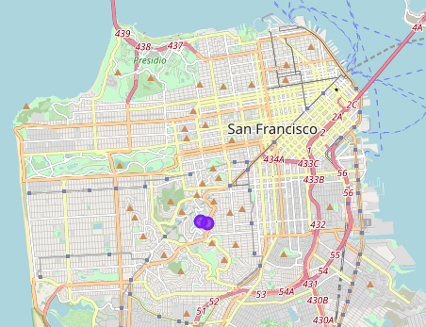
Cluster 1
Graphic and Table
Introduction
It is not recommended to open a coffee shop

Slide 27
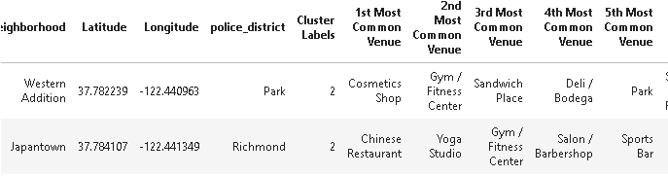
Cluster 2
Introduction
According to labels=2 The most popular categories are:
Cosmetic Shop
Gym / Fitness Center
Sandwich Place
Deli / Bodega
Park
Sports Bar
Yoga Studio
Chinese Restaurant
It is not recommended to open a coffee shop

Slide 28
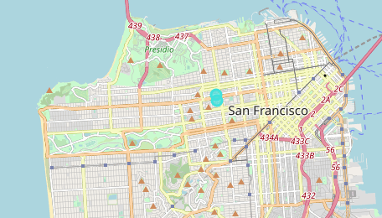
Cluster 2
Graphic and Table
Introduction
According to labels=2 The most popular categories are:
Cosmetic Shop
Gym / Fitness Center
Sandwich Place
Deli / Bodega
Park
Sports Bar
Yoga Studio
Chinese Restaurant
It is not recommended to open a coffee shop

Slide 29
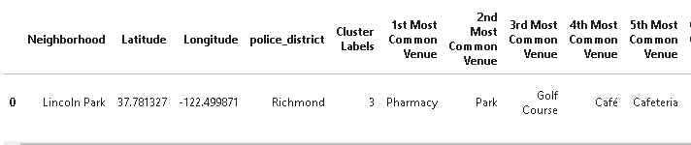
Cluster 3
Introduction
According to labels=3 The most popular categories are:
Pharmacy
Park
Gold Course
Café
Cafeteria
Bus Stop
It is recommended to open a coffee shop

Slide 30
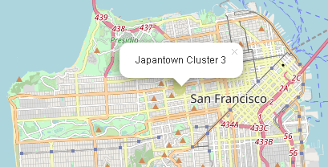
Cluster 3
Graphic and table
Introduction
According to labels=3 The most popular categories are:
Pharmacy
Park
Gold Course
Café
Cafeteria
Bus Stop
It is recommended to open a coffee shop

Slide 31

Answers to Initial Questions
Which all areas have more number of coffee shops?
According to reports are: Lincoln Park, Castro/Upper Market, Haight Ashbury, Hayes Valley, Inner Sunset, Lone Mountain, Inner Richmond, Outer Richmond, Presidio Heights , Western Addition
Which all areas have less number of coffeeshops?
According to reports are: Inner Richmond, JapanTown, Twin Peaks
Which districts have the neighborhoods safest ?
According to reports are: Park and Richmond
Which districts Neighborhoods The Most Unsafe Districts ?
According to reports are: Marina, South of Market, Tenderloin, District/ south Beachark, BayView and misión.
By: Marcos Cifuentes – mrmacisu@hotmail.com

Slide 32

Conclusion
According to the final clustering aplying modeling with k-means and elbow=4, it is recommende to open a Coffee Shop on the venues corresponding to Lincoln Park (corresponding to Richmond) and / or Lincoln Park, Castro/Upper Market, Haight Ashbury, Hayes Valley, Inner Sunset, Lone Mountain, Inner Richmond, Outer Richmond, Presidio Heights , Western Addition (corresponding to Park).
By: Marcos Cifuentes – mrmacisu@hotmail.com

