Slide 1
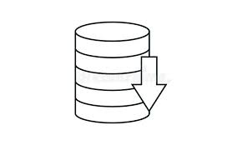




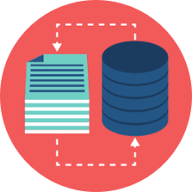
1
Part 1
Crime Rate in San Francisco Section
Dataset
Crime Rate in San Francisco Section
Loan Incidents
Clean Data
Display Data understanding
Data Preparation
Business
Understanding
Getting Data
7.1
7.2
7.3 – 7.4 – 7.5
7.6
Part 2
Dataset with locations of business
2
Neighborhood Visualization – top 5 venues category and Freq.
Dataset
Clean ,
Removing
Data
locations of businesses
DataSet Crime’s San francisco Clasification
Data
Preparation
Visualize Data understanding
Loan dataset
With locations
8.9
8.7 – 8.8
8.4 – 8.5 - 8,6
8.3
8.1 – 8.2
Clustering Neighborhoods
Display
Data
Add cluster
labels
Create
Map
Clusters
Visualize
Clusters
Examine
Clusters
Apply Elbow
8.10
Dataframe :: Crime Rate in San Francisco Section
Conclusion
Dataframe :: Business Locations + Safest Districts

Slide 2
Business
Understanding
Analytic Approach
Data Requirements
Data Collection
Conclusion
Data Cleaning
Evaluation
Data understanding
Modeling
Data preparation

