Slide 1
GOOGLE SOLUTION CHALLENGE 2026
AnchalAI
🤱
Maternal Care Intelligence
Smart Resource Allocation — Data-Driven Volunteer Coordination for Social Impact
24,000+
MLx Gemini
End-to-End
Protecting every mother. Empowering every ASHA.
maternal deaths/year in India
dropout prediction + vernacular AI
ADK multi-agent pipeline
AnchalAI | Google Solution Challenge 2026

Slide 2
Team Details
Meet the AnchalAI Team
Team Name
Google Solution Challenge 2026
AnchalAI
👑 Team Leader
🎯 Problem Statement
Hannan Ali Mallick
Smart Resource Allocation — Data-Driven Volunteer Coordination for Social Impact
GitHub: mrmallick07 https://github.com/mrmallick07/AnchalAI
🌍 SDG 3 — Good Health and Well-Being | Focus: Maternal mortality reduction in rural India
AnchalAI | Google Solution Challenge 2026

Slide 3
Solution Brief
What AnchalAI does
⚠️ The Problem
✅ The Solution: AnchalAI
India loses 24,000+ mothers annually to preventable complications.
ASHA workers — the last-mile healthcare volunteers — are overwhelmed:
• No tool to prioritize outreach from scattered field data
• No early warning for antenatal dropout risk
• Rely on manual registers and memory
• Language barriers in multilingual communities
The result: high-risk pregnant women are missed until it's too late.
AnchalAI predicts which pregnant women are at highest risk of dropping out of antenatal care.
🤖 ML Dropout Prediction
Trained Random Forest model on RCH registration data to score each woman by dropout probability.
🗣 Gemini Vernacular Messaging
Google Gemini generates personalized outreach messages in Bengali, Hindi, and English — tailored to risk factors.
🤝 ADK Multi-Agent Pipeline
RiskAnalystAgent → CommunicationAgent → EscalationAgent pipeline turns registration data into coordinated community action.
AnchalAI | Google Solution Challenge 2026

Slide 4
Opportunities & Uniqueness
Why AnchalAI stands out
🏆 Uniqueness
💡 Solution Approach
⭐ USP — Technical Edge
• Only tool combining ML risk prediction with vernacular AI outreach specifically for ASHA community health volunteers
• Bridges the gap between raw RCH registration data and actionable field intervention
• Designed for low-digital-literacy users in multilingual rural India
• Deployable with zero hardware — runs entirely on smartphones via GitHub Pages
• Converts scattered, incomplete registration data into a ranked priority list
• Removes guesswork — ASHA workers see exactly who needs contact first
• Gemini AI drafts the message so the ASHA worker doesn't need to compose it
• Escalation agent flags life-threatening cases for immediate supervisor action
• End-to-end ADK multi-agent pipeline on Cloud Run with Vertex AI
• Two independent Cloud Run services: Flask API + Agent API
• Session state management across agents for coherent decision-making
• Random Forest model with clinically-informed feature engineering
• GitHub Pages frontend — zero hosting cost for the dashboard
AnchalAI | Google Solution Challenge 2026

Slide 5
Key Features
AnchalAI capabilities at a glance
🧠
ML Dropout Prediction
📊
Real-Time ASHA Dashboard
🗣
Gemini Vernacular Messaging
Random Forest model trained on RCH data predicts each patient's probability of dropping out of antenatal care
GitHub Pages dashboard shows live risk scores, priority list, and outreach history — no app install needed
Google Gemini generates personalized outreach scripts in Bengali, Hindi, and English based on specific risk factors
🤖
ADK Multi-Agent Pipeline
🚨
Escalation Decision Engine
☁️
Fully Cloud Deployed
RiskAnalystAgent → CommunicationAgent → EscalationAgent: a full coordinated intelligence pipeline
EscalationAgent auto-identifies critical cases and notifies supervisors — prevents deaths from being overlooked
Two Cloud Run services, Vertex AI, GitHub Pages — production-ready, scalable, and pay-as-you-go
AnchalAI | Google Solution Challenge 2026

Slide 6
Process Flow
From registration to intervention
1
2
3
4
Pregnant Woman Registers
RCH Data Ingested
AnchalAI Prediction Model
Risk Score Generated
Patient enrolled in RCH portal
→
Registration data pulled into system
→
Random Forest scores dropout risk
→
High / Medium / Low classification
5
6
7
8
ASHA Dashboard Updated
Gemini Message Generated
ASHA Contacts Woman
Follow-up Logged
Worker sees ranked priority list
→
Vernacular outreach message created
→
Call / visit made with AI-drafted script
→
Outcome recorded, model updated
AnchalAI | Google Solution Challenge 2026

Slide 7
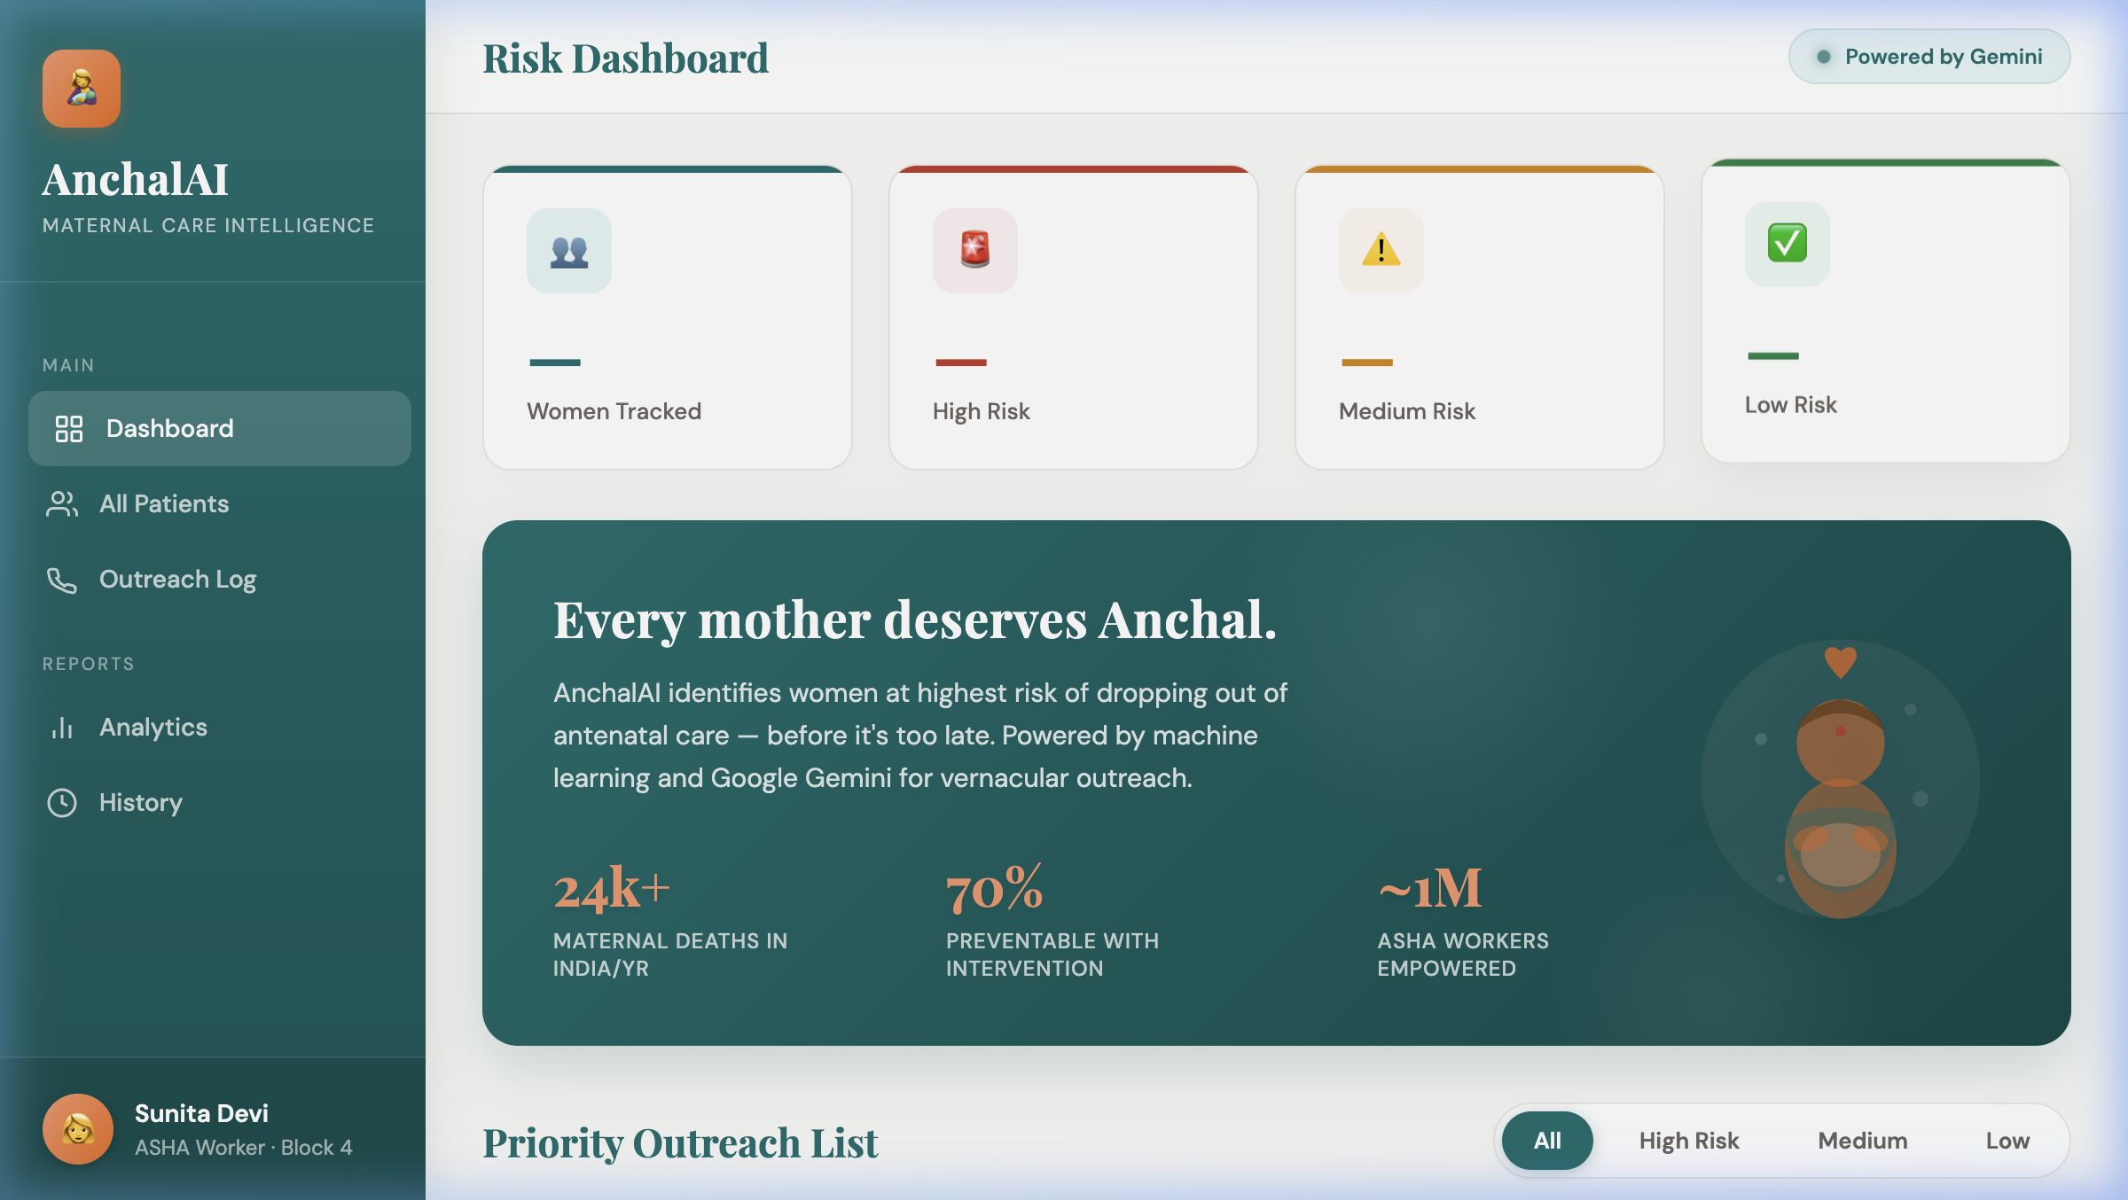
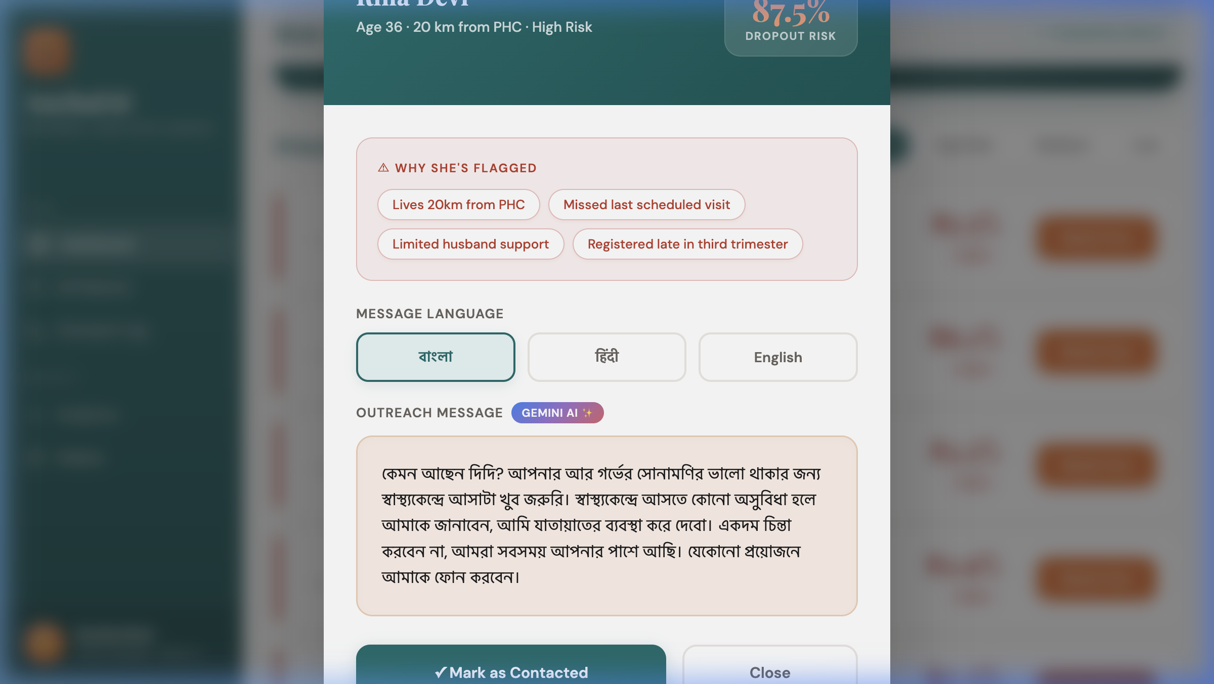
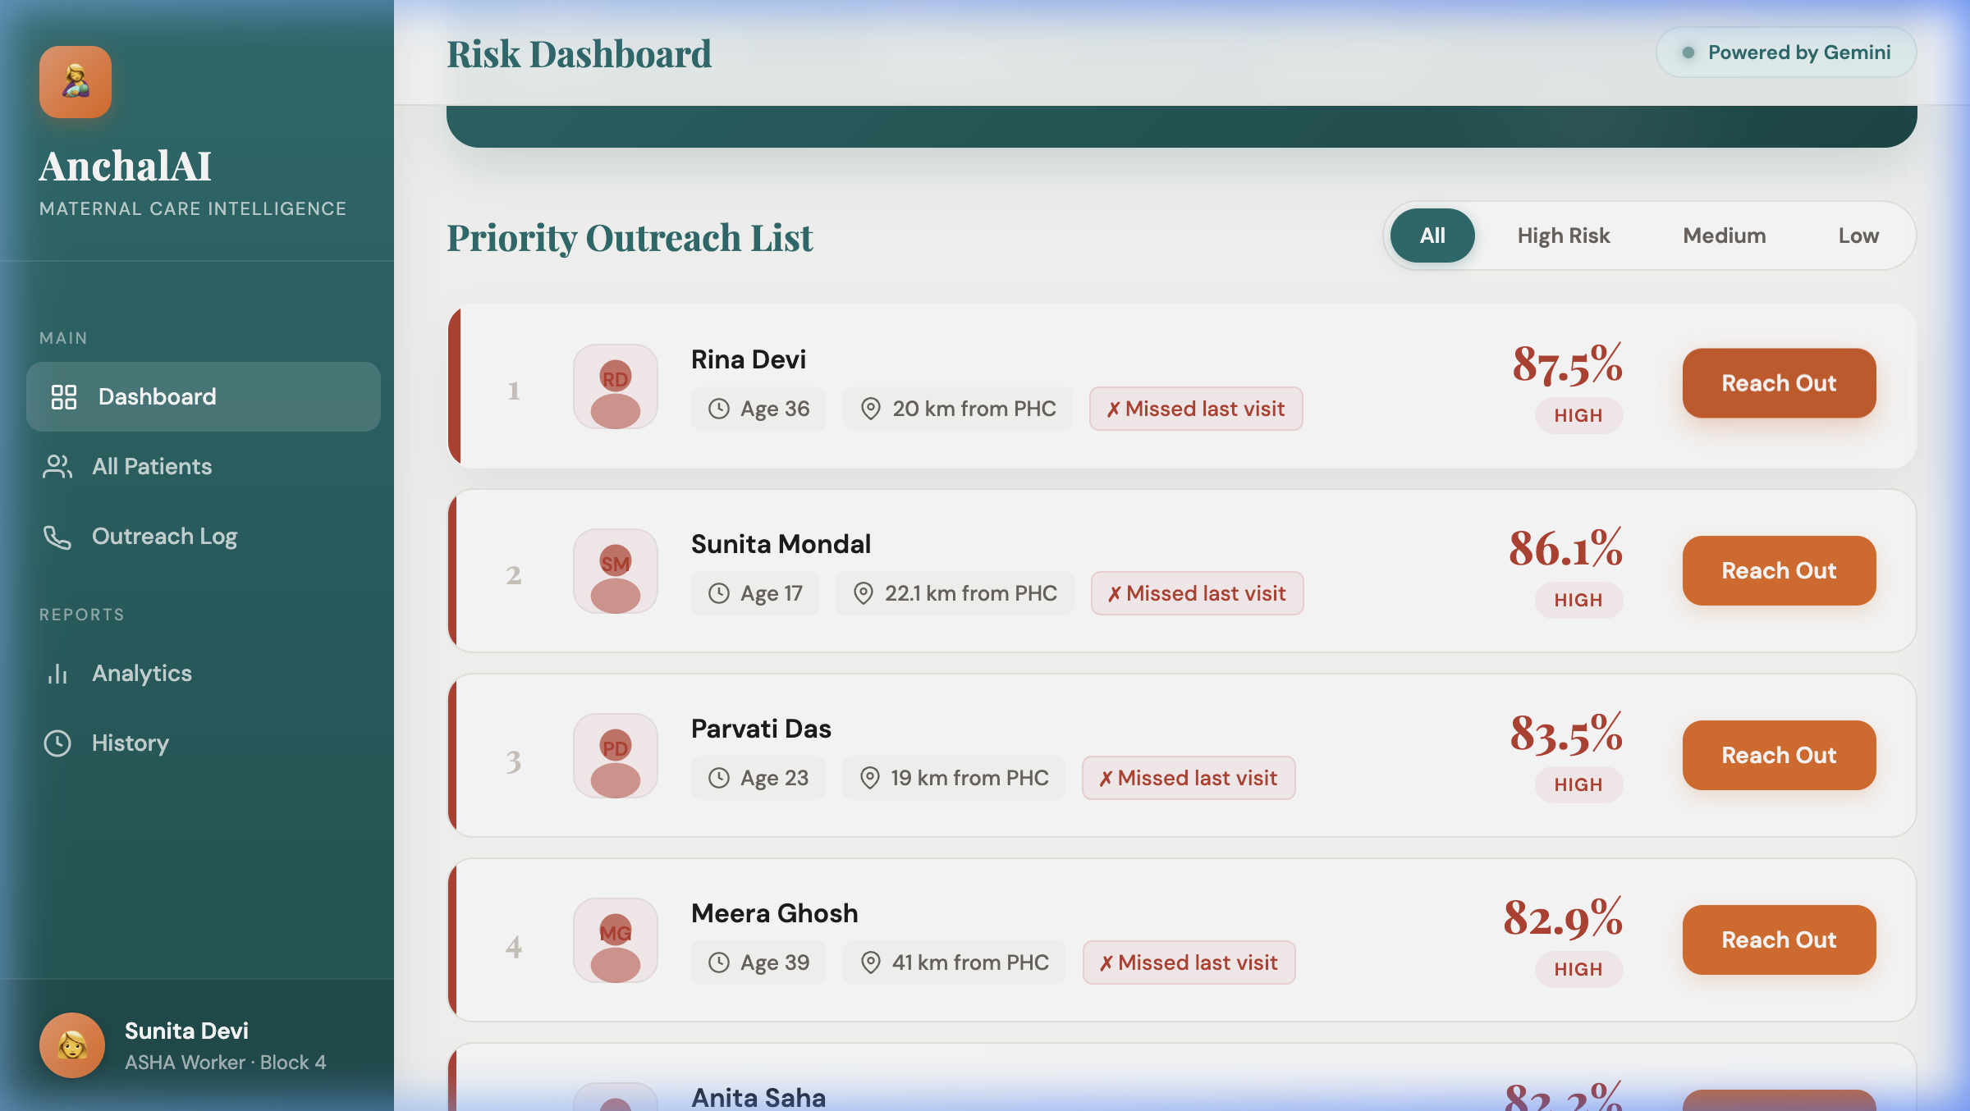
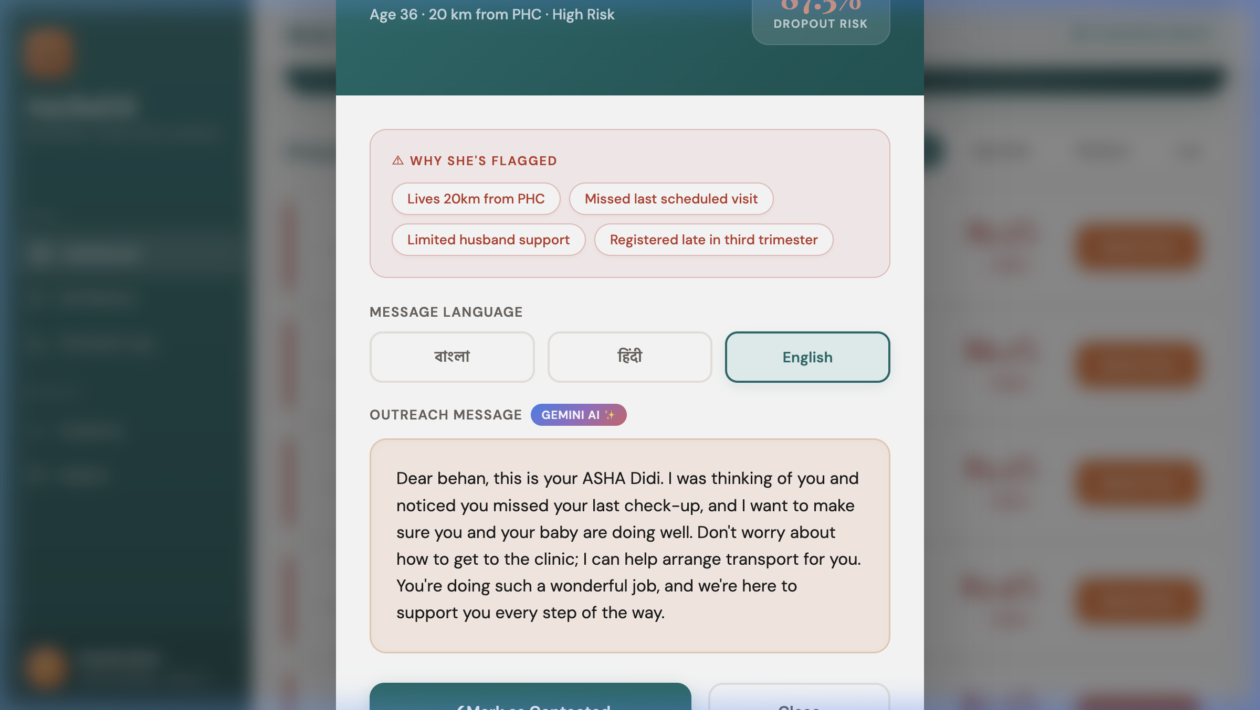
Dashboard Wireframes & UI Snapshots
AnchalAI MVP — Live at GitHub Pages
UI Components
📂 Sidebar Navigation
All Patients · Outreach Log · Analytics · History
📊 Stats Bar
High / Medium / Low risk patient counts at a glance
📋 Priority List
Women ranked by dropout risk %; key risk factor labels
💬 Gemini Modal
AI message in Bengali / Hindi / English per patient
🚨 Risk Filter
One-click filter: High Risk only view for rapid triage
AnchalAI | Google Solution Challenge 2026

Slide 8
System Architecture
End-to-end technical overview
👩‍⚕️ ASHA Worker
🌐 GitHub Pages Dashboard
⚙️ Flask API (Cloud Run #1)
🧠 ML Model (Random Forest)
→
→
→
↓
ADK Multi-Agent Pipeline (Cloud Run Service #2)
🔎 RiskAnalystAgent
✉️ CommunicationAgent
🚨 EscalationAgent
→
→
↑ Gemini API call
🌟 Vertex AI Gemini
💬 Response to Dashboard
AnchalAI | Google Solution Challenge 2026

Slide 9
Technologies Used
Google-first technology stack
🌐 Google Cloud Technologies
🛠 Open Source & Supporting Stack
Google Gemini (Vertex AI)
Python Flask
Natural language generation for vernacular outreach messages in Bengali, Hindi, English
REST API backend serving predictions and Gemini responses
scikit-learn / Random Forest
Google ADK (Multi-Agent)
ML model for dropout probability scoring
RiskAnalystAgent, CommunicationAgent, EscalationAgent orchestration framework
FastAPI
Agent API service framework for ADK pipeline
Google Cloud Run (×2)
Flask API + Agent pipeline — serverless, containerized, auto-scaling
GitHub Pages
Zero-cost frontend hosting for the ASHA dashboard
Vertex AI Platform
Python 3.11
Hosts Gemini inference, scalable ML serving infrastructure
Runtime for all services
Docker / Cloud Build
Containerization and CI/CD on GCP
AnchalAI | Google Solution Challenge 2026

Slide 10
Cost Analysis
Pay-as-you-go — designed for scale
☁️
🌟
🌐
💾
Cloud Run
Vertex AI Gemini
GitHub Pages
Cloud Storage / DB
~$0
~$0.001
$0
~$0
at prototype scale (pay per request)
per message generated (gemini-2.0-flash)
completely free static hosting
file-based model at prototype stage
📈 Scale Cost Projection
1,000 ASHA workers × ~50 messages/month = 50,000 Gemini calls → ~$50/month
Cloud Run auto-scales; cost is proportional to usage. Zero idle cost.
Full production deployment (10,000 workers): estimated under $500/month.
AnchalAI | Google Solution Challenge 2026

Slide 11
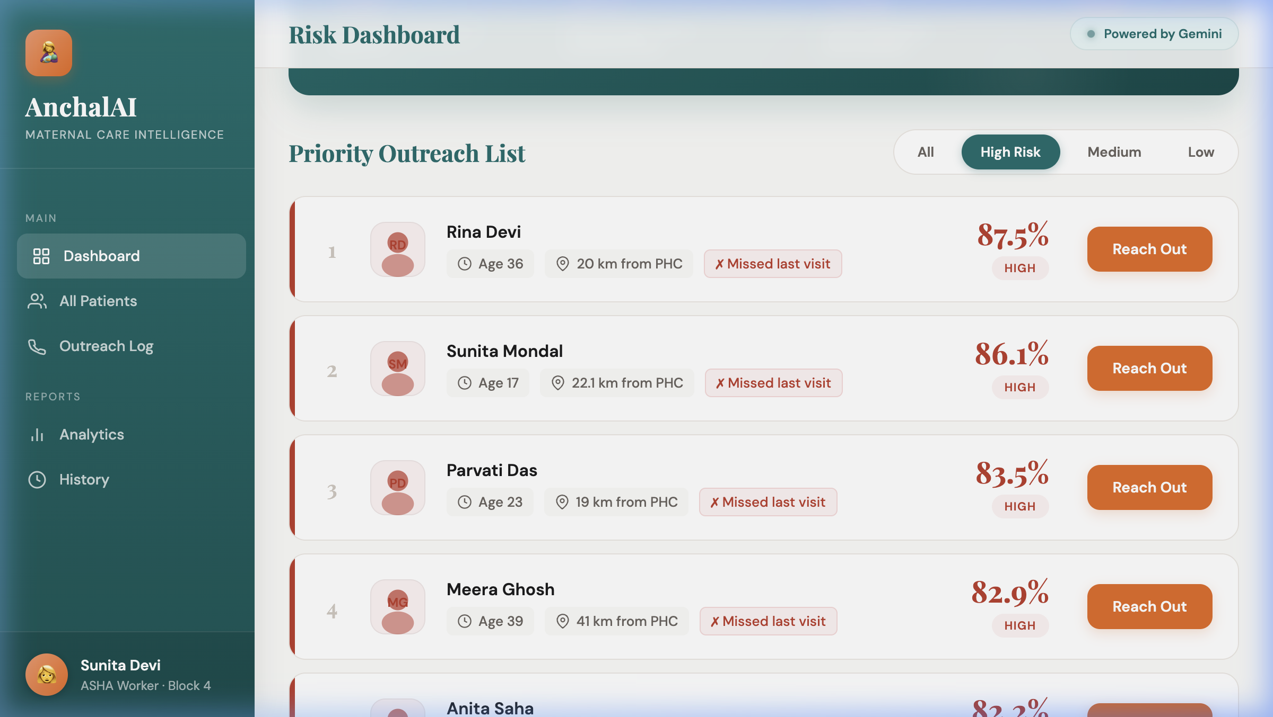
MVP Snapshots
Live prototype at mrmallick07.github.io/AnchalAI
Main Dashboard — Risk Statistics
Priority Outreach List — Ranked by Risk %
Gemini Modal — Bengali Message
Gemini Modal — English Message
Filtered: High Risk Only View
AnchalAI | Google Solution Challenge 2026

Slide 12
Future Development Roadmap
Scaling AnchalAI for national impact
Phase 1 — Integration
Phase 2 — Offline & Mobile
• Integration with NHM RCH Portal API for live patient data
• Replace mock data with real-time hospital feeds
• Automated nightly risk score refresh pipeline
• Offline Android app for low-connectivity rural areas
• Local SQLite storage with background sync when online
• Progressive Web App (PWA) support for feature phones
Phase 3 — Disease Expansion
Phase 4 — Infrastructure
• TB adherence monitoring and dropout prediction
• Child immunization schedule dropout detection
• Nutrition program follow-up coordination
• AlloyDB for real outcome data storage and training
• WhatsApp Business API for direct ASHA-to-patient outreach
• National NHM dashboard for district health officers
• Federated learning for multi-state model improvement
AnchalAI | Google Solution Challenge 2026

Slide 13
Important Links & Resources
Connect with AnchalAI
🐙 GitHub Repository
https://github.com/mrmallick07/AnchalAI
Full source code — agents, ML model, Flask API, frontend
🌐 Live MVP Dashboard
https://mrmallick07.github.io/AnchalAI/
Prototype dashboard — runs in browser, no install needed
🤖 Agent API Endpoint
https://anchalai-agent-961197586142.asia-south1.run.app
ADK multi-agent pipeline deployed on Cloud Run (asia-south1)
🎬 Demo Video
[To be added — link available at presentation]
Full walkthrough of ASHA workflow — risk prediction to outreach
"Every data point is a mother. Every prediction is a life saved." — AnchalAI
AnchalAI | Google Solution Challenge 2026

