Slide 1

Dashboard Prototype
SMS group – Basic presentation
Confidential

Slide 2

Dashboard’s Powered by Plotly, Python & Panda
Digitalization makes it possible to take different points of view

Slide 3
plotly | Dash: - Dash is a Python framework for building analytical web applications. No JavaScript required build on top of Plotly.js, React, and Flask, Dash ties modern UI elements like dropdowns, sliders, and graphs directly to your analytical python code.
pandas is a Python package providing fast, flexible, and expressive data structures designed to make working with "relational" or "labeled" data both easy and intuitive. It aims to be the fundamental high-level building block for doing practical, real world data analysis in Python.
Both projects are open source and license under MIT and BSD3 respectively.

Slide 4
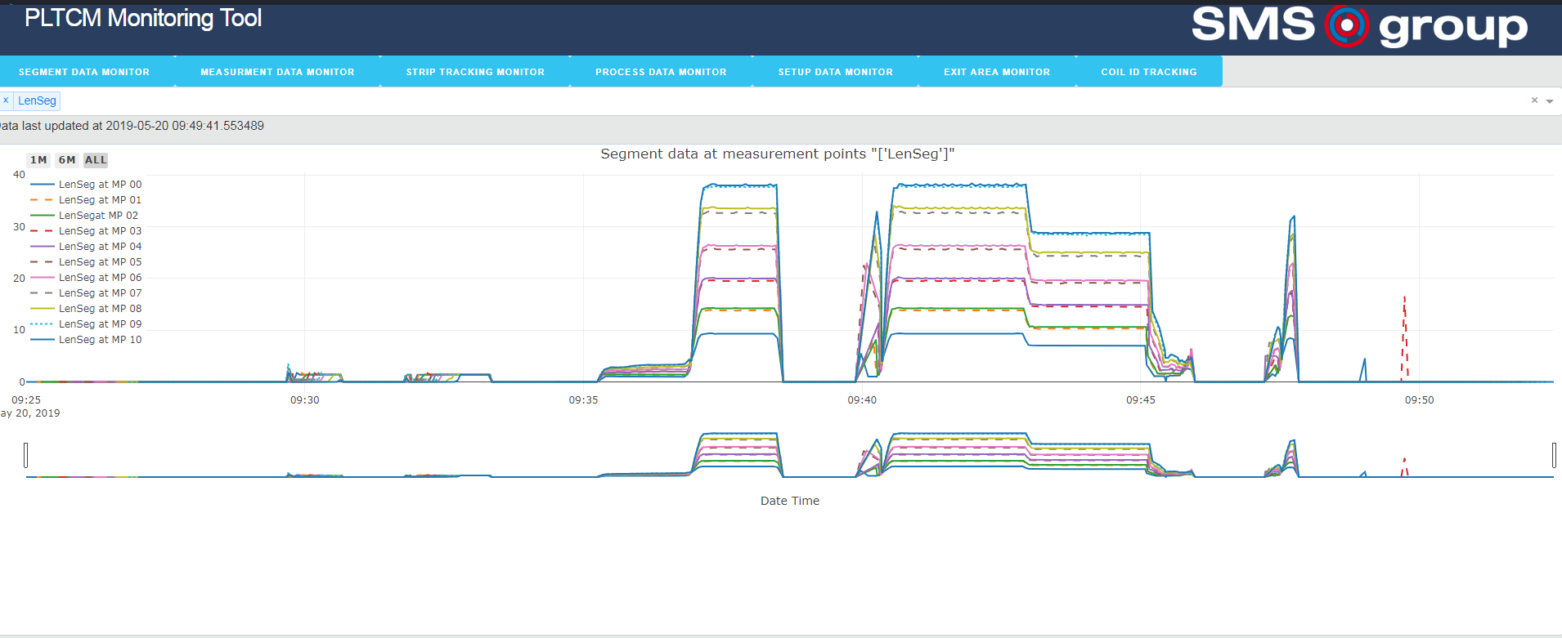

Slide 5
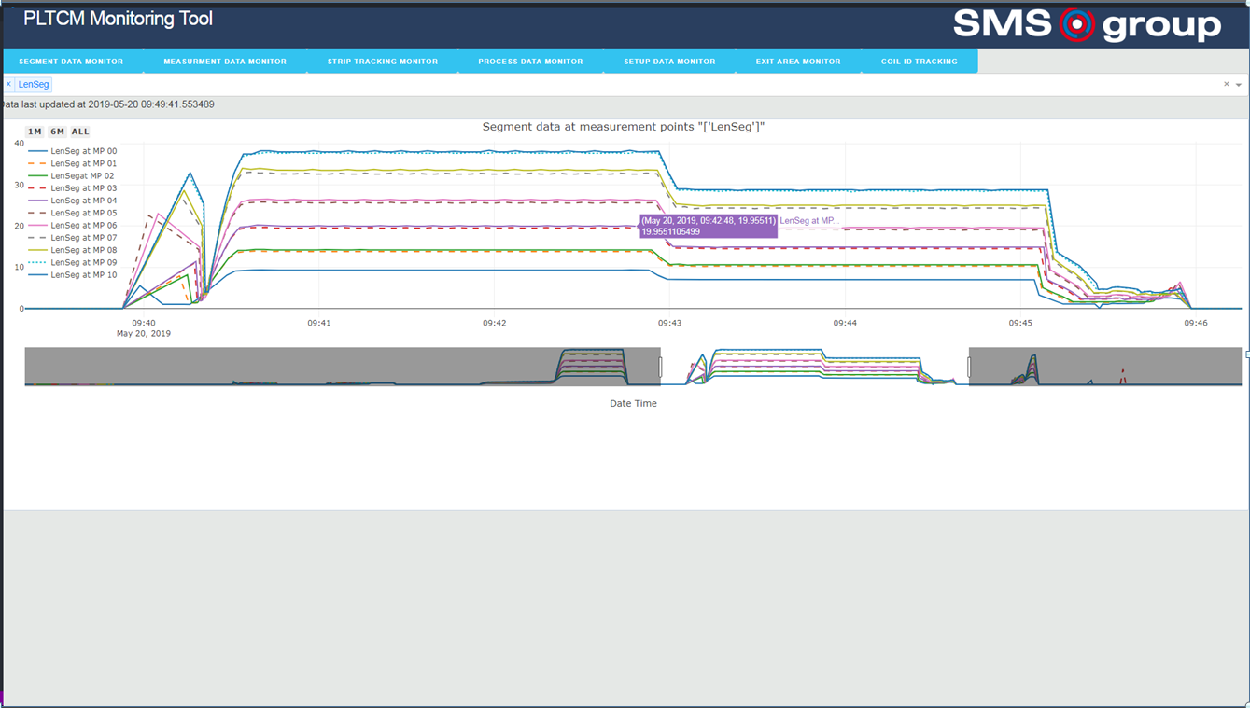

Slide 6
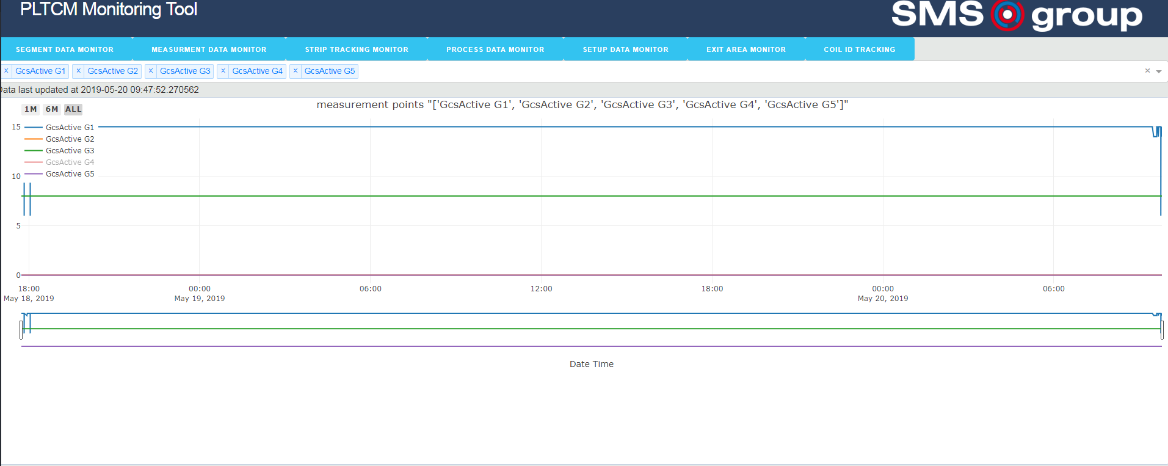

Slide 7
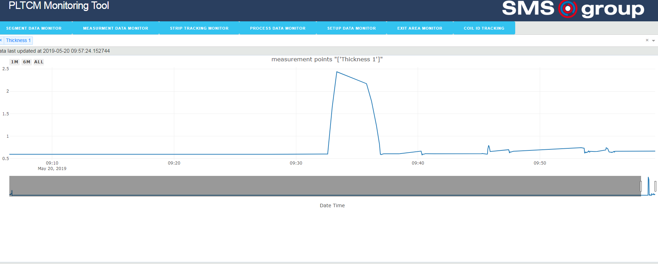

Slide 8
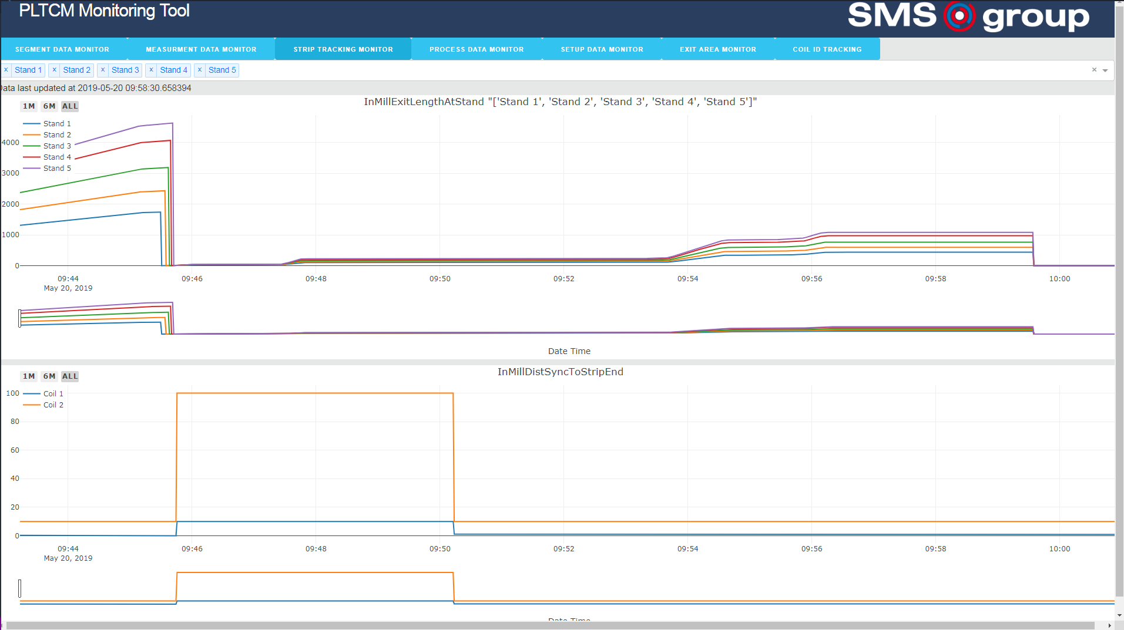

Slide 9
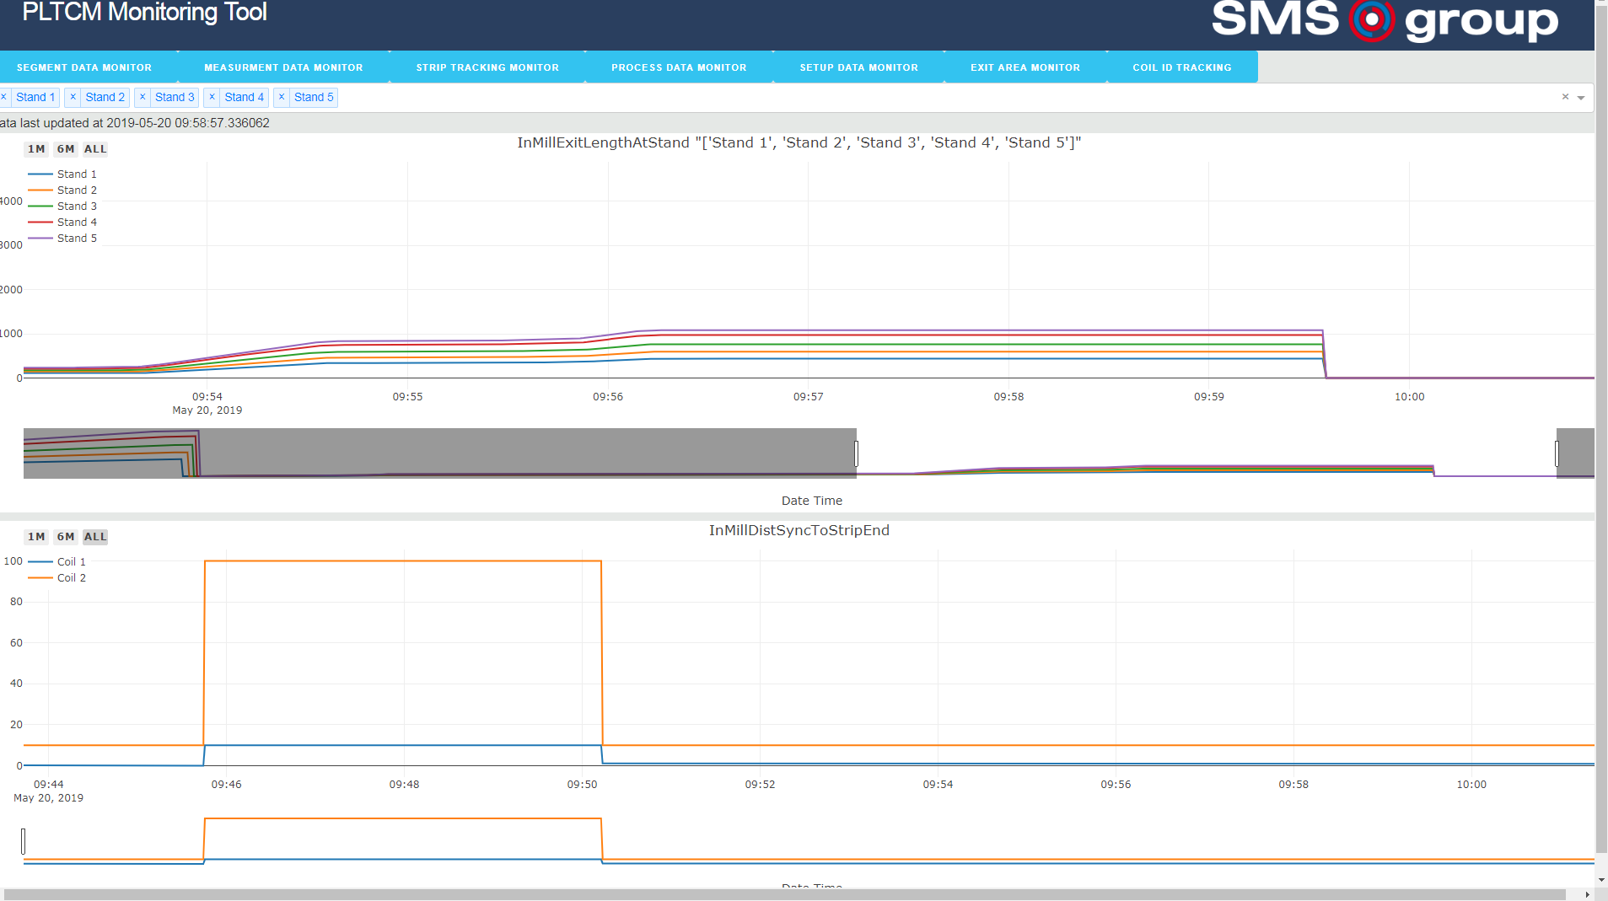

Slide 10
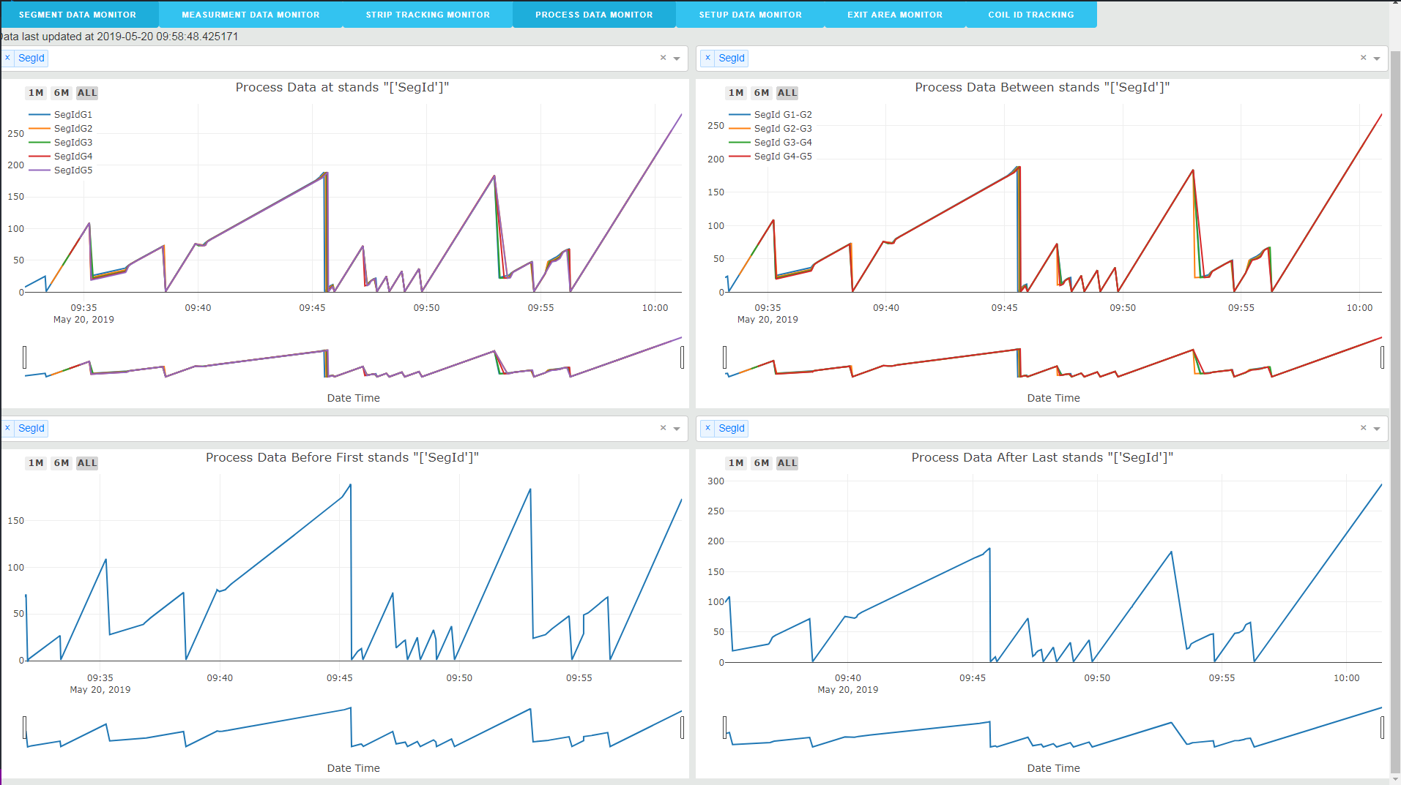

Slide 11
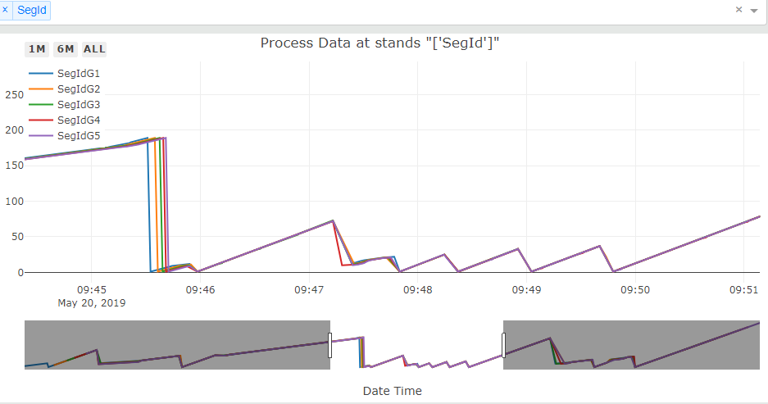

Slide 12
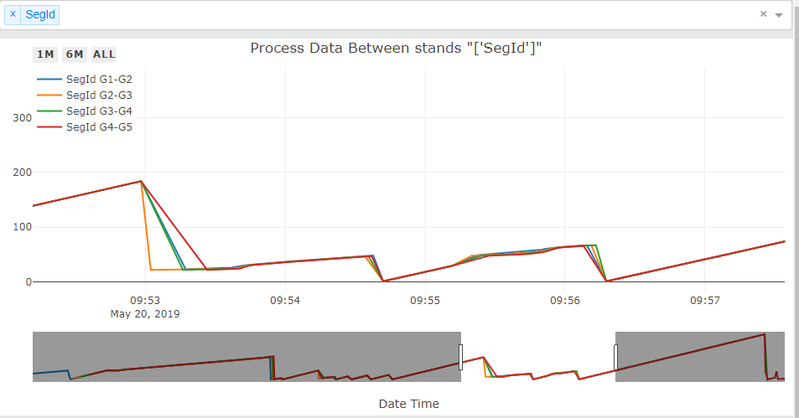

Slide 13
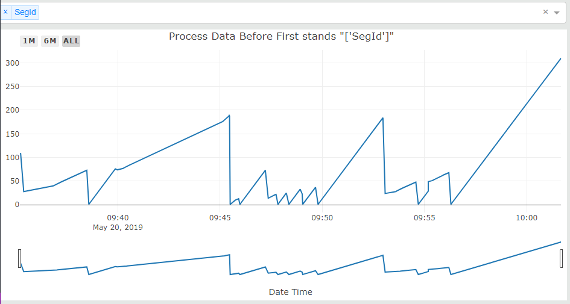

Slide 14
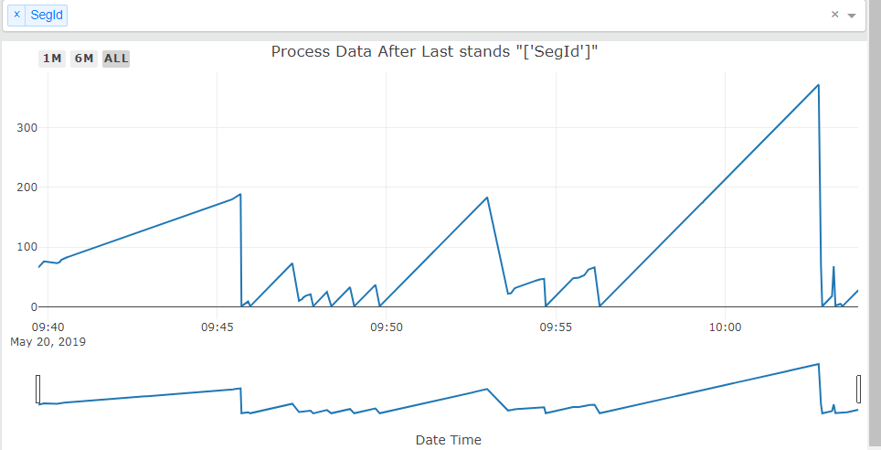

Slide 15
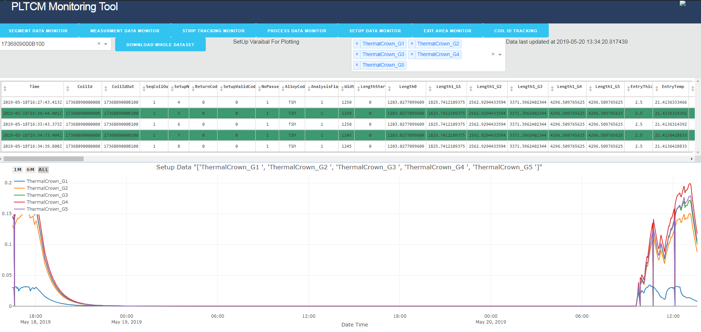

Slide 16
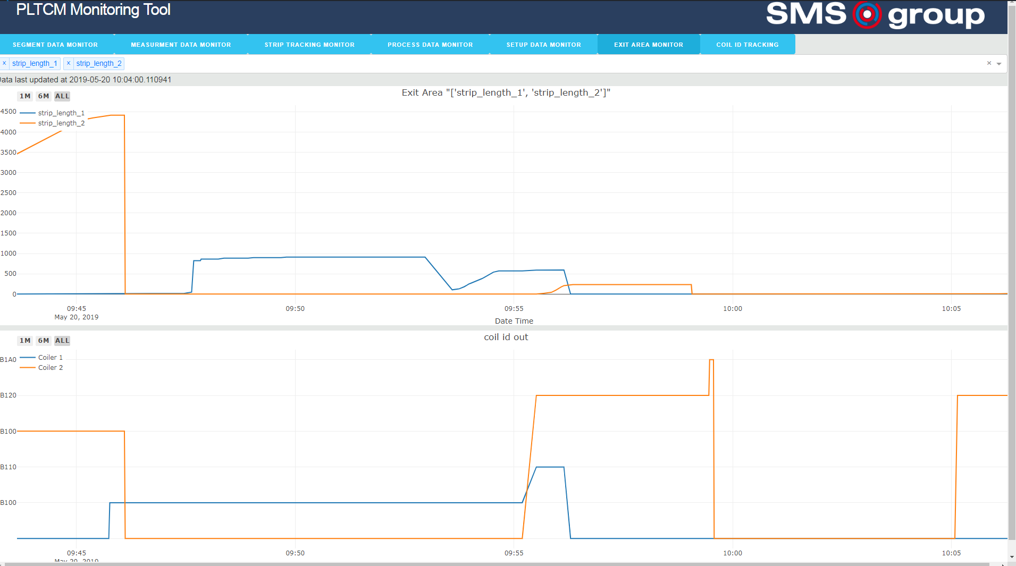

Slide 17
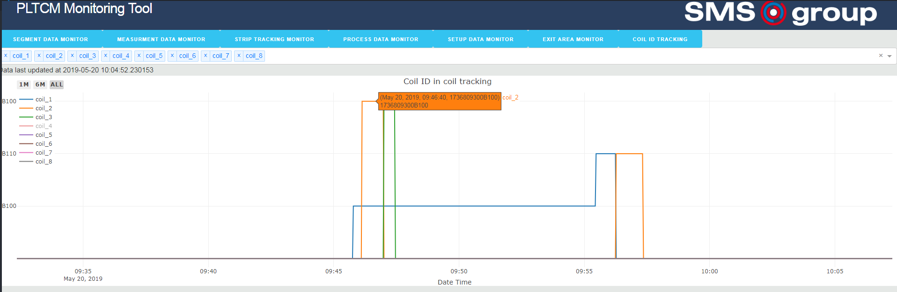

Slide 18
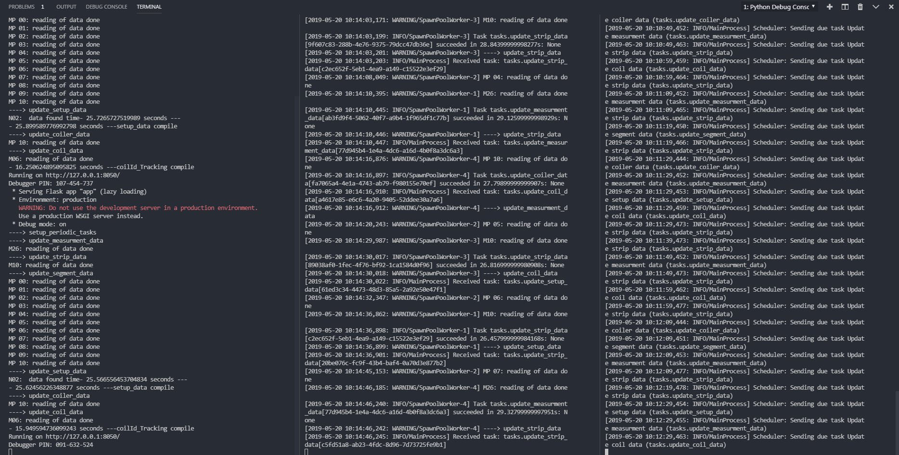

Slide 19
