Slide 1

Dashboard Prototype
Author: ROYM
hfghghfgh
Confidential

Slide 2
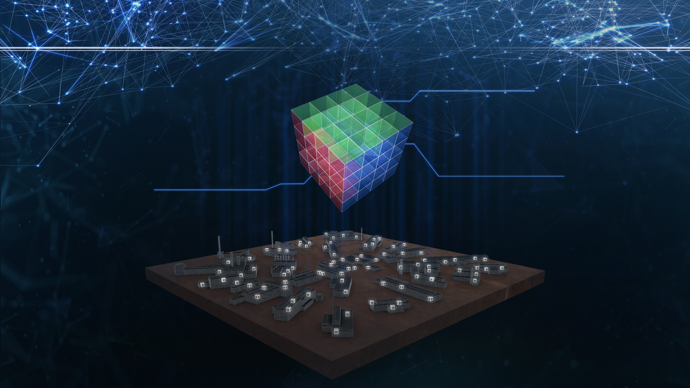
Dashboard’s Powered by Plotly, Python & Panda
Digitalization makes it possible to take different points of view

Slide 3
Introduction
While working on PLTCM Web HMI project I came across data visualization tool used in this project. The tool simply uses the matplotlib(open source lib for plotting graphs) to plot data from data’s received from respective machine.
However this tool require full user intervention to load the data from a flat file system. As data’s are huge it’s take ample amount of time before rendering the plot.
Bottleneck
It’s good tool to visualize the data from machine and verify the various process event that has happened during the process. But at same time it’s not automated, Interactive and real time as user has to refresh the data every time by loading it to form.

Slide 4
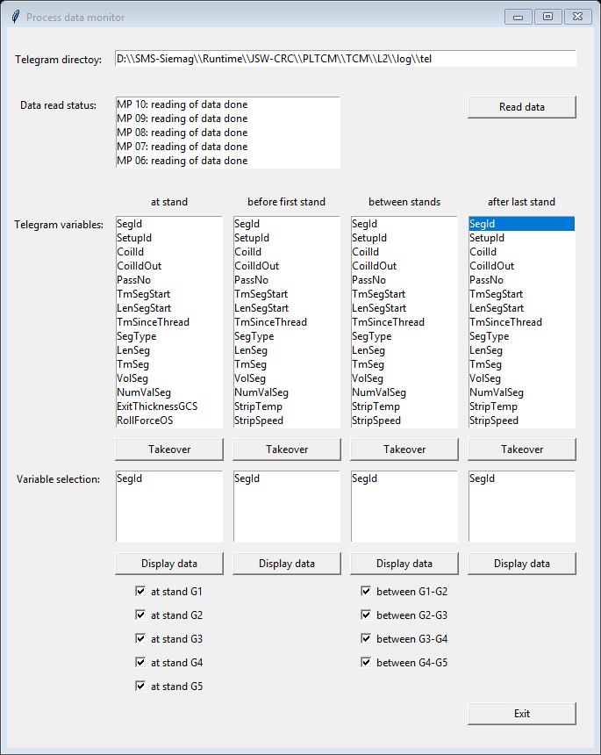
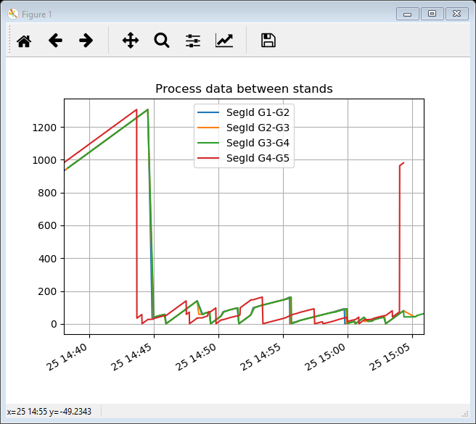
Old visualization tool was based on python and Matplotlib

Slide 5
Enhancement
Plotly | Dash: - Dash is a Python framework for building analytical web applications. No JavaScript required build on top of Plotly.js, React, and Flask, Dash ties modern UI elements like dropdowns, sliders, and graphs directly to your analytical python code.
pandas is a Python package providing fast, flexible, and expressive data structures designed to make working with "relational" or "labeled" data both easy and intuitive. It aims to be the fundamental high-level building block for doing practical, real world data analysis in Python.
pandas is a Python package License under BSD 3-Clause. http://pandas.pydata.org/pandas-docs/stable/getting_started/overview.html#license
Plotly | Dash is License under MIT. https://github.com/plotly/dash/blob/master/LICENSE

Slide 6
NumPy: -NumPy is a library for the Python programming language, adding support for large, multi-dimensional arrays and matrices, along with a large collection of high-level mathematical functions to operate on these arrays.
Celery: Distributed Task Queue
Celery is an asynchronous task queue/job queue based on distributed message passing. It is focused on real-time operation, but supports scheduling as well.
The execution units, called tasks, are executed concurrently on a single or more worker servers using multiprocessing, Eventlet, or gevent. Tasks can execute asynchronously (in the background) or synchronously (wait until ready).
Celery is licensed under The BSD License (3 Clause). https://github.com/celery/celery/blob/master/LICENSE
NumPy is licensed under the BSD license, enabling reuse with few restrictions.
https://www.numpy.org/license.html

Slide 7
Redis is an open source (BSD licensed), in-memory data structure store, used as a database, cache and message broker. It supports data structures such as strings, hashes, lists, sets, sorted sets with range queries, bitmaps, hyperloglogs, geospatial indexes with radius queries and streams. Redis has built-in replication, Lua scripting, LRU eviction, transactions and different levels of on-disk persistence, and provides high availability via Redis Sentinel and automatic partitioning with Redis Cluster.
https://redis.io/topics/license

Slide 8
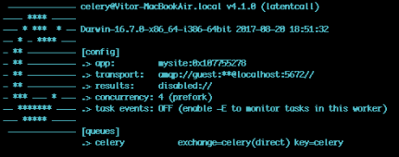
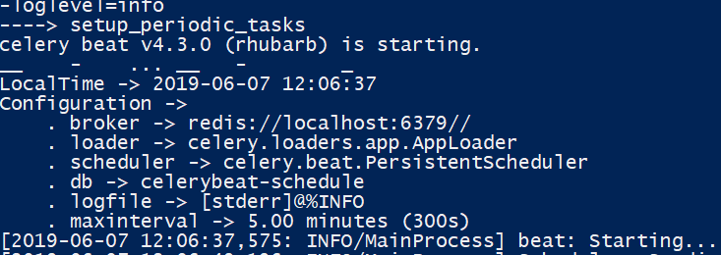
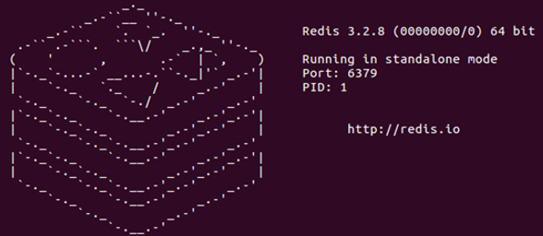
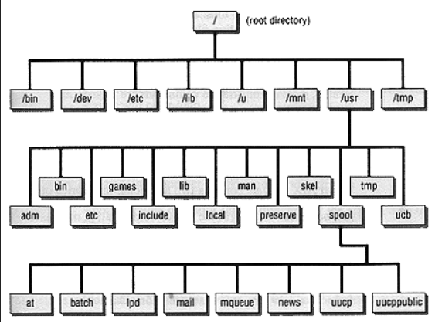
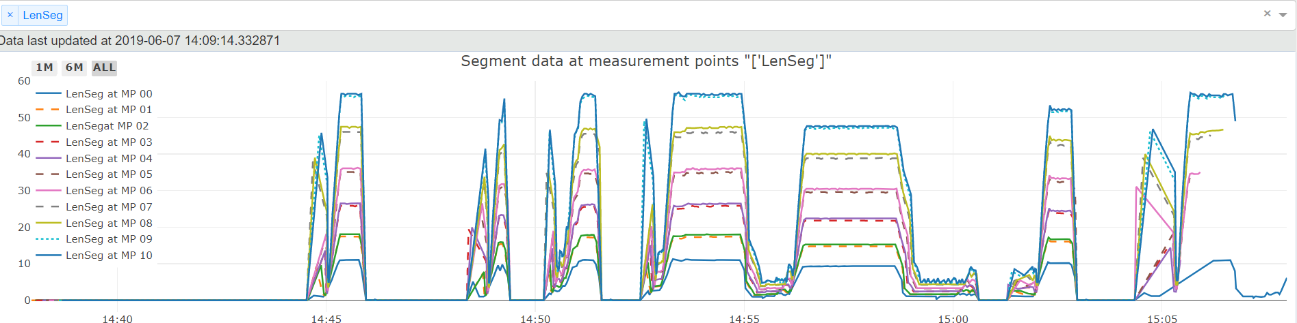
Application Architecture
Celery Worker
Celery Beat
File System
Redis Database
Dash App

Slide 9
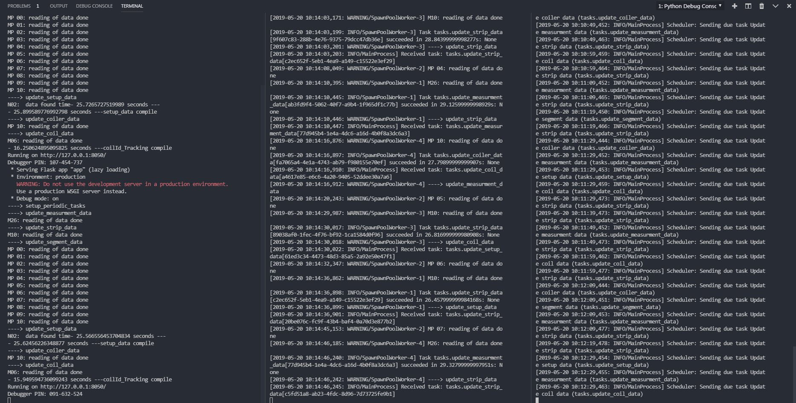
Flask Application
Celery Worker
Celery Beat

Slide 10
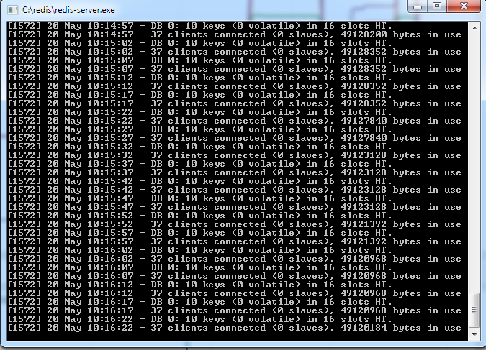
Redis Database

Slide 11
Software Cost Matrix
Name | Description | License Type | Cost
Dash | Dash is a Python framework for building analytical web applications | Open Source | Nil
Plotly | online data analytics and visualization tools | Open Source | Nil
Pandas | real world data analysis in Python. | Open Source | Nil
Numpy | multi-dimensional Array Handling in Python | Open Source | Nil
Celery | Celery is an asynchronous task queue/job queue based on distributed message passing | Open Source | Nil
Redis | In-memory data structure store, used as a database, cache and message broker | Open Source | Nil

Slide 12
World of Metals
Dash will easily fit into our company requirement for data analytics and Production/Maintenance dashboard.
This could be our first data driven package for the steel plant where we can present the customer with the dashboard, Data visualization, Machine learning model output.

Slide 13
Dash App Architecture
Structuring a Multi-Page App
Here's how to structure a multi-page app, where each app is contained in a separate file.
File structure:
app.py
index.py
apps
-- __init__.py
-- app1.py
-- app2.py
It is worth noting that in both of these project structures, the Dash instance is defined in a separate app.py, while the entry point for
running the app is index.py.
This separation is required to avoid circular imports: the files containing the callback definitions require access to the
Dash app instance however if this were imported from index.py, the initial loading of index.py
would ultimately require itself to be already imported, which cannot be satisfied.

Slide 14
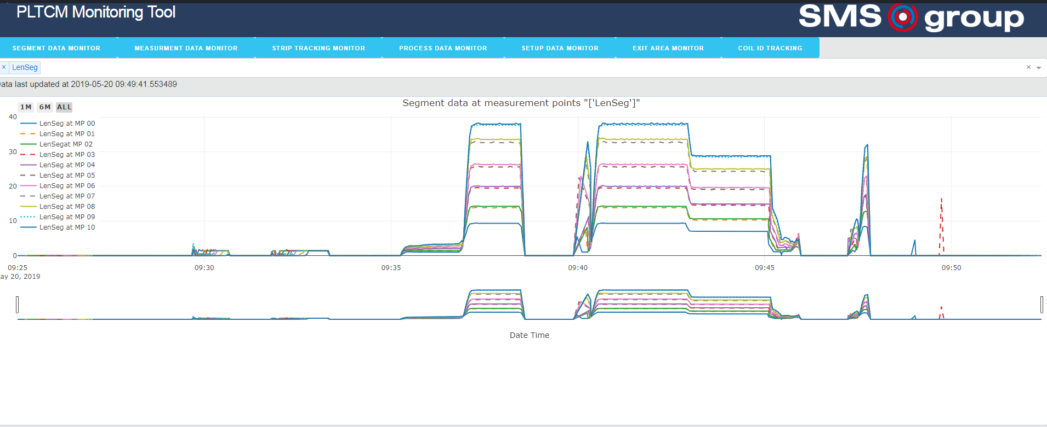
Machine Data Visualization

Slide 15
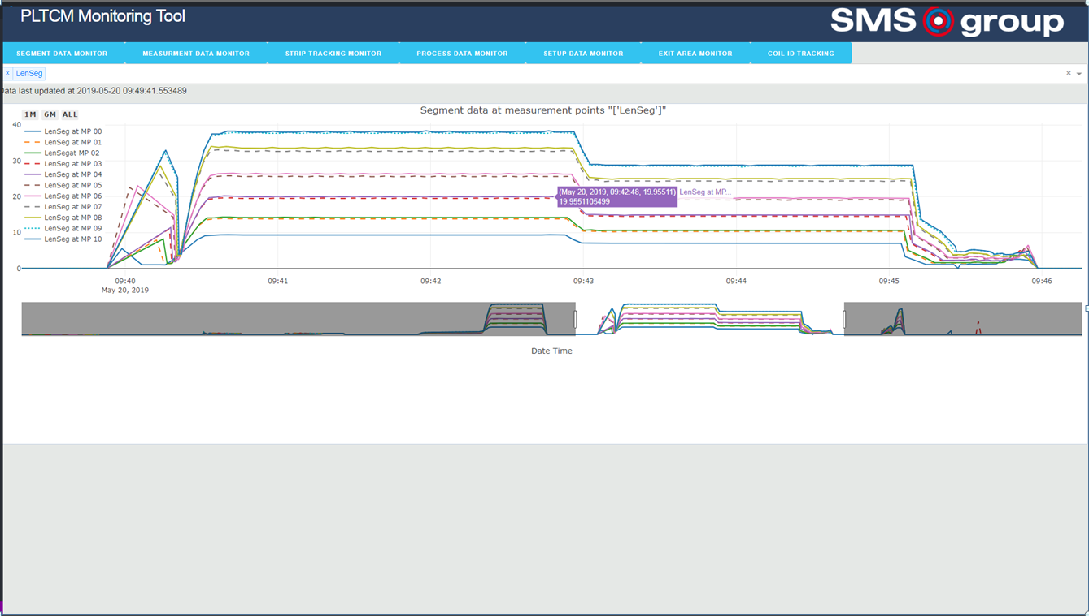

Slide 16
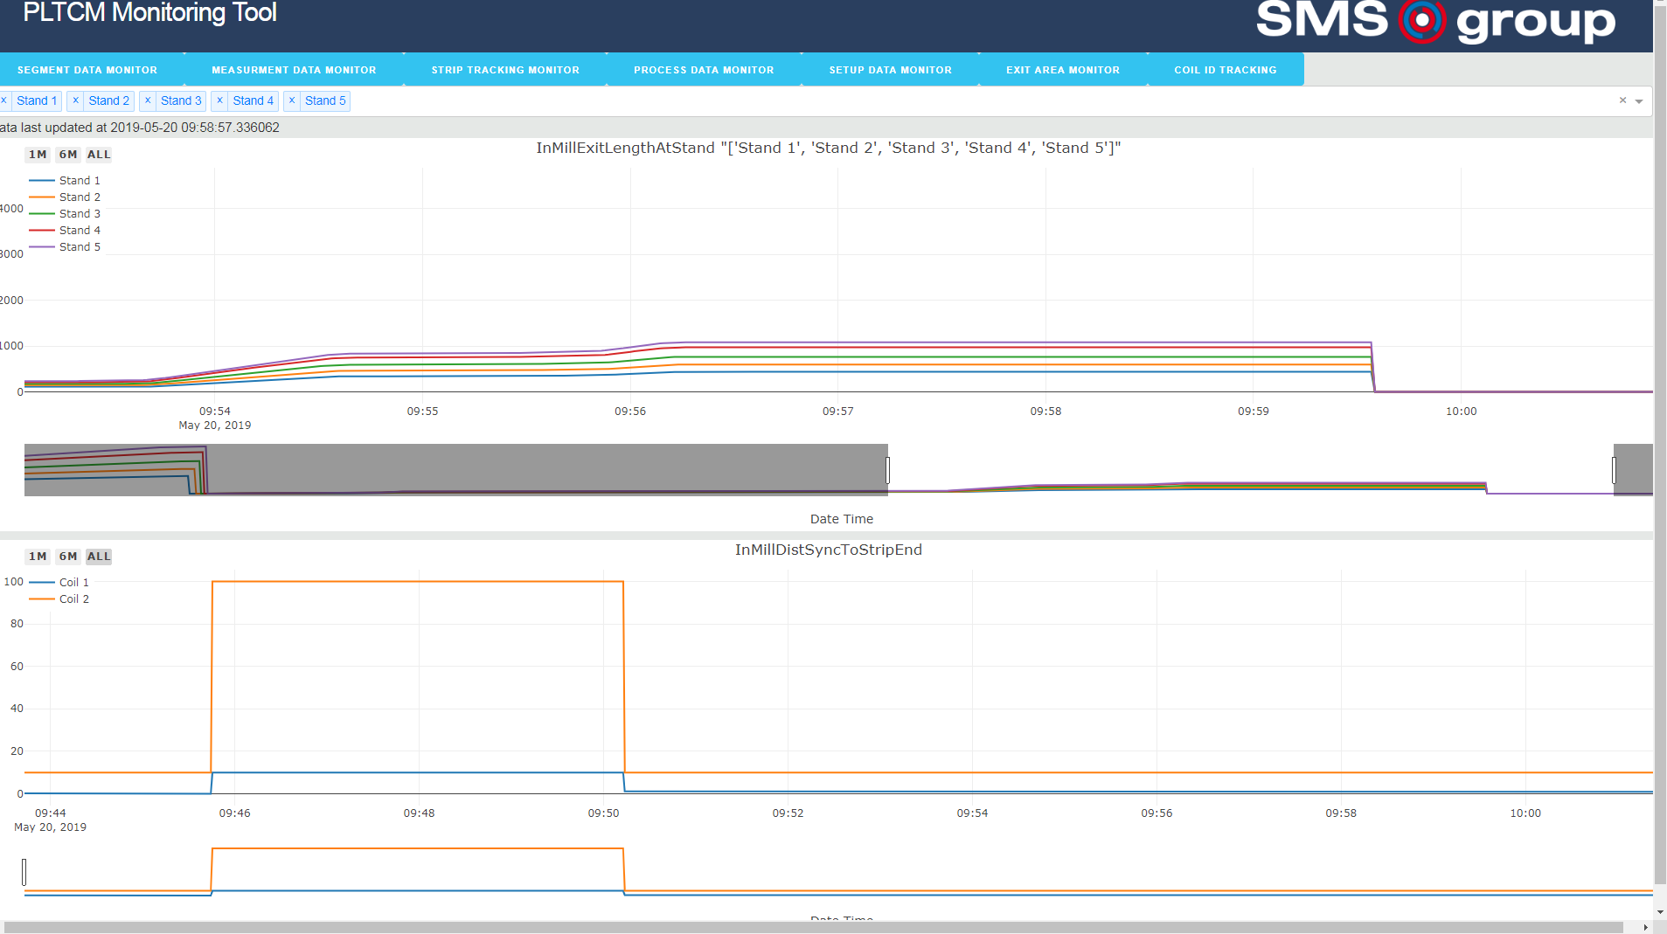

Slide 17
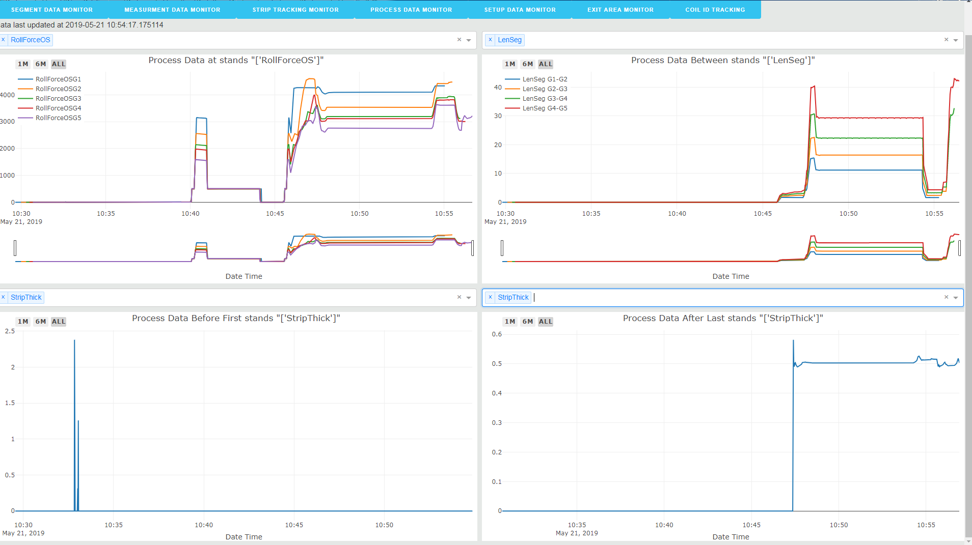

Slide 18
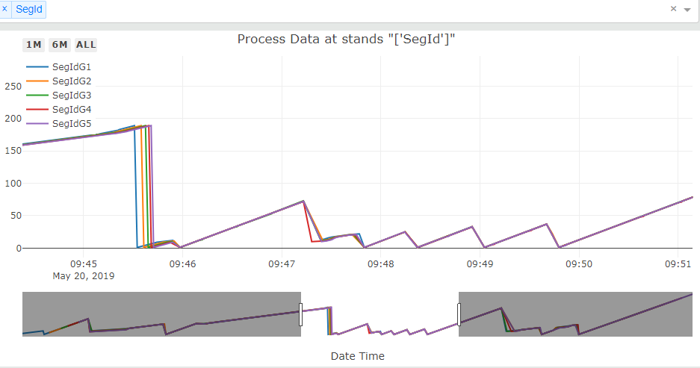

Slide 19
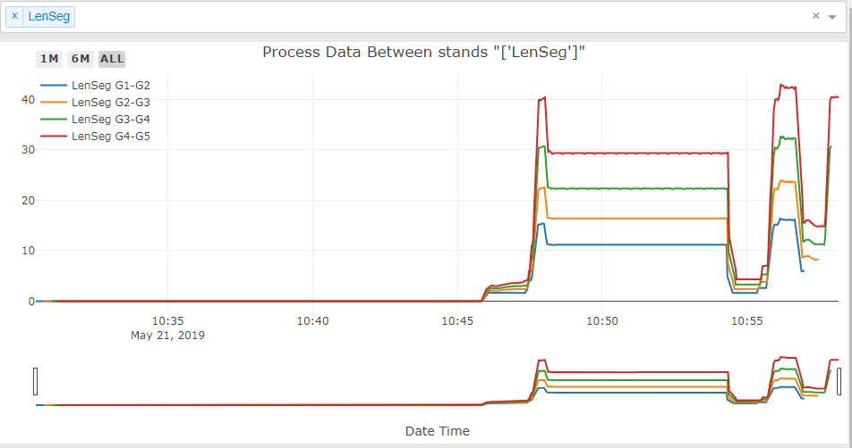

Slide 20
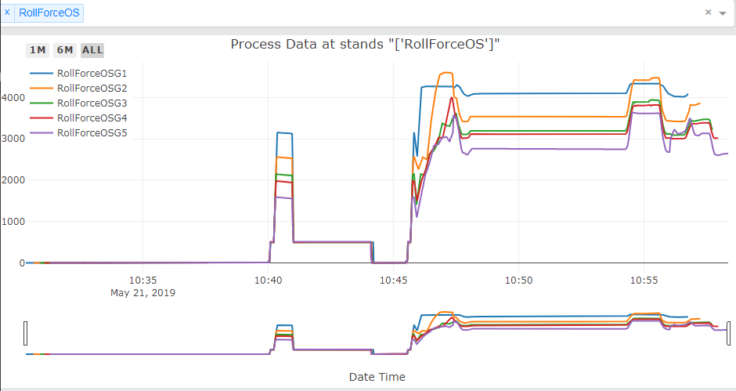

Slide 21
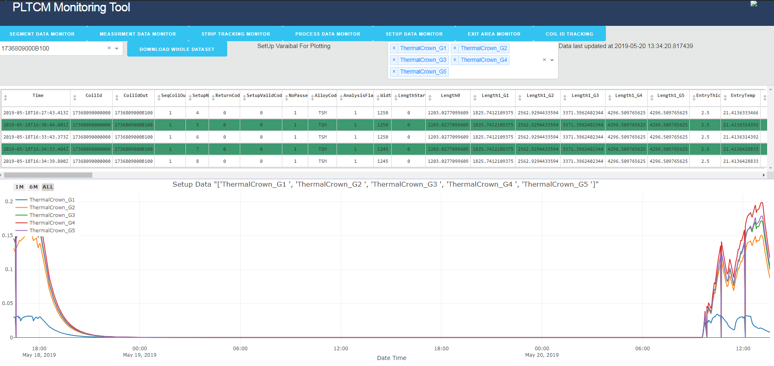

Slide 22
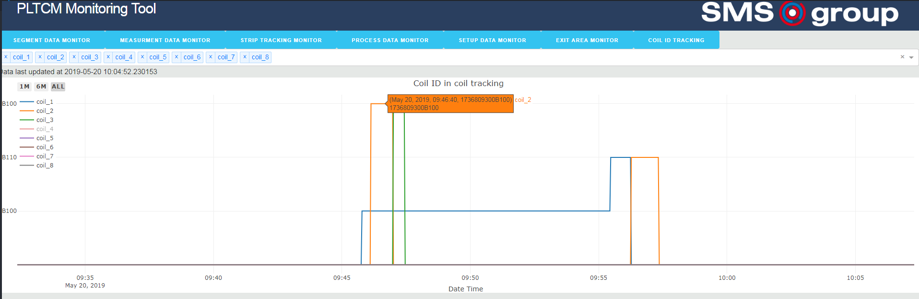

Slide 23
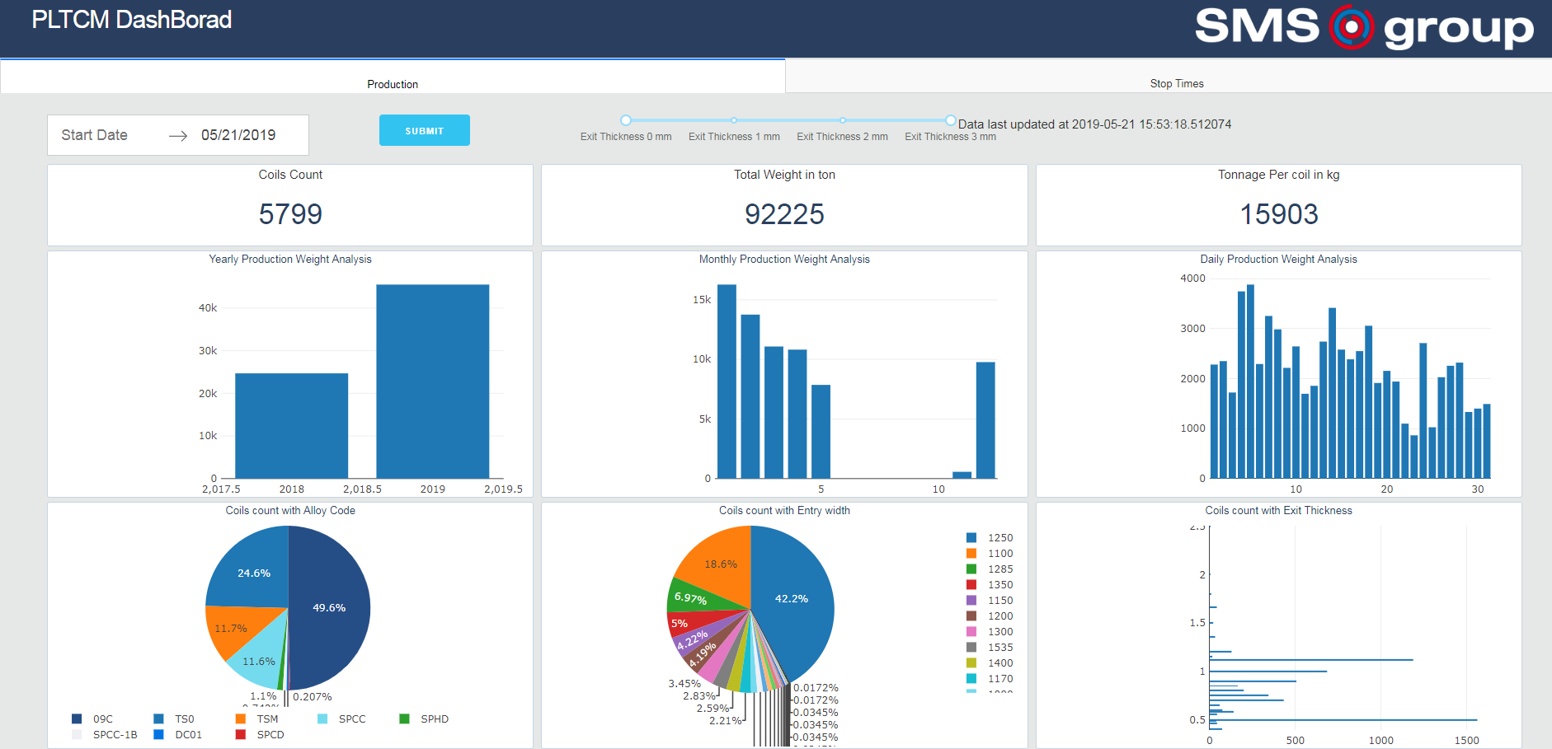
Prototype of Production DashBoard

Slide 24
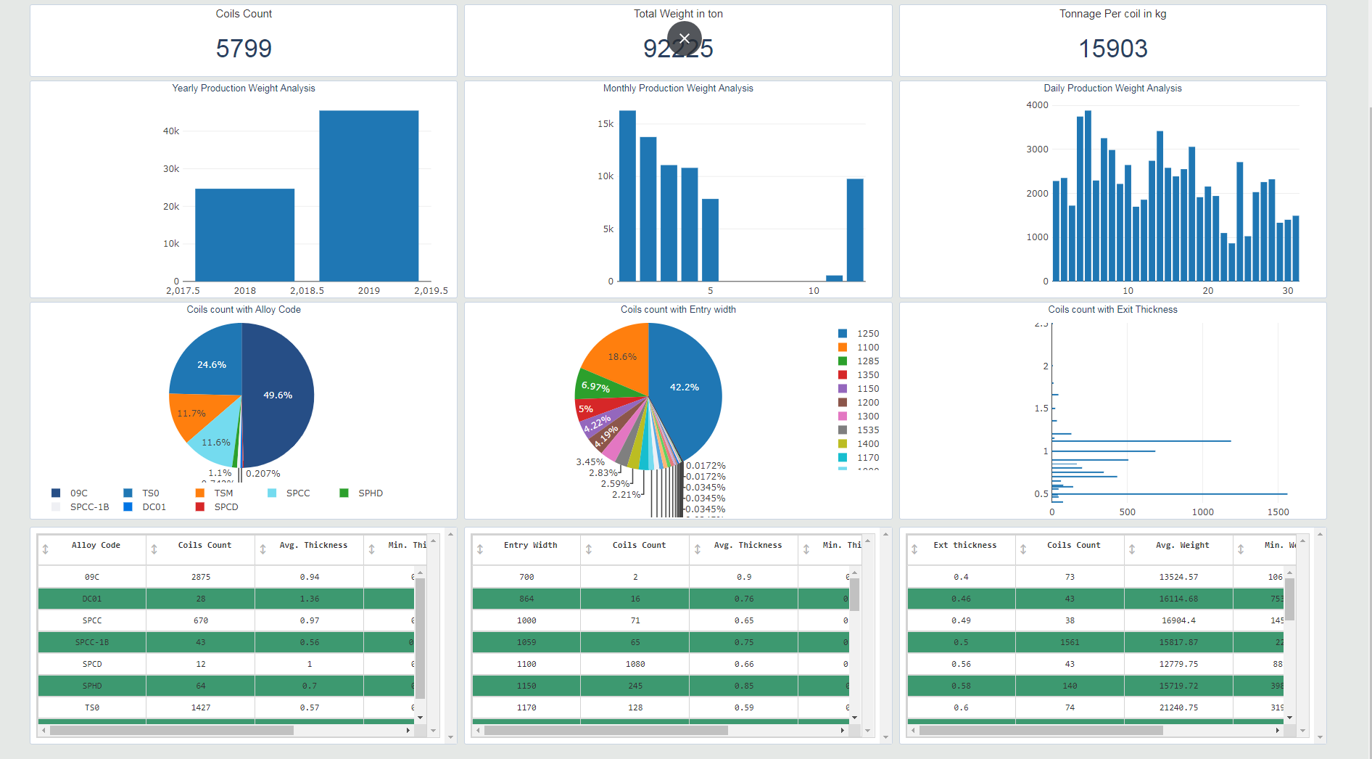

Slide 25
