Slide 1
POWER BI PROJECT PRESENTATION
DATA JOB MARKET
ANALYSIS
Understanding job demand, salary patterns,
industries and technical skills
742 job postings • 343 companies • 60 industries
Interactive dashboard and business insights
PROJECT REPORTING DECK

Slide 2
01 | CONTEXT
Project overview
A descriptive analysis of job-posting records using Power Query and Power BI.
JOB POSTINGS
COMPANIES
INDUSTRIES
AVERAGE SALARY
742
343
60
101.48
Records in the loaded dataset
Distinct company names
Distinct industry values
Dashboard measure; USD K assumed
• Explore where job postings are concentrated.
• Compare job-role and industry demand.
• Review salary, education, company-rating and skill indicators.
• Translate dashboard patterns into practical questions and recommendations.
DATA JOB MARKET ANALYSIS | POWER BI PROJECT
02

Slide 3
02 | METHOD
Objectives and analysis workflow
01 PREPARE
02 CLEAN
03 MODEL
04 ANALYZE
Import CSV files
Promote headers
Assign data types
Replace -1 placeholders
with null where appropriate
Remove one unwanted column
Create DAX measures
for counts, salary,
companies and skills
Build KPI cards and charts
for geography, roles,
industries and salary
Project output: an interactive Power BI dashboard supported by a written analysis.
The walkthrough showed 742 rows and 42 columns before one column was removed; the loaded model displayed 41 columns.
DATA JOB MARKET ANALYSIS | POWER BI PROJECT
03

Slide 4
03 | DATA
Dataset and data preparation
Visible dataset fields
Preparation steps
• Job title, salary estimate and job location
• Company name, headquarters and company size
• Founded year, age, industry and sector
• Revenue, competitors, rating and education
• Technology indicators such as Python, SQL, Excel, AWS and Spark
• Imported CSV data into Power Query.
• Promoted the first row to column headers.
• Assigned data types and removed one unwanted column.
• Replaced -1 placeholders with null for selected fields, including Founded and Age.
• Loaded the cleaned table into Power BI.
Validation note: full duplicate and missing-value audits across all 41 columns should be completed before final publication.
DATA JOB MARKET ANALYSIS | POWER BI PROJECT
04

Slide 5
04 | ANALYSIS MODEL
Power BI measures
Total Job Openings
Counts records in the data table
Average Salary
Average of Avg_SalaryK
Minimum / Maximum Salary
Minimum Lower_Salary / maximum Upper_Salary
Total Companies
Distinct company count
Total Industries
Distinct industry count
Average Rating
Average company rating
Skill indicators
Sum of Python, SQL, Excel, AWS and Spark flags
Salary values are shown as USD thousands in the dashboard; confirm source currency and parsing before external use.
DATA JOB MARKET ANALYSIS | POWER BI PROJECT
05

Slide 6
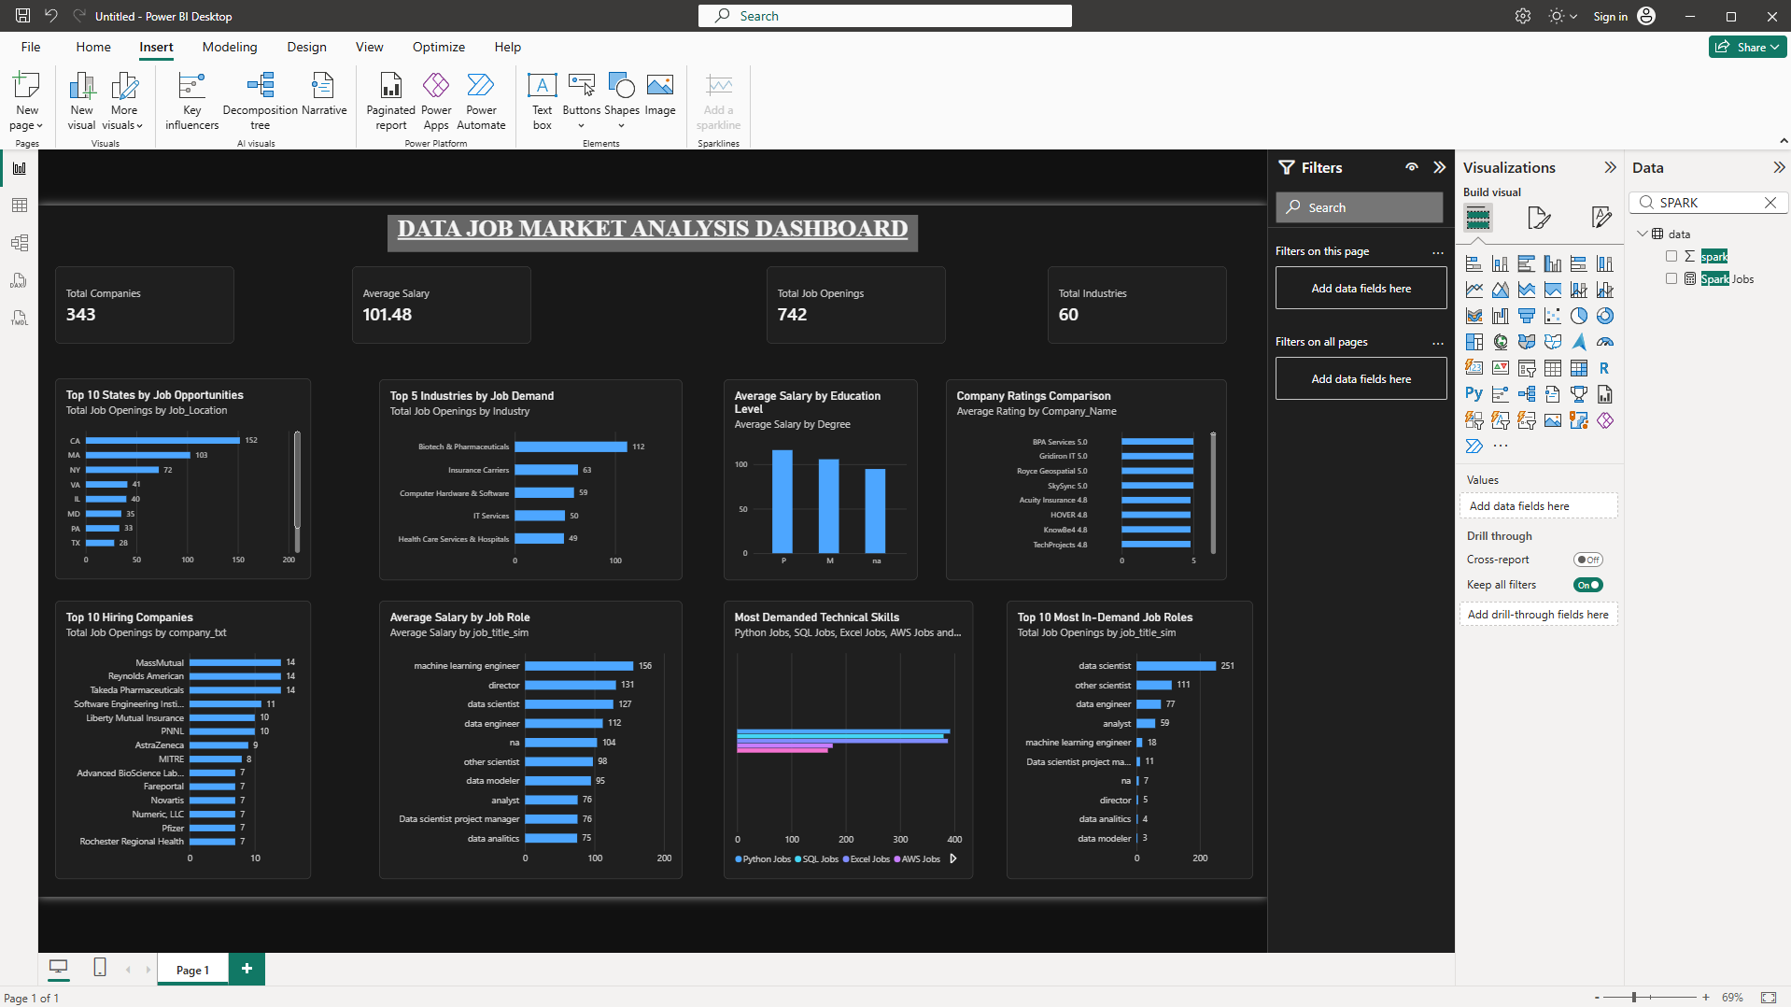
05 | POWER BI OUTPUT
Dashboard overview
Dashboard screenshot supplied during the project walkthrough.
DATA JOB MARKET ANALYSIS | POWER BI PROJECT
06

Slide 7
06 | GEOGRAPHIC FINDINGS
Where are postings concentrated?
Visible leading states
Key observation
California
152
California leads the visible state ranking with 152 postings, followed by Massachusetts (103) and New York (72).
Massachusetts
103
New York
72
Virginia
41
Illinois
40
Interpretation
Maryland
35
This reflects the records in this dataset; it does not establish the causes of regional concentration or represent the whole job market.
Pennsylvania
33
Texas
28
DATA JOB MARKET ANALYSIS | POWER BI PROJECT
07

Slide 8
07 | DEMAND FINDINGS
Which roles and industries lead?
Top displayed job-role categories
Top displayed industries
Data Scientist
251
Biotech & Pharmaceuticals
112
Other Scientist
111
Insurance Carriers
63
Data Engineer
77
Computer Hardware & Software
59
Analyst
59
IT Services
50
Machine Learning Engineer
18
Health Care Services & Hospitals
49
Counts are transcribed from the visible dashboard. Categories reflect the dashboard's consolidated job-title field.
DATA JOB MARKET ANALYSIS | POWER BI PROJECT
08

Slide 9
08 | SUPPORTING ANALYSIS
Salary, education, skills and ratings
• Average salary by job role is included to compare compensation across role categories.
• Average salary by education is included; visible labels such as P, M and na need clearer category mapping.
• The skills visual compares Python, SQL, Excel, AWS and Spark indicator measures.
• The company-rating visual compares ratings by company; sample sizes should be checked before ranking employers.
Reporting caution
Do not claim a salary premium, a definitive skill ranking or a best-rated employer until the underlying values and sample sizes are validated.
DATA JOB MARKET ANALYSIS | POWER BI PROJECT
09

Slide 10
09 | WHAT THE RESULTS SUGGEST
Business recommendations
01
Explore high-volume locations
Investigate opportunities in California, Massachusetts and New York, including remote and hybrid roles.
02
Build role-specific skills
Compare requirements in Data Scientist and Data Engineer postings and align learning plans.
03
Investigate industry pathways
Explore biotech, insurance, technology and healthcare roles and their skill expectations.
04
Compare salary ranges
Use lower and upper estimates by role and location, not averages alone.
05
Validate comparisons
Standardize company names and review skill flags and rating sample sizes before ranking.
DATA JOB MARKET ANALYSIS | POWER BI PROJECT
10

Slide 11
10 | WRAP-UP
Limitations and conclusion
Limitations to keep in view
Conclusion
• Dataset contains 742 records; it is not a complete labor-market census.
• Source provenance and collection date were not available in the project evidence.
• Salary currency and units need confirmation.
• Education labels, missing values and duplicates need final validation.
• Company-rating sample sizes and skill-indicator logic should be checked.
The dashboard combines data preparation, DAX calculations and visual analysis to reveal patterns in job postings across locations, roles and industries.
The clearest visible findings are California's leading state count, Data Scientist as the largest displayed role group, and Biotech & Pharmaceuticals as the leading displayed industry.
DATA JOB MARKET ANALYSIS | POWER BI PROJECT
11

Slide 12
11 | NEXT ACTIONS
Project completion checklist
• Save the final Power BI report as a .pbix file.
• Keep the original CSV files and document the source.
• Validate salary units, data types, duplicate IDs and missing values.
• Improve education labels and ensure all chart titles and data labels are readable.
• Export final dashboard screenshots.
• Add the PBIX, report, presentation, dataset notes and screenshots to the GitHub repository.
THANK YOU
DATA JOB MARKET ANALYSIS | POWER BI PROJECT
12

