Slide 1
HR ANALYTICS
PRDA-03 | Power BI Dashboard Analysis
Objective: analyze workforce composition, hiring patterns, and employee distribution.
Visuals: KPI cards, hiring trend, state, department, race, and gender charts.
Source: dashboard screenshot provided for review.

Slide 2
Project Objectives
Measure total employees, remote/HQ percentages, and average age.
Understand hiring activity over time.
Compare employees by state, department, race, and gender.
Translate dashboard patterns into practical HR recommendations.

Slide 3
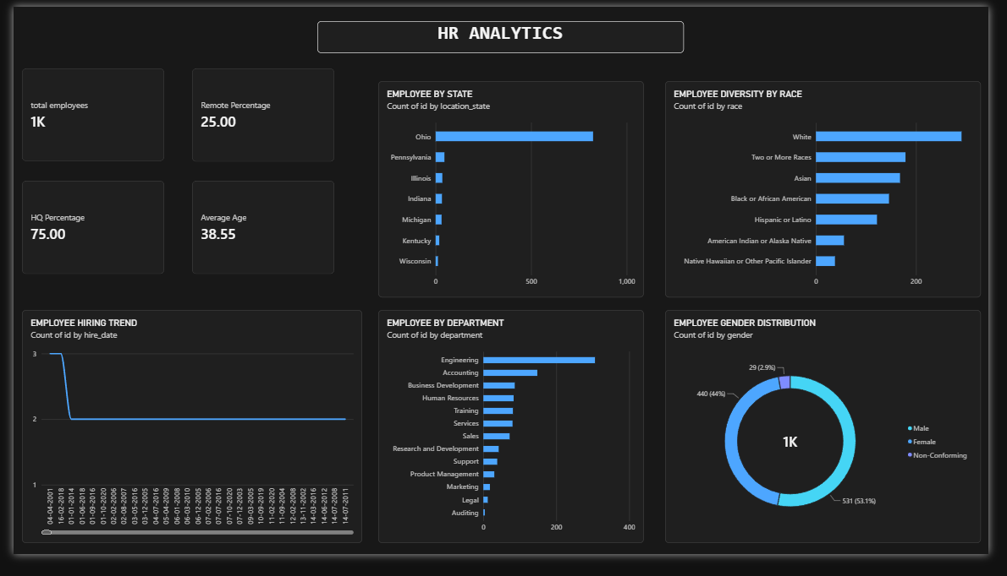
Dashboard Overview
Screenshot supplied by the project owner

Slide 4
KPI Summary
Total employees: 1K (rounded display; exact count should be shown).
Remote employees: 25.00%.
HQ employees: 75.00%.
Average employee age: 38.55 years.

Slide 5
Workforce Distribution
Ohio is the largest state category in the displayed state chart.
Engineering is the largest department, followed by Accounting and Business Development.
The dashboard shows a predominantly HQ-based workforce: 75% HQ and 25% remote.

Slide 6
Diversity Overview
Race chart: White is the largest displayed category; Two or More Races and Asian follow.
Gender chart: Male 531 (53.1%), Female 440 (44.0%), Non-Conforming 29 (2.9%).
Use consistent, inclusive reporting and monitor representation over time.

Slide 7
Hiring Trend – Quality Check
Current chart appears to plot individual hire dates rather than annual totals.
Create a Year column from hire_date and use Year on the X-axis.
Use Count of id on the Y-axis and sort Year ascending.
Avoid drawing conclusions about annual hiring until this visual is corrected.

Slide 8
Recommendations
Review Engineering staffing needs against workload and capacity.
Assess geographic concentration in Ohio and broaden recruitment reach where appropriate.
Evaluate remote and HQ arrangements using productivity and engagement measures.
Track annual hires alongside terminations to assess net workforce change.
Use dashboard slicers for department, state, race, gender, and work location.

Slide 9
Conclusion
The dashboard gives a useful snapshot of workforce composition.
Key visible figures: 25% remote, 75% HQ, and average age 38.55 years.
Before submission, correct the hiring trend and show the exact employee count.
Validate all findings against the underlying HR dataset.

Slide 10
Data Notes & Limitations
This presentation is based on the supplied dashboard screenshot, not the raw employee table.
State and department chart counts are not legible enough to quote precisely.
Total employee KPI is rounded to 1K in the screenshot.
Confirm the gender field exists in the loaded source; it is not listed among the 13 assignment attributes.

