Slide 1
Deep Reinforcement Learning
TD3 in OpenAI Gym
by
Martin Baur
mail: mail@martinbaur.eu
Notes:
Baut auf Grundlagen von David auf

Slide 2
Agenda
TD3 algorithm
What to learn?
DDPG vs. Twin Delayed DDPG
Three Tricks
Experiment setup
Experiment: 2D Swing a Pendulum
Experiment: 3D Ant
Literature

Slide 3
TD3
Original Paper published 22 October 2018
Twin Delayed Deep Deterministic Policy Gradient
Successor of DDPG
Off-policy [1]
Notes:
First Branch:
Model of the environment -> function which predicts state transitions and rewards.
Model-free usually easier to implement -> Agent doesnt need to learn it.
Off-policy means the agent can learn from historical data. This is the case when you have an experience replay memory.
On-policy means the agent can only learn on new data, or on new observations.

Slide 4
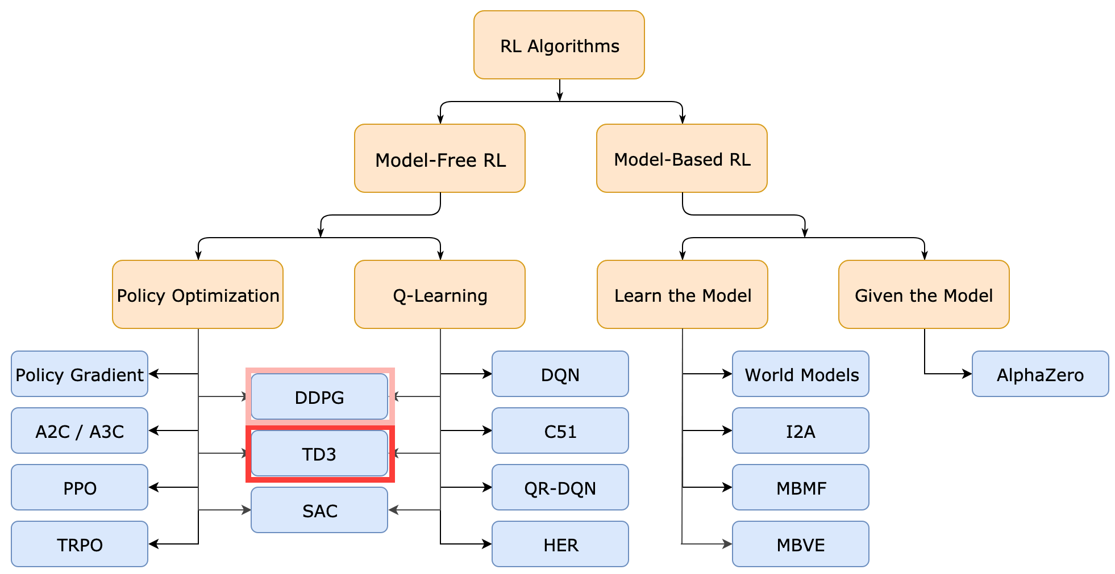
TD3
A Taxonomy of RL Algorithms [2]

Slide 5
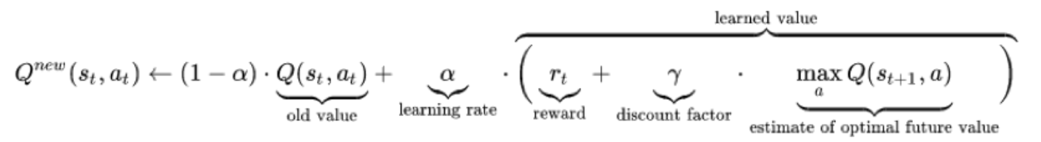
TD3 – What to learn: Q-Learning
Q-table
Q-Learning
How it works:
Selection of random state (s) and taking random action (a)
Next state reached (s‘)
Getting a reward (r)
Updating Q-Value
maximum expected future rewards for each action in each state
Q-learning update function [3]
Notes:
Intuitively, you can think of the Q-table as a cheat sheet for the agent to figure out which action to perform to reach its goal.

Slide 6
TD3 – What to learn: Q-Learning II
Here: Deep Q-Learning
Not iterativ but a neural network
How it works:
Predicts the Q-Values of current state
Take action with highest Q-Value
get reward
Reach s‘
Q-loss is calculated with target and prediction
Goal: reduce loss
Source: [7]

Slide 7
TD3 – What to learn: Policy Learning
Second neural network: Policy Gradient
Updates policy weights
Input: states
Output: actions with probability (agent chooses)
Notes:
As heard by David

Slide 8
TD3 - DDPG vs. Twin Delayed DDPG
TD3 is a direct successor of Deep Deterministic Policy Gradient (DDPG)
DDPG:
Base paper published in 2014 but first described in 2015 [8]
Learns Q-function and policy
„DDPG is an off-policy algorithm.
DDPG can only be used for environments with continuous action spaces.“[4]
Problems with DDPG:
overestimates Q-values because of exploitation of errors in Q-function

Slide 9
TD3 - Three Tricks
Solutions for DDPG Issue:
Twin: Double-Q Learning
Learns two Q-functions
Smaller is used to update the Q-value
-> favors underestimation of Q-values
Delayed: Delayed Policy Updates
Policy Updates are delayed
Usally two Q-function updates and one policy update
-> more stable and efficient training
Target Policy Smoothing
Adding noise to action to make Q-function error exploitation harder
-> more robust actions are chosen
Notes:
favours underestimation of Q values which isn’t a problem as the low values will not be propagated through the algorithm, unlike overestimate values.
Adressing the Q-function exploitation of DDPG: To make TD3 policies explore better, we add noise to their actions at training time.
((Target policy smoothing essentially serves as a regularizer for the algorithm. It addresses a particular failure mode that can happen in DDPG: if the Q-function approximator develops an incorrect sharp peak for some actions, the policy will quickly exploit that peak and then have brittle or incorrect behavior.))

Slide 10
Experiment Setup
Algorithm: TD3 of stable-baselines
Pendulum Env from OpenAI Gym
Ant Env from PyBullet Gym
Running on Google Colab
Logging with Tensorboard
Notes:
Stable Baselines is a OpenAI Gym fork

Slide 11
Experiment: Swing a Pendulum
„ In this version of the problem, the pendulum starts in a random position, and the goal is to swing it up so it stays upright.“ [6]
First run
Standard Settings
50000 timesteps
Second run
High Noise
Third run
Higher learning rate
Fourth run
Very high learning rate
Notes:
Stable Baselines is a OpenAI Gym fork

Slide 12
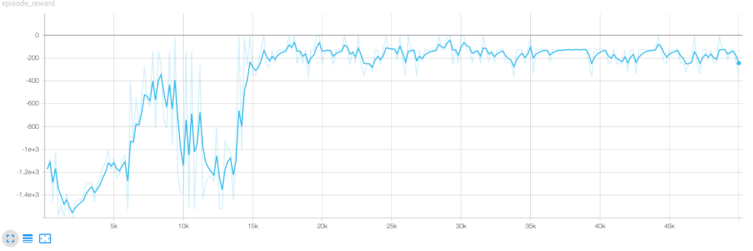
Experiment: Swing a Pendulum

Slide 13
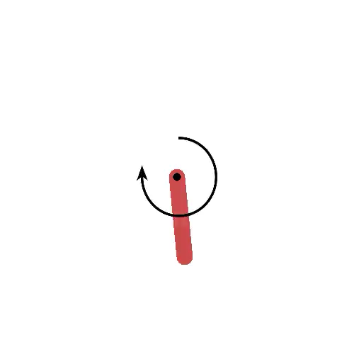
Start Video

Slide 14
Experiment: Swing a Pendulum

Slide 15
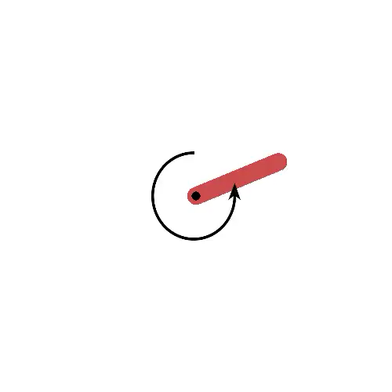
Video

Slide 16
Experiment: Swing a Pendulum

Slide 17
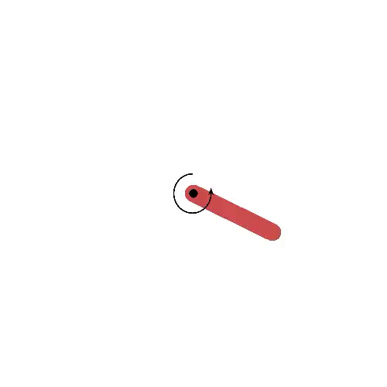
Video

Slide 18
Experiment: Swing a Pendulum

Slide 19
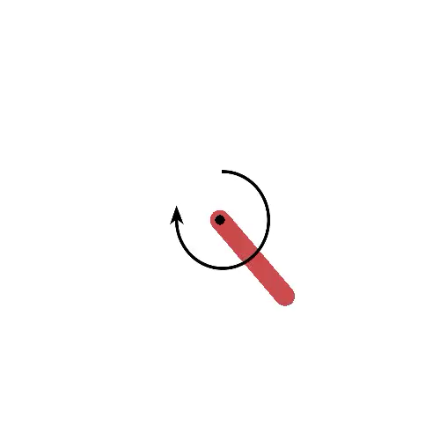
Video
Notes:
Not enough Noise?

Slide 20
Higher noise

Slide 21
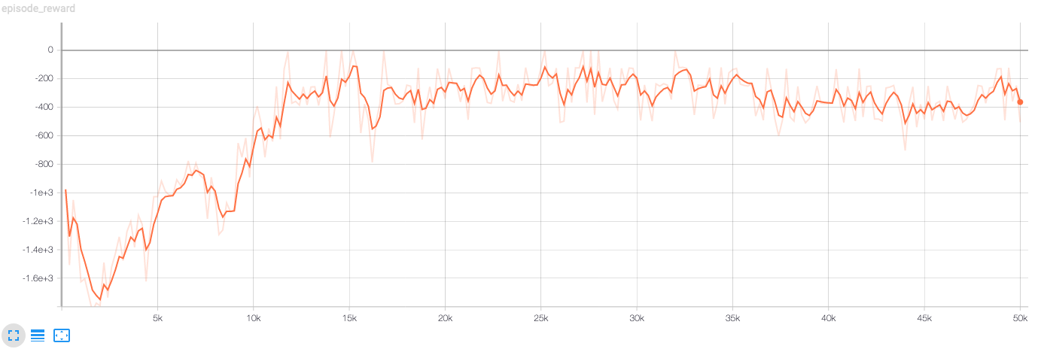
High Noise

Slide 22
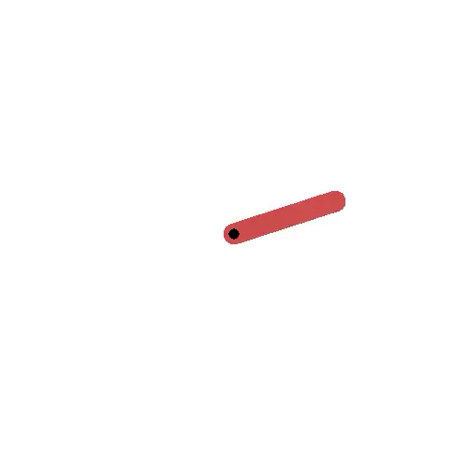
High Noise

Slide 23
Higher learning rate (x100)

Slide 24
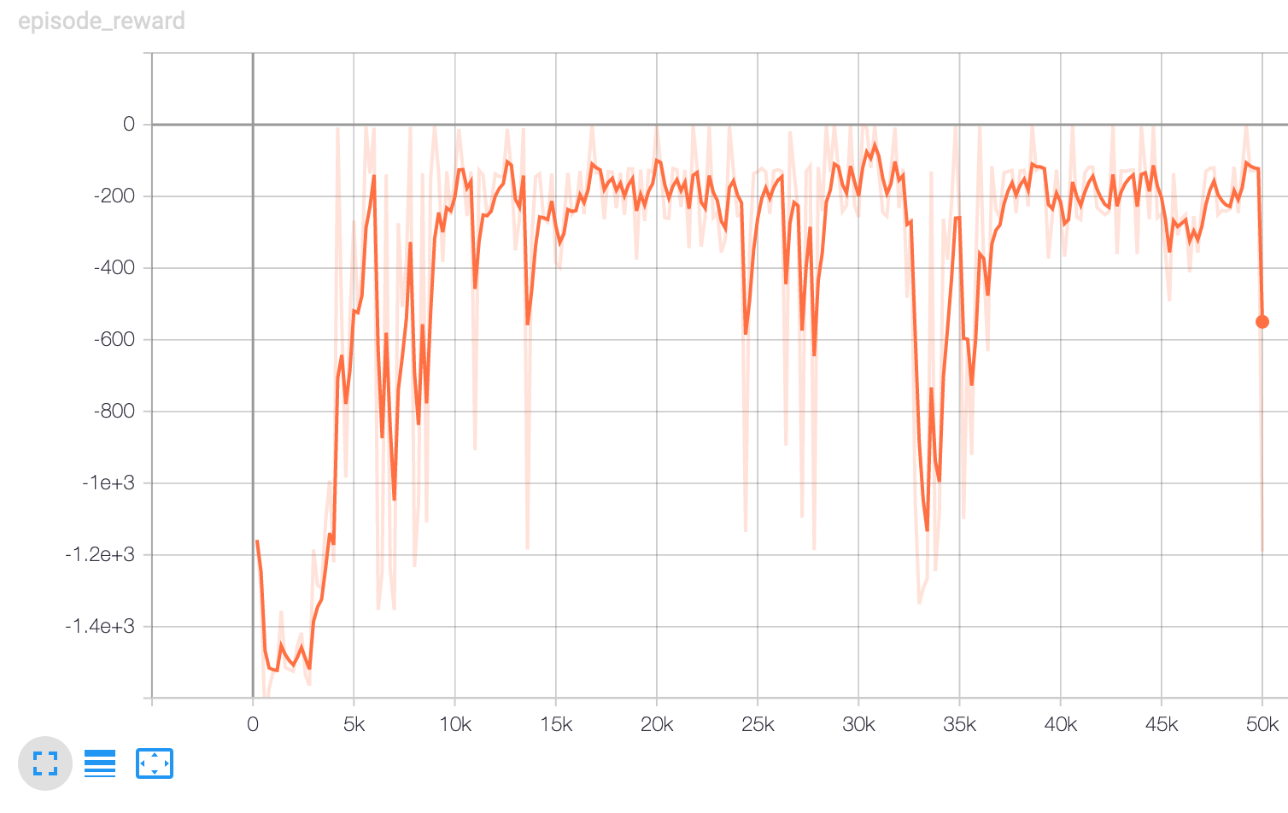
Higher learning rate
Notes:
Higher LR

Slide 25
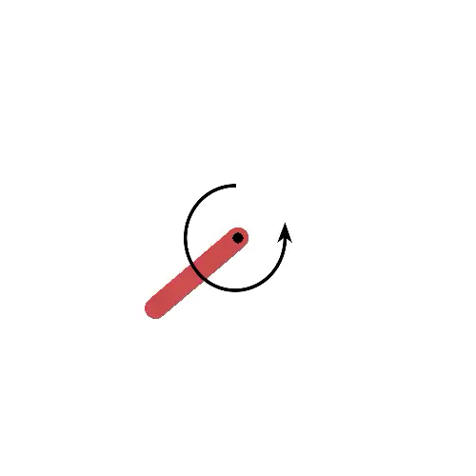
Higher learning rate

Slide 26
Higher learning rate (x1000)

Slide 27
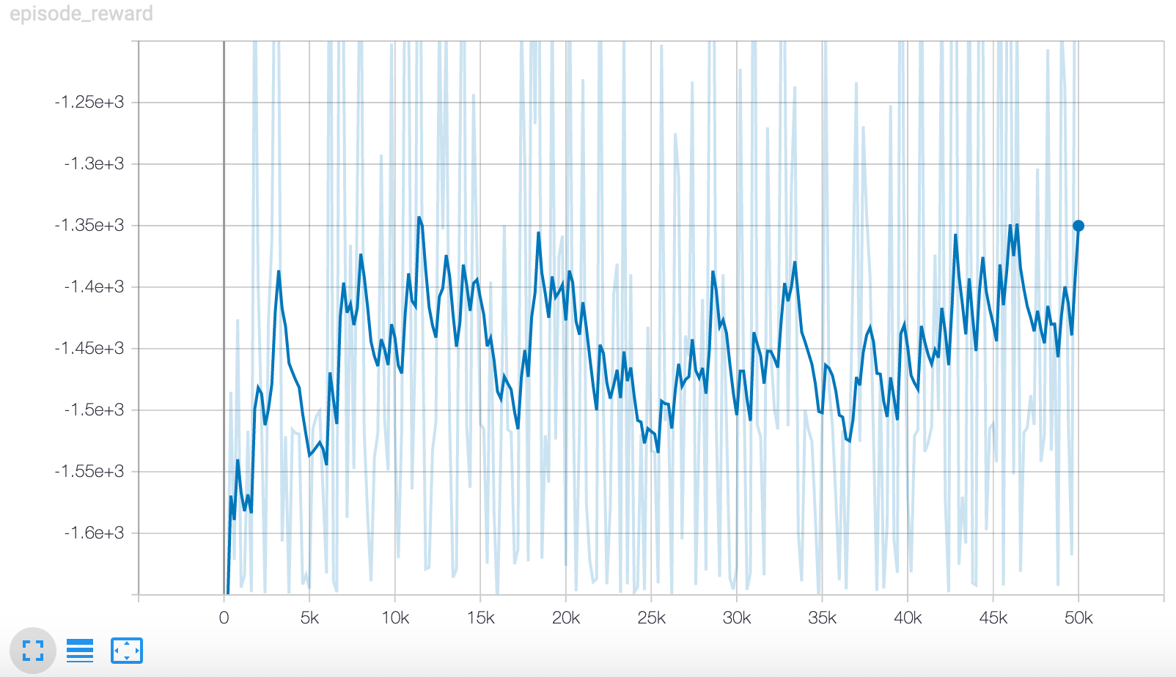
High learning rate

Slide 28
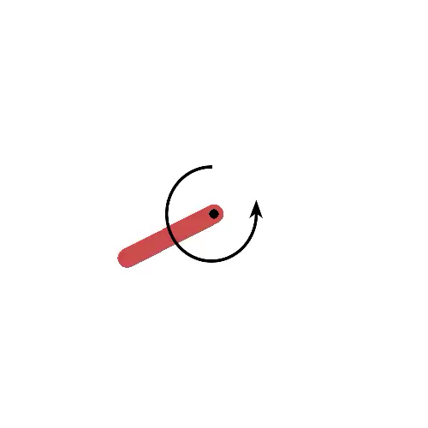
High Noise

Slide 29
Experiment: Walking Ant
Walking Ant
Default Settings with a little more noise

Slide 30
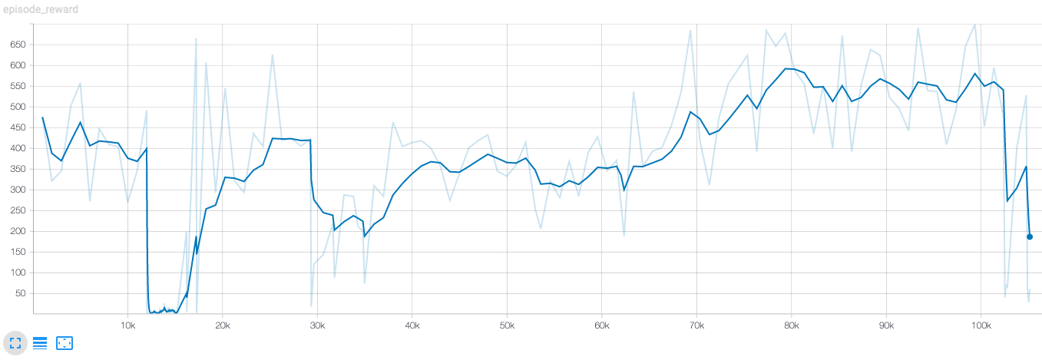
Experiment: Walking Ant

Slide 31
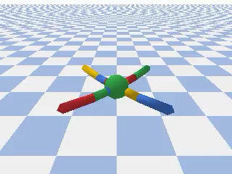
Experiment: Walking Ant

Slide 32
Experiment: Walking Ant

Slide 33
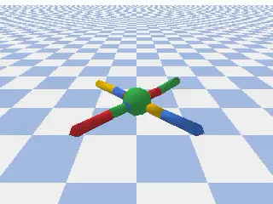
Experiment: Walking Ant

Slide 34
Experiment: Walking Ant

Slide 35
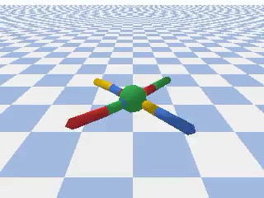
Experiment: Walking Ant

Slide 36
Thank you!

Slide 37
Literature
[1] https://spinningup.openai.com/en/latest/algorithms/td3.html (02.12.2019)
[2] https://spinningup.openai.com/en/latest/spinningup/rl_intro2.html (02.12.2019)
[3] https://towardsdatascience.com/q-learning-54b841f3f9e4 (05.12.2019)
[4] https://spinningup.openai.com/en/latest/algorithms/ddpg.html#the-q-learning-side-of-ddpg (18.12.2019)
[5] https://www.mlq.ai/deep-reinforcement-learning-twin-delayed-ddpg-algorithm/ (18.12.2019)
[6] https://gym.openai.com/envs/Pendulum-v0/ (25.12.2019)
[7] https://towardsdatascience.com/q-learning-54b841f3f9e4
[8] https://arxiv.org/abs/1509.02971
Github: https://github.com/mrmarthy/DLSeminar/blob/master/PendulumTD3.ipynb

