Slide 1

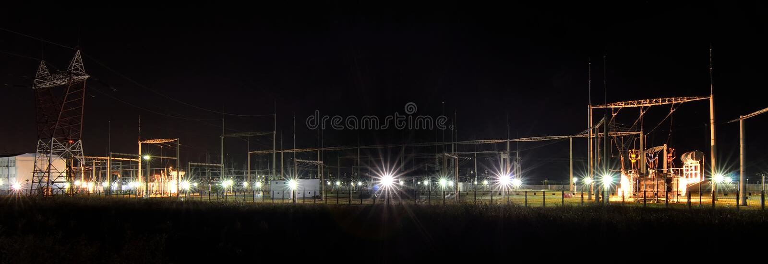
HOME PRODUCTS SERVICES DOWNLOADS CONTACT US
COMMITED TO GIVE YOU POWER
HOME PRODUCTS SERVICES DOWNLOADS CONTACT US
TENEBRAS LIGHTING & ELECTRICAL
Sition Kamias 3 Sumulong Hi-way, Brgy Mambugan , Antipolo City, PH
+63968 784 8290 tenlights.trdg@gmail.com find us on facebook

