Slide 1
Normalization using Trinity
Modified version of Diginorm
Method:
Create catalog of k-mers
Identify median abundance (C) for read abundance
Target size (T) designated as –max_cov
Reads are kept using the probability min(1, T/C)
If standard deviation of read coverage exceeds C
Throw away read

Slide 2
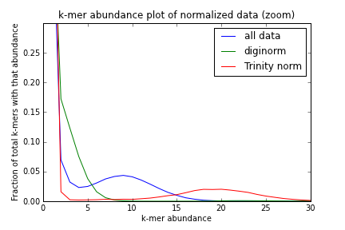
What does this mean?

