Slide 1
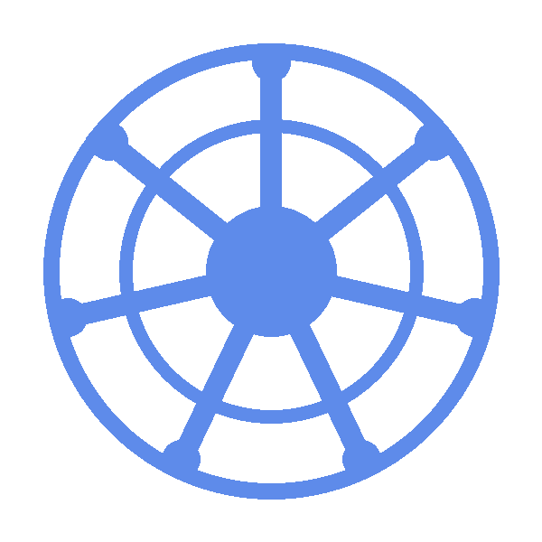
CKA Daily Recap
Day 1 | April 6, 2026
Abe's CKA Journey

Slide 2
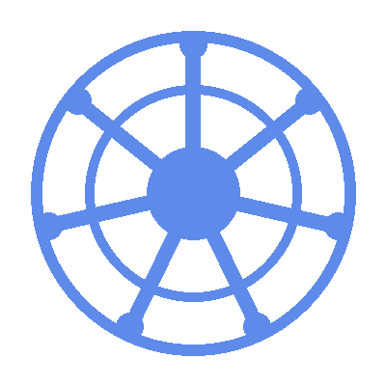
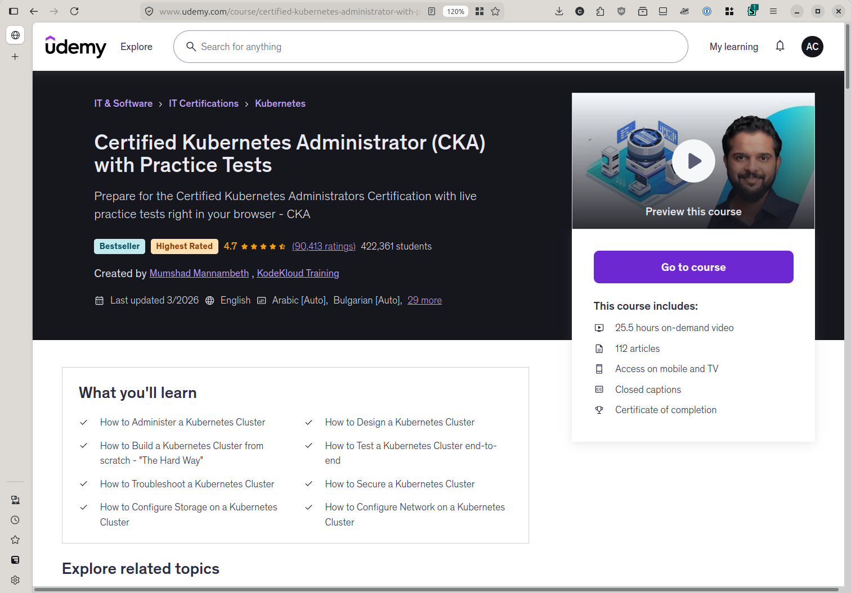
CKA STUDY
Day 1 | April 6, 2026
Udemy Course
Abe's CKA Journey · Daily Recap

Slide 3
CKA STUDY
Day 1 | April 6, 2026
Cluster Architecture & Control Plane
What is Kubernetes (k8s)?
K8s is an open source platform designed to automate deploying, scaling and managing containerized applications.
What are the components that a k8s clusters are made up of?
Control Plane:
API Server, etcd, Scheduler, Controller Manager.
Node/s:
Kubelet, Kube Proxy, Container Runtime
What is a container runtime?
Specialized software resposible for the actual execution and management of containers.
What is etcd?
A distributed key-value store backing all cluster states.
What is the API Server?
The single entry point for all cluster operations.
Abe's CKA Journey · Daily Recap

Slide 4
That's Day 1
See you in the next one.
mrmcmuffinz.dev
Abe's CKA Journey · Daily Recap

