Slide 1
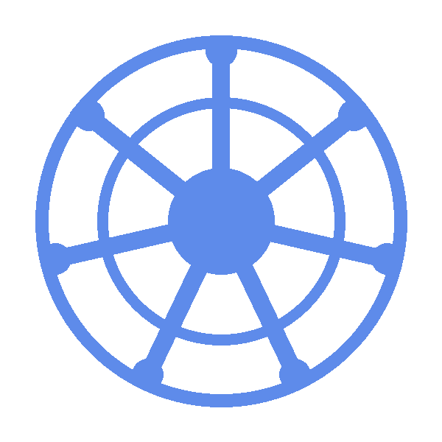
CKA Daily Recap
Day 2 | April 7, 2026
Abe's CKA Journey

Slide 2

CKA STUDY
Day 2 | April 7, 2026
Core Concepts
What is a container?
Lightweight, isolated process that packages an application with everything it needs to run.
What is a pod?
The smallest deployable unit in Kubernetes. Ephemeral by nature, wrapping one or more containers that share the same network namespace, ip address and storage.
What is a ReplicaSet?
A controller that watches the cluster and ensures a specified number of Pod replicas are always in the desired state.
What is a deployment?
The standard way to run stateless workloads in Kubernetes.
Manages a ReplicaSet, which manages Pods, adds rolling updates and rollback.
Key commands to familiarize yourself with?
Kubectl run <name> --image <img>...
kubectl create/apply/replace <object>...
kubectl get <object> -o <format>...
kubectl scale <type> <name> --replicas <num>...
Abe's CKA Journey · Daily Recap

Slide 3
That's Day 2
See you in the next one.
mrmcmuffinz.dev
Abe's CKA Journey · Daily Recap

