Slide 1

Real or Not? NLP with Disaster Tweets
By: Quinn Knudsen, Sean O’Neil & Chris Bryla

Slide 2
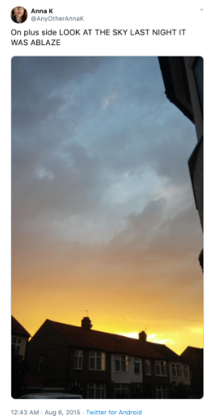
Challenge Description
Our team worked on a Kaggle competition that focused on Natural Language Processing (NLP).
NLP is a subfield of linguistics and computer science that uses artificial intelligence to help computers interpret human languages.
NLP is a field of artificial intelligence that has a projected growth from $10.2 billion in 2019 to $26.4 billion by 2024
The competition asked for us to use a training dataset of around 7,000 tweets to evaluate on the test set of around 3000 tweets whether the tweet was referring to a real life disaster or not.
Over average, there are 500 million tweets per day (Sayce, 2019).
Disaster relief organizations and news agencies are interested in understanding whether tweets with seemingly similar language are referring to a disaster or some other life event that may appear in a similar linguistic manner to a disaster.

Slide 3
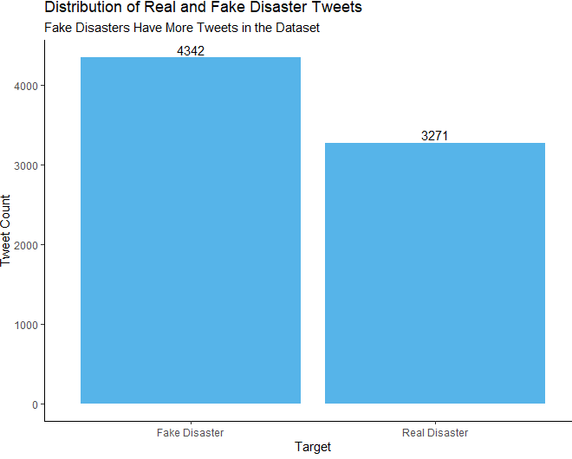
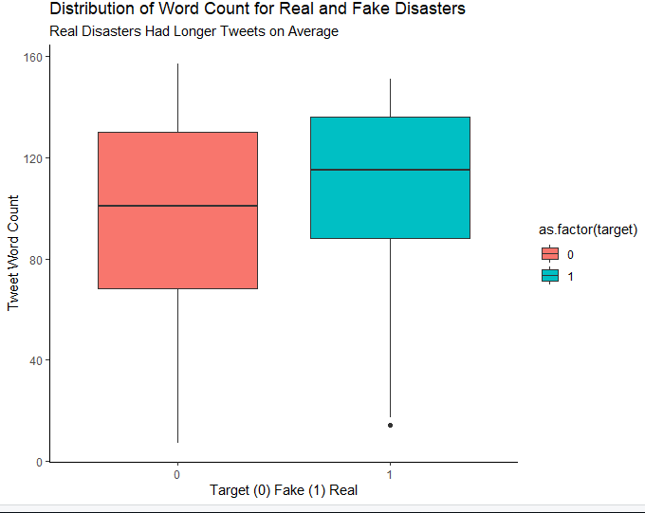
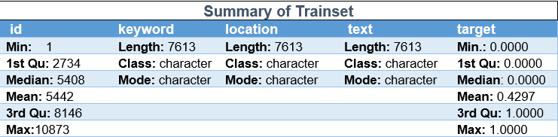
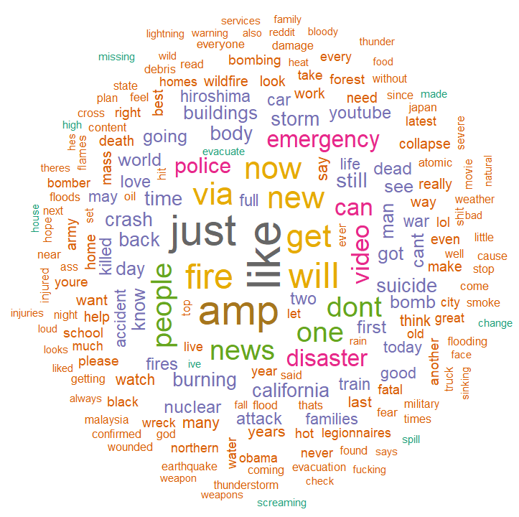
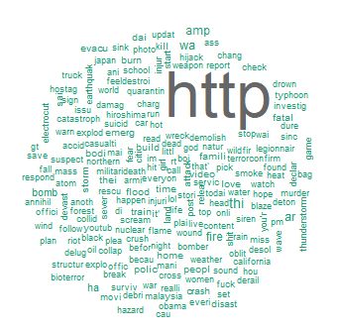
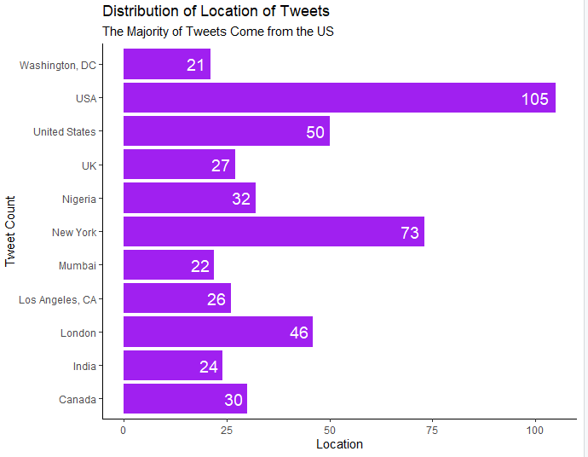
Exploratory Data Analysis
7613 train examples, 3263 test
Slight imbalance in classes
33% of location data is missing, so it was not used in analysis
Word cloud exploration indicated that links made up many of the “words”
Stemming was explored but lemmatization gave more favorable results

Slide 4
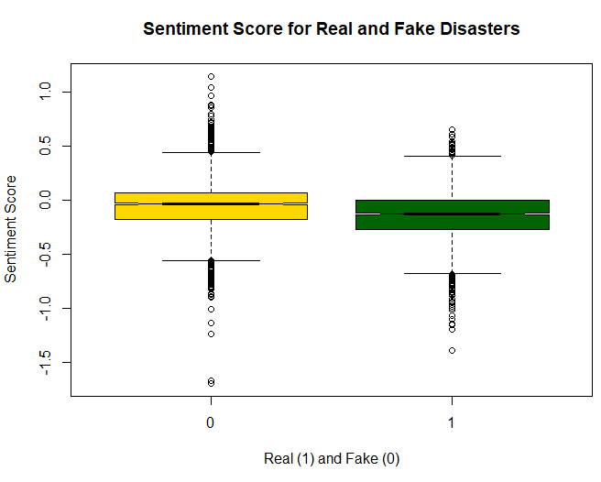
Sentiment Analysis
A sentiment analysis is a data mining technique which identifies and extracts substantive information for words based upon a predetermined score of their indication of positivity or negativity (Schmunl et al., 2014).
For this analysis, each sentence was given a sentiment score utilizing negators and amplifiers to help hone the accuracy of the information processing.
This was used to test the hypothesis that all disasters would have a negative sentiment, but true disasters would be more inflammatory and subsequently achieve a lower average sentiment score.
Our hypotheses were confirmed, as True Disasters (-0.15) scored lower than Non-Disasters (-0.06) p <.001. However, despite the means being different, the distributions overlapped enough that sentiment did not improve classification models.

Slide 5
Classification Models
The text data was split into tokens using a custom tokenizer developed for tweets developed at CMU, and words occurring in only one tweet or not occurring in both the training or test set were removed
A document-term matrix was created, using counts of each remaining word in each tweet as features
Additional preprocessing options were tried, including removing stopwords, mentions, and URLs, lemmatization, adding part-of-speech tags, and adding bigrams, and postprocessing including normalizing by document length, and using the TF-IDF transformation
Models were systematically trained with 5-fold cross-validation with the different preprocessing options until the best model of each type was found, then the predictions were submitted to Kaggle.
Support Vector Machine
Linear kernel
Worked best with minimal preprocessing
Best model had an average F score of 83.73%
Random Forest
500 trees
Also worked best with minimal preprocessing
Best model had an average F score of 82.98%, the lowest of all these models
Multinomial Naïve Bayes
The only models which performed better on preprocessed data with stopwords, mentions, and URLs removed, along with TF-IDF transformation
Best model had an average F score of 83.27%

Slide 6
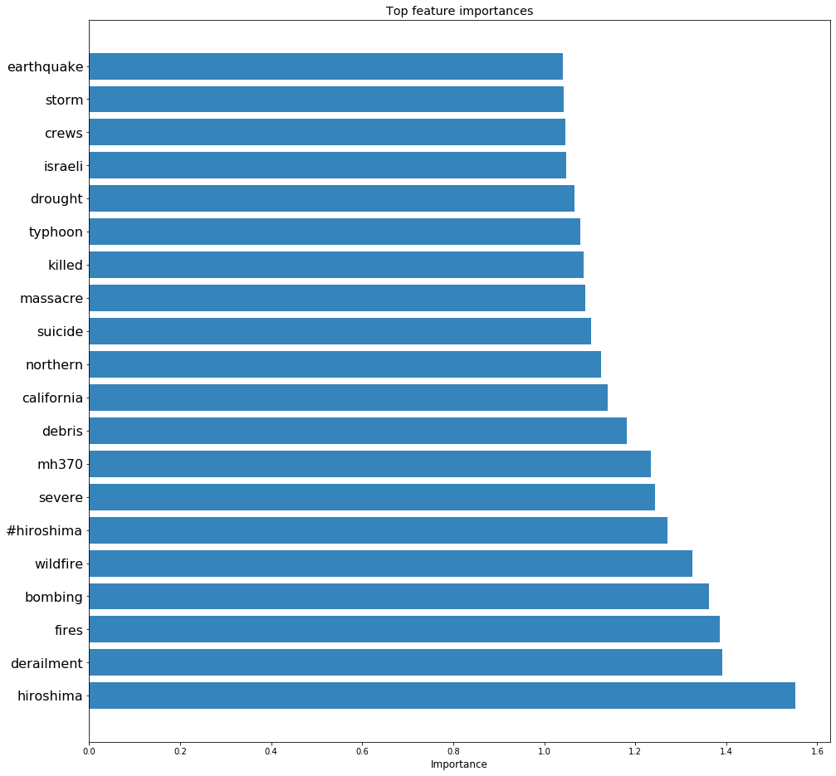
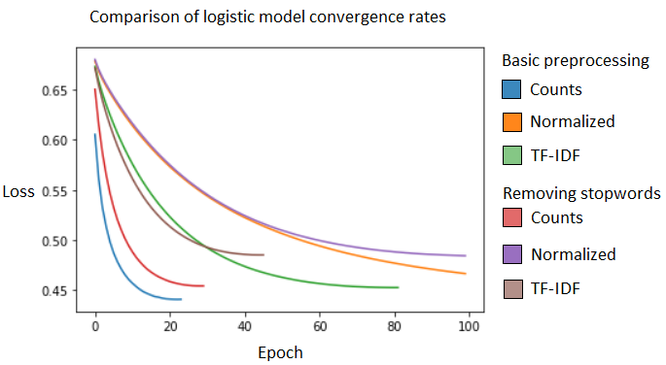
Classification Models (Cont.)
Logistic Regression / Neural Network
Again, minimal preprocessing was best
Trained with TensorFlow Keras, with early stopping and dropout for deeper networks to avoid overfitting
Best logistic model got avg. F of 83.88%, and adding any additional layers did not improve this; best neural net reached 83.87%. Logistic worked best out of all models, including on submission to Kaggle

Slide 7
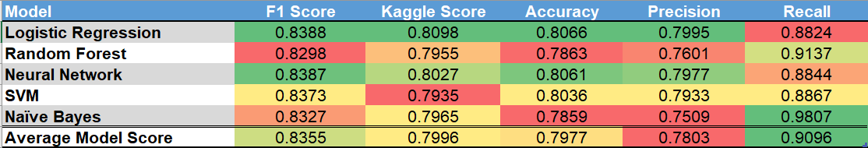
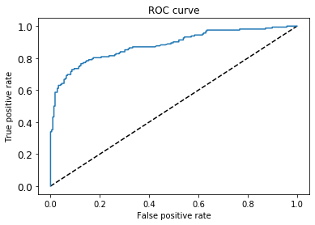
Conclusion/Discussion
Final Results
Best submitted model was logistic regression with minimal preprocessing, with a final score of 80.98%.
All models were several percentage points lower in score on the test data than the training data, indicating that there was some overfitting. This is a result of the test data having a different distribution of words than the training data, and when testing on out-of-distribution data, lower scores are expected.
Interestingly, applying preprocessing or adding a feature for sentiment only seemed to decrease the scores.
Limitations and Future Directions
Some tweets not properly categorized in the Kaggle dataset
Working in different programming languages
Better utilizing location data accompanying the tweets
Weighting key words without overfitting the model
Building in anomaly detection for tweet volume by location/topic area
Building up syntax trees and using word sense disambiguation
Utilizing BERT and other state-of-the-art NLP modeling

Slide 8
References
Koo, Ching & Liew, Mei & Mohamad, Mohd & Salleh, Abdul. (2013). A Review for Detecting Gene-Gene Interactions Using Machine Learning Methods in Genetic Epidemiology. BioMed research international. 2013. 432375. 10.1155/2013/432375.
Pang-Ning Tan, Michael Steinbach, and Vipin Kumar (2005) Introduction to Data Mining. Addison Wesley, 2005.
Schmunk, Sergej & Höpken, Wolfram & Fuchs, Matthias & Lexhagen, Maria. (2014). Sentiment Analysis: Extracting Decision-Relevant Knowledge from UGC. Information and Communication Technologies in Tourism 2014. 10.1007/978-3-319-03973-2_19.
https://www.dsayce.com/social-media/tweets-day/
https://www.businesswire.com/news/home/20191230005197/en/Global-Natural-Language-Processing-NLP-Market-Size
https://elitedatascience.com/machine-learning-algorithms
https://www.cs.cmu.edu/~ark/TweetNLP/#pos

