Slide 1

Industrial/Organizational Psychology: An Applied Approach, 9e
Chapter 3: Legal Issues in Employee Selection
Michael G. Aamodt, Industrial/Organizational Psychology: An Applied Approach, 9th Edition. © 2023 Cengage. All Rights Reserved. May not be scanned, copied or duplicated, or posted to a publicly accessible website, in whole or in part.

Slide 2
Icebreaker
Break into pairs of students.
Discuss with your partner any instances of organizations that have had legal issues that were reported in the news or media.
Share your discussions with the class.

Slide 3
Learning Objectives
By the end of this chapter, you should be able to:
03-01 Describe the legal process involving employment law
03-02 Identify what classes of people are protected by federal law
03-03 Determine the legality of an employment practice
03-04 Explain the concept of adverse impact
03-05 Define affirmative action
03-06 Describe the important issues involving employee privacy rights

Slide 4
The Legal Process

Slide 5
Resolving the Complaint Internally
Alleged discriminatory act
Internal investigation
Internal resolution process
Essential to have a formal policy
Options
Grievance system
Mediate a solution
Arbitrate a decision

Slide 6
Alternative Dispute Resolution
Grievance system
Internal committee
Mediation
Neutral third party
Disputants reach agreement
Arbitration
Neutral third party
Arbitrator makes decision
Binding
Nonbinding

Slide 7
Filing a Discrimination Charge
Alleged discriminatory act
Complaint filed
180 days for nondeferral states
300 days for deferral states
Employer notified within 10 days

Slide 8
Outcomes of an EEOC Investigation
Charge does not have merit
Complainant accepts and process ends
Complainant does not accept and is issued a “right to sue” letter
Charge does have merit
EEOC will try to work a settlement between claimant and employer
Case goes to federal district court if a settlement cannot be reached and becomes case law
U.S. Supreme Court

Slide 9
Determining Whether an Employment Decision Is Legal

Slide 10
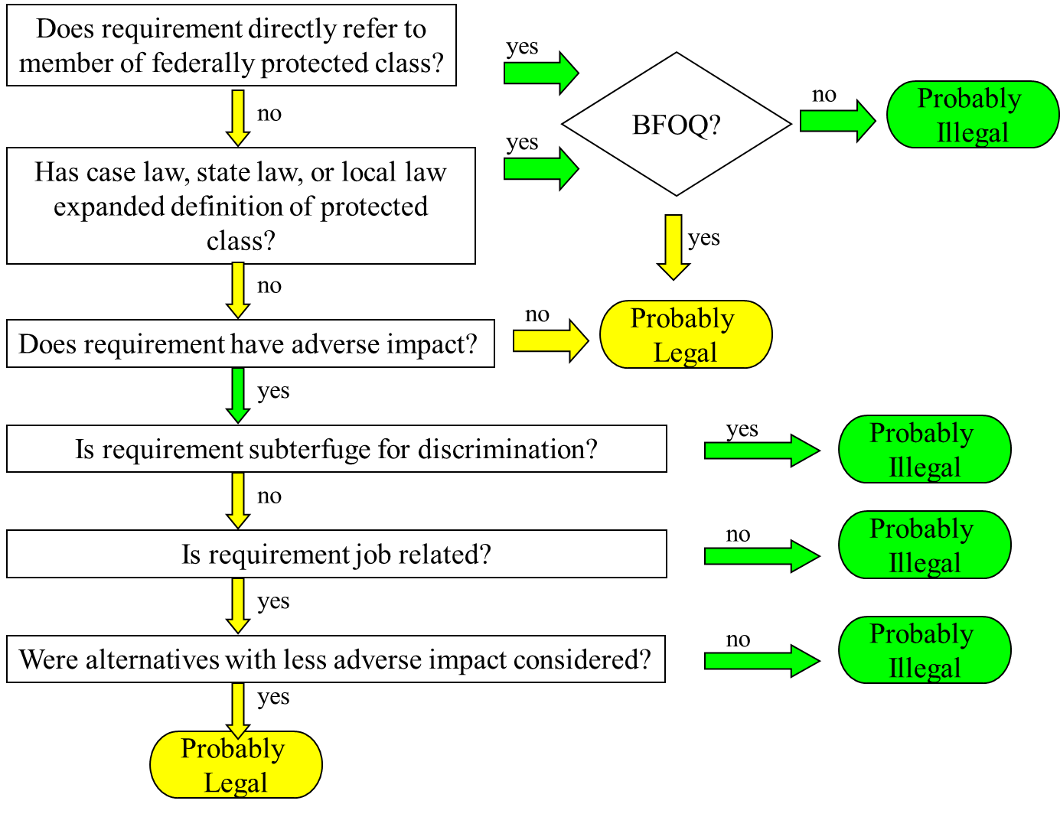
Flowchart for Determining Whether an Employment Decision Is Legal

Slide 11
Does Practice Directly Refer to a Member of a Federally Protected Class?
Sex (Civil Rights Act)
Race (CRA)
Black
White
Asian
Native Hawaiian or Other Pacific Islander
Native American or Alaskan Native
National origin (CRA)
Color (CRA)
Age (over 40; ADEA)
Religion (CRA)
Disability (ADA)
Current
Previous
Regarded as such
Pregnancy
Military veteran status (VEVRAA)

Slide 12
Americans With Disabilities Act (ADA) & 2008 ADA Amendments Act
Organizations must make reasonable accommodation for people with physical or mental disabilities, unless doing so would impose an undue hardship

Slide 13
Activity: Discussion about Coworkers with Disabilities
What experiences have you had with coworkers with disabilities?

Slide 14
Definition of Disability
A physical or mental impairment that substantially limits one or more major life activities
A record of such impairment, or
Being regarded as having such an impairment

Slide 15
Reasonable Accommodations
Providing readers or interpreters
Modifying work schedules or equipment
Making facilities more accessible

Slide 16
Clarifications
Act does not require an organization to hire individuals with disabilities
Act does not require an organization to give preference to individuals with disabilities
Act requires that individuals with disabilities be given an equal opportunity, and if the best qualified, to be given the job

Slide 17
Is the Requirement a Bona Fide Occupational Qualification (BFOQ)?
Only members of a particular class can perform the job
There can be no exceptions
According to the courts:
Gender seldom is
Customer preference doesn’t matter

Slide 18
Activity: Discussion of BFOQ
Is gender a BFOQ for Hooters?

Slide 19
Has Local, State, or Case Law Added Protected Classes?
State Law Examples
Virginia protects marital status
Wisconsin protects gender identification
Local Law Examples
Cincinnati protects people of Appalachian heritage
Santa Cruz, CA outlaws discrimination based on height and physical appearance
Case Law Examples
Former drug use is not a disability

Slide 20
Does the Requirement Have Adverse Impact on Members of a Protected Class?
Employment decision results in negative consequences for one group more than another group
Four-fifths rule
Occurs when the selection rate for one group is less than 80% of the rate for the highest scoring group

Slide 21
Adverse Impact - Example
 | Male | Female
Number of applicants | 50 | 10
Number hired | 25 | 4
Selection ratio | 0.50 | 0.40
0.40/0.50 = 0.80 to avoid adverse impact
http://www.adverseimpact.org/CalculatingAdverseImpact.htm
This site provides a tool that can estimate adverse impact by using statistical and practical tests (spreadsheet posted on Canvas).

Slide 22
Was the Requirement Designed to Intentionally Discriminate Against a Protected Class?
City limits requirements
Literacy test requirements

Slide 23
Can the Employer Prove that the Requirement Is Related?
Exceptions
Bona fide seniority system
National security
Veteran’s preference rights
Job Related
Types
BFOQ
Valid testing procedure

Slide 24
Did Employer Look for Reasonable Alternatives with Less Adverse Impact?
Alternative valid selection tests that would have less adverse impact

Slide 25
Harassment

Slide 26
Activity: Discussion of Workplace Harassment
What examples of harassment have you seen in the workplace?

Slide 27
EEOC Complaints - 2019
26,211 charges of harassment
7,514 were for sexual harassment charges of sexual harassment
16.8% of the charges were made by men
Harassment Charges
33% racial
29% sexual
38% other protected classes

Slide 28
Types of Harassment
Quid Pro Quo
Hostile Environment

Slide 29
Quid Pro Quo Harassment Claims
Granting of sexual favors is tied to employment decisions
Single incident is enough
Organization is always liable

Slide 30
Hostile Environment Harassment Claims
Pattern of behavior
Based on gender
Is negative to the “reasonable person”

Slide 31
Organizational Liability for Sexual Harassment
Quid pro quo: organization is always liable
Hostile: organization must demonstrate reasonable care to prevent and correct sexual harassment behavior
Preventing sexual harassment
Correcting sexual harassment behavior

Slide 32
Preventing Sexual Harassment
Well-conceived policy regarding sexual harassment that:
Explains types of harassment
Includes a list of names to whom an employee can report harassment
Communication of policy to employees
Enforced the policy

Slide 33
Correcting Sexually Harassing Behavior
All complaints must be investigated
Organization’s policy must encourage victims to file complaints
Complaints must be kept confidential to protect accused / accuser
Actions must be taken to protect the accuser during the investigation
Due process for accused and accuser
Results must be communicated in writing to both parties
Severity of punishment must match severity of violation

Slide 34
Family Medical Leave Act (FMLA)

Slide 35
Family Medical Leave Act
12 weeks of unpaid leave each year for:
Births, adoptions, or placement for foster care
To care for a child, parent, or spouse with a serious health condition
Employee’s own serious health condition
Employee eligibility
Department of Labor definition of serious health condition

Slide 36
Affirmative Action

Slide 37
Activity: Discussion of Affirmative Action
What is affirmative action? Is it a good idea?

Slide 38
Reasons for Affirmative Action Plans
Involuntary
Government regulation
Court order
Voluntary
Consent decree
Desire to be a good citizen

Slide 39
Affirmative Action Strategies
Monitoring, hiring, and promotion statistics
Intentional recruitment of minority applicants
Identification and removal of employment practices that work against minority applicants and employees
Preferential hiring and promotion of minorities

Slide 40
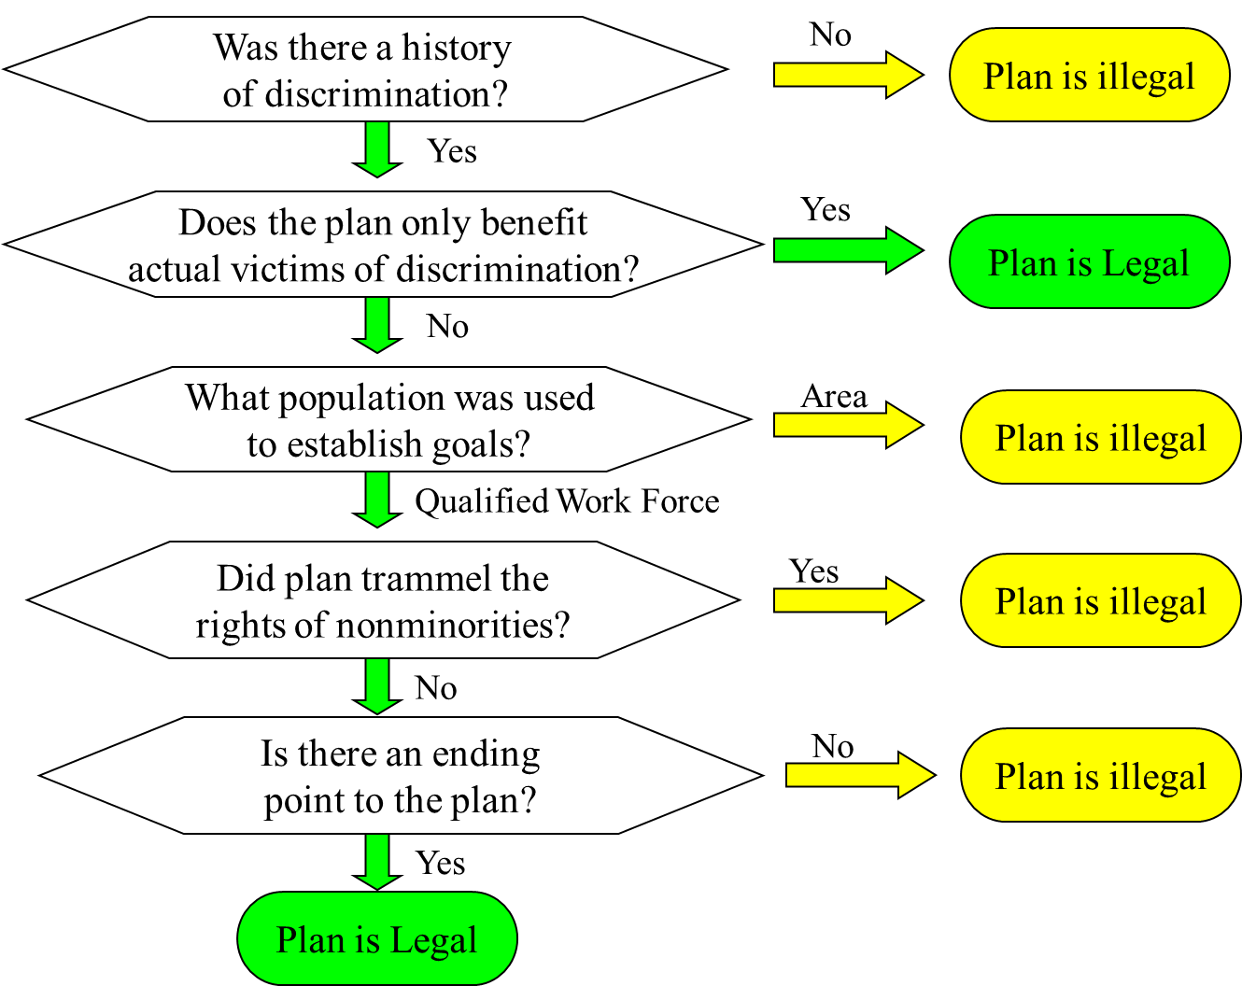
Visualization: Legality of Preferential Hiring

Slide 41
Legality of Preferential Hiring: Was There a History of Discrimination?
A history of discrimination must be demonstrated
Numeric disparity
can establish history
numeric disparity by itself may not be enough
Affirmative action posture and efforts will also be considered
Other reasons, such as lack of interest in the position, must be considered along with the disparity

Slide 42
Legality of Preferential Hiring: Who Are the Beneficiaries of the Plan?
Extent to which the plan benefits people who were not actual victims of discrimination

Slide 43
Legality of Preferential Hiring: What Population Was Used to Establish Hiring or Promotion Goals?
Area population
Qualified work force
minimum standards
minority interest in occupation

Slide 44
Legality of Preferential Hiring: What Is the Impact on Non-minorities?
Magnitude of the goal must be reasonable
All people hired must be qualified
Race/gender can be used to break ties among equally qualified applicants

Slide 45
Legality of Preferential Hiring: Is There an Ending Point to the Plan?
Progress must be periodically reviewed
Plan must end when goals have been achieved

Slide 46
Unintended Consequences of Affirmative Action Programs
People hired due to affirmative action:
are perceived by coworkers as being less competent
tend to devalue their own performance
behave negatively toward other AA people

Slide 47
Activity: Discussion of Preferential Practices
Is preferential hiring and promotion a good idea?

Slide 48
Privacy Issues

Slide 49
Privacy Issues
Drug testing
Office and locker searches
Psychological tests
Electronic surveillance

Slide 50
Activity: Discussion of Ethics
Consider these questions regarding ethics behind workplace privacy:
Do you think the legal reasons for these workplace practices outweigh the ethical responsibilities of organizations?
Are companies being unfair, and therefore unethical, by engaging in such activities?
What are the ethical responsibilities to employees from companies who choose to use such practices?
What are some other ethical dilemmas that you think could arise from such practices?
Conduct an Internet search on the Genetic Information Nondiscrimination Act. Do you think that act is fair to employers and employees? Why or why not?

Slide 51
Self-Assessment
What would make an employment practice a BFOQ?
Is affirmative action still needed? Why or why not?
Why do public employees have more privacy than private employees?
If an employee asks out a coworker, is this sexual harassment? Would your answer be different if the employee were a supervisor rather than a coworker? Why or why not?
Would a color-blind person be considered disabled under the ADA? Why or why not?

Slide 52

Can you solve the riddle?
Notes:
https://youtu.be/4kFC7669quE

Slide 53
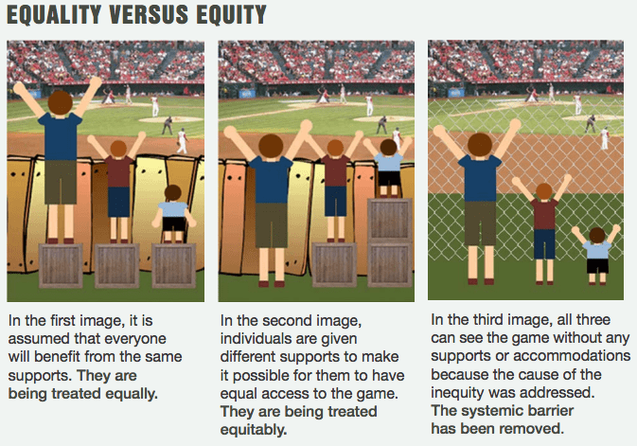
Law and the impact on Diversity, Equity & Inclusion

Slide 54
Summary
Now that the lesson has ended, you should have learned how to:
Describe the legal process involving employment law
Identify what classes of people are protected by federal law
Determine the legality of an employment practice
Explain the concept of adverse impact
Define affirmative action
Describe the important issues involving employee privacy rights
Notes:
Review objectives.

