Slide 1
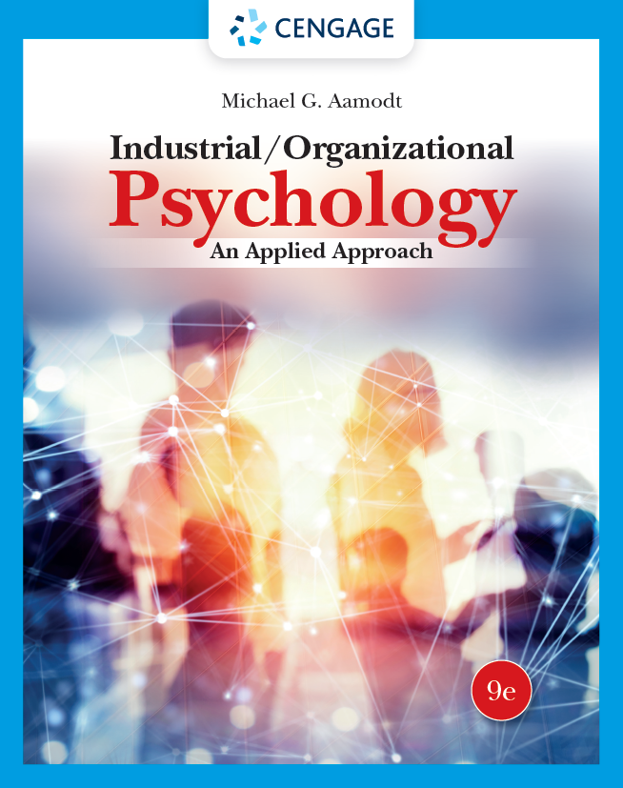
Industrial/Organizational Psychology: An Applied Approach, 9e
Chapter 5: Employee Selection: References and Testing
Michael G. Aamodt, Industrial/Organizational Psychology: An Applied Approach, 9th Edition. © 2023 Cengage. All Rights Reserved. May not be scanned, copied or duplicated, or posted to a publicly accessible website, in whole or in part.

Slide 2
Icebreaker
Break into pairs of students.
Discuss various types of tests you have either taken or heard about during an interview process.
Share your discussions with the class.

Slide 3
Learning Objectives
05-01 Explain why references typically don’t predict performance
05-02 Choose the right type of employment test for a particular situation
05-03 Describe the different types of tests used to select employees
05-04 Create and score a biodata instrument
05-05 Write a well-designed rejection letter

Slide 4
Workbook Exercise 5.6 Would you Hire this Applicant?

Slide 5
Predicting Performance Using References and Letters of Recommendation

Slide 6
References and Letters of Recommendation
Differentiating between:
Reference check
Reference
Letter of recommendation

Slide 7
Reasons for Using References and Recommendations
Confirming details on a resume
Checking for discipline problems
Discovering new information about the applicant
Predicting future performance

Slide 8
Confirming Details on a Resume
Why Check?
People commonly engage in resume fraud
25% of employers in the UK withdrew job offers in 2017 due to resume fraud
23% of employers in the UK fired current employees in 2017 due to resume fraud

Slide 9
Checking for Potential Discipline Problems
Poor attendance
Sexual harassment
Violence
Negligent hiring

Slide 10
Discovering New Information about the Applicant
Types of Information
work habits
character
personality
Skills
Problems
inaccurate
purposefully untrue

Slide 11
Predicting Future Performance
References are not good predictors of performance
Uncorrected validity is 0.18
Low validity is due to:
Leniency
Knowledge of the applicant
Low reliability
Extraneous factors

Slide 12
Why the Leniency?
Applicants often choose their own references
Applicants often have the right to see their files
Former employers fear legal ramifications

Slide 13

Potential Legal Ramifications
Conditional or qualified privilege
Allows free communication in certain relationships without the risk of an action for defamation
Defamation (“reference detectives”)
Action of damaging the good reputation of someone; slander or libel.
Negligent reference
Failure to supply information to a prospective employer about a former employee's potential legal trouble

Slide 14

Knowledge of the Applicant
References often have a limited opportunity to view behavior
Professors
Supervisors

Slide 15
Reliability
Reference reliability is 0.22
Higher correlation between two letters written by the same person for two people than between letters written by two people for the same person
They say more about the person writing the letter than the person being written about

Slide 16
Extraneous Factors Surrounding the Reference
Method is more important than content
Specific examples better than generalizations
Referees who like the applicant write longer references

Slide 17
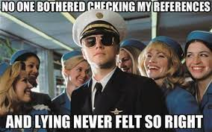
Ethical Issues
Three guidelines that reference providers should follow:
Explicitly state your relationship
Be honest
Let the applicant see your reference

Slide 18
Predicting Performance Using Applicant Training and Education
Notes:
_______________________________________________________________
_______________________________________________________________
_______________________________________________________________
_______________________________________________________________
_______________________________________________________________
_______________________________________________________________
_______________________________________________________________
_______________________________________________________________

Slide 19
Applicant Training and Education Predictors
Education
College GPA

Slide 20
Predicting Performance Using Applicant Knowledge

Slide 21
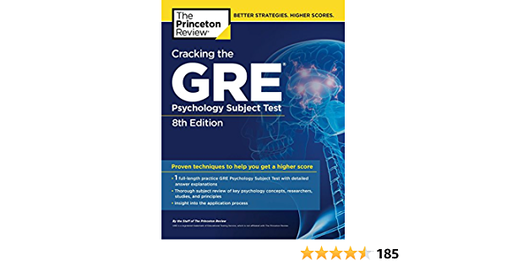
Using Applicant Knowledge to Predict Job Performance
Taps job-related knowledge
Good validity
Dye et al. (1993)
r = 0.22
ρ = 0.45
Face valid
Can have adverse impact

Slide 22
Predicting Performance Using Applicant Ability

Slide 23
Applicant Ability
Cognitive ability tests
Perceptual ability
Psychomotor ability
Physical ability

Slide 24
Cognitive Ability Tests
Oral and written comprehension, oral and written expression, numerical facility, originality, memorization, reasoning, and general learning
General mental ability (g)
Related to employee performance across job type, job complexity, and country

Slide 25
Strengths of Cognitive Ability Tests
Highest validity of all selection measures
Easy to administer
Relatively inexpensive

Slide 26
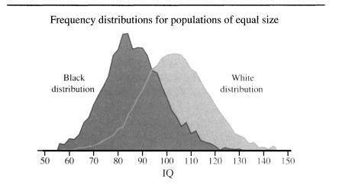
Weaknesses of Cognitive Ability Tests
Likely to cause adverse impact
Difficulty of setting passing score

Slide 27
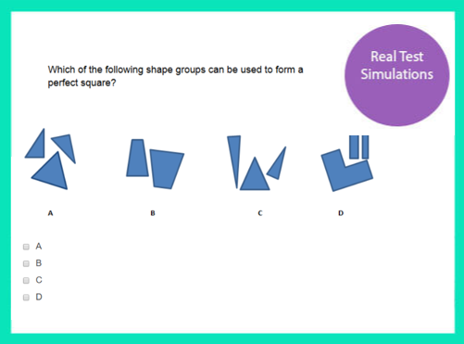
Some Specific Cognitive Ability Tests
Wonderlic Personnel Test
Siena Reasoning Test

Slide 28
Workbook Exercise 5.1 Sample Cognitive Ability Test

Slide 29
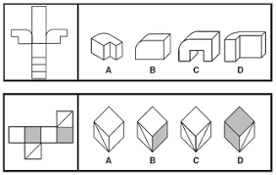
Perceptual Ability Tests
Perceptual ability (Fleishman & Reilly,1992b)
Vision (near, far, night, peripheral)
Color discrimination
Depth perception
Glare sensitivity
Speech (clarity, recognition)
Hearing (sensitivity, auditory attention, sound localization)

Slide 30

Psychomotor Ability Tests
Psychomotor ability (Fleishman & Reilly, 1992b)
Dexterity (finger, manual)
Control precision
Multilimb coordination
Response control
Reaction time
Arm-hand steadiness
Wrist-finger speed
Speed-of-limb movement

Slide 31
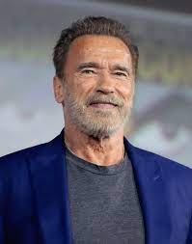
Physical Ability: Measures and Issues
Used for jobs with high physical demands
Two common ways to measure
Simulations
Physical agility tests
Three Issues
Job relatedness
Passing scores
When the ability must be present

Slide 32
Physical Abilities
Physical abilities (Fleishman & Reilly, 1992b)
Dynamic strength (strength requiring repetitions)
Trunk strength (stooping or bending over)
Explosive strength (jumping or throwing)
Static strength (strength not requiring repetitions)
Dynamic flexibility (speed of bending or stretching)
Extent flexibility (degree of bending or stretching)
Gross body equilibrium (balance)
Gross body coordination (coordination when the body is in motion)
Stamina (ability to exert effort over long periods of time)

Slide 33
Predicting Performance Using Applicant Skill

Slide 34
Work Samples
Applicants perform tasks that replicate actual job tasks
Advantages
Directly related to the job
Good criterion validity
Good face validity
Less adverse impact than cognitive ability
Provide realistic job previews
Disadvantages
Can be expensive to develop and maintain

Slide 35

Assessment Centers: What Are They?
A selection technique that uses multiple job-related assessment exercises and multiple assessors to observe and record behaviors of candidates performing job-related tasks
Unproctored Internet-based testing

Slide 36
Guidelines for Assessment Center Practices
Based on job analysis
Behavioral classification
Use multiple assessment techniques
Develop a dimension-by-exercise matrix
Simulations
Use multiple assessors
Assessor training
Recording behavior
Reports
Standardization
Overall judgment based on integration of information

Slide 37
Assessment Center Exercises
In-basket technique
Simulations
Situational exercises
Work samples
Leaderless group discussions
Business simulation games
Gamified assessments

Slide 38
Evaluation of Assessment Centers: Strength
Successful in predicting employee behavior

Slide 39
Evaluation of Assessment Centers: Weaknesses
Weaknesses
Very expensive
Better methods are more cost-effective
Time consuming
Ability of assessment center developed at one location may not predict performance in similar jobs at other locations
May have adverse impact on some groups

Slide 40
Workbook Exercise 5.2 Leaderless Group Discussion
Notes:
LEADERLESS GROUP DISCUSSION VIDEO

Slide 41
Predicting Performance Using Prior Experience

Slide 42
Four Ways to Measure Prior Experience
Application/resume information
Biodata
Reference checks
Interviews

Slide 43
Experience Ratings
Weak predictor of future work performance
Types of experience
Work
Life

Slide 44
When Experience Predicts Best
Credit prior work experience only:
In the same occupational area as that in which performance is to be predicted
In the performance of tasks or functions that have direct application on the job
Recency of experience should be used as a decision rule for awarding credit only when justified on a case-by-case basis
Credit for duration of work experience should be limited to a few years
Notes:
_________________________________________________________________________________________________________________________________________________________________________________________________________________________________________________________________________________________________________________________________________________________________________________________________________________________________________________________

Slide 45
Experience for Selection: Some Concerns
Sullivan (2000) claims that “experience in solving ‘past problems’ is rapidly losing its applicability to current and future problems”
Knowledge obtained through experience has a “shelf life”

Slide 46
Biodata
A selection method that considers an applicant’s life, school, military, community, and work experience

Slide 47
Example of Biodata Items
Member of high school student government?
Yes No
Number of jobs in past 5 years?
1 2 3-5 More than 5
Transportation to work:
Walk Bus Bike Own Car Other

Slide 48
Development of Biodata Items
File approach or questionnaire approach to obtain information
Create biographical questionnaire
Choose a criterion to measure behavior
Split into two criterion groups
Assign weights to items
Vertical percentage method
Form composite score for employees

Slide 49
Biodata Weighting Process
Variable | Long Tenure (%) | Short Tenure (%) | Differences in % | Unit Weight
Education
High School | 40 | 80 | -40 | -1
Bachelor’s | 59 | 15 | +44 | +1
Masters | 1 | 5 | -4 | 0

Slide 50
Strengths of Biodata
Can predict in a variety of jobs
Can predict for variety of criterion measures
Higher organizational profit and growth
Easy to use, quickly administered, inexpensive, and not subject to individual bias

Slide 51
Weaknesses of Biodata
Validity may not be stable over time
Legal requirements in federal Uniform Guidelines
May cause adverse impact
Biodata can be faked

Slide 52
Four Standards for Each Item
Gandy and Dye (1989)
Must deal with events under a person’s control
Must be job-related
Must be verifiable
Must not invade applicant’s privacy

Slide 53
Reducing Faking on Biodata Items
Stokes et al. (1993)
Warning applicants about presence of lie scale
Objective, verifiable items
Elaboration
Bogus items

Slide 54
Predicting Performance Using Personality, Interest, and Character

Slide 55
Personality Inventories
Personality is a collection of traits that persist across time and situations and differentiate one person from another
Personality inventories predict a wide variety of work behaviors and attitudes

Slide 56
Differences in Personality Inventories
Types of personality inventories
Tests of normal personality
Tests of psychopathology
Basis for personality dimensions
Theory based
Statistically based
Empirically based
Scoring
Objective
Projective

Slide 57
Five-Factor Model (The Big 5)
Openness to experience
imaginative, curious, cultured
Conscientiousness
organized, disciplined, careful
Extraversion
outgoing, gregarious, fun-loving
Agreeableness
trusting, cooperative, flexible
Neuroticism (emotional stability)
anxious, insecure, vulnerable to stress

Slide 58
Evaluation of Personality Inventories
Strengths
Relatively cheap
Easy to administer
Little adverse impact
Predicts best when based on a job analysis
Weaknesses
Scale development
Validity
Faking

Slide 59
Workbook Exercise 5.3 Sample Personality Inventory

Slide 60
Interest Inventories
Tap an applicant’s interest in particular types of work or careers
Moderate predictor
There are better predictors of job satisfaction

Slide 61
Workbook Exercise 5.4 Sample Interest Inventory

Slide 62
Integrity Tests
Estimate the probability that applicants will steal money, time, or merchandise
Used mostly in retail, but gaining acceptance for other occupations

Slide 63
Types of Integrity Tests
Electronic Testing
Polygraph testing
Voice stress analyzer
Paper and Pencil Testing
Overt
Personality based

Slide 64
Polygraph Testing
Polygraph (lie detector) is a machine that measures the physiological responses that accompany the verbal responses an individual makes to a direct question asked by polygraph operator.

Slide 65
Legal Guidelines for Polygraph Testing
Employee Polygraph Protection Act of 1988 makes it illegal to use polygraph or voice stress analyzer
The following situations are exempt from these prohibitions
Law enforcement agencies
National security

Slide 66
Paper and Pencil Integrity Tests
Overt integrity tests
Directly ask for attitudes about theft and occurrences of theft behavior
Personality-based measures
Measure traits linked to several theft-related employee behaviors that are detrimental to the organization

Slide 67
Other Behaviors Integrity Tests Can Predict
Theft
Absenteeism
Violence
Work performance
Counterproductive work behaviors
Training performance

Slide 68
Difficulty of Predicting Actual Theft
Personal tendency
Economic pressure
Normal to steal
Reaction to organizational policy

Slide 69
Evaluation of Integrity Tests
Advantages
Inexpensive to use
Easy to administer
Little to no racial adverse impact
Disadvantages
Males have a higher fail rate than females
Younger people have a higher fail rate than older people
Failure has a negative psychological impact on applicants
Applicants don’t think highly of them

Slide 70
Workbook Exercise 5.5 Sample Integrity Test

Slide 71
Conditional Reasoning Tests
Designed to reduce faking
Applicants are given a series of statements and asked to select the reason that justifies each statement
Aggressive individuals tend to believe
most people have harmful intentions behind their behavior (hostile attribution bias)
it is important to show strength or dominance in social interactions (potency bias)
it is important to retaliate when wronged rather than try to maintain a relationship (retribution bias)
powerful people will victimize less powerful individuals (victimization bias)
evil people deserve to have bad things happen to them (derogation of target bias)
social customs restrict free will and should be ignored (social discounting bias)

Slide 72
Credit History
25% of employers conduct credit checks
Reasons:
Employers believe people who owe money may be more likely to steal or accept bribes
Employers believe employees with good credit are more responsible and conscientious
May cause adverse impact
Federal Credit Reporting Act

Slide 73
Criminal History
93% of employers check an applicant’s criminal history
Must be job-related
Best practices for criminal history policy include:
Avoid a policy that an organization will never hire applicants with criminal records
Consider only convictions, not arrests
Don’t ask about criminal history until a conditional job offer
Only consider criminal history if it is relevant to the job

Slide 74
Graphology
Concept
A person’s handwriting is a reflection on their personality and character
Evaluation
Not a useful technique in employee selection
Best when the writing sample is autobiographical

Slide 75
Predicting Performance Limitations Due to Medical and Psychological Problems

Slide 76
Drug Testing
Use
In a survey published in 2019, 49% of U.S. organizations tested for drugs
In a survey published in 2007, 8.9% of employees admitted to using drugs in the past month
Drug users are more likely to
Miss work
Use health care benefits
Be fired or quit
Have an accident

Slide 77
Drug-Free Workplace Act of 1988
Requires federal contractors:
Communicate that being under the influence of drugs is prohibited
Establish a drug awareness program
Require employees to notify the organization of any conviction for workplace drug use
Take remedial actions on employees convicted for workplace drug use

Slide 78
Two Stages of Drug Testing
Initial screening of hair or urine
Confirmation test
Typically used only after a positive initial screening

Slide 79
Forms of Testing
Pre-employment testing
Employee testing
Random selection at predetermined times
Random selection at random times
Testing after an accident or disciplinary action

Slide 80
Activity: Discussion of Drug Testing
Should organizations test for drugs?

Slide 81
Psychological Exams
Clinical psychologist interview
Examination of applicant’s life history
Administration of psychological test
Not designed to predict employee performance

Slide 82
Medical Exams
Physician is given job description
Determine any medical conditions that will prevent safe job performance

Slide 83
Comparison of Techniques

Slide 84
Validity
Good predictors: ability, work samples, biodata, and structured interviews
Not good predictors: unstructured interview, education, interest inventories, and some personality traits
Combination of selection tests

Slide 85
Typical Corrected Validity Coefficients
Method | Validity | Method | Validity
Structured Interview | 0.57 | Experience | 0.27
Cognitive ability | 0.51 | Situational judgment tests | 0.26
Biodata | 0.51 | Conscientiousness | 0.24
Job knowledge | 0.45 | Unstructured interviews | 0.20
Work samples (verbal) | 0.48 | Integrity tests | 0.18
Assessment centers | 0.38 | Interest inventories | 0.10
College grades | 0.32 | Handwriting analysis | 0.02
References | 0.29 | Projective personality tests | 0.00

Slide 86
Legal Issues
Highest levels of adverse impact: cognitive ability, GPA
Lowest levels of adverse impact: integrity tests, references, personality inventories
Highest face validity: interviews, work samples/simulations, and resumes
Lowest face validity: graphology, integrity tests, personality tests

Slide 87
Adverse Impact
Technique | White-Black | White-Hispanic | Meta-analysis
Cognitive ability | 0.99 | 0.83 | Roth et al. (2001)
GPA | 0.78 |  | Roth & Bobko (2000)
Work sample | 0.73 |  | Roth et al. (2008)
Assessment centers | 0.52 | 0.28 | Dean et al. (2008)
Job knowledge | 0.48 | 0.47 | Roth et al. (2003)
Situational judgment | 0.38 | 0.24 | Whetzel et al. (2008)
Biodata | 0.33 |  | Bobko et al. (1999)
Structured interview | 0.23 |  | Huffcutt & Roth (1998)
Personality | 0.09 |  | Schmitt et al. (1996)
References | 0.08 |  | Aamodt & Williams (2005)
Integrity tests | 0.07 | –0.05 | Ones & Viswesvaran (1998)

Slide 88
Rejecting Applicants

Slide 89
Best Practices in Rejecting Applicants
Best practices:
Personally addressed and signed
Appreciation for applicant applying
Compliment about qualifications
Comment about high qualifications of other applicants
Information about hired individual
Wish of good luck
Promise to keep resume on file

Slide 90
Activity: Discussion of New London Police
Applied Case Study: New London, CT Police Department

Slide 91
Activity: Focus on Ethics: Using Personality Inventories (1 of 2)
In your class, your professor will probably ask you to take the Employee Personality Inventory in your workbook. After you do, consider whether or not you want your job performance to be judged based on the results of such a test. Would you say that this test would fairly predict your ability to perform in certain jobs?
Does it accurately portray how you would fit into an organization’s culture or how you would get along with others? If it doesn’t accurately portray you, would you then say such a test is unethical?
Should the tests be better regulated? Are companies right in using them in their selection process?

Slide 92
Activity: Focus on Ethics: Using Personality Inventories (2 of 2)
Do you see any other ethical concerns related to using personality inventories?
Is there a fairer and more ethical way for companies to determine if applicants will fit into the organizational culture and get along with others?

Slide 93
Self-Assessment
Should an organization provide reference information for former employees? Why or why not?
What should be the most important factors in choosing a selection method? Explain your answers.
What selection methods are most valid?
Should employers test employees for drugs? Why or why not?
Are integrity tests fair and accurate? Explain your answer.

Slide 94
Summary
Now that the lesson has ended, you should have learned how to:
Explain why references typically don’t predict performance
Choose the right type of employment test for a particular situation
Describe the different types of tests used to select employees
Create and score a biodata instrument
Write a well-designed rejection letter
Notes:
Review objectives.

